Slide 1
ch6 z-Transform
--Definition
--ROC (Region of Converges)
--Inverse z-Transform
--z-Transform Properties
--Transfer Function

Slide 2
z-Transform
In continuous signal system, we use S-Transform and FT as the tools in the transform domain;
In discrete signal system, we use z-Transform and DTFT.
The DTFT provides a frequency-domain representation of discrete-time signals and LTI discrete-time systems.
Because of the convergence condition, in many cases, the DTFT of a sequence may not exist.
z-transform may exist for many sequences for which the DTFT does not exist; z-Transform can make the solution for discrete time systems very simple.

Slide 3
6.1 Definition and Properties
key point
For a given sequence g[n], its z-transform G(z) is defined as:
where z= Re(z) + jIm(z) is a complex variable.
If z=re^{jω},
r = 1 (|z| = 1), z-transform reduces to its DTFT, provided the latter exists。
The contour |z| = 1 is a circle in the z-plane of unity radius and is called the unit circle。
MOOC

Slide 4
6.1 Definition and Properties
key point
Like the DTFT, there are conditions on the convergence of the infinite series：
For a given sequence, the set R of values of z for which its z-transform converges is called the region of convergence (ROC)
G(z) converges, if g[n]r^{-n} is absolutely summable，
i.e.
MOOC

Slide 5
6.1 Definition and Properties
key point
In general, the ROC of a z-transform of a sequence g[n] is an annular region of the z-plane:
where
Note: The z-transform is a form of a Laurent series and is an analytic function at every point in the ROC。

Slide 6
6.1 Definition and Properties
Example - Determine the z-transform X(z) of the causal sequence x[n]=α^{n}μ[n] and its ROC.
Now
The above power series converges to:
MOOC
ROC is the annular region |z|>|α|.

Slide 7
6.1 Definition and Properties
Example - The z-transform m(z) of the unit step sequence can be obtained from:
by setting a = 1,
MOOC
ROC is the annular region .

Slide 8
6.1 Definition and Properties
Example - Consider the anti-causal sequence:
Its z-transform is given by:
MOOC
ROC is the annular region

Slide 9
6.1 Definition and Properties
key point
Note: The unit step sequence is not absolutely summable, and hence its DTFT does not converge uniformly.
Note: An unique sequence can be associated with a z-transform is by specifying its ROC.
Note: The existence of the DTFT does not always imply the existence of the z-transform.
Notes:
当序列的z变换ROC包括单位圆，则其DTFT存在；

Slide 10
Example - The finite energy sequence
has a DTFT given by
It converges in the mean-square sense.
However, h_{LP}[n] does not have a z-transform as it is not absolutely summable for any value of r.

Slide 11
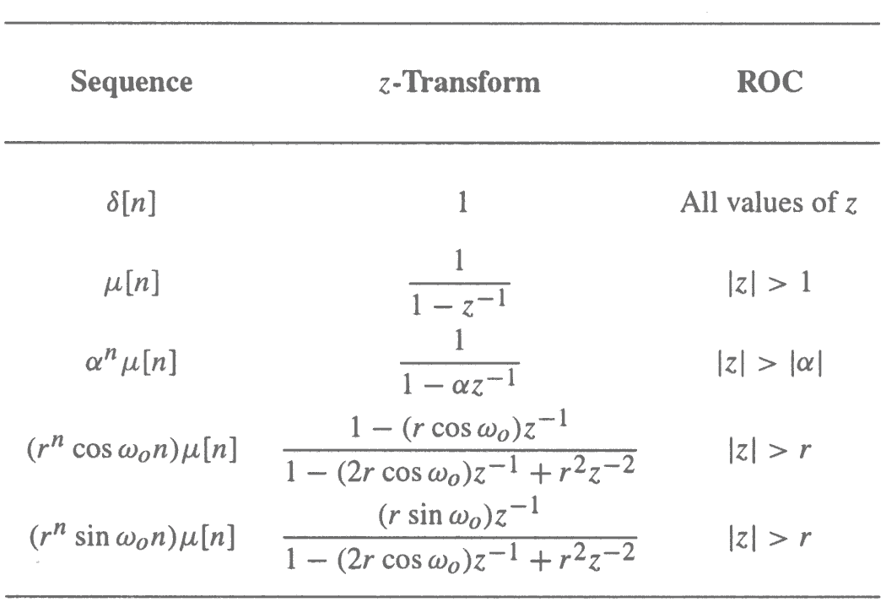
Commonly Used z-transform
MOOC

Slide 12
6.2 Rational z-Transform
In the case of LTI discrete-time systems we are concerned with in this course, all pertinent z-transforms are rational functions of z⁻¹.
That is, they are ratios of two polynomials in z⁻¹ :
MOOC

Slide 13
6.2 Rational z-Transform
A rational z-transform can be alternately written in factored form as:
MOOC

Slide 14
6.2 Rational z-Transform
At a root z=ξ_{l} of the numerator polynomial G(ξ_{l})=0, these values of z are known as the zeros of G(z).
At a root z= λ_{l} of the denominator polynomial G(λ_{l})→∞, these values of z are known as the poles of G(z).
G(z) has M finite zeros and N finite poles:
If N>M there are additional N-M zeros at z=0
If N<M there are additional M-N poles at z=0
MOOC

Slide 15
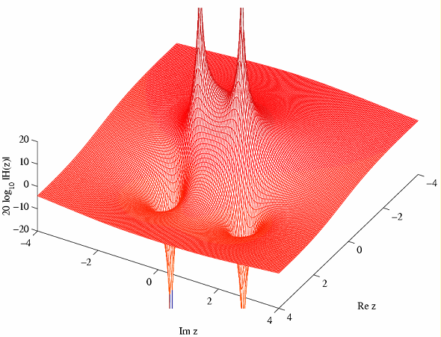
6.2 Rational z-Transform
20log₁₀|G(z)|
poles z=0.4±j0.6928
zeros z=1.2±j1.2

Slide 16
6.3 ROC of a Rational z-transform
If the ROC of a z-transform includes the unit circle, the DTFT of the sequence is obtained by simply evaluating the z-transform on the unit circle.
To understand the relationship between the poles and the ROC, it is instructive to examine the pole-zero plot of a z-transform.
有限长序列z变换的ROC为整个z平面，可能要去掉0或无穷大；
右边序列的z变换的ROC为离原点最远极点的圆外部；
左边序列的z变换的ROC为离原点最近极点的圆内部；

Slide 17
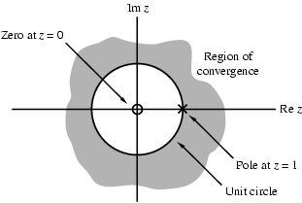
6.3 ROC of a Rational z-transform
Consider the pole-zero plot of the z-transform μ(z)
zplane(zeros,poles)
zplane(num,den)
MOOC
Notes:
The pole-zero plot is determined using the function zplane

Slide 18
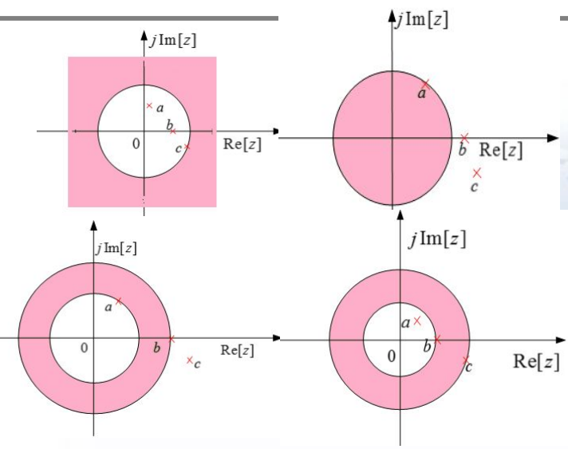
6.3 ROC of a Rational z-transform
Three poles and possible ROCs
MOOC

Slide 19
Matlab fuctions
[z, p, k] = tf2zp(num, den)
[num,den] = zp2tf(z, p, k)
sos = zp2sos(z, p, k)

Slide 20
6.4 The Inverse z-Transform
General Expression
Inverse z-Transform by Table Look-up Method
Inverse z-Transform by Partial-Fraction Expansion
Inverse z-Transform via Long Division
MATALB Computation

Slide 21
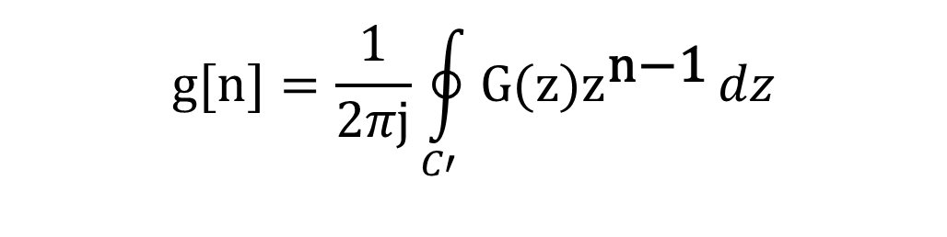
6.4.1 General Expression
Inverse ZT is given as:
$$g[n]=\frac{1}{2πj}\oint_{C′}{G(z)z^{\text{n}\text{−1}}}dz$$
where C’ is a counterclockwise contour of integration defined by |z|=r.

Slide 22
6.4.2 Table Look-up Method
Illustrate this method in Example 6.12:
From table 6.1, we get:
MOOC
So:

Slide 23
6.4.3 Partial-Fraction Expansion
In practical application, the X(z) is the rational fraction of z.
Where A(z),B(z) are polynomials of z.
So:
Note:you must make each X_{k}(z) easy to solve its IZT, and pay attention to it’s ROC.
MOOC

Slide 24
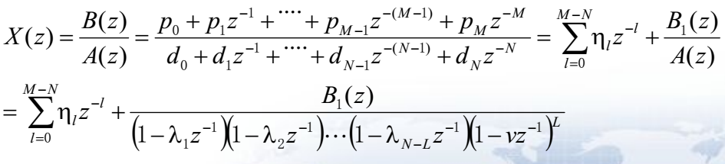
6.4.3 Partial-Fraction Expansion
If:
Then X(z) is expanded as partial-fraction:
Where v is a L-order poles of X(z) ,
each λ_{l} is a single pole of X(z)(k=1,2,…,N-L).
MOOC

Slide 25
6.4.3 Partial-Fraction Expansion
η_{l}: when M≥N,it exists ; M<N, it equals to 0.
ρ_{l}: based on residue theorem, we get:
l=1, 2,…, N-L
γ_{i}:
MOOC

Slide 26
6.4.3 Partial-Fraction Expansion
Example 6.13
By long division we arrive at:
MOOC

Slide 27
6.4.3 Partial-Fraction Expansion
Example 6.14 Let the z-transform H(z) of a causal sequence h[n] be given by:
A partial-fraction expansion of H(z) is then of the form:
MOOC

Slide 28
6.4.3 Partial-Fraction Expansion
MOOC

Slide 31
6.4.5 Inverse z-Transform via Long Division
For X(z) is a rational fraction, we can divide numerator polynomial by denominator polynomial to get the expansion of the power series.
Note: When we use long division methods, we must first estimate the ROC of x[n], then expand X(z) into appropriate x[n].

Slide 32
Solution：Roc of X(z) is annular，so x[n] is a two-sided sequence
pole z=1/4 relates to right-sided sequence, pole z=4 relates to left-sided sequence.
Expand X(z) into Partial-Fraction Expansion:

Slide 35
Inverse z-Transform Using MATLAB
[r,p,k]= residuez(num,den)
[num,den]= residuez(r,p,k)
[y,t]= impz(num,den,L)
num: numerator coefficients
den: denominator coefficients
Vector r contains the residues
Vector p contains the poles
Vector k contains the constants

Slide 36
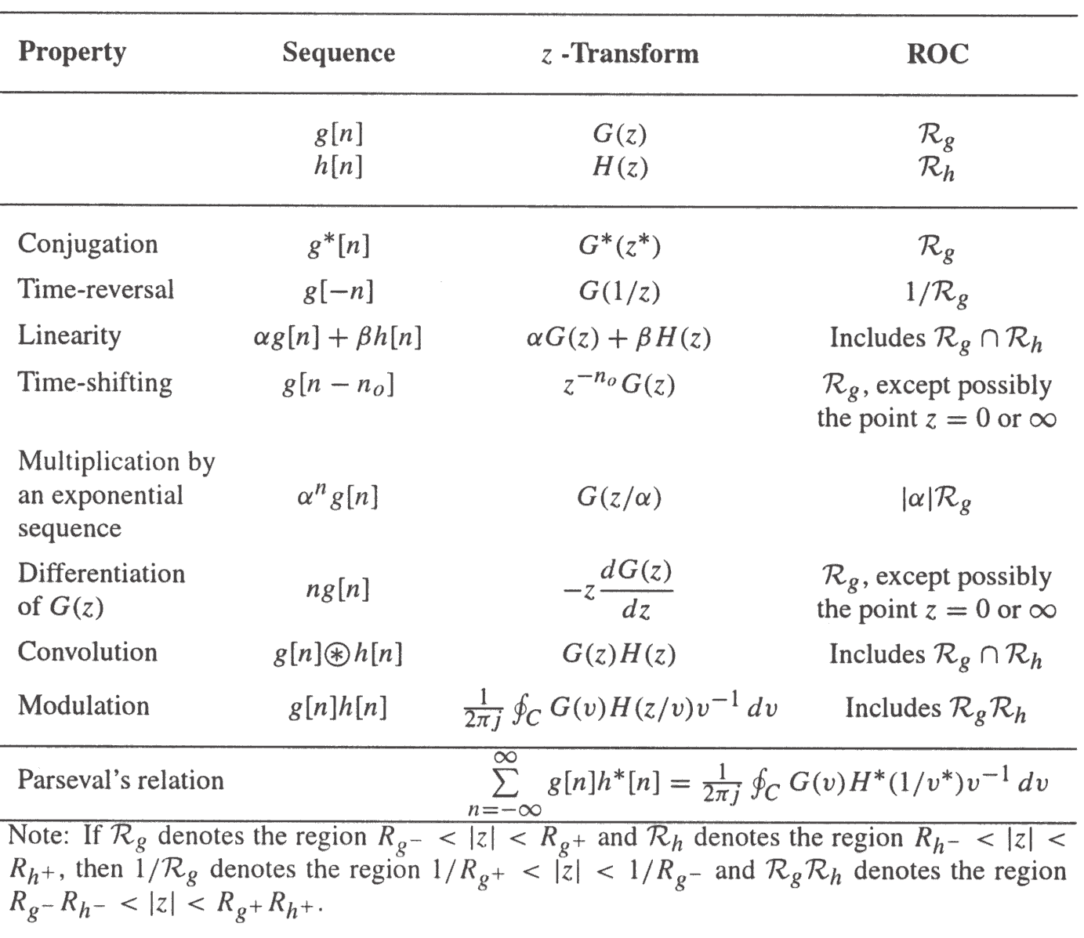
6.5 z-Transform Properties
key point
MOOC

Slide 37
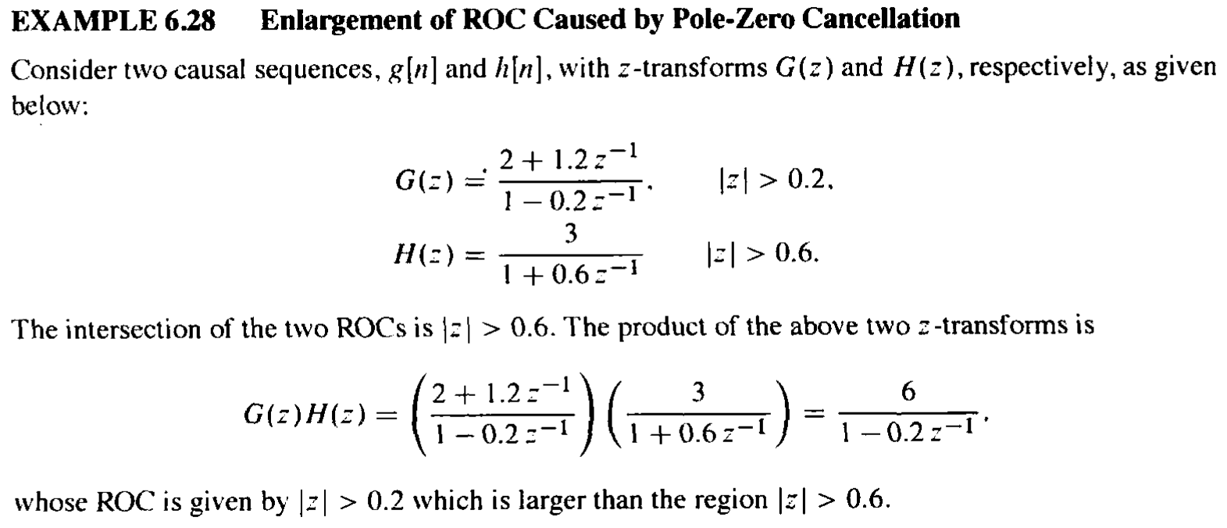

Slide 38
6.6 Computation of the Convolution Sum of Finite-Length Sequences
Tabular methods for the computation of the linear and circular convolution have been outlined.
Now, we describe alternate methods for the computation of the linear and circular convolution that based on the multiplication of two polynomial.

Slide 39
6.6.1 Linear Convolution
Let x[n] and h[n] be two sequences of lengths L+1 and M+1, respectively. Their z-transforms, X(z) and H(z) be:
So, the z-transform of linear convolution sequence y[n] is Y(z):
And its coefficient is y[n].

Slide 40
6.6.2 Circular Convolution
Let x[n] and h[n] both be two sequences of degree N-1, their z-transforms, X(z) and H(z) be:
So, the z-transform of linear convolution sequence y[n] is Y(z):
x[n]和h[n]的圆周卷的z变换是Y_{c}(z): 即令z^{-N}=1

Slide 41
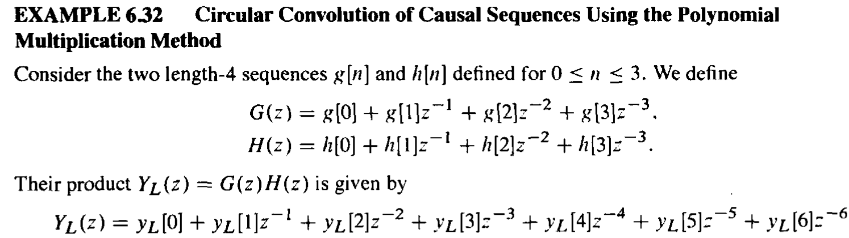
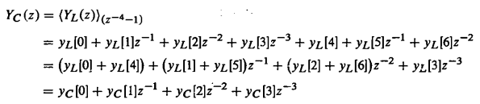
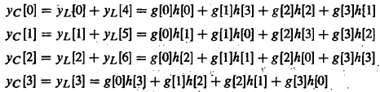

Slide 42
6.7 The Transfer Function
The z-transform of the impulse response of an LTI system, called the transfer function, is a polynomial in z⁻¹.
In most practical cases, the LTI digital filter of interest is characterized by a linear different equation with constant and real coefficient, so it’s transfer function is rational z-transform.

Slide 43
6.7.1 Definition
In time domain, use unit sample response h[n] to represent a LTI system:
To do ZT for both sides, we get:
Then:
It’s the transfer function of a LTI system.
MOOC

Slide 44
6.7.2 Transfer Function Expression
FIR Digital Filter
it‘s h[n] defined for N₁ ≤n≤N₂. So, the transfer function is given by:
IIR Digital Filter
Consider a difference equation
Its transfer function is obtained by taking the z-transform of both sides of the above equation,

Slide 45
6.7.2 Transfer Function Expression
1. are the finite zeros, and
are the finite poles of H(z).
2.If N>M, there are additional (N-M) zeros at z=0;
If N＜M, there are additional (M-N) poles at z=0.
3.For a causal IIR filter, the ROC of H(z) is:

Slide 46
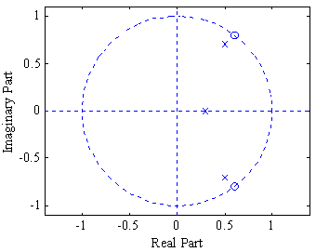
Example
A causal LTI IIR digital filter is described by a constant coefficient difference equation given by
y[n]=x[n-1]-1.2x[n-2]+x[n-3]+1.3y[n-1] -1.04y[n2]+0.222y[n-3]
Its transfer function is therefore given by
Alternate forms:
Note: Poles farthest from z=0 have a magnitude
ROC:

Slide 47
6.7.3 Frequency Response from Transfer Function
The relationship between H(z) and H(e^{jω}).

Slide 48
6.7.4 Geometric Interpretation of FR Computation
Use zero-vectors and pole-vectors in z-plane to interpret the frequency response.

Slide 49
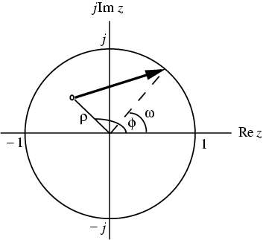
6.7.4 Geometric Interpretation of FR Computation
As shown below in the z-plane the factor represents a vector starting at the point and ending on the unit circle at

Slide 50
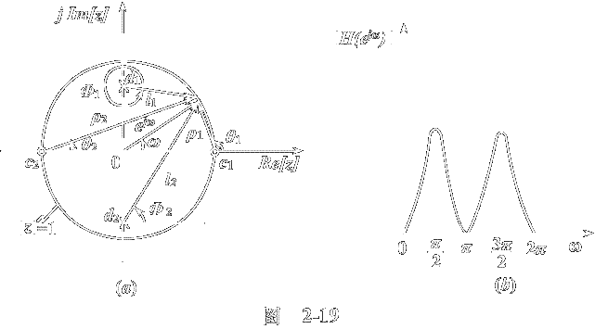
Position of zeros will affect the position and depth of dips
Zeros at the unit cycle, the amplitude of dips will be zero
Zeros tend to the unit cycle, the amplitude of dips tend to zero
Position of poles will affect the position and depth of peaks
Poles tend to the unit cycle, the amplitude of peaks tend to infinite
Poles is outside the unit cycle, the system is unstable

Slide 52
lowpass
highpass

Slide 53
bandpass
bandstop

Slide 54
allpass
multiband

Slide 55
6.7.5 Stability Condition in Term of Pole Locations
An LTI digital filter is BIBO stable if and only if:
So, the ROC of the transfer function H(z) of a BIBO stable LTI digital filter should contains the unit circle.
The causal LTI digital filter is stable with all its poles are inside the unit cycle.
For a causal LTI FIR, the stability is always satisfied；For a causal LTI IIR, it may be unstable.

Slide 56
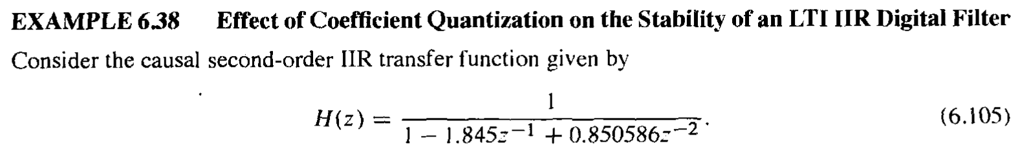
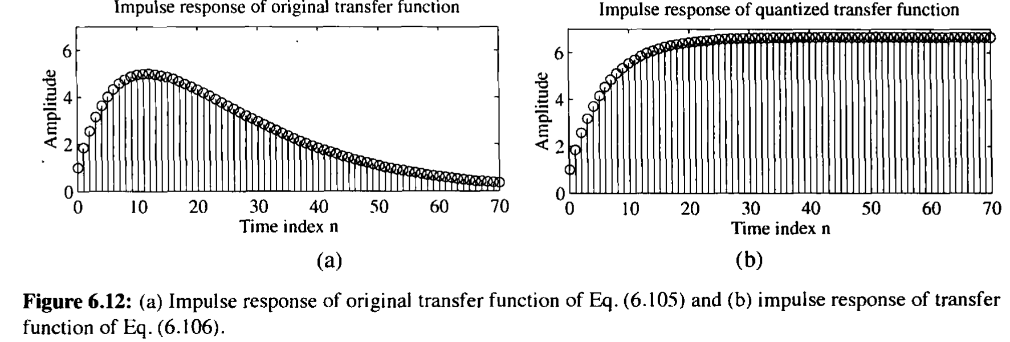
6.7.5 Stability Condition in Term of Pole Locations

Slide 57
Homework
Problems
6.6, 6.7, 6.12, 6.18, 6.42, 6.44,
6.47, 6.65, 6.66, 6.81
M6.1, M6.2, M6.3
MOOC: 6.13,6.22,6.25

