Slide 1
Chapter7 LTI Discrete-Time Systems in the Transform Domain
--Transfer Function Classification
--Types of Linear-Phase Transfer Functions
--Simple Digital Filters

Slide 2
Types of Transfer Functions
The time-domain classification of a digital transfer function based on the length of its impulse response sequence:
Finite impulse response (FIR) transfer function.
Infinite impulse response (IIR) transfer function.
In the case of digital transfer functions with frequency-selective frequency responses, there are two types of classifications:
Classification based on the shape of the magnitude function |H(e^{iω})|.
Classification based on the form of the phase function θ(ω).

Slide 3
7.1 Transfer Function Classification Based on Magnitude Characteristics
Digital Filters with Ideal Magnitude Responses
Bounded Real Transfer Function
Allpass Transfer Function
MOOC

Slide 4
7.1.1 Digital Filters with Ideal Magnitude Responses
A digital filter designed to pass signal components of certain frequencies without distortion should have a frequency response equal to 1 at these frequencies, and should have a frequency response equal to 0 at all other frequencies.
The range of frequencies where the frequency response takes the value of 1 is called the passband.
The range of frequencies where the frequency response takes the value of 0 is called the stopband.
MOOC

Slide 5
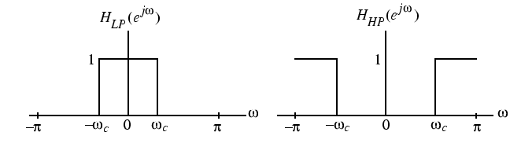
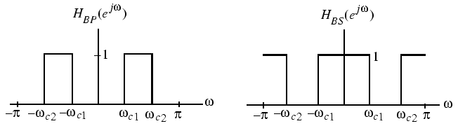
7.1.1 Digital Filters with Ideal Magnitude Responses
Magnitude responses of the four popular types of ideal digital filters with real impulse response coefficients are shown below:
The frequencies ω_{c}, ω_{c1}, and ω_{c2} are called the cutoff frequencies.
An ideal filter has a magnitude response equal to 1 in the passband and 0 in the stopband, and has a 0 phase everywhere.

Slide 6
7.1.1 Digital Filters with Ideal Magnitude Responses
The inverse DTFT of the frequency response H_{LP}(e^{jω}) of the ideal lowpass filter is:
h_{LP}[n]=sin(ω_{c}n)/(πn), - ∞ <n< ∞
The above impulse response is not absolutely summable, and hence, the corresponding transfer function is not BIBO stable.
Also, h_{LP}[n] is not causal and is of doubly infinite length.
The remaining three ideal filters are also characterized by doubly infinite, noncausal impulse responses and are not absolutely summable.
Thus, the ideal filters with the ideal “brick wall” frequency responses cannot be realized with finite dimensional LTI filter.
MOOC
Notes:
This permits the magnitude response to decay slowly from its maximum value in the passband to the 0 value in the stopband.

Slide 7
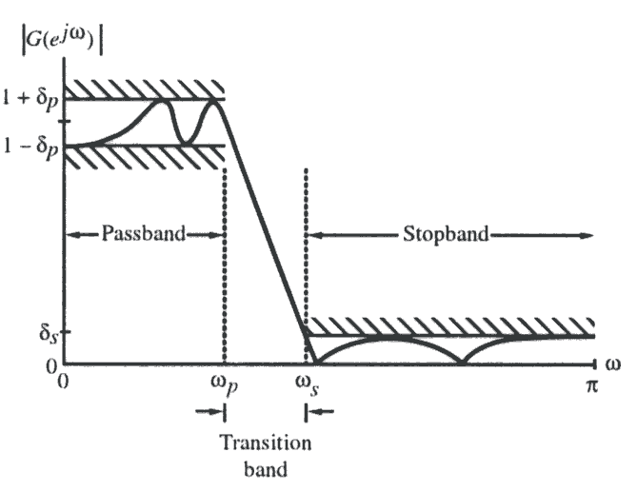
7.1.1 Digital Filters with Ideal Magnitude Responses
To develop stable and realizable transfer functions, the ideal frequency response specifications are relaxed by including a transition band between the passband and the stopband.
Moreover, the magnitude response is allowed to vary by a small amount both in the passband and the stopband.
Typical magnitude response specifications of a lowpass filter are shown as:
MOOC

Slide 8
7.1.2 Bounded Real Transfer Functions
A causal stable real-coefficient transfer function H(z) is defined as a bounded real (BR) transfer function if:
for all values of ω
Let x[n] and y[n] denote, respectively, the input and output of a digital filter characterized by a BR transfer function H(z) with X(e^{jω}) and Y(e^{jω}) denoting their DTFTs.
MOOC

Slide 9
7.1.2 Bounded Real Transfer Functions
Then the condition implies that:
Integrating the above from-π to π, and applying Parseval’s relation we get:
Thus, for all finite-energy inputs, the output energy is less than or equal to the input energy.
MOOC

Slide 10
7.1.2 Bounded Real Transfer Functions
It implies that a digital filter characterized by a BR transfer function can be viewed as a passive structure.
A causal stable real-coefficient transfer function H(z) with
is called lossless bounded real (LBR) transfer function.
The BR and LBR transfer functions are the keys to the realization of digital filters with low coefficient sensitivity.
MOOC

Slide 11
7.1.2 Bounded Real Transfer Functions
Example: Consider the causal stable IIR transfer function:
where K is a real constant.
Its square-magnitude function is given by:
MOOC

Slide 12
7.1.2 Bounded Real Transfer Functions
for α>0,
( |H(e^{jω})|² )_{max} = K²/(1- α)² | _{ω=0}
( |H(e^{jω})|² ) _{min} = K²/(1+ α)² | _{ω=π}
for α<0,
(2αcosω )_{max} = -2α | _{ω= π}
(2αcosω )_{min} = 2α | _{ω=0}
Here, ( |H(e^{jω})|² )_{max} = K²/(1+ α)² | _{ω= π}
( |H(e^{jω})|² )_{min} = K²/(1- α)² | _{ω= 0}
MOOC

Slide 13
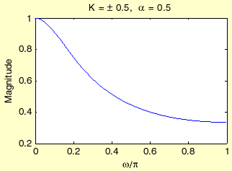
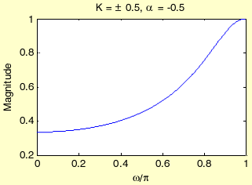
7.1.2 Bounded Real Transfer Functions
When K≤±(1-α),
is BR function.
MOOC
Lowpass filter
Highpass filter
Notes:
the magnitude function for α=±0.5 with values of K chosen to make H(z) a BR function

Slide 14
7.1.3 Allpass Transfer Function
The magnitude response of allpass system satisfies: |A(e^{jω})|²=1, for all ω.
The H(z) of a simple 1th-order allpass system is:
Where a is real, and
Or a is complex ,the H(z) should be:
MOOC

Slide 15
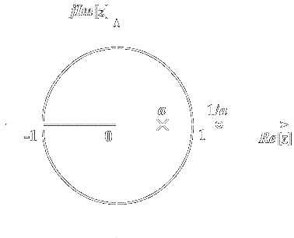
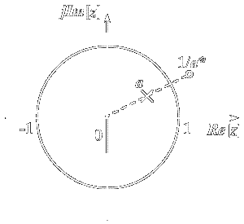
7.1.3 Allpass Transfer Function
one real pole
one complex pole

Slide 16
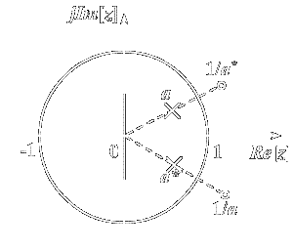
7.1.3 Allpass Transfer Function
Two order allpass transfer function
ploes：
zeros：
MOOC

Slide 17
7.1.3 Allpass Transfer Function difficulty
Generalize, the Mth-order allpass system is:
If we denote polynomial:
MOOC
So:

Slide 18
7.1.3 Allpass Transfer Function difficulty
The numerator of a real-coefficient allpass transfer function is said to be the mirror-image polynomial of the denominator, and vice versa.
We shall use the notation to denote the mirror-image polynomial of a degree-M polynomial D_{M}(z) , i.e.,
MOOC

Slide 19
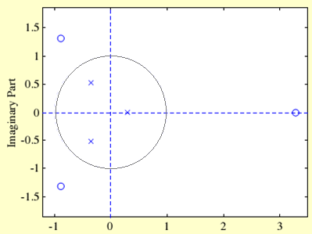
7.1.3 Allpass Transfer Function difficulty
implies that the poles and zeros of a real-coefficient allpass function exhibit mirror-image symmetry in the z-plane.
MOOC

Slide 20
7.1.3 Allpass Transfer Function
To show that |A_{M}(e^{jω})|=1 we observe that:
Therefore:
Hence:
MOOC

Slide 21
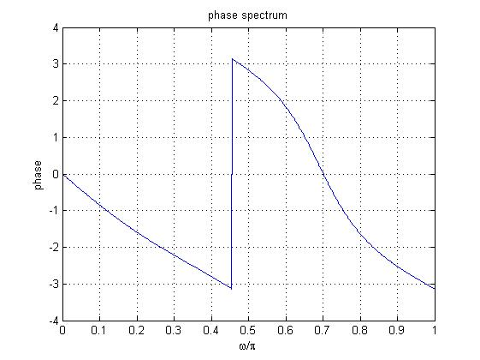
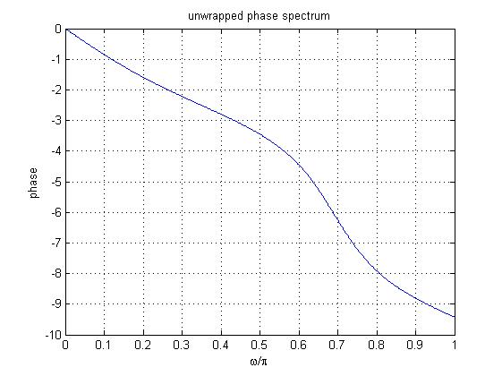
Figure below shows the principal value of the phase of the 3rd-order allpass function:
Note: The phase function of any arbitrary causal stable allpass function is a continuous function of ω.

Slide 22
7.1.3 Allpass Transfer Function
Properties:
A causal stable real-coefficient allpass transfer function is a lossless bounded real (LBR) function or, equivalently, a causal stable allpass filter is a lossless structure.
The magnitude function of a stable allpass function A(z) satisfies:
MOOC

Slide 23
7.1.3 Allpass Transfer Function
(3) Let τ_{g}(ω) denote the group delay function of an allpass filter A(z), i.e.,
The unwrapped phase function θ_{c}(ω) of a stable allpass function is a monotonically decreasing function of ω so that τ_{g}(ω) is everywhere positive in the range 0 < ω < π.
MOOC

Slide 24
Application of allpass system
Any causal stable system can be denoted as: H(z)=H_{min}(z)A(z)
Where H_{min}(z) is a minimum phase-delay system.
Use allpass system to help design stable filters.
Use allpass system to help design linear phase system.
A simple example. (delay equalizer Fig 7.7, 7.8)

Slide 25
7.2 Transfer Function Classification Based on Phase Characteristic
1、The phase delay will cause the change of signal waveform
幅度
原始信号
时间 t
幅度
相移90º
时间 t
幅度
相移 180º
时间 t

Slide 26
2、The nonlinearity of system phase delay will cause the signal distortion
Time delay of signal is depended on system
phase characteristic
ϕ(ω)
时延
f1 f2
f
f1 f2
f
ϕ(ω)
时延
MOOC
f1 f2
f
f1 f2
f

Slide 27
3、If we ignore the phase information, then
输入波形
DFT变换
忽略相位信息
IDFT变换
MOOC
输出波形

Slide 28
4、The linear phase FIR filter
linear phase requirement：
—— group delay

Slide 29
7.2 Transfer Function Classification Based on Phase Characteristic
Zero-Phase Transfer Function
Linear-Phase Transfer Function
Minimum-Phase and Maximum-Phase Transfer Functions

Slide 30
7.2.1 Zero-Phase Transfer Function
One way to avoid any phase distortions is to make the frequency response of the filter real and nonnegative, to design the filter with a zero phase characteristic.
But for a causal digital filter it is impossible.
Only for non-real-time processing of real-valued input signals of finite length, the zero phase condition can be met.
MOOC

Slide 31
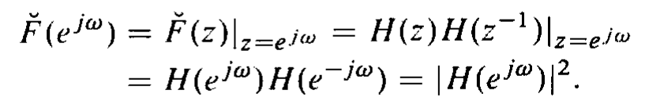
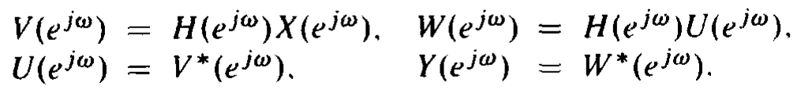
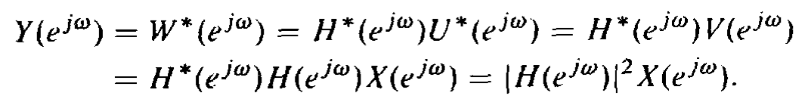
7.2.1 Zero-Phase Transfer Function
Let H(z) be a real-coefficient rational z-transform with no poles on the unit cycle, then F(z)=H(z)H(z⁻¹) has a zero phase on the unit cycle.
One zero-phase filtering scheme is sketched below:
x[n]
H(z)
v[n]
u[n]
H(z)
w[n]
u[n]=v[-n], y[n]=w[-n]
Notes:
The function filtfilt implements the above zero-phase filtering scheme.

Slide 32
7.2.3 Minimum-Phase and Maximum-Phase Transfer Function
Based on the expression:
The phase function is:
Where, ξ_{k} andλ_{k} are zeros and poles, respectively.

Slide 33
7.2.3 Minimum-Phase and Maximum-Phase Transfer Function
We define the expression (e^{jω}- ξ_{k} )and (e^{jω} - λ_{k} ) as zero vectors and pole vectors.
When ξ_{k} and λ_{k} are inside the unit circle, and ω change from 0 to 2π, the change of phase of the (e^{jω}- ξ_{k} )and (e^{jω} - λ_{k} ) vectors are 2π.
When ξ_{k} and λ_{k} are outside the unit circle, and ω change from 0 to 2π, the change of phase of the (e^{jω}- ξ_{k} )and (e^{jω} - λ_{k} ) vectors are 0.
So, only zeros or poles inside the unit circle can affect phase function of H(e^{jω}).
Notes:
只有单位圆里面的零点和极点对相位有影响

Slide 34
7.2.3 Minimum-Phase and Maximum-Phase Transfer Function
For causal stable system, we can deduce:
So, it’s the phase delay (lag) system.
1) When all zeros are all inside the unit circle (if N=M):
It’s the minimum phase delay system.
Notes:
因果稳定系统的极点一定在单位圆里面。

Slide 35
7.2.3 Minimum-Phase and Maximum-Phase Transfer Function
2) When all zeros are all outside the unit circle, we get:
Where N is the number of poles.
And it’s the maximum phase delay system.
3) A transfer function with zeros inside and outside the unit circle is called a mixed-phase transfer function.

Slide 36
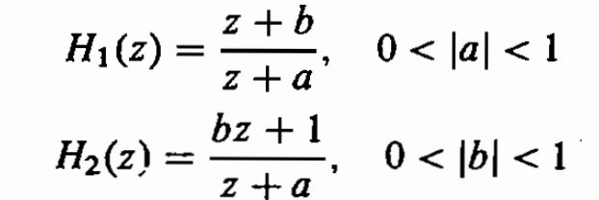
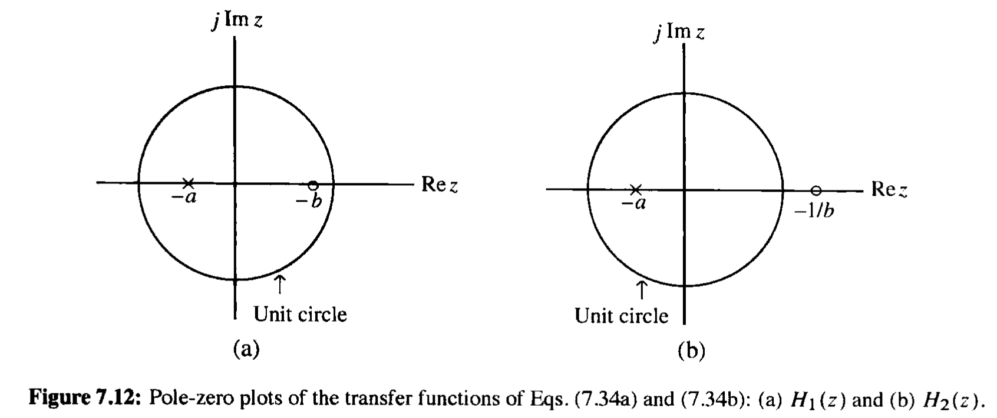

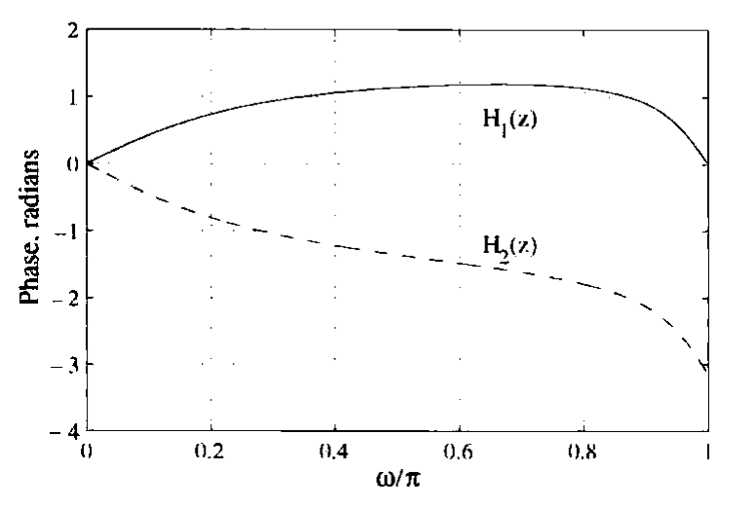
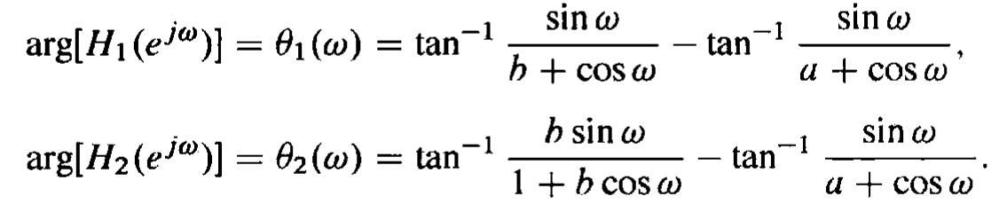
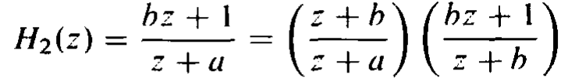

Example

Slide 37
Example7.2: Determine the transfer fuction from specified
square magnitude function:

Slide 38

Example7.4:
consider the mixed-phase transfer function:
We can rewrite H(z) as

Slide 39
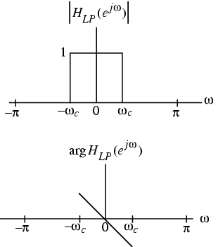
7.2.2 Linear-Phase Transfer Function
key point
The phase distortion can be avoided by ensuring that the transfer function has a unity magnitude and a linear-phase.
y[n]=x[n-D] => Y(e^{jω})= e^{-jωD}X(e^{jω})
=> H(e^{jω})= Y(e^{jω}) / X(e^{jω})= e^{-jωD}
The transfer function of a filter should exhibit a unity magnitude response and a linear-phase response in the band of interest.

Slide 40
7.2.2 Linear-Phase Transfer Function
key point
Example - Determine the impulse response of an ideal lowpass filter with a linear phase response:
Applying the frequency-shifting property of the DTFT to the above impulse response filter, we arrive at the linear phase lowpass filter:
MOOC

Slide 41
7.2.2 Linear-Phase Transfer Function
key point
By truncating the impulse response to a finite number of terms, a realizable FIR approximation to the ideal lowpass filter can be developed.
The truncated approximation may or may not exhibit linear phase, depending on the value of n₀ chosen.
If we choose n₀= N/2 with N a positive integer, the truncated and shifted approximation is:
^
MOOC

Slide 42
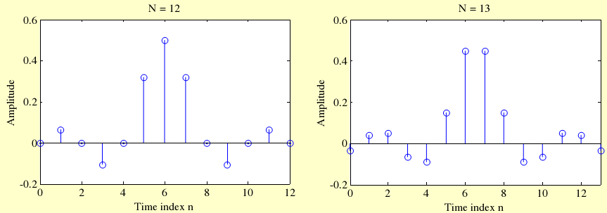
7.2.2 Linear-Phase Transfer Function
Figure below shows the filter coefficients obtained using the function sinc for two different values of N.
MOOC
Notes:
It is always possible to design an FIR transfer function with an exact linear-phase response.

Slide 43
7.3 Types of Linear-Phase FIR Transfer Functions
Consider a causal FIR transfer function H(z) of length N+1, i.e., of order N:
If H(z) is to have a linear-phase, its frequency response must be of the form
Where c and β are constants, and called the amplitude response, also called the zero-phase response, is a real function of ω .

Slide 44
7.3 Types of Linear-Phase FIR Transfer Functions
For a real impulse response, the magnitude response |H(e^{jω})| is an even function of , i.e., |H(e^{jω})| = |H(e^{-jω})|
Since , the amplitude response is then either an even function or an odd function of ω, i.e.
H(e^{jω})=H*(e^{-jω}) =>
If is an even function, the above relation leads to:
e^{jβ} = e^{-jβ}, implying that either β=0 or β=π.

Slide 45
7.3 Types of Linear-Phase FIR Transfer Functions
=>
Substituting the value of β in the above
Replacing ω with -ω in the previous equation we get
Let l = N-n,

Slide 46
7.3 Types of Linear-Phase FIR Transfer Functions
As , we have
$h[n]e^{\text{−}\text{j}ω(\text{c}\text{+}\text{n})}=$ $h[N−n]e^{\text{j}ω(\text{c}\text{+}\text{N}\text{-}\text{n})}$
The above leads to the condition when
c = -N/2 , h[n]=h[N-n] 0≤n≤N
Thus, the FIR filter with an even amplitude response will have a linear phase if it has a symmetric impulse response.

Slide 47
7.3 Types of Linear-Phase FIR Transfer Functions
If is an odd function, the above relation leads to:
e^{jβ} = -e^{-jβ}, implying that either β= π/2 or β= -π/2
As

Slide 48
7.3 Types of Linear-Phase FIR Transfer Functions
Let l = N-n,
When c=-N/2：h[n]= -h[N-n], 0≤n≤N antisymmetric impulse response.
Thus, a FIR filter with an even amplitude response will have a linear phase if it has a symmetric impulse response.
And a FIR filter with an odd amplitude response will have linear-phase response if it has an antisymmetric impulse response.
We arrive at the condition for linear phase as:

Slide 49
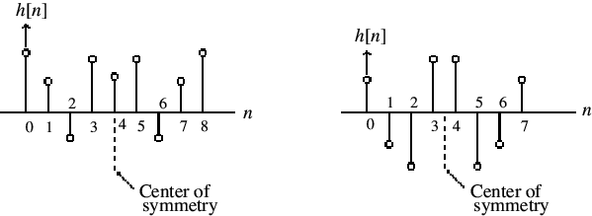
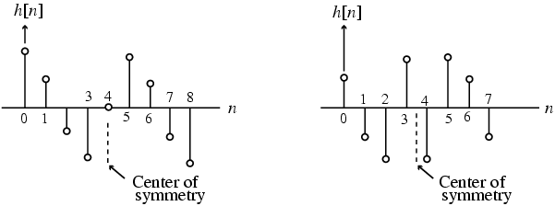
four types of linear-phase FIR transfer functions:
length=N+1
对称、奇数长度
对称、偶数长度
Type 1: N = 8
Type 2: N = 7
反对称、奇数长度
反对称、偶数长度
Type 3: N = 8
Type 4: N = 7

Slide 50
Type 1: Symmetric Impulse Response with Odd Length
Let N = 8
Notes:
h[0]=h[8], h[1] = h[7], h[2] = h[6], and h[3] = h[5]

Slide 51
The quantity inside the { } is a real function of ω ( ), and can assume positive or negative values in the range 0≤|ω|≤π.
The phase function is:
β is either 0 or π
The group delay is:
indicating a constant group delay of 4 samples

Slide 52
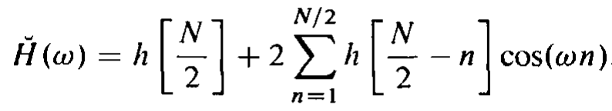
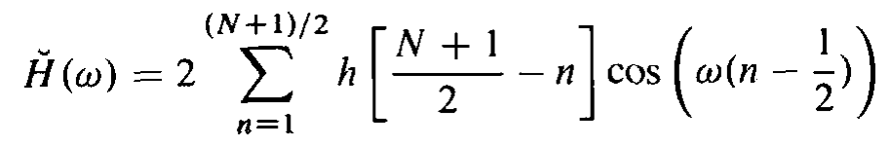
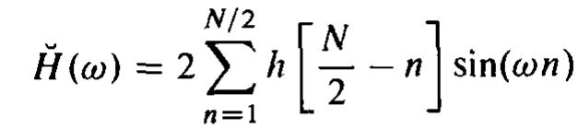
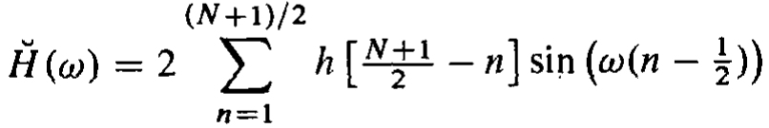
In the general case, each of four types of causal linear phase FIR filters, the frequency response is of the form:
β is either 0 or π for type1 or type2 filters, and π/2 or -π/2 for type3 or type4 filters.
Notes:
四种因果线性相位FIR滤波器频响的通式

Slide 53
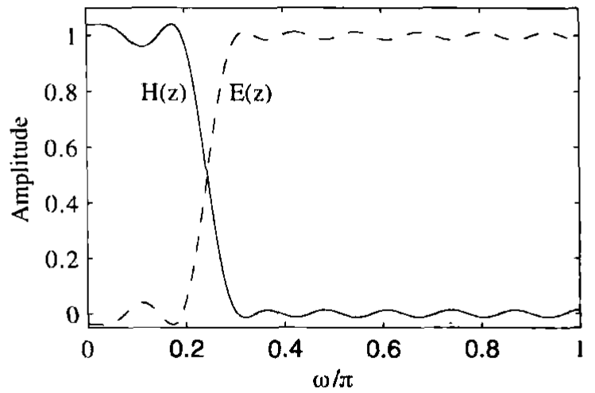
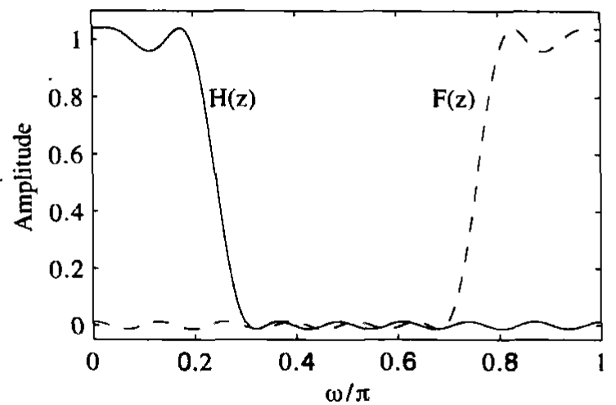
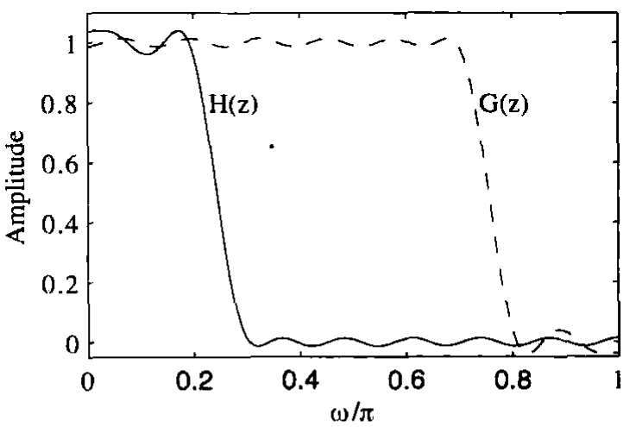
Example7.5:
firlp2hp: generate E(z) and G(z) from H(z);
firlp2lp: generate F(z) from H(z).

Slide 54
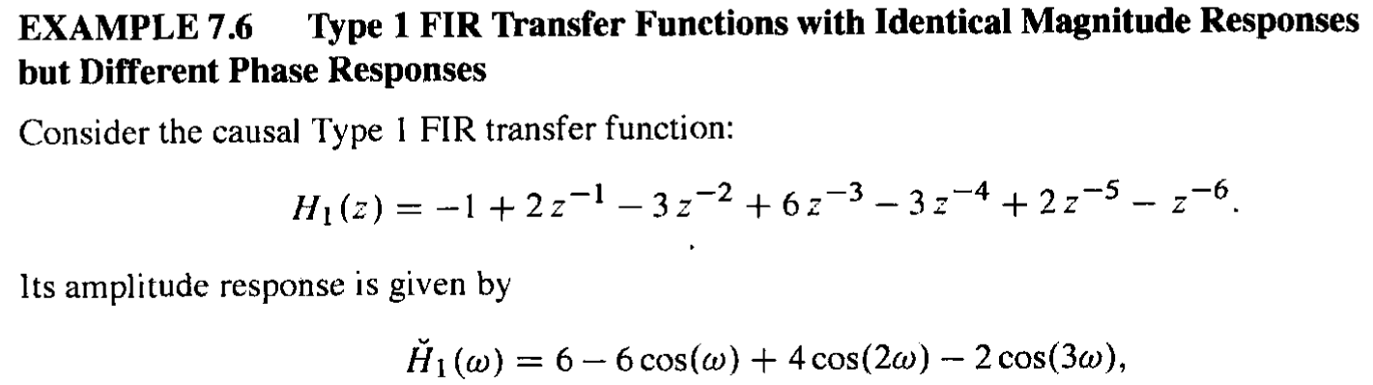

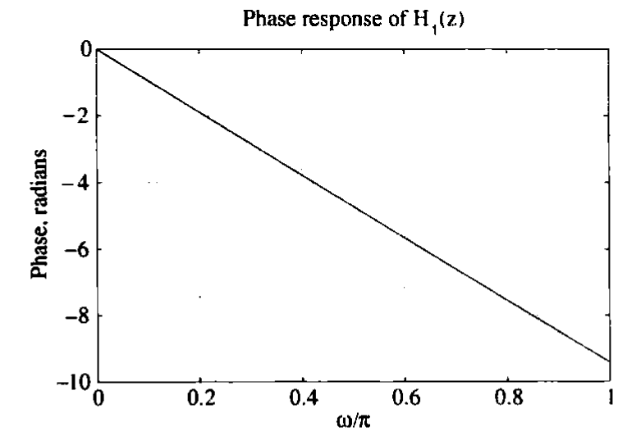
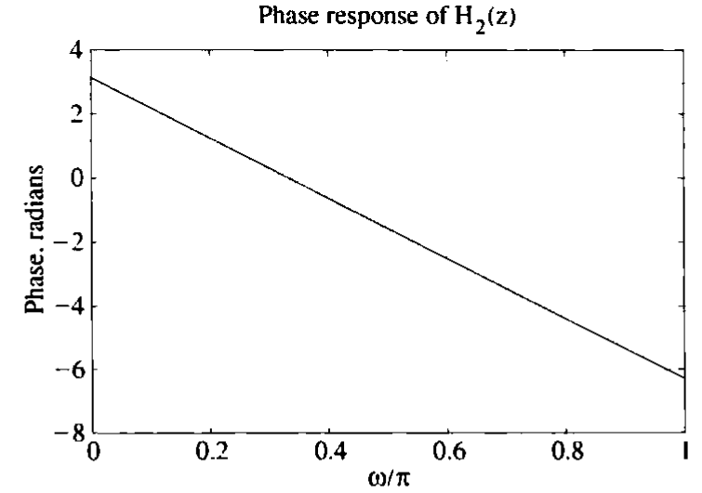


7.3 Types of Linear-Phase FIR Transfer Functions

Slide 55
7.3 Types of Linear-Phase FIR Transfer Functions
Example
1
which is seen to be a slightly modified version of a length-7 moving-average FIR filter
The above transfer function has a symmetric impulse response and therefore a linear phase response
modified filter
0.8
moving-average
0.6
Magnitude
0.4
0.2
0
0
0.2
0.4
0.6
0.8
1
ω
/
π

Slide 56
7.3 Types of Linear-Phase FIR Transfer Functions
Note the improved magnitude response obtained by simply changing the first and the last impulse response coefficients of a moving-average (MA) filter
It can be shown that we can express
which is seen to be a cascade of a 2-point MA filter with a 6-point MA filter
Thus, H₀(z) has a double zero at z= -1, i.e., (ω = π)

Slide 57
Linear-Phase FIR Transfer Functions satisfy:
7.3.1 Zero Locations of Linear-Phase FIR Transfer Functions
For a symmetric impulse response,
For a anti-symmetric impulse response,

Slide 58
Mirror-image symmetry and complex conjugate!
For a linear-phase FIR filter, the zeros are in mirror-image pairs.
Moreover, for a FIR filter with a real impulse response, the zeros occur in complex conjugate pairs.

Slide 59
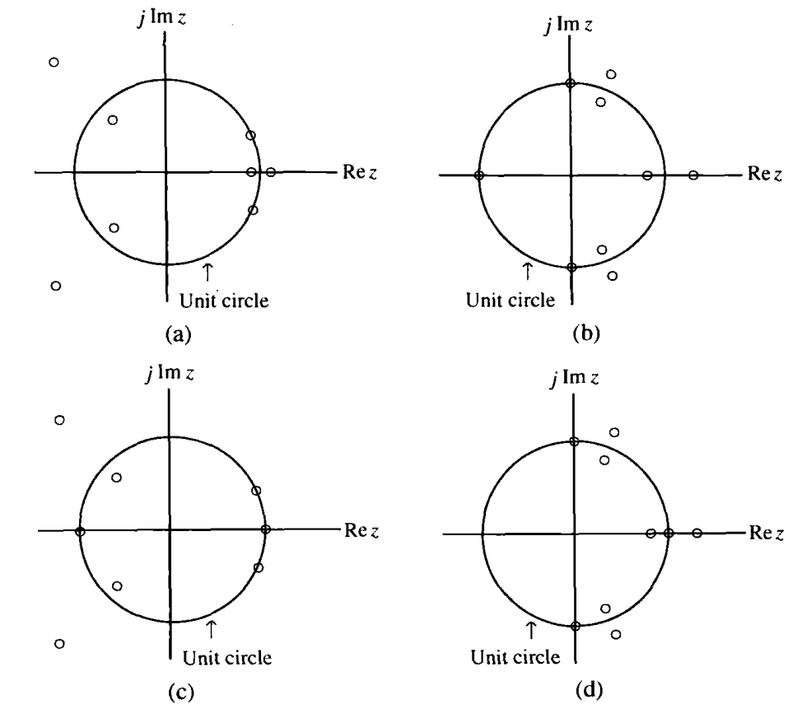
7.3.1 Zero Locations of Linear-Phase FIR Transfer Functions
(a)Type 1: Either an even number or no zeros at z=1& z=-1.
(b)Type 2: Either an even number or no zeros at z=1, and an odd number of zeros at z=-1.
(c)Type 3: An odd number of zeros at z=1& z=-1.
(d)Type 4: An odd number of zeros at z=1, and either an even number or no zeros at z=-1.

Slide 60
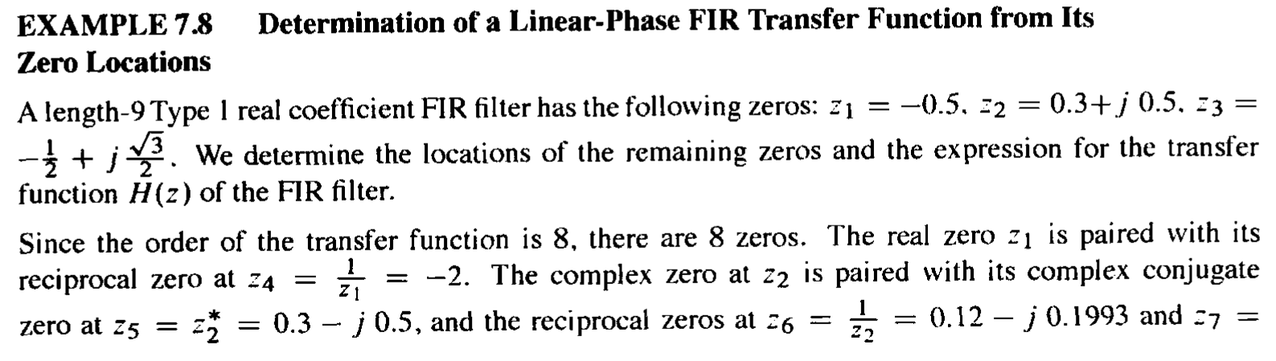
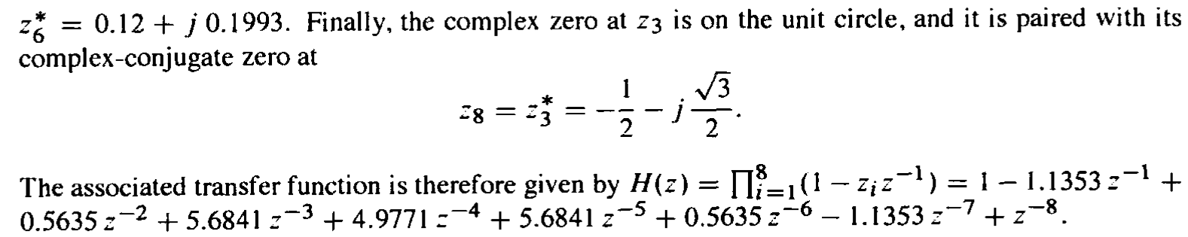

Slide 61







7.4 Simple Digital Filters
Simple FIR Digital Filters
Lowpass:
Highpass:
Notch:
Comb:

Slide 62






7.4 Simple Digital Filters
Simple IIR Digital Filters
Lowpass:
Highpass:
Bandpass:
Bandstop:

Slide 63
Homework
Problems
7.4, 7.8, 7.10, 7.21, 7.28, 7.30, 7.41, 7.51, 7.68
M7.1, M7.5

