Slide 1
Review outline
Course requirements
Main contents divided by knowledge points

Slide 2
Course requirements
1. Master the analysis in time domain, transform domain and the implementation methods of discrete signals and systems.
2. Understand the relationship between DTFT, DFT and ZT deeply, and master the concept of frequency response of discrete-time system.
3. Deeply understand the digital processing process and frequency domain concept of continuous signal.
4. Master the common structure of digital filter.

Slide 3
Course requirements
5. Master the bilinear transformation (IIR) and window function (FIR) design methods of digital filter (main low-pass), and understand the physical concept of digital filter parameters.
6. Understand the idea of FFT algorithm, can use FFT for engineering design.
7. Understand ADC quantization concept.

Slide 4
Topic 1 The Time-Domain Analysis of Discrete time signals and systems
Requirements:
(1) Time domain expression of discrete signals and systems
(2) System equation description
(3) LTI of property：causality, stable system property
(4) Convolution sum operation.
The corresponding ranges in the book ：2.1---2.5,
4.1--4.7

Slide 5
1. Time domain expression of discrete signals and systems
The time domain representation of discrete time signal is as follows. It is represented by the sequence x [n].
（1） Function description way.
（2）Graphical way.
It includes the basic calculation of sequence time domain, the properties of sequence and common sequence.
The time domain representation of discrete time system is as follows:
（1） unit impulsion response h[n] 。
（2） Linear difference equations with constant coefficients.

Slide 6
2 System equation description
A linear time invariant system is usually described by a linear difference equation with constant coefficients.
The unit sampling response of the system can be solved by iterative method in time domain according to the initial conditions of the system.
Different initial conditions of the system will make the system properties expressed by the same system equation be different.

Slide 7
3 Properties of LTI system
Definition and properties of linear system
Definition and properties of time invariant system
The definition and properties of causal system
The definition and properties of stable system
It is required to judge the performance of a given system according to the definition of the above system properties.

Slide 8
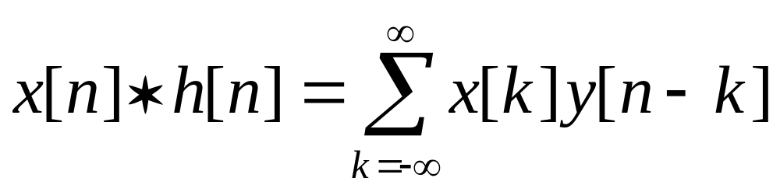
4 Convolution sum operation
The definition of convolution ：
Convolution calculation: using the basic operation of sequence to fold, shift, add, sketch and discuss the Processing.
Convolution properties: exchange, combination, distribution.

Slide 9
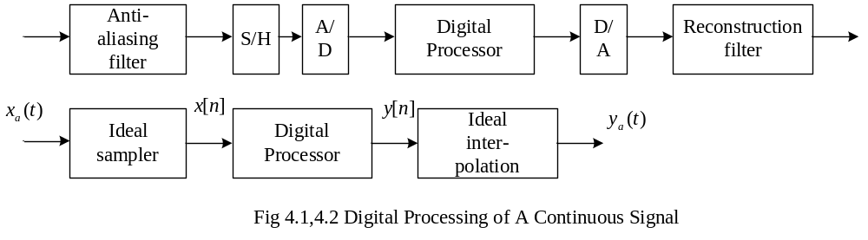
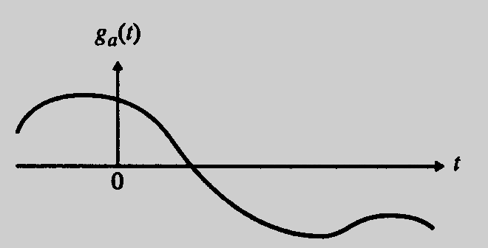
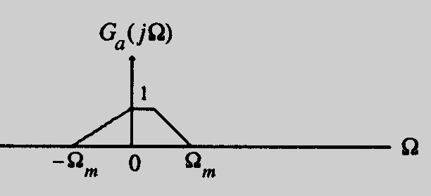
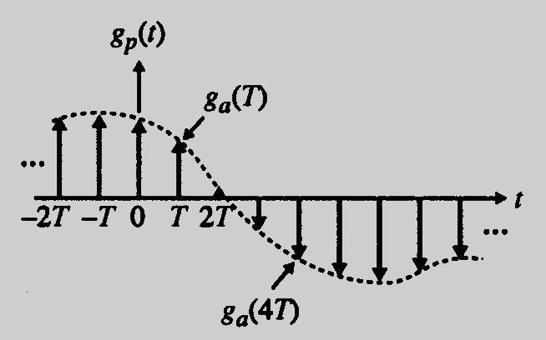
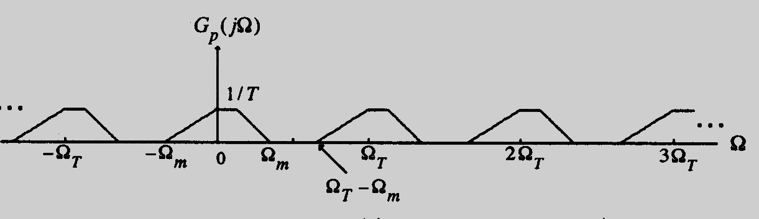
The Discretization The periodization
In time Domain In Frequency Domain
Ω=ω/T

Slide 10
Topic 2 :Discrete Time Fourier Transform
Requirements: deep understanding of time Fourier transform (DTFT). Including：
（1） The relationship between time domain and frequency domain of DTFT.
（2） The definition and properties of DTFT.
The corresponding range in the book ：3.1---3.7

Slide 11
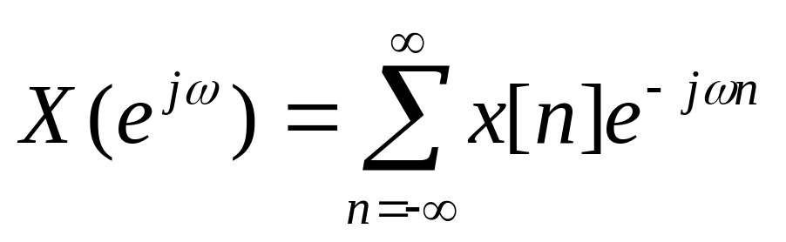
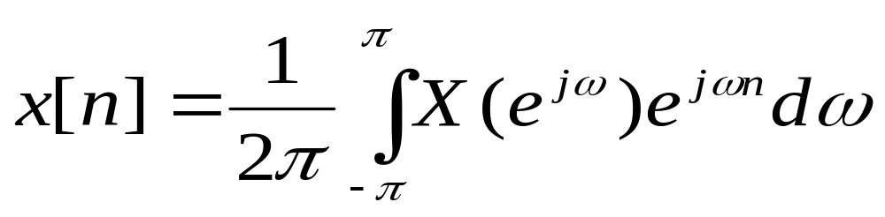
Calculation and properties of DTFT
Definition of DTFT transform pairs ：
Spectrum characteristics :
Periodic function (so frequency domain can be expanded into Fourier Series)
Common transformation pairs. Table 3.3
Basic properties and symmetry properties: Table 3.1,3,2,3.4

Slide 12
Topic 3: z-transformation
（1）The definition of z-transform and its relationship with DTFT
（2）Common z-transform pairs
（3）z-transform of rational fraction
（4）Calculation of inverse z-transform by partial fraction method
（5）Properties of z-transform
Corresponding range in the book: 6.1 -- 6.6

Slide 13
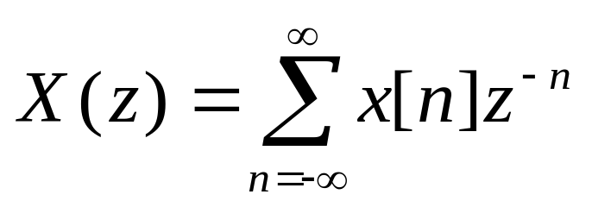
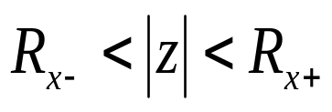
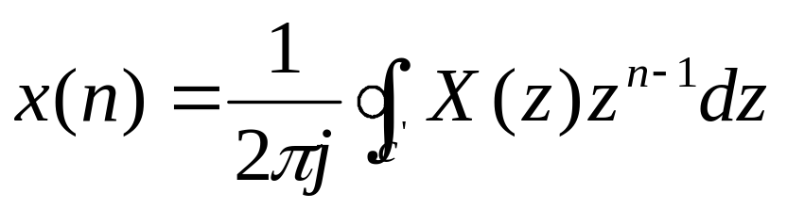
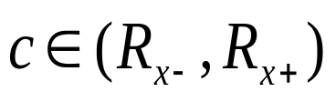
Calculation and properties of ZT
The definition of ZT transformation pairs：
Note: the convergence region of Z-transform must be indicated.
Several convergence cases (on z plane) ： 6.3
Common transformation pairs (mainly used for inverse transformation)：Table 6.1
Basic properties： table 6.2
Notes:
*

Slide 14
Topic 4: Analysis of Transform Domain of Discrete Time Systems
(1) The concept of frequency response of LTI discrete time systems.
(2) Phase delay and group delay.
(3) Definition of transfer function.
(4) Analysis of the system based on transfer function.
(5) Discrete time systems with various magnitude characteristics.
(6) Discrete time systems with various phase characteristics.
(7) Linear phase LTI discrete time system.
Corresponding ranges of the book: 4.8, 4.9, 6.7, 7.1--7.4

Slide 15
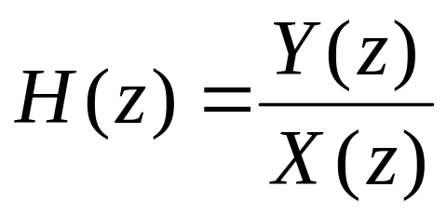
1.Transfer Function H (z)
The transfer function H(z) is the z-transformation of the impulse response h[n].
According to the difference equation of the system, the transfer function of the system can be obtained by taking z-transformation for input and output
According to the transfer function, the zero / pole plot of the system is drawn to judge the stability of the system.

Slide 16
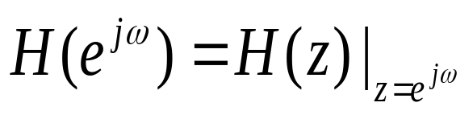
2.Frequency Response
The frequency response H(e^{jω}) is the DTFT of the unit sample response h[n] .
The transfer function H (z) is the z-transformation of the unit sample response h [n]
The frequency response H(e^{jω}) can be obtained from the transfer function H(z) of the system ：
Two components of frequency response: magnitude frequency and phase frequency characteristics.

Slide 17
2.Frequency Response
Magnitude response characteristics: the amplitude frequency diagram will be discussed in combination with geometric interpretation.
Concept of Filtering
To kill a signal cos(wn) or e^{jwn} , frequency response |H(jw)|=0
Phase response characteristics: understand the concepts of linear phase characteristics, phase delay and group delay.

Slide 18
3. Other Concepts
Energy spectral density
Band limited discrete time signal
Unwrapped Phase Function
Phase delay and group delay

Slide 19
4. FIR and IIR Systems，the Basic Properties of 4 Linear Phase FIR System
Different system classification standards lead to different system types.
Classification based on magnitude response
Classification based on phase response
The characteristics of FIR and IIR systems.
The characteristics of 4 kinds of linear phase FIR system and the determination of their zero position.

Slide 20
Topic 5: Digital Processing of Continuous Signals
understand the digital processing process of continuous signals and the corresponding frequency domain concept。
The corresponding range in the book ：3.8--3.9
Understand the digital processing steps of continuous signal block diagram, and explain the function of each step.
Deeply understand the time domain and frequency domain characteristics of ideal sampling and practical sampling process, and be able to derive their time domain and frequency domain expressions.

Slide 21
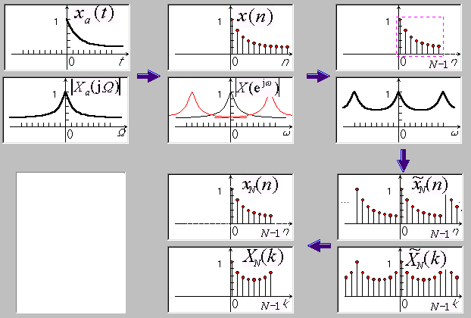

Slide 22
Topic 6: Calculation of Frequency Spectrum of Discrete Time Signals
The definition of DFT and the corresponding relationship between time domain and frequency domain.
The relationship between DFT and DTFT.
Properties of DFT.
The engineering calculation of DFT :
（1）DFT calculations of real sequences
（2）The idea of FFT algorithm
（3）Using DFT to calculate linear convolution

Slide 23
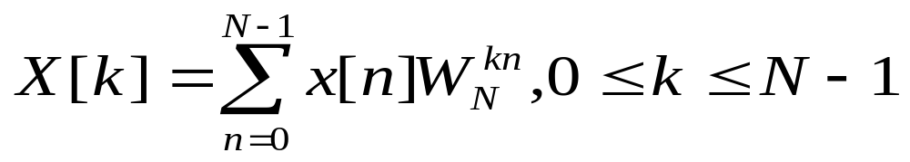
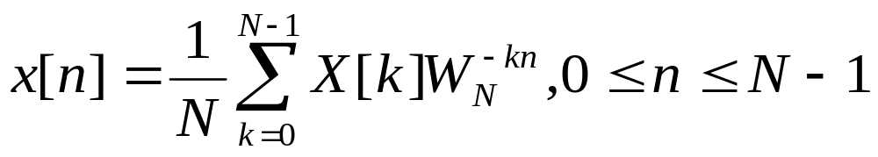
1. Calculation and properties of DFT
The definition of DFT transformation pairs：
Spectrum characteristics:
Discrete periodic sequence(so in time / frequency domain it can be expanded as Fourier Series)
Basic properties and symmetry properties

Slide 24
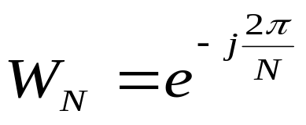
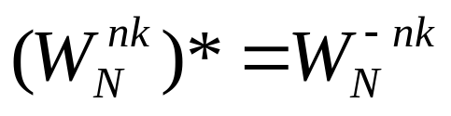
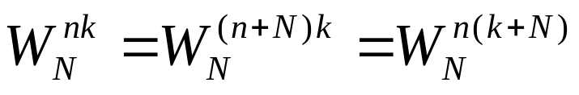
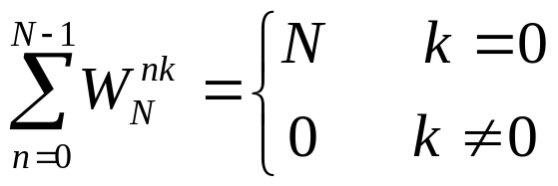
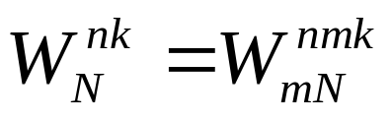
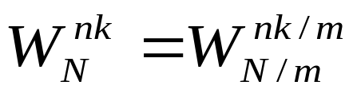
2. FFT
Requirements: understand the FFT algorithm and its application
Using the property of W_{N} to reduce the times of multiplication
１、 Properties of W_{N}
Symmetry ：
Periodicity ：
Reducibility:

Slide 25
Basic skills of FFT
Compute DFTs of two N-point real sequences: first, combine them into an N-point complex sequence (two real sequences are set to the real part and imaginary part of the complex sequence respectively), and then calculate the N-point complex sequence DFT.
Compute DFT of a 2N point real sequence: first, turn it into an N-point complex sequence (take the even and odd points of the sequence as the real and imaginary parts of the complex sequence respectively), and then calculate the N-point complex sequence DFT. Finally, the DFT of the original real sequence is obtained from the DFT of the complex sequence.

Slide 26
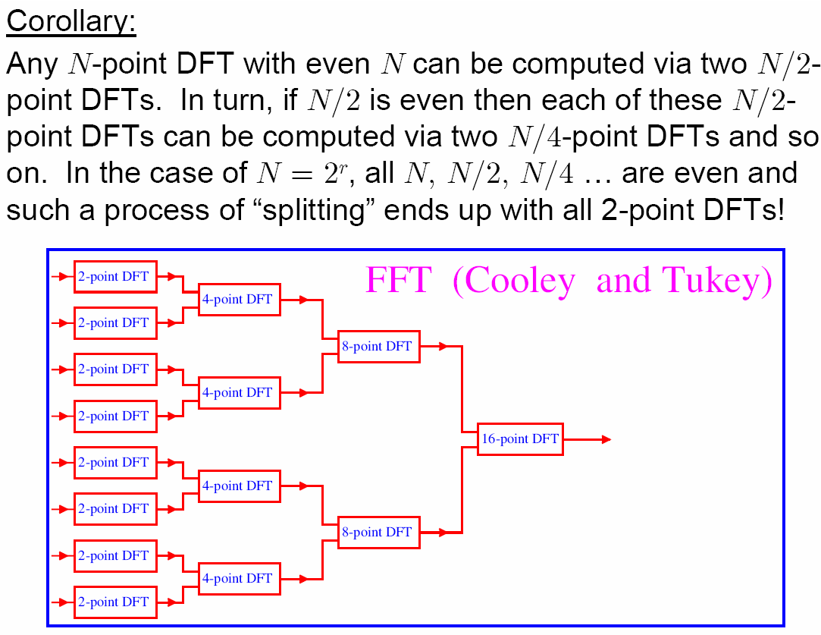
Basic skills of FFT

Slide 27
The basic idea of FFT
Because the calculation of DFT and IDFT is very heavy, the calculation of DFT can be simplified according to the properties of W_{N}.
Based on time (radix 2): the sequence is divided into two groups according to the parity of N, and the N-point DFT can be obtained by combining the N/2-point DFT of these two subsequences.
Based on frequency (radix 2): the sequence is divided into two parts according to the order of N, and the influence on the spectrum is divided according to the odd and even of k by deduction. N-point DFT can be obtained by combining the two N/2-point DFT.

Slide 28
3 The Relationship of Several Transformations
The relationship between ZT and DTFT ：
DTFT is the z-transform on the unit circle in z plane.
The relationship between DTFT and DFT：
DFT is the uniform interval (2π/N) sampling of DTFT on the unit circle in z plane.
Linear convolution and circular convolution have their own definitions, application scope and relationship.

Slide 29
Topic 7: The Structure of Digital Filter
Requirements: ：
（1） The description of filter block diagram and signal flow diagram.
Common structure of digital filter
（2） IIR direct form realizion, cascade realizion and parallel realization
（3） FIR direct realization and cascade realizaton
Corresponding range: 8.1-8.5

Slide 30
1. Description of filter block diagram and signal flow diagram
Given the block diagram, the difference equation can be written as the representation of basic components.
The difference equation is given to draw a block diagram.
Master how to use transpose theorem (seeking equivalent structure), the definition of canonic structure and noncanonic structure.

Slide 31
2. Basic structure of filter
Direct realization: easy to implement, but inconvenient to adjust zero and pole .
Direct form I: obtained completely from the difference equation (noncanonic structure).
Direct form II: canonic structure, derived from form I.
Cascade realization: it is composed of first-order and second-order nodes in cascade form. It is convenient to adjust the zero point, but it will increase the amount of calculation.
Parallel realization: it is convenient to adjust poles, and by partial fractional expansion to get, which is convenient to discuss the properties of the system represented by a series of sub transfer functions.

Slide 32
Topic 8: Design of digital filter
Requirements：
(1) Understand the physical concepts of digital filter parameters (passband edge frequency, stopband edge frequency, passband ripple, stopband ripple, order, etc.).
(2) The basic analog filter approximation.
(3) Design method of IIR digital filter-- the bilinear transformation.
The corresponding ranges in the book ：9.1---9.6, A.1--A.4

Slide 33

1. Physical meaning of specifications of digital filter
Characteristics of digital filter :
Passband edge frequency
Passband ripple
Stopband edge frequency
stopband ripple
Peak passband ripple
Stopband attenuation
Order N.
Conversion formula of analog angular frequency to digital angular frequency:

Slide 34
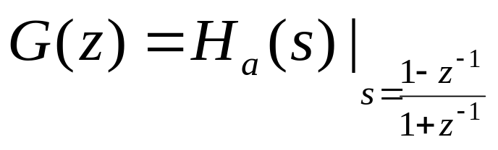
2. Design of IIR low pass filter
Design of IIR filter ：
Impulse invariance method, bilinear transformation method.
From the basic idea of transformation itself to understand the design method.
Design steps of bilinear transformation method ：
(1) The given edge frequencies is prewarpped and the analog prototype filter H_{a}(s) is designed.
Ω = tan(ω/2)
（2）The transfer function of digital filter is obtained by bilinear transformation mapping:

Slide 35
2. Design of FIR filter ：
Window fourier series method, frequency sampling method. From the basic idea of transformation itself to understand the design method.
Design steps of window function method ：
(1）The corresponding ideal digital impulse response is found out according to the design requirements.
f_{c} = (f_{p}+f_{s})/2
（2）According to the design requirements, look up table 10.2 to find out the window that meets the conditions, determine the order of the filter, and add a window to the idea impulse response (pay attention to delay).
（3） Check the results to see if they meet the design requirements, otherwise redesign.

