Slide 1

Dr. Pócza Krisztián
kpocza@kpocza.net

Slide 2
Microsoft ♥ Linux
Azure
VMs running Linux distributions
Server software on Linux
PowerShell
SQL Server 2016
Joined the Linux Foundation as Platinum Member
Bash on Ubuntu on Windows

Slide 3
History
3rd party:
Cygwin, MinGW
POSIX v1 support
SFU
Project Drawbridge
MS Research
Library OS
Main building blocks
Project Astoria - Windows Bridge for Android
Abandoned
LXSS, LWS, Ubuntu on Windows

Slide 4
Ubuntu on Windows
Windows 10 Anniversary Update
OptIn feature
Developer Mode
Feature: Windows Subsystem for Linux (beta)
Start bash.exe
Ubuntu 14.04 LTS
Cooperation with Canonical
Focus on console apps and developer tools+servers
64 bit only
Native Linux ELF binaries
Updated in Windows 10 Creators Update (redstone 2)
Other distributions can be hacked onto

Slide 5
Ubuntu on Windows
Demo
Notes:
Start bash, file listing, top, vim, permissions, sudo, devices, lsb_release, mount, dpkg
Show where it lives in user profile

Slide 6
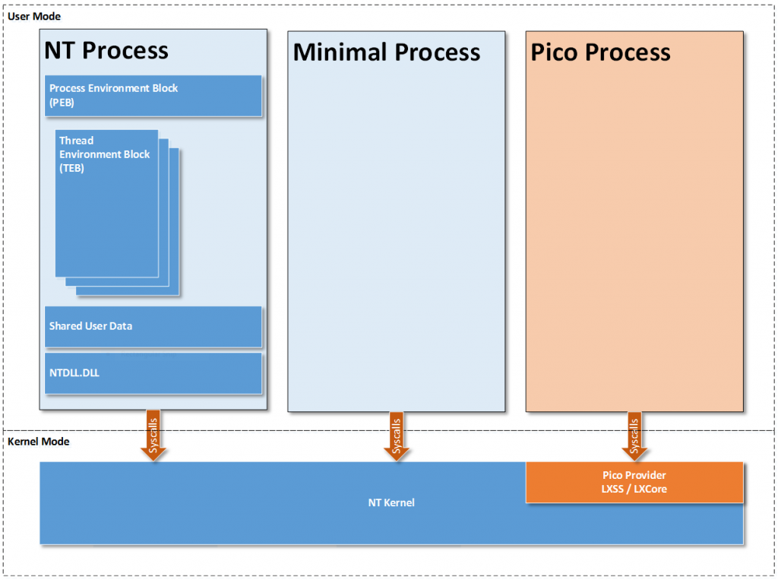
{NT, Minimal, Pico} Process
* https://blogs.msdn.microsoft.com/wsl/2016/05/23/pico-process-overview/

Slide 7
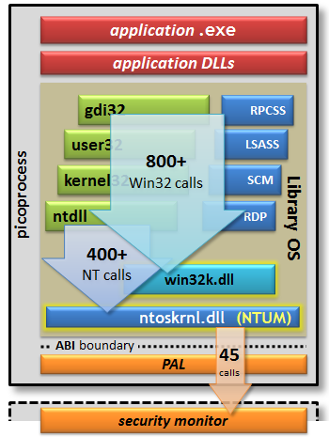
Outlook to Project Drawbridge
Pico process
Container like
Split kernel
Reduced set of NT syscalls
->
SQL 2016 on Linux

Slide 8
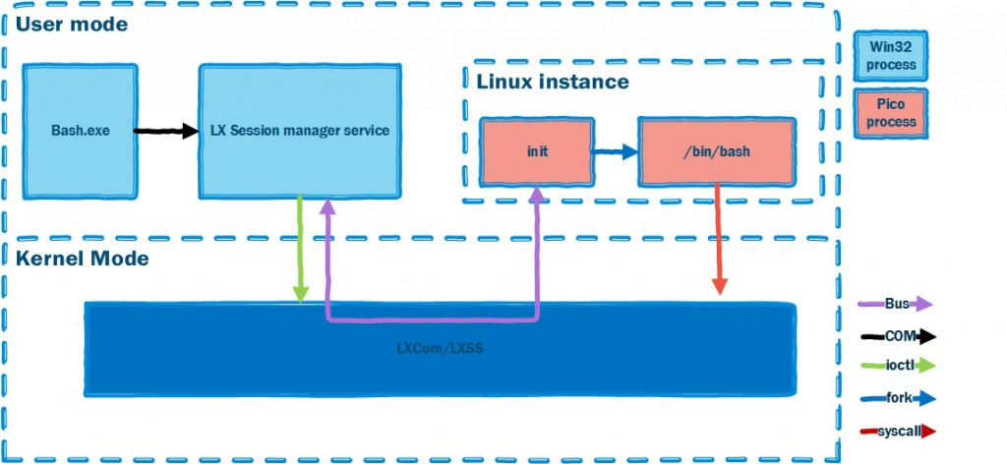
LWS Architecture
* https://blogs.msdn.microsoft.com/wsl/2016/04/22/windows-subsystem-for-linux-overview/

Slide 9
Syscalls
ACCEPT, ACCEPT4, ACCESS, ALARM, ARCH_PRCTL, BIND, BRK, CAPGET, CAPSET, CHDIR, CHMOD, CHOWN, CLOCK_GETRES, CLOCK_GETTIME, CLOCK_NANOSLEEP, CLONE, CLOSE, CONNECT, CREAT, DUP, DUP2, DUP3, EPOLL_CREATE, EPOLL_CREATE1, EPOLL_CTL, EPOLL_WAIT, EVENTFD, EVENTFD2, EXECVE, EXIT, EXIT_GROUP, FACCESSAT, FADVISE64, FCHDIR, FCHMOD, FCHMODAT, FCHOWN, FCHOWNAT, FCNTL64, FDATASYNC, FLOCK, FORK, FSETXATTR, FSTAT64, FSTATAT64, FSTATFS64, FSYNC, FTRUNCATE, FTRUNCATE64, FUTEX, GETCPU, GETCWD, GETDENTS, GETDENTS64, GETEGID, GETEGID16, GETEUID, GETEUID16, GETGID, GETGID16, GETGROUPS, GETPEERNAME, GETPGID, GETPGRP, GETPID, GETPPID, GETPRIORITY, GETRESGID, GETRESGID16, GETRESUID, GETRESUID16, GETRLIMIT, GETRUSAGE, GETSID, GETSOCKNAME,GETSOCKOPT, GETTID, GETTIMEOFDAY, GETUID, GETUID16, GETXATTR, GET_ROBUST_LIST, GET_THREAD_AREA, INOTIFY_ADD_WATCH, INOTIFY_INIT, INOTIFY_RM_WATCH, IOCTL, IOPRIO_GET, IOPRIO_SET, KEYCTL, KILL, LCHOWN, LINK, LINKAT, LISTEN, LLSEEK, LSEEK, LSTAT64, MADVISE, MKDIR, MKDIRAT, MKNOD, MLOCK, MMAP, MMAP2, MOUNT, MPROTECT, MREMAP, MSYNC, MUNLOCK, MUNMAP, NANOSLEEP, NEWUNAME, OPEN, OPENAT, PAUSE, PERF_EVENT_OPEN, PERSONALITY, PIPE, PIPE2, POLL, PPOLL, PRCTL, PREAD64, PROCESS_VM_READV, PROCESS_VM_WRITEV, PSELECT6, PTRACE, PWRITE64, READ, READLINK, READV, REBOOT, RECV, RECVFROM, RECVMSG, RENAME, RMDIR, RT_SIGACTION, RT_SIGPENDING, RT_SIGPROCMASK, RT_SIGRETURN, RT_SIGSUSPEND, RT_SIGTIMEDWAIT, SCHED_GETAFFINITY, SCHED_GETPARAM, SCHED_GETSCHEDULER, SCHED_GET_PRIORITY_MAX, SCHED_GET_PRIORITY_MIN, SCHED_SETAFFINITY, SCHED_SETPARAM, SCHED_SETSCHEDULER, SCHED_YIELD, SELECT, SEND, SENDMMSG, SENDMSG, SENDTO, SETDOMAINNAME, SETGID, SETGROUPS, SETHOSTNAME, SETITIMER, SETPGID, SETPRIORITY, SETREGID, SETRESGID, SETRESUID, SETREUID, SETRLIMIT, SETSID, SETSOCKOPT, SETTIMEOFDAY, SETUID, SETXATTR, SET_ROBUST_LIST, SET_THREAD_AREA, SET_TID_ADDRESS, SHUTDOWN, SIGACTION, SIGALTSTACK, SIGPENDING, SIGPROCMASK, SIGRETURN, SIGSUSPEND, SOCKET, SOCKETCALL, SOCKETPAIR, SPLICE, STAT64, STATFS64, SYMLINK, SYMLINKAT, SYNC, SYSINFO, TEE, TGKILL, TIME, TIMERFD_CREATE, TIMERFD_GETTIME, TIMERFD_SETTIME, TIMES, TKILL, TRUNCATE, TRUNCATE64, UMASK, UMOUNT, UMOUNT2,UNLINK, UNLINKAT, UNSHARE, UTIME, UTIMENSAT, UTIMES, VFORK, WAIT4, WAITPID, WRITE, WRITEV
* https://msdn.microsoft.com/en-us/commandline/wsl/release_notes

Slide 10
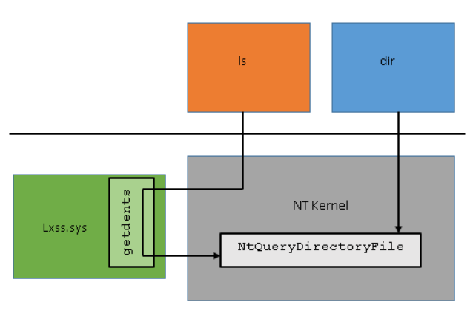
Syscall mechanism
- Handled by Pico Provider
- 1-1 counterpart
- Own implementation
- Prepare + run NT call
Step | Getdents | NtQueryDirectoryFile
1 | mov rax, __NR_getdents64 | mov rax, #NtQueryDirectoryFile
2 | mov rdi, Fd | mov rcx, Foo
3 | mov rsi, Buffer | mov rdx, Bar
4 | mov rdx, sizeof(Buffer) | mov r8, Baz
5 | syscall | syscall
6 | cmp rax, 0xFFFFFFFFFFFFF001 | test eax, eax
* https://blogs.msdn.microsoft.com/wsl/2016/06/08/wsl-system-calls/

Slide 11
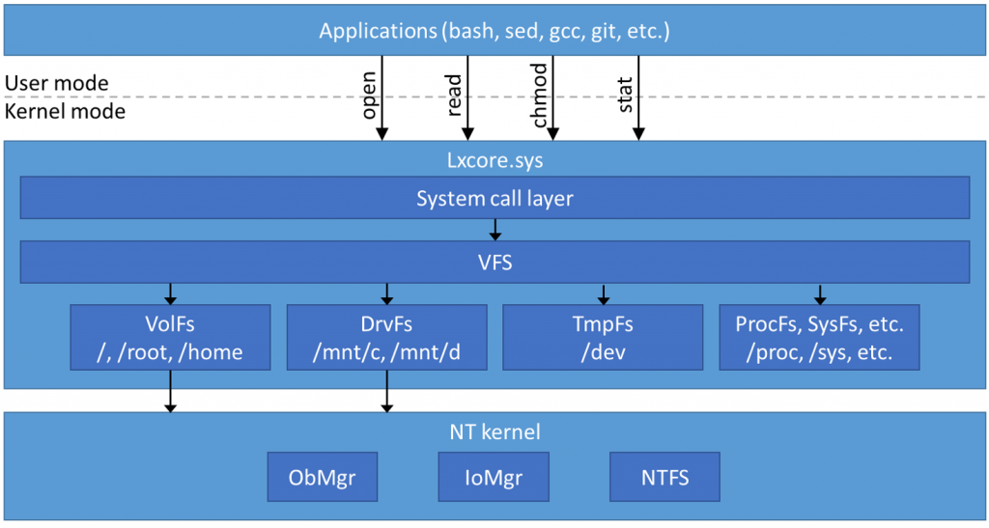
File systems
Unix/Linux: Everything is a file
NTFS
ADS
Extended attributes
* https://blogs.msdn.microsoft.com/wsl/2016/06/15/wsl-file-system-support/

Slide 12
Others
Networking
DNS
Socket - TCP, UDP, RAW
localhost
Process interoperability
Security, permissions
Sudo
Firewall & AV

Slide 13
Limitations
No Sound
No Graphics
No X
No Mice
X can be done via 3rd party X server and export DISPLAY
http://www.pcworld.com/article/3055403/windows/windows-10s-bash-shell-can-run-graphical-linux-applications-with-this-trick.html
Reason: No /dev-s

Slide 14
LoWe
Linux on Windows extender
Extends LWS with some features
Graphics via Framebuffer
PCM Sound
X
Mouse (and Keyboard) handling for X
No need for 3rd party X server
https://github.com/kpocza/LoWe
MIT license

Slide 15
LoWe
Demo
Notes:
Missing devices
Demo1:
- Strace mplayer
Demo2:
Mplayer playing video and sound
Demo3:
Starting X
Starting wmaker
Running some programs on it like a browser

Slide 16
How LoWe works?
Creates missing device files on demand
/dev/fb0, /dev/snd/controlC0, /dev/snd/pcmC0D0p, /dev/input/mice
+ /dev/input/kbd
Goal: real file handle
Attaches to the UoW Linux process as a debugger – ptrace
Jumps syscall to syscall
Debuggee
attach
Debugger
handle event
control

Slide 17
How LoWe works?
The Debugger app is called LoweAgent
Handle syscalls for the mentioned device files via ptrace
open
ioctl, read, write, mmap
Forwards operations, data to a WPF app via network sockets, process responses
WPF app is displaying graphics, providing sound, handling mouse and keyboard
WPF app is called LoweExposer

Slide 18
LoWe - Architecture
Ubuntu on Windows
Win32
app
ptrace
LoWeAgent
…
LoWeExposer
X Server
ptrace
Localhost
socket
FB
Mice
KB
PCM
X App, Window Manager

Slide 19
LoWe – features, properties
Requires configuration
Device handlers
Set of apps
X Server
Default config
Code
LoWeAgent: C++
LoWeExposer: C#/WPF
Extensible device handler interface
Room for performance improvement
Configurable logger

Slide 20
How emulation works?
Graphical framebuffer
/dev/fb0
Originally the file was periodically read and presented
Now sending memory content on a localhost socket
Sound
ALSA calls
PCM
/dev/snd/controlC0, /dev/snd/pcmC0D0p
Commands sent on socket
NAudio library

Slide 21
How emulation works?
Mouse
Record positions
/dev/input/mice
LWS side enquires the movement and button state
Routes the enquiries to the WPF app on socket
ExPS/2 protocol implemented
Keyboard
Only for X
/dev/input/kbd (not a real device, X configured)
Keyboard scancodes are responded through the socket

Slide 22
Thank you
Q&A
kpocza@kpocza.net
http://kpocza.net/
https://github.com/kpocza/LoWe

