Slide 1

Dr. Pócza Krisztián
kpocza@kpocza.net

Slide 2
Microsoft ♥ Linux
Azure
VMs running Linux distributions
Server software on Linux
PowerShell
SQL Server 2016
Joined the Linux Foundation as Platinum Member
Bash on Ubuntu on Windows

Slide 3
History
3rd party:
Cygwin, MinGW
Posix v1 support
SFU
Project Drawbridge
MS Research
Library OS
Main building blocks
Project Astoria - Windows Bridge for Android
Abandoned
LXSS, LWS, Ubuntu on Windows

Slide 4
Ubuntu on Windows
Windows 10 Anniversary Update
OptIn feature
Developer Mode
Feature: Windows Subsystem for Linux (beta)
Start bash.exe
Ubuntu 14.04 LTS
Cooperation with Canonical
Focus on console apps and developer tools+server
64 bit only
Native Linux ELF binaries
Updated in Windows 10 Creators Update (redstone 2)
Other distributions can be hacked

Slide 5
Ubuntu on Windows
Demo
Notes:
Start bash, file listing, top, vim, permissions, sudo, devices, lsb_release, mount
Show where it lives in user profile

Slide 6
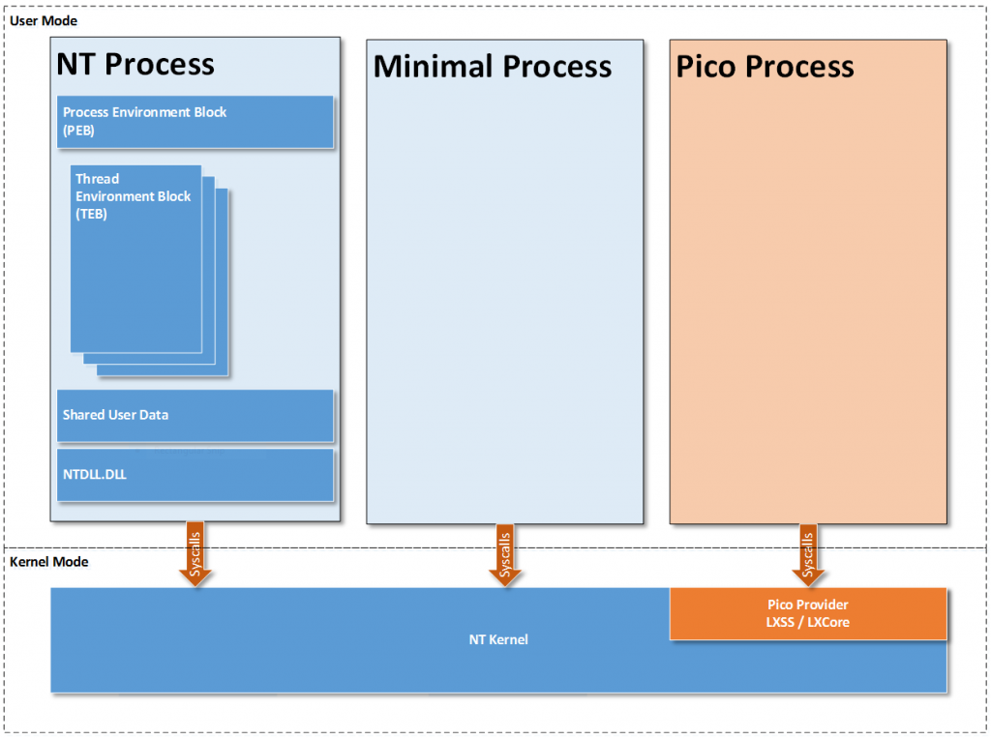
{NT, Minimal, Pico} Process
* https://blogs.msdn.microsoft.com/wsl/2016/05/23/pico-process-overview/

Slide 7
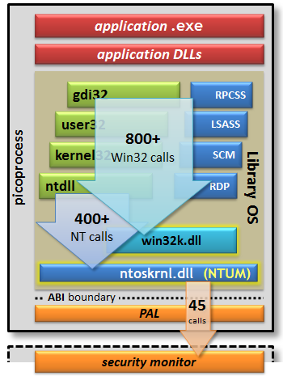
Outlook to Project Drawbridge
Pico process
Container like
Split kernel
Reduced set of NT syscalls

Slide 8
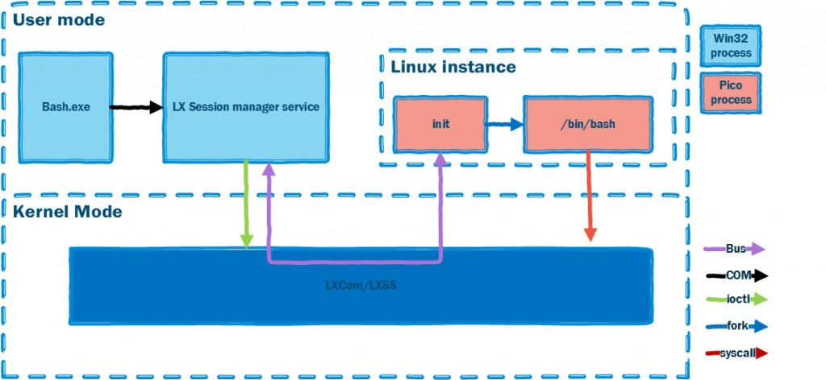
LWS Architecture
* https://blogs.msdn.microsoft.com/wsl/2016/04/22/windows-subsystem-for-linux-overview/

Slide 9
Syscalls
ACCEPT, ACCEPT4, ACCESS, ALARM, ARCH_PRCTL, BIND, BRK, CAPGET, CAPSET, CHDIR, CHMOD, CHOWN, CLOCK_GETRES, CLOCK_GETTIME, CLOCK_NANOSLEEP, CLONE, CLOSE, CONNECT, CREAT, DUP, DUP2, DUP3, EPOLL_CREATE, EPOLL_CREATE1, EPOLL_CTL, EPOLL_WAIT, EVENTFD, EVENTFD2, EXECVE, EXIT, EXIT_GROUP, FACCESSAT, FADVISE64, FCHDIR, FCHMOD, FCHMODAT, FCHOWN, FCHOWNAT, FCNTL64, FDATASYNC, FLOCK, FORK, FSETXATTR, FSTAT64, FSTATAT64, FSTATFS64, FSYNC, FTRUNCATE, FTRUNCATE64, FUTEX, GETCPU, GETCWD, GETDENTS, GETDENTS64, GETEGID, GETEGID16, GETEUID, GETEUID16, GETGID, GETGID16, GETGROUPS, GETPEERNAME, GETPGID, GETPGRP, GETPID, GETPPID, GETPRIORITY, GETRESGID, GETRESGID16, GETRESUID, GETRESUID16, GETRLIMIT, GETRUSAGE, GETSID, GETSOCKNAME,GETSOCKOPT, GETTID, GETTIMEOFDAY, GETUID, GETUID16, GETXATTR, GET_ROBUST_LIST, GET_THREAD_AREA, INOTIFY_ADD_WATCH, INOTIFY_INIT, INOTIFY_RM_WATCH, IOCTL, IOPRIO_GET, IOPRIO_SET, KEYCTL, KILL, LCHOWN, LINK, LINKAT, LISTEN, LLSEEK, LSEEK, LSTAT64, MADVISE, MKDIR, MKDIRAT, MKNOD, MLOCK, MMAP, MMAP2, MOUNT, MPROTECT, MREMAP, MSYNC, MUNLOCK, MUNMAP, NANOSLEEP, NEWUNAME, OPEN, OPENAT, PAUSE, PERF_EVENT_OPEN, PERSONALITY, PIPE, PIPE2, POLL, PPOLL, PRCTL, PREAD64, PROCESS_VM_READV, PROCESS_VM_WRITEV, PSELECT6, PTRACE, PWRITE64, READ, READLINK, READV, REBOOT, RECV, RECVFROM, RECVMSG, RENAME, RMDIR, RT_SIGACTION, RT_SIGPENDING, RT_SIGPROCMASK, RT_SIGRETURN, RT_SIGSUSPEND, RT_SIGTIMEDWAIT, SCHED_GETAFFINITY, SCHED_GETPARAM, SCHED_GETSCHEDULER, SCHED_GET_PRIORITY_MAX, SCHED_GET_PRIORITY_MIN, SCHED_SETAFFINITY, SCHED_SETPARAM, SCHED_SETSCHEDULER, SCHED_YIELD, SELECT, SEND, SENDMMSG, SENDMSG, SENDTO, SETDOMAINNAME, SETGID, SETGROUPS, SETHOSTNAME, SETITIMER, SETPGID, SETPRIORITY, SETREGID, SETRESGID, SETRESUID, SETREUID, SETRLIMIT, SETSID, SETSOCKOPT, SETTIMEOFDAY, SETUID, SETXATTR, SET_ROBUST_LIST, SET_THREAD_AREA, SET_TID_ADDRESS, SHUTDOWN, SIGACTION, SIGALTSTACK, SIGPENDING, SIGPROCMASK, SIGRETURN, SIGSUSPEND, SOCKET, SOCKETCALL, SOCKETPAIR, SPLICE, STAT64, STATFS64, SYMLINK, SYMLINKAT, SYNC, SYSINFO, TEE, TGKILL, TIME, TIMERFD_CREATE, TIMERFD_GETTIME, TIMERFD_SETTIME, TIMES, TKILL, TRUNCATE, TRUNCATE64, UMASK, UMOUNT, UMOUNT2,UNLINK, UNLINKAT, UNSHARE, UTIME, UTIMENSAT, UTIMES, VFORK, WAIT4, WAITPID, WRITE, WRITEV
* https://msdn.microsoft.com/en-us/commandline/wsl/release_notes

Slide 10
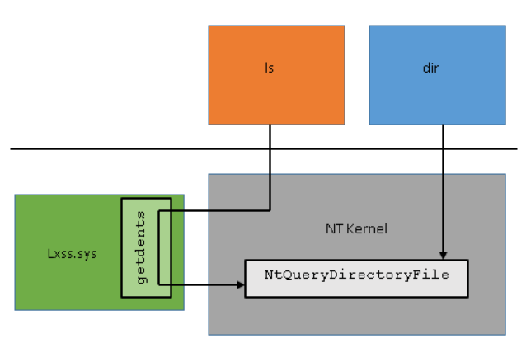
Syscall mechanism
- Handled by Pico Provider
- 1-1 counterpart
- Own implementation
- Prepare + run NT call
Step | Getdents | NtQueryDirectoryFile
1 | mov rax, __NR_getdents64 | mov rax, #NtQueryDirectoryFile
2 | mov rdi, Fd | mov rcx, Foo
3 | mov rsi, Buffer | mov rdx, Bar
4 | mov rdx, sizeof(Buffer) | mov r8, Baz
5 | syscall | syscall
6 | cmp rax, 0xFFFFFFFFFFFFF001 | test eax, eax
* https://blogs.msdn.microsoft.com/wsl/2016/06/08/wsl-system-calls/

Slide 11
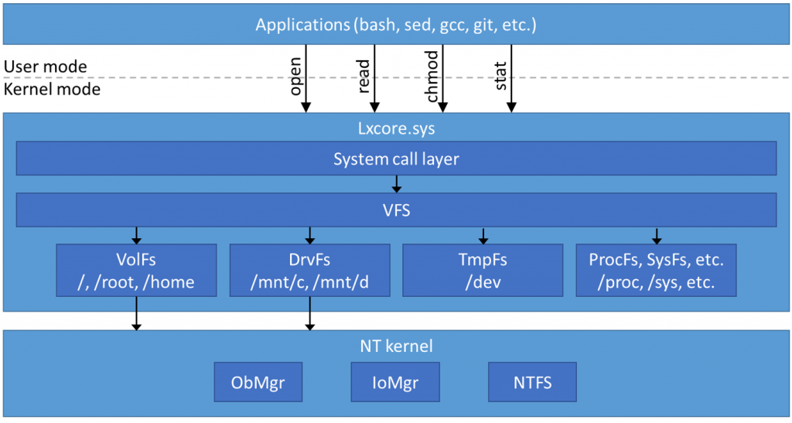
File systems
Unix/Linux: Everything is a file
NTFS
ADS
Extended attributes
* https://blogs.msdn.microsoft.com/wsl/2016/06/15/wsl-file-system-support/

Slide 12
Others
Networking
localhost
Process interoperability
Security, permissions
Sudo
Firewall & AV

Slide 13
Limitations
No Sound
No Mice
No Graphics
No X
X can be done via 3rd party X server and export DISPLAY
http://www.pcworld.com/article/3055403/windows/windows-10s-bash-shell-can-run-graphical-linux-applications-with-this-trick.html
Reason: No /dev-s

Slide 14
LoWe
Linux on Windows extender
Extends LWS with some features
Graphics via Framebuffer
PCM Sound
X
Mouse (and Keyboard) handling for X
No need for 3rd party X server
https://github.com/kpocza/LoWe
MIT license

Slide 15
LoWe
Demo
Notes:
Missing devices
Demo1:
- Strace mplayer
Demo2:
Mplayer playing video and sound
Demo3:
Starting X
Starting wmaker
Running some programs on it like a browser

Slide 16
How LoWe works?
Creates missing device files on demand
/dev/fb0, /dev/snd/controlC0, /dev/snd/pcmC0D0p, /dev/input/mice
+ /dev/input/kbd
Goal: real file handle
Attaches to the remote process as a debugger – ptrace
Jumps syscall to syscall
Handle syscalls for the above device files via ptrace
open
ioctl, read, write, mmap
Forwards operations, data to a WPF process via network sockets, process responses

Slide 17
LoWe - Architecture
Ubuntu on Windows
Win32
LoWeAgent
X Server
ptrace
LoWeExposer
Localhost
socket
X App, Window Manager
FB
Mice
KB
PCM

Slide 18
LoWe – features, properties
Requires configuration
Device handlers
Set of apps
X Server
Default config
Code
LoWeAgent: C++
LoWeExposer: C#/WPF
Extensible device handler interface
Room for performance improvement
Configurable logger

Slide 19
How emulation works?
Graphical framebuffer
/dev/fb0
Originally the file was periodically read and presented
Now sending memory content on a localhost socket
Sound
ALSA calls
PCM
/dev/snd/controlC0, /dev/snd/pcmC0D0p
Commands sent on socket
NAudio library

Slide 20
How emulation works?
Mouse
Record positions
/dev/input/mice
LWS side enquires the movement and buttons
Routes the enquiries to the WPF app on socket
ExPS/2 protocol implemented
Keyboard
Only for X
/dev/input/kbd (not a real device, X configured)
Keyboard scancodes are responded through the socket

Slide 21
Thank you
Q&A
kpocza@kpocza.net
http://kpocza.net/
https://github.com/kpocza/LoWe

