Slide 1
LSST thermal model
Hervé Grabas

Slide 2
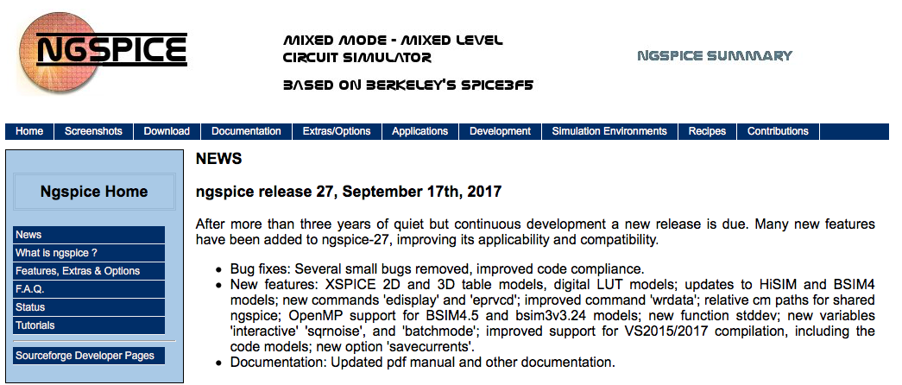
ngspice – actively maintained – latest release from Sept. 2017

Slide 3
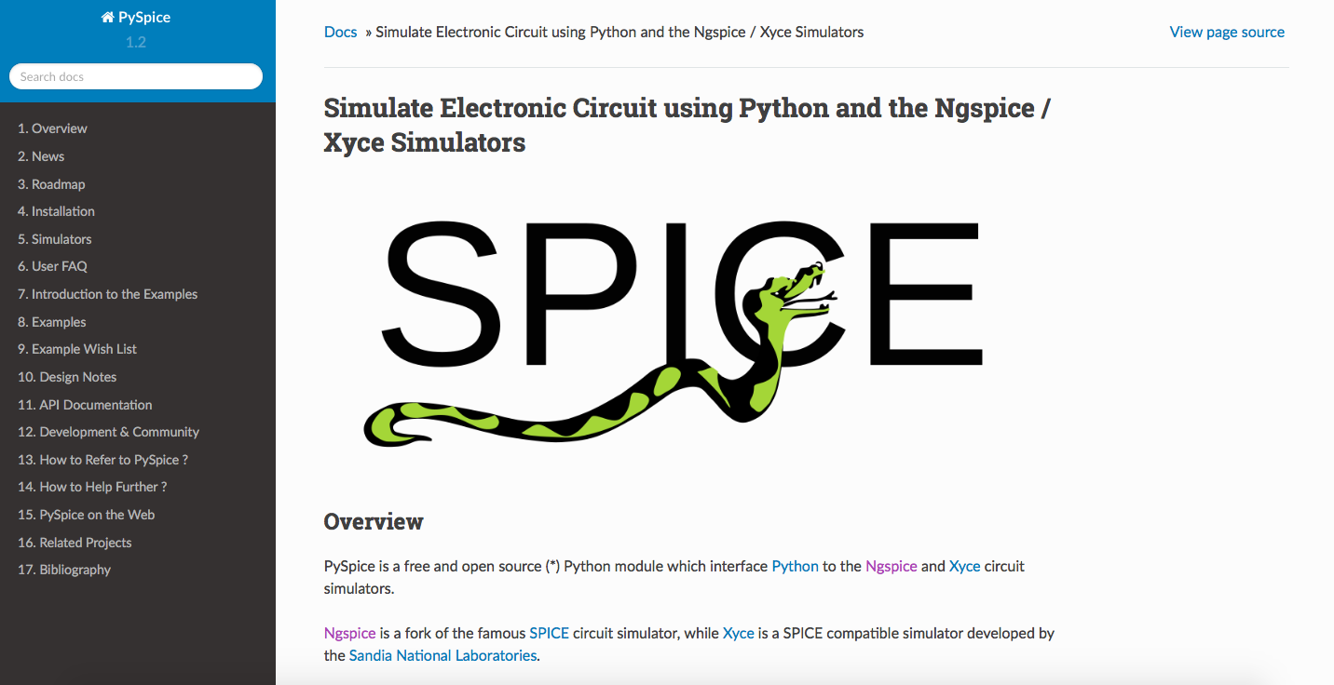
Using Python to simulate SPICE circuit.

Slide 4
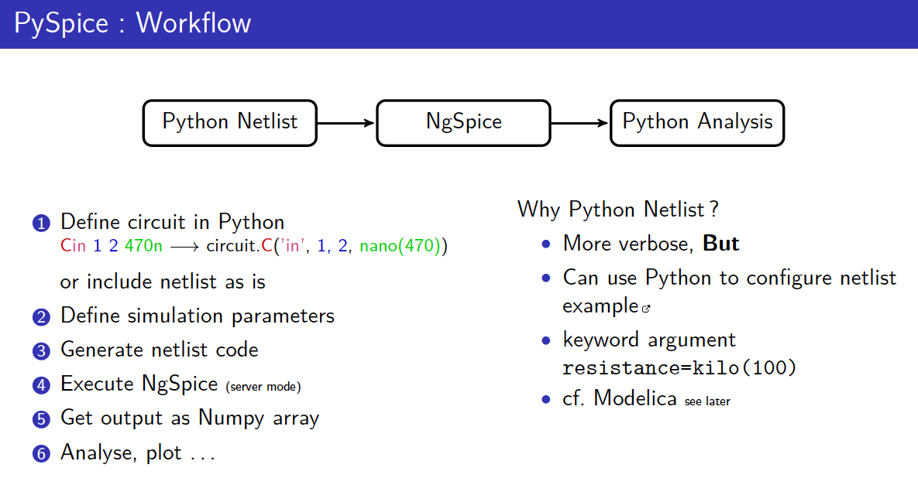
PySpice workflow

Slide 5
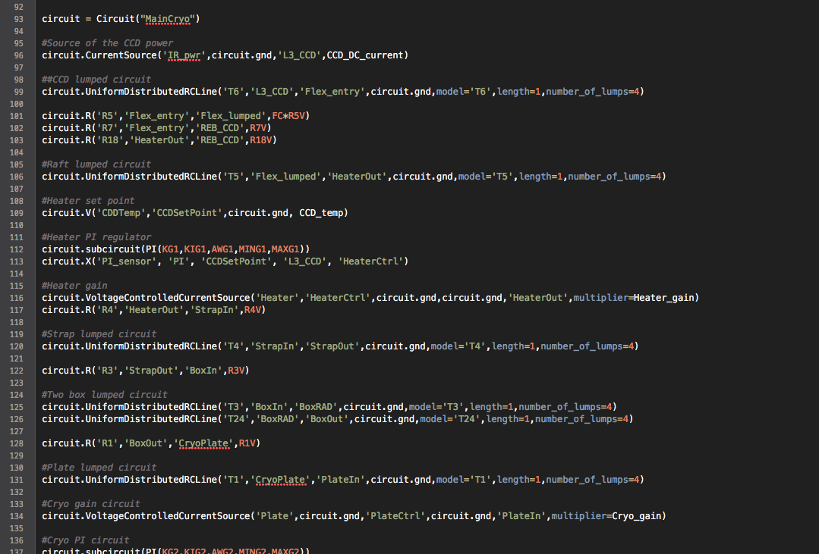
Python circuit code

Slide 6
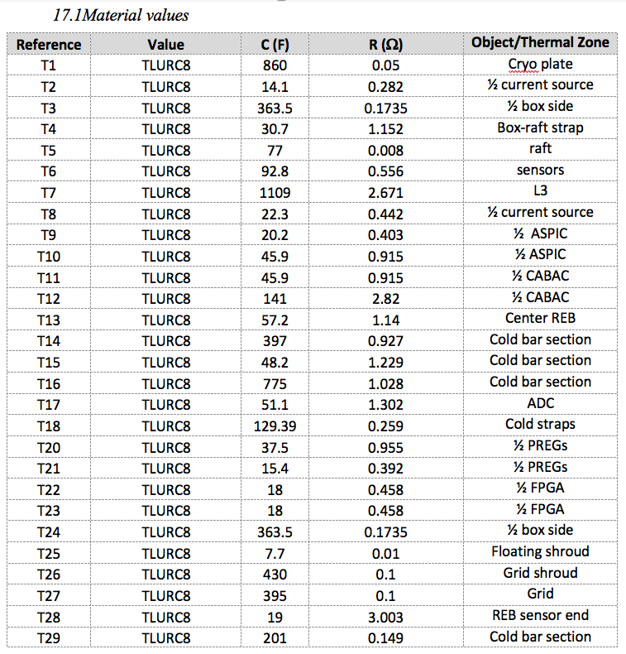

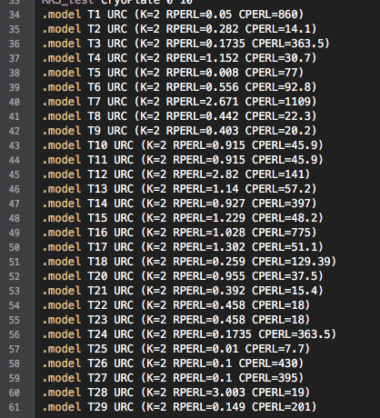
Python advantages
Python CSV read and netlist generation
SPICE netlist
CSV model files with parameters values

Slide 7
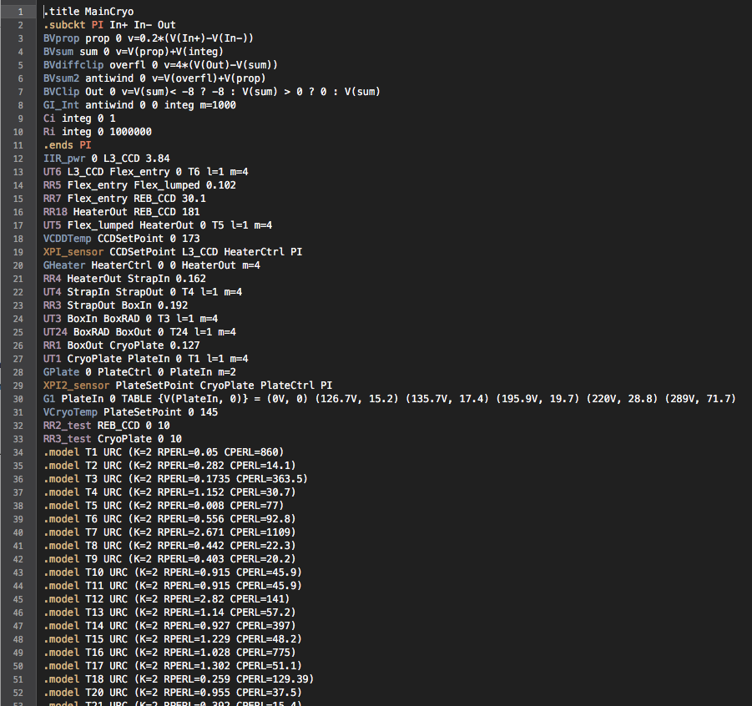
Python-generated SPICE netlist
The SPICE netlist can be saved and visualized.

Slide 8
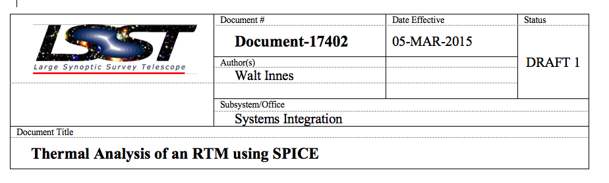
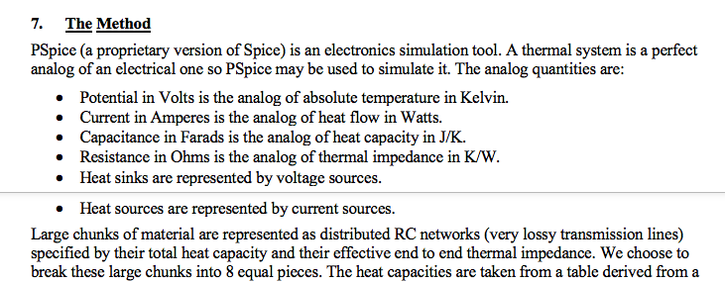
Model adopted by Walt

Slide 9
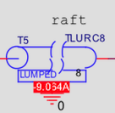
In Walt’s schematic these RC network are represented by these symbols

Slide 10
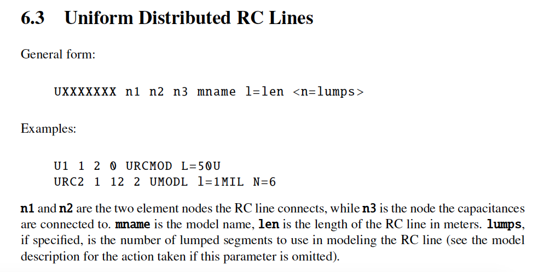
In ngspice
In Spice lumped RC elements are modeled using URC

Slide 11
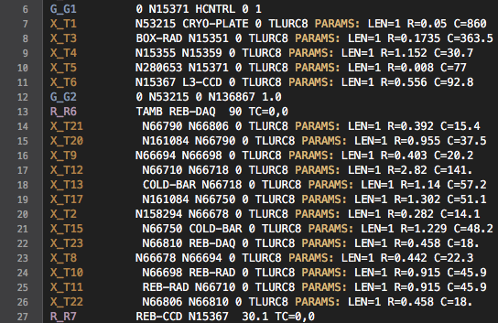
SPICE netlist from Walt OrCad
SPICE netlist from OrCad
✓ Walt’s OrCad uses the same model for lumped RC lines.

Slide 12
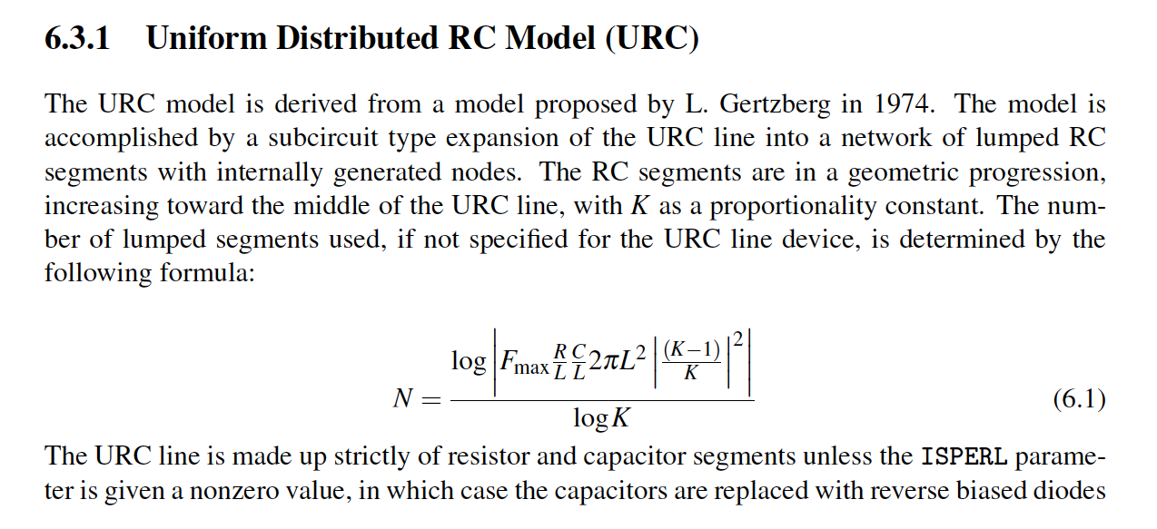
Uniform distributed RC lines
I need confirmation that this is the model used for lumped thermal loads

Slide 13
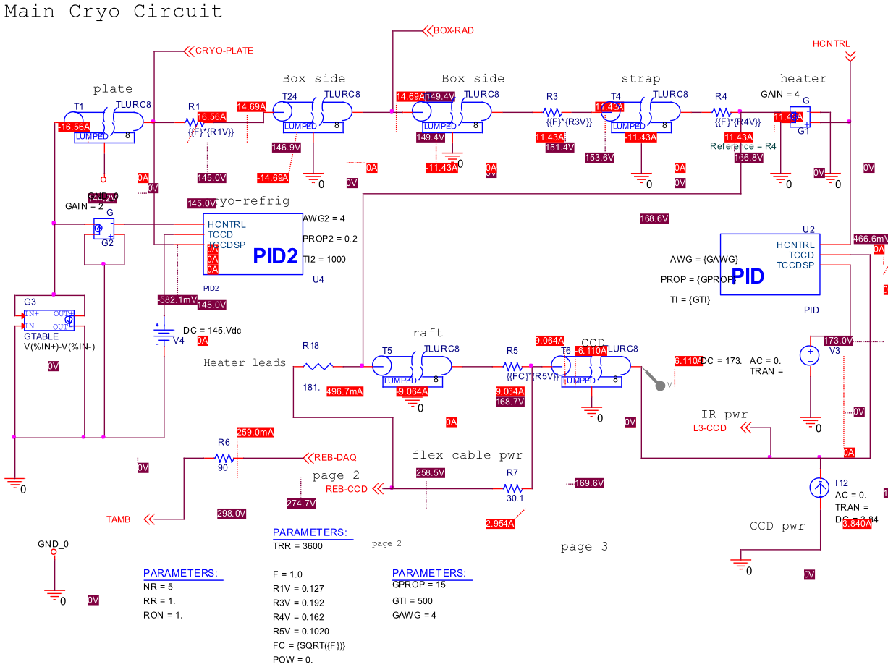
I coded all schematics included in Walt’s LSST thermal analysis report.
Walt’schematic

Slide 14
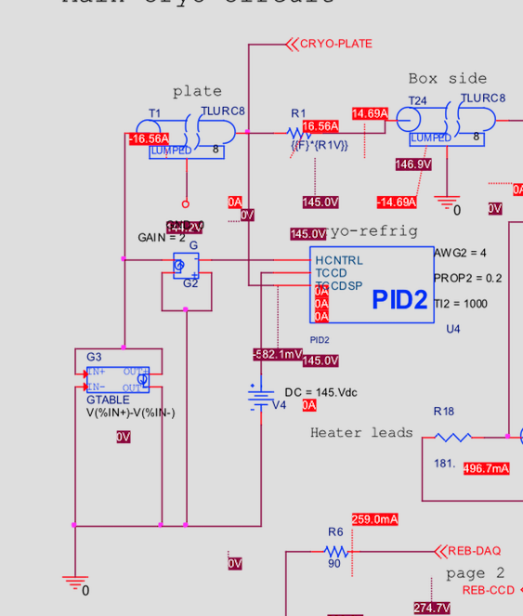
Circuit schematic issue?
Walt’schematic
I don’t understand the PI2 set point in Walt schematic
Bug?
See later: temperature of Cryo-plate seems to high.
Here the set point seems reversed with the input

Slide 15
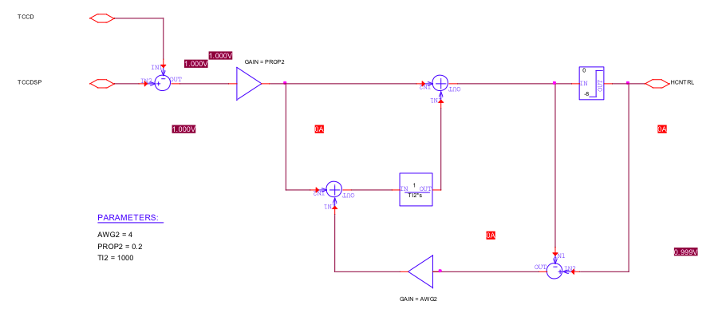
PI block - schematic

Slide 16
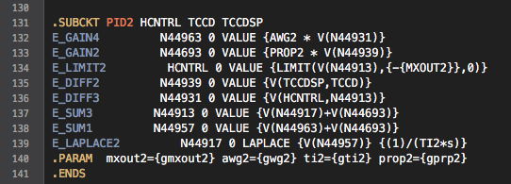
OrCad PID implementation from Walt
Walt used a Laplace function which is not supported for DC sim (AC and transient supported only in ngSpice)

Slide 17
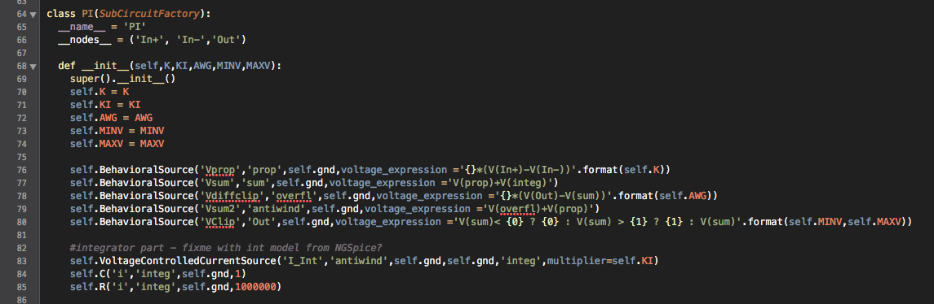
PI block – defined as a subcircuit for reuse
Integrator: R//C with voltage controlled current source – OK?

Slide 18
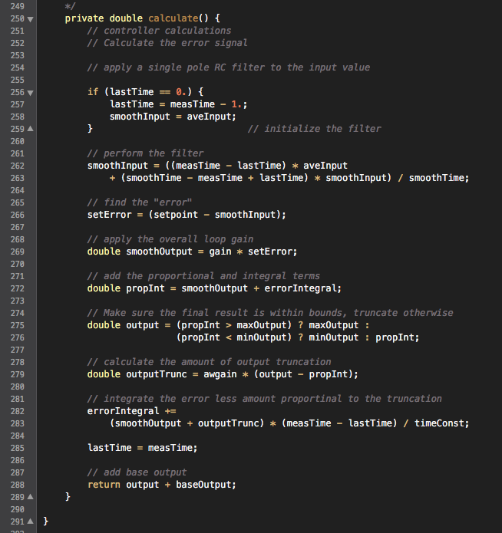
Java PID model
Java PID code from Owen
I have the implementation of the PID block done in Java.
Can run unit tests to make sure that Python SPICE implementation matches Java implementation.
Missing PID instantiation with parameters values.

Slide 19

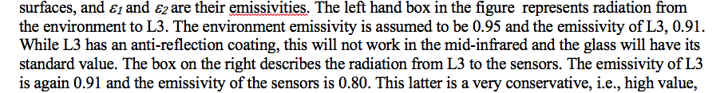
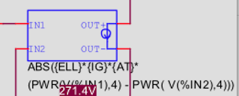
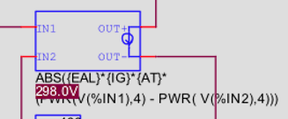
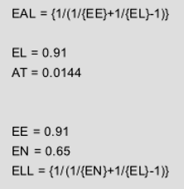
Lens model – double check values
I coded the lens emissivity model:
Value don’t agree with text

Slide 20

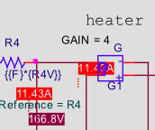

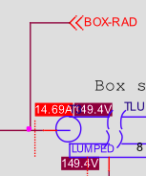
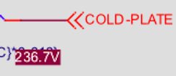

Temperature comparison Walt vs PySPICE
Walt’ schematics
PySpice results
Node rebdaq: 274.7 V
Node heaterout: 168.6 V
Node rebccd: 258.5 V
Node coldplate: 237.3 V
Node boxrad: 149.4 V
Node cryoplate: 145.0 V
There are a lot more values available.
Temperature a very similar but not exactly similar.
Probably due to bad CryoPlate PID connection?

Slide 21
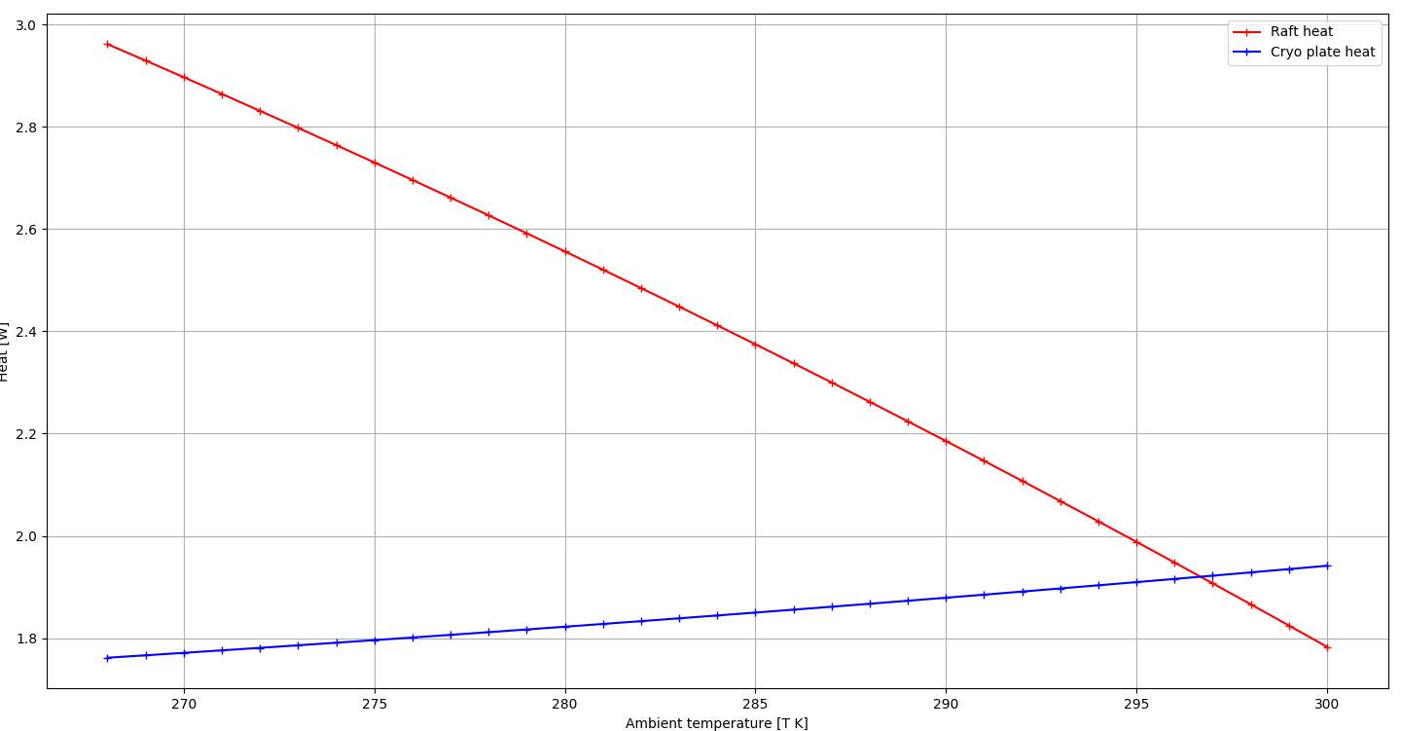
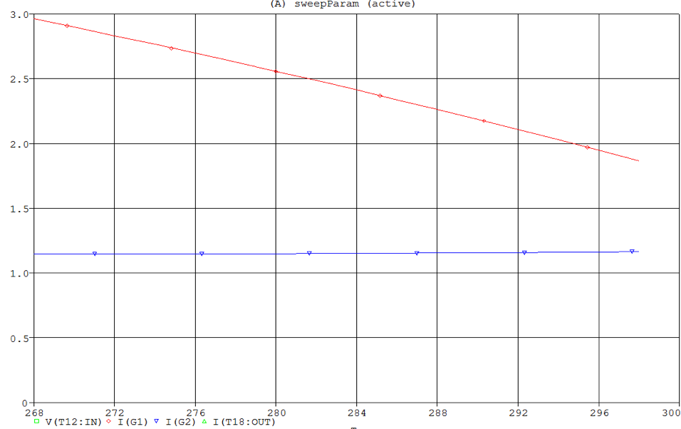
First prelim. comparisons Python vs OrCad
simulation Raft and Cryo heat vs Ambient temperature
Ouput of Python SPICE
Orignial simulation result from Walt

Slide 22
Work done & next steps
Thermal model netlist is fully implemented in Python
I have defined classes in Python for PI and Stefan-Boltzmann described surfaces.
Next steps:
Check PID model against Java implementation
Run simulations
What kind?
Do I have expected results to compare it to?

Slide 23
Summary - Questions
Moving the Python SPICE simulation to a Jupyter notebook to generate report automatically
Got PI models
Need also PI 1,2 & 3 instantiations and their parameters
What kind of unit test – QA can we have on this model to make sure it is not bugged?
Was there changes in the thermal model values or controls since document 17402 has been written (MAR-2015) ?
I got a SPICE netlist export from OrCAD.
Looks like I am missing some part of it still (e.g. only 2 PID blocks in the netlist).
Will double check against my spice netlist against the historic one.
I may also be able to import it into PySpice and run it for QA.

