Slide 1
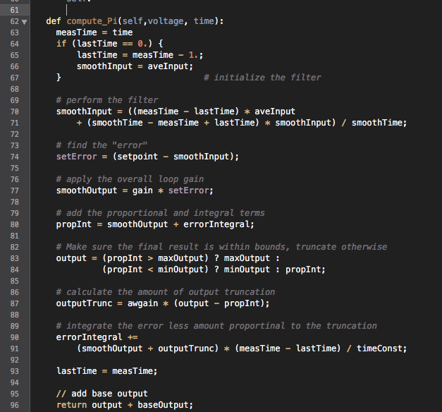
Get node data using ngSpice callback
Set node data using ngSpice callback
Python function processing node data - process node data from ngSpice send_data cb - pass new value to get_vrsrc_data

