Slide 1
Capstone Project Customer Churn Ananlysis
By
Hari Haran

Slide 2
Business Problem Understanding
An E Commerce company is facing a lot of competition in the current market and it has become a challenge to retain the existing customers in the current situation. Hence, the company wants us to develop a model through which they can do churn prediction of the accounts and provide segmented offers to the potential churners. In this company, account churn is a major thing because a single account can have multiple users. So if they loose one account then the company may be loose more than one customer. This can adversely affect the company’s revenue stream.
We have been assigned to develop a churn prediction model for this company and provide business recommendations. We have to provide best possible solutions and recommendations to retain their customer base. Our report must have recommendations and insights must suggest sound improvements, if any, to retain their existing customer base.

Slide 3
Data Report
Understandings from the given data
The given data is collected for 11260 different unique account ID.
The given data has 19 variables( or features) with one variable ‘ Churn’ as the dependant variable and others independent variables.
The data has been collected for 12 months for each of the 11260 account IDs.
The customers data is based on their account tenure, account_segment, Login_device, gender and marital_status.
There are various payment modes.
The data also contain customer ratings on the basis of customer care services, ratings based on the services provided by the customer, customer contact and complains raised and over a period of 12 months.
The data on various payment modes is also available along with any coupons or cashback, which suggests the company provides offer to their customers.
rev_per_month shows the monthly revenue generation based on the spending of each account
rev_growth_yoy shows yearly growth in revenue based on these accounts.

Slide 4
Data Dictionary
Variable | Description
AccountID | account unique identifier
Churn | account churn flag (Target)
Tenure | Tenure of account
City_Tier | Tier of primary customer's city
CC_Contacted_LY | How many times all the customers of the account has contacted customer care in last 12months
Payment | Preferred Payment mode of the customers in the account
Gender | Gender of the primary customer of the account
Service_Score | Satisfaction score given by customers of the account on service provided by company
Account_user_count | Number of customers tagged with this account
account_segment | Account segmentation on the basis of spend
CC_Agent_Score | Satisfaction score given by customers of the account on customer care service provided by company
Marital_Status | Marital status of the primary customer of the account
rev_per_month | Monthly average revenue generated by account in last 12 months
Complain_ly | Any complaints has been raised by account in last 12 months
rev_growth_yoy | revenue growth percentage of the account (last 12 months vs last 24 to 13 month)
coupon_used_l12m | How many times customers have used coupons to do the payment in last 12 months
Day_Since_CC_connect | Number of days since no customers in the account has contacted the customer care
cashback | Monthly average cashback generated by account in last 12 months
Login_device | Preferred login device of the customers in the account

Slide 5
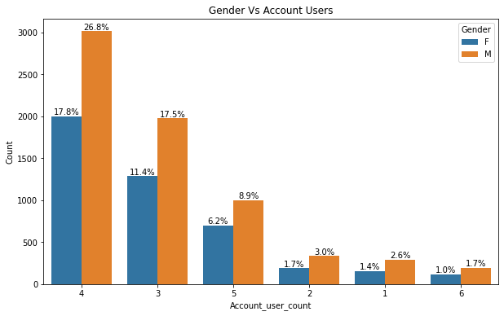
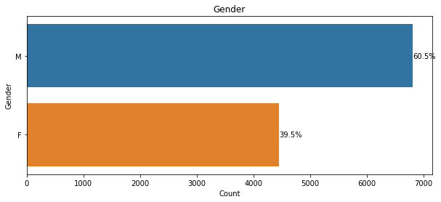
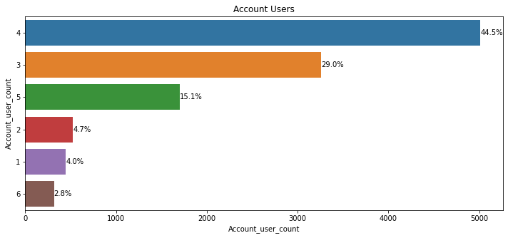
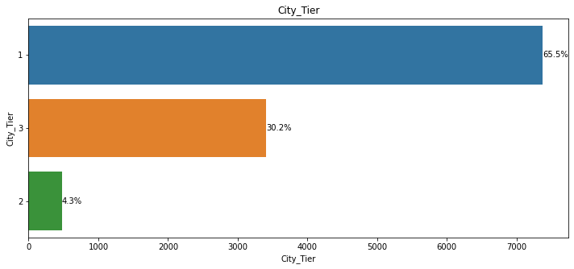
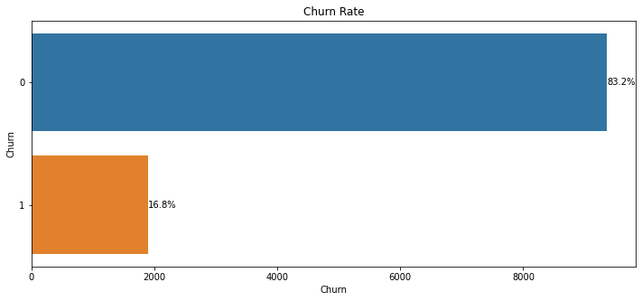
Exploratory Data Analysis(EDA)
Male - 60.5 %
Female - 39.5%
44.5% of accounts have 4 users
- 65.5% Users are from Tier 1 cities.
- 30.25 from Tier 3 and only 4.3% from Tier 2 Cities.
Current churn rate = 16.8%

Slide 6
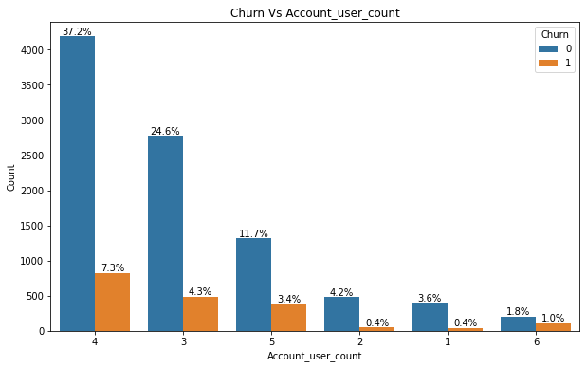
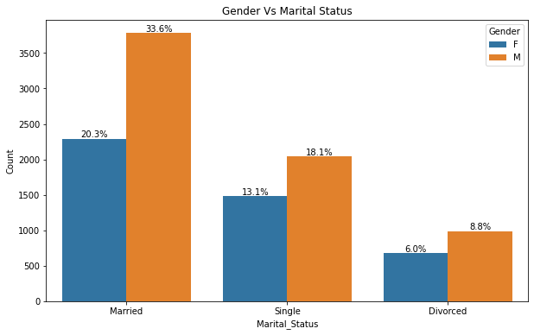
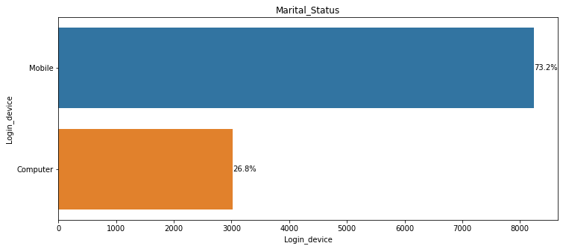
Exploratory Data Analysis(EDA)
Highest Churn -7.3 %
Most Users are Male and 33.6% of them are married.
Most user accounts have 4 members and 26.8 % are male whereas 17.8% are female.
73.2% of Married Customers uses Mobile.

Slide 7
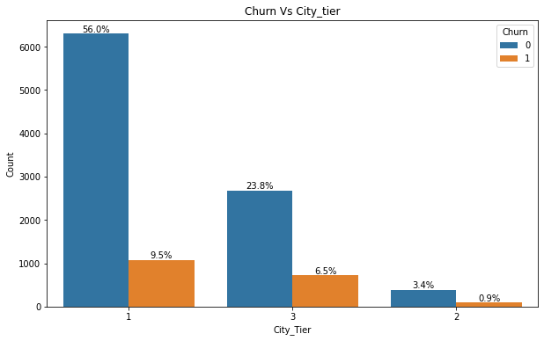
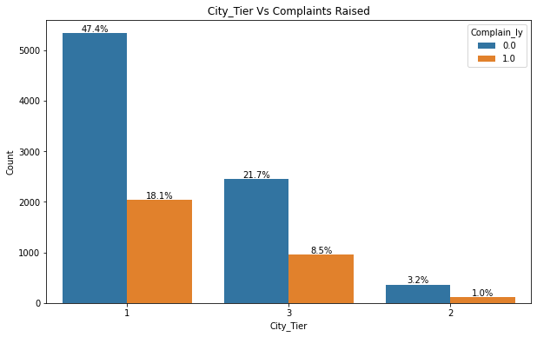
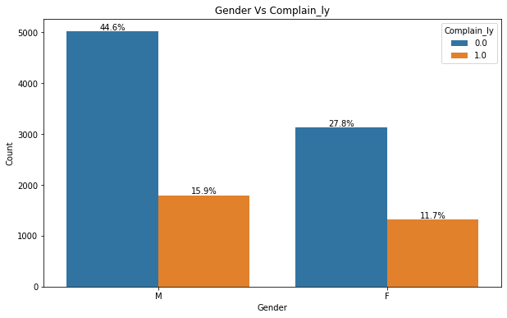
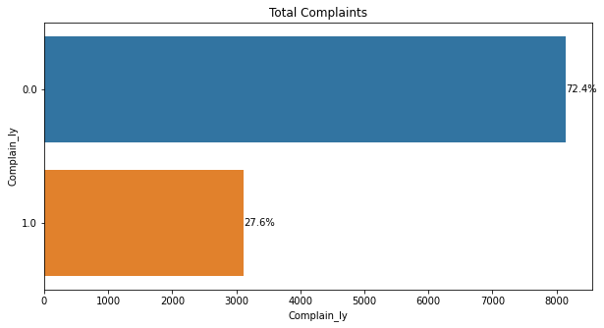
Exploratory Data Analysis(EDA)
Highest Churn is from Tier 1 Cities as it has highest users - 9.5%
18.1 % of complaints are raised from tier 1 cities with highest user count.
15% compalints are from male and only 11% from female users
27.6% compalints have been raised over a period of 12 months

Slide 8
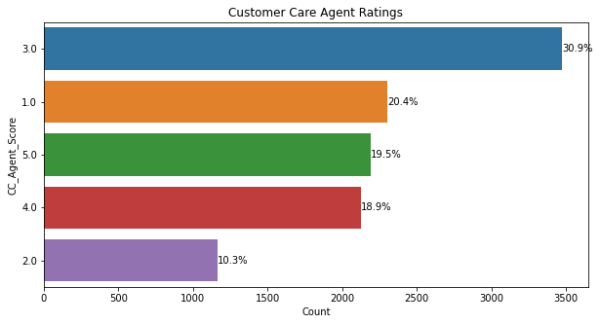
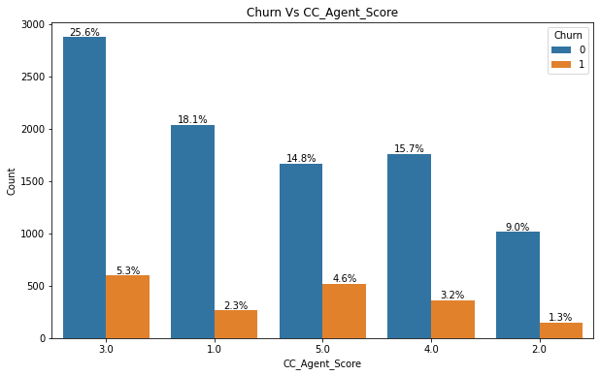
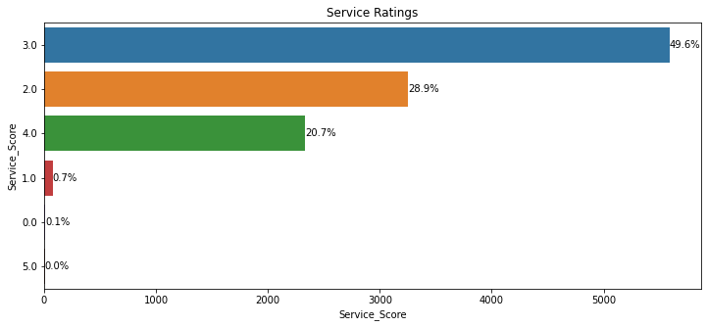
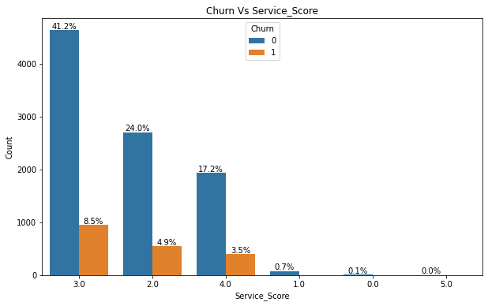
Exploratory Data Analysis(EDA)
5.3% of Churn with 3 score ratings = Highest
- Most Customer have rated 3 = 30.9%
- Only 19.5% have rated 5
-10% have given 2
49.5% of users have given rating score = 3
Rating with 5 doesn’t show any churn

Slide 9
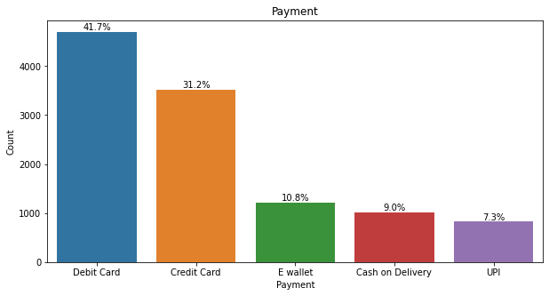
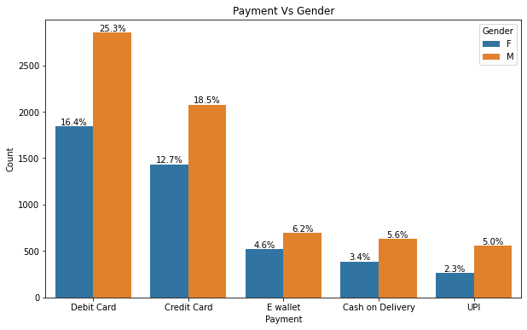
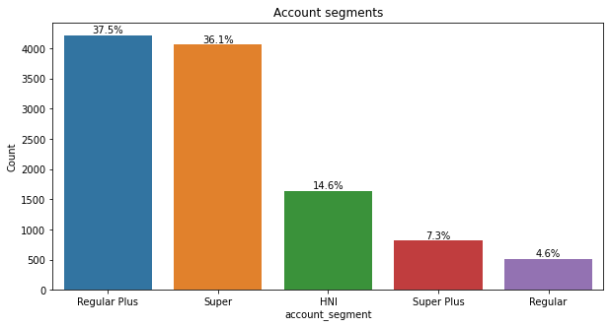
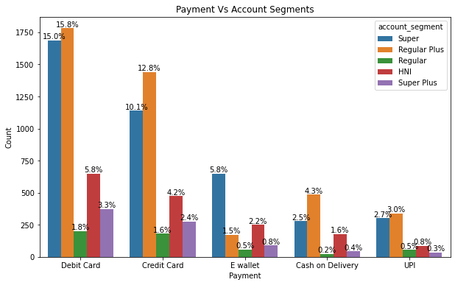
Exploratory Data Analysis(EDA)
Debit card have highest users 41.7% both Male and Female
16.4 % of Female and 25.3 % of Males users use debit card
Regular plus = 37.5% have highest no. of users
15.8% customers regular plus accounts pay throught debit card.

Slide 10
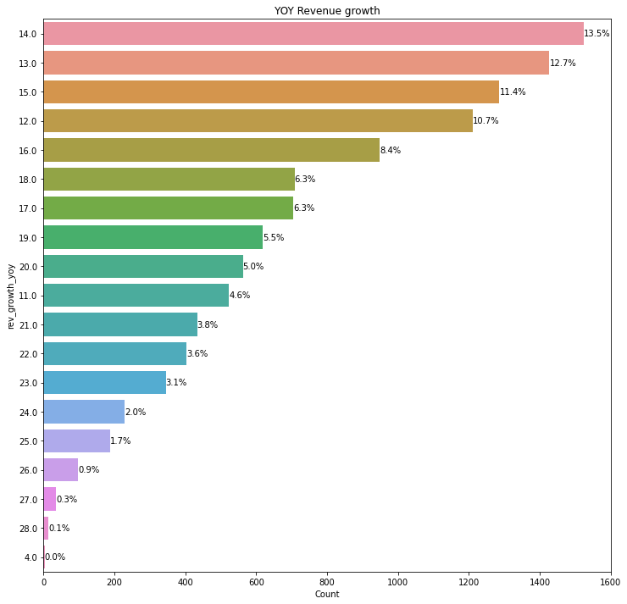
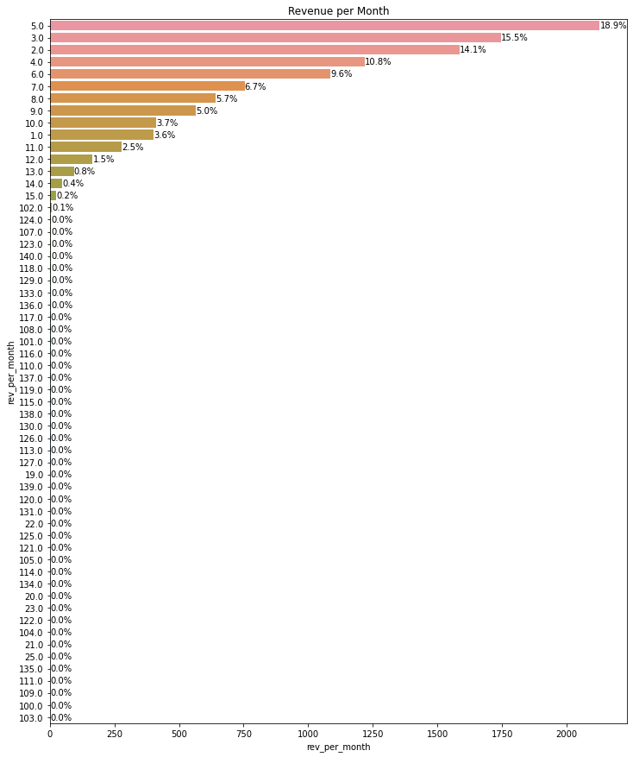
Exploratory Data Analysis(EDA)
Highest YOY growth = 13.5%
Highest Revenue per Month = 18.9%

Slide 11
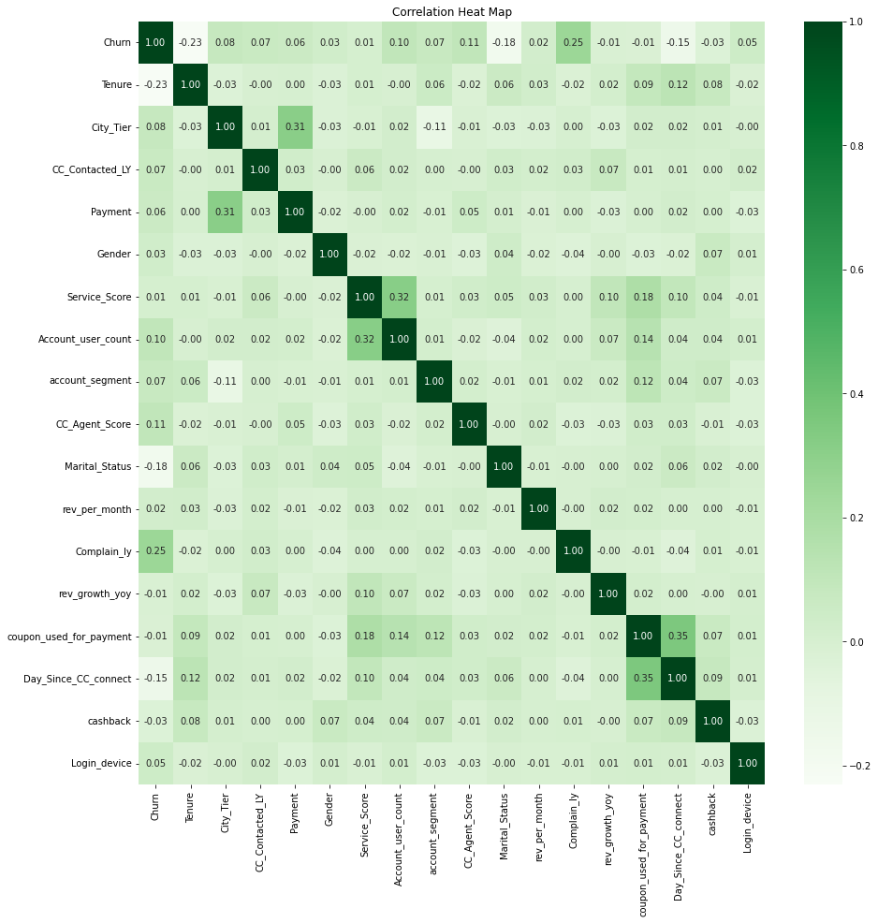
Exploratory Data Analysis(EDA)
Negative Correlation with Churn :
Tenure
Marital status
Revenue grwoth YOY
Coupons used for payment
Cash Back
Days_since_CC_connect - For 12 Months
Positive Correlations with Churn :
City Tier
CC_Contact - Customer Care contact
Payment
Gender
Service Score
Account_user_count
Account Segment
CC_agent_score- customer care agent’s rating
rev_per_month
Compain_ly
Login_device

Slide 12
Modelling Approach Used & Why
In this part, we are building models, applying tuning and validation of the model performance based on metrics ,i.e, Accuracy, F1 Score, Recall, Precession, AUC score, confusion matrix, classification report and ROC-AUC curve plot.
Based on this we will choose the best model which does not underfit or overfit along with best accuracy.
Also, we will calculate mean-square error and cross-validation method to validate our models.
Objectives of the Model :
Whether the customer will churn or not?
Understanding factors affecting churn rate whether its payment method, city tier, gender, customer service, etc.
Controlling the churn rate by controlling the factors affective it positively.
Why Best Accuracy Scores ?
Our current business firm needs to predict whether the customer will churn or not.
Churn = 1 and Not churn = 0
Higher the accuracy score better the model

Slide 13
Best Models
MODELS | Accuracy (in %) |  | Precision (in %) |  | Recall (in %) |  | F1-Score (in %) |  | AUC Score (in %)
Data Set | Train | Test | Train | Test | Train | Test | Train | Test | Train | Test
KNN MODEL
KNN Model (Default) | 97.72 | 95.50 | 95.33 | 90.04 | 90.87 | 82.46 | 93.05 | 86.08 | 99.53 | 96.93
KNN Tuned | 100.00 | 97.63 | 100.00 | 94.87 | 100.00 | 90.88 | 100.00 | 92.83 | 100.00 | 99.14
KNN Balanced | 97.87 | 93.25 | 96.11 | 73.49 | 99.79 | 93.86 | 97.91 | 82.43 | 99.97 | 97.35
GAUSSIAN NAIVE BAYES MODEL (NB)
NB_Balanced | 75.64 | 70.78 | 72.98 | 34.12 | 81.44 | 78.60 | 76.98 | 47.58 | 84.65 | 82.83
RANDOM FOREST MODEL (RF)
RF_Balanced | 100.00 | 96.95 | 100.00 | 93.64 | 100.00 | 87.89 | 100.00 | 90.68 | 100.00 | 98.99
ENSEMBLE MODELS
Bagging (RF estimator) | 99.35 | 95.62 | 99.77 | 96.27 | 96.38 | 77.02 | 98.04 | 85.58 | 99.99 | 98.72
ADB_Tuned | 90.03 | 90.14 | 77.22 | 78.42 | 57.77 | 57.37 | 66.09 | 66.26 | 91.85 | 90.98
GB_Model | 91.64 | 91.21 | 82.86 | 82.58 | 63.42 | 60.70 | 71.85 | 69.97 | 94.82 | 92.71

Slide 14
Observations On Model Comparison
Based on above models KNN_Model (Default set) is the best opyimum model. Although, Bagging model is performing well to but when compared to the recall of both KNN and Bagging Model withdefault set the recall value is better in KNN model. (Highlighted with bright green)
KNN Model with balanced set is also performing well. (Highlighted with light green)
Although KNN Tuned, RF_Model and RF_Balanced have good scores but they seems to be over-fitted models hence cannot be recommended.
The worst performing model is Gaussian Naive Bayes model (NB) with balanced set.
Building is an iterative method, more models can be built and tweaked or tuned to get optimum model. So more models can be built and improved further for better results.

Slide 15
Insights & Recommendations
Business can provide more offers to customers who are more than 5 years and have spent considerable amount.
3 - 5 years of loyalty programmes can be introduced to attract new customers.
The cashback and coupon offers attracts good revenue but company needs to gather information if there are customers who are not aware of these benefits.
Tier 2 cities have lowest customer base and hence company can focus in this region.
Customer care experience is moderate and hence business provide training to their customer care representative.
Customer care should act as customer-centric provided it doesn’t adversely affect the business under any circumstances.
Gift vouchers and gift coupons can be introduced for accounts with more than 1 user and additional data can be collected if they are family or friends.

Slide 16
Insights & Recommendations
A curated offers can be given to for the single users to add their family and friends with cash back or discounts on every first purchase made by them.
Referral programme can be introduced to attract more customers through existing customer with value offers or loyalty points
More products can be introduced as there more Male customers than Female, keeping in view to attract more female customers.
Most customers use debit card and credit card. Company emphasize more digital mode of transaction UPI and E wallet as they are a safe-way of transaction with proof of billing.
1 and 3 account_segments are the highest spenders. Business needs to focus on other segments as well.
More value-added services can be implemented in terms customer care and services.
Business can focus high spending loyal customers with good customer care and service ratings of 4 or 5.

Slide 17
Implication of Model on Business
The above recommended models, if implemented can help the business improve their strategies.
They can monitor customer activities and predict the outcomes.
The business can improve offers for customers and other services.
Business will have clear idea of the buying behavior of their customers.
Business can predict customer churn for each user account.
Business monitor customer care and services and their long term implication on the business.
Revenue growth predictions can be drawn out based on the churn rate.

