Slide 1
LRIZZ Chemistry&Biology

Slide 2





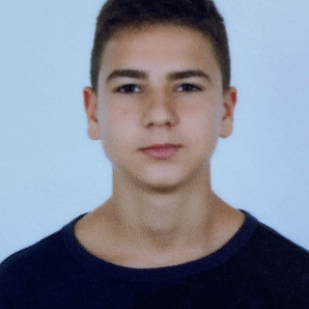
Our TEAM
Хакан Чандър
Иван Црънгалов
Иван Челебиев
Александър Баев
Димитър Василев
Back-end
Back-end
Back-end
Designer
SCRUM trainer

Slide 3











Tech Stack

Slide 4
Stages of development
1. Gathered as a team
2 . Got an idea
3. Realization

Slide 5

Idea
Our idea is to create a chemistry game in which you run a chemistry lab. You run a chemistry business, you get orders from companies and you have to synthesize chemistry products for them. Your biggest opponent is time. You have only 2 minutes to get the product and send it via the delivery services.

Slide 6
Let’s see our game now!

