Slide 1

团队介绍
Team Introduction
计算机17-1班
李明轩 17
吴家剑 34
关皓元 11
林俊 22

Slide 2
LOVE
What is

Slide 3
What is love and what is like?
什么是爱，什么是喜欢
When you look at the person you love, you are shy.
当你与你爱的人四目相对时，你会害羞
When you talk to someone you love, you find it hard to talk.
当你与你爱的人对话,你觉得难以启齿
When the one you love is crying, you will cry with her.
当你爱的人哭,你会陪她一起哭
But when you meet someone you like, you smile.
但当你与你喜欢的人四目交投,你只会微笑
But when you talk to someone you like, you can talk freely.
但当你和你喜欢的人对话,你可以畅所欲言
But when the person you like is crying, you can comforther with skill.
但当你喜欢的人哭,你会技巧的安慰她

Slide 4
Love is a feeling, embellishing it with anything, and decorating it in any language is inappropriate.
爱情是一种感觉，用任何的东西来修饰它 ，用任何的语言来装饰它都不恰当

Slide 5
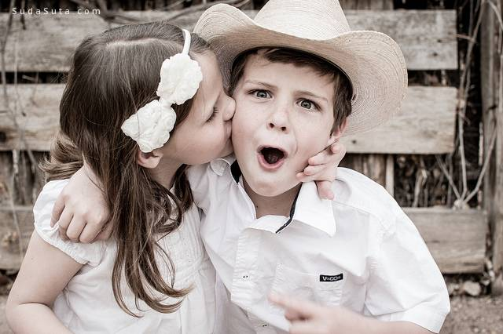
About us
Everyone's love is a movie. He is the protagonist and director of the movie. What is the movie that he interprets? Sad film? Silent film? Business film? Disaster film or love film? It all depends on your attitude towards life!
每个人的爱情都是一部电影，自己是这部电影的主角兼导演，自己诠释的这部电影到底是艺术片？悲情片？无声片？商业片？灾难片还是爱情片？都取决于自己对待人生的态度！

Slide 6
Love is inclusive rather than indulging in love is caring rather than loving and loving is a blend of love rather than a love of love is not all sweetness.
爱是包容而不是放纵 爱是关怀而不是宠爱 爱是相互交融而不是单相思 爱是百味而不全是甜蜜
True love is not necessarily a perfect match for the eyes of others.
真正的爱情并不一定是他人眼中的完美匹配
It's that the people who love each other fit into each other's hearts.
而是相爱的人彼此心灵的相互契合
In order to make the other person live better and silently.
是为了让对方生活得更好而默默奉献

Slide 7
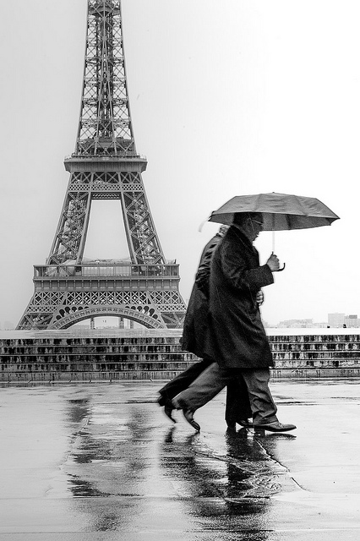
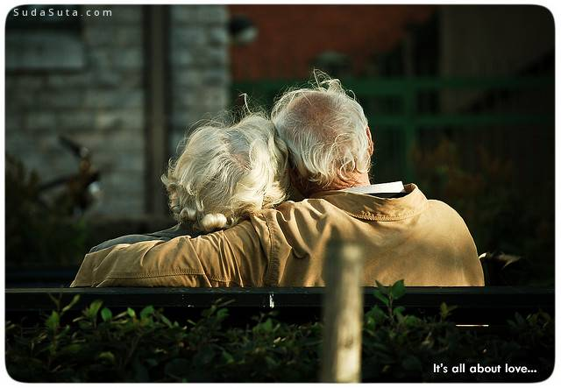
Love is when you are old and can't move that day. The one you love doesn't run away from you.
爱情,就是在自己老了,不能动了那一天,你爱的他并没有逃离身边,而是毅然决然的陪伴.
Love is keeping old. 爱情是相守到老

Slide 8
张爱玲曾经说过：
She said to those in love: "the greatest happiness in life is to find that the one you love is just in love with yourself."
她对恋爱的人说：人生最大的幸福，是发现自己爱的人正好也爱着自己。
She said to a secret lover: " for most women, love means being loved. "
她对暗恋的人说：对于大多数女人，爱的意思，就是被爱。
She said:"there is always a person in the world waiting for you, no matter where you are, whenever you know, you know, there will always be a person."
她对未恋的人说：在这个世界上总有一个人在等你,无论你在什么地方,无论是什么时候，反正你知道，总会有那么一个人。

Slide 9
Thanks For
Listening

