Slide 1
電腦視覺與深度學習 (Computer Vision and Deep Learning) Homework 1
TA:
真禎: nckubot65904@gmail.com
Office Hour: 14:00~16:00, Mon.
10:00~12:00, Fri.
At CSIE 9F Robotics Lab.

Slide 2
Notice (1/2)
Copying homework is strictly prohibited!! Penalty: Score will be zero for both persons!!
Due date => 09:00:00, 2022/11/03 (Thu.)
No delay. Penalties for late homework:
Up to 7 days late, loss of 50% of the score awarded
After 7 days, the score will be marked as 0.
You must attend the demonstration, or your score will be 0. The demonstration schedule will be announced on NCKU moodle.
You must make a GUI and follow the format, or you will get some penalties.
Upload to => 140.116.154.1 -> Upload/Homework/Hw1_04
Upload/Homework/Hw1_05
User ID: cvdl2022 Password: cvdl2022
Format
Filename: Hw1_04_StudentID_Name_Version.rar
Hw1_05_StudentID_Name_Version.rar
Ex: Hw1_04_F71234567_林小明_V1.rar
If you want to update your file, you should update your version to be V2.
Ex: Hw1_04_F71234567_林小明_V2.rar
Content: project folder*( excluding the pictures, only source code ) *note: remove your “Debug” folder to reduce file size
2

Slide 3
Notice (2/2)
Python (recommended)
Python 3.7 (https://www.python.org/downloads/)
opencv-contrib-python (3.4.2.17)
Matplotlib 3.1.1
UI framework: pyqt5 (5.15.1)
C++ (check MFC guide in ftp)
OpenCV 3.3.1 (https://opencv.org/release.html)
Visual Studio 2015 (download from http://www.cc.ncku.edu.tw/download/)
UI framework: MFC
3

Slide 4
Assignment scoring (Total: 100%)
1. (20%) Camera Calibration
1.1 (4%) Corner detection
1.2 (4%) Find the intrinsic matrix
1.3 (4%) Find the extrinsic matrix
1.4 (4%) Find the distortion matrix
1.5 (4%) Show the undistorted result
2. (20%) Augmented Reality
2.1 (10%) Show words on board
2.2 (10%) Show words vertically
3. (20%) Stereo Disparity Map
3.1 (10%) Stereo Disparity Map
3.2 (10%) Checking the Disparity Value
4. (20%) SIFT
4.1 (10%) Keypoints
4.2 (10%) Matched Keypoints
5. (20%) Training Cifar10 Classifier Using VGG19
5.1 (2%) Load Image and Show 9 Training Images with Different Label
5.2 (2%) Show Model Structure
5.3 (2%) Show Data Augmentation Result
5.4 (2%) Show Accuracy and Loss
5.5 (12%) Inference
(出題：Jessica)
(出題：Ming)
(出題：Maton)
(出題：Mei)
Question 4 or 5 need to upload separately.
(出題：Wen)

Slide 5
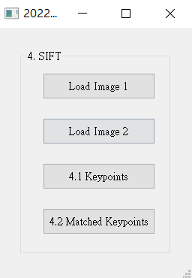
4. (20%) SIFT
(出題：Mei)
4.1 (10%) Keypoints
4.2 (10%) Matched Keypoints

Slide 6
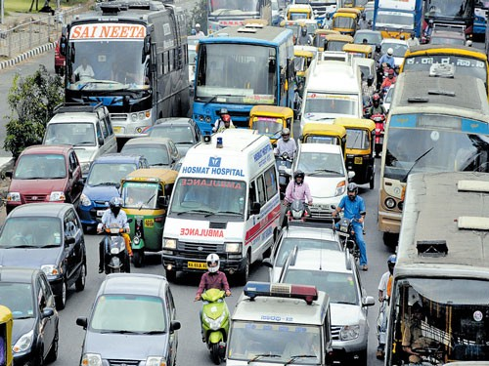
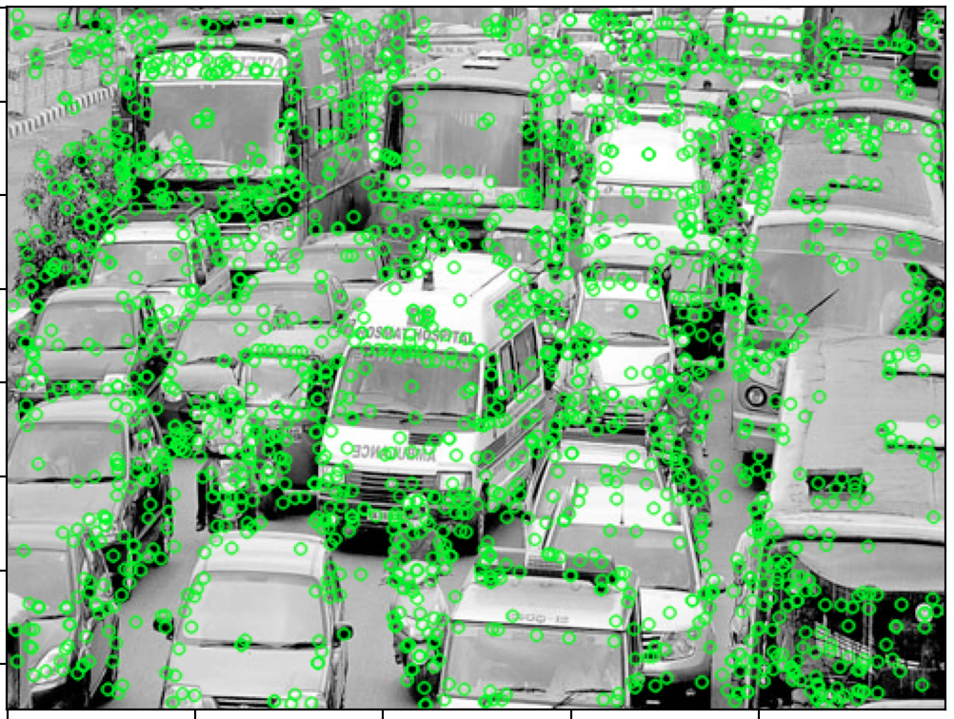
4.1 (10%) Keypoints
(出題：Mei)
Click button “4.1 Keypoints” to show:
Detect keypoints on traffics.png
then save and draw the keypoints of traffics.png as figure 1:
Input:
Output:
traffics.png
Figure 1
Hint : (ref. : opencv2refman_2.4.7.pdf) ref. p663 ~ p670

Slide 7
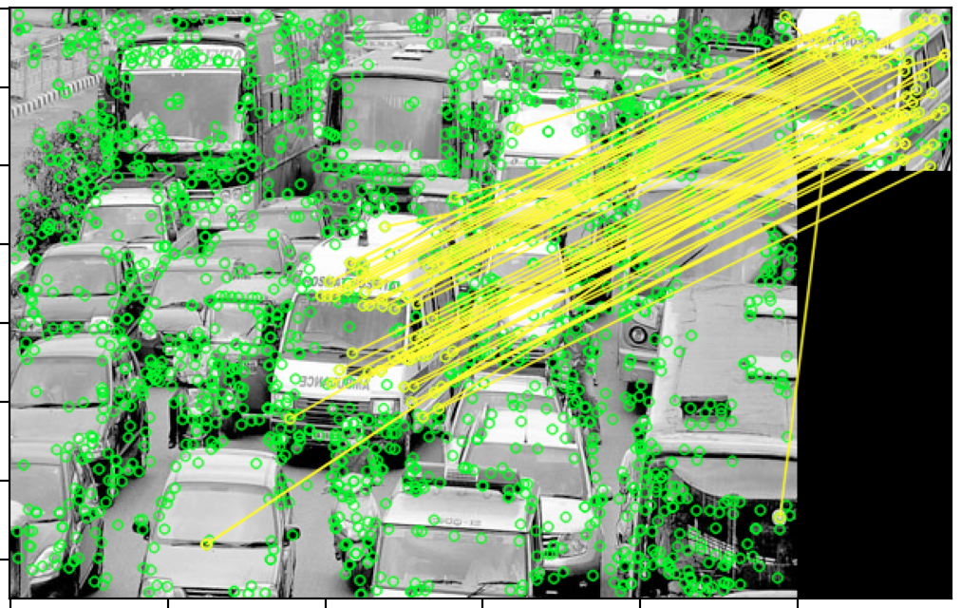

4.2 (10%) Matched Keypoints
(出題：Mei)
Click button “4.2 Matched Keypoints”,
Draw the matched feature points between two image: traffics.png and ambulance.png and show the results as figure 2:
Input:
Output:
ambulance.png
traffics.png
figure 2
Hint : (ref. : opencv2refman_2.4.7.pdf) ref. p663 ~ p670

Slide 8
5. Training Cifar10 Classifier Using VGG19 (20%)
5.1 Load Image and Show 9 Training Images with Different Label(4%)
5.2 Show Model Structure (4%)
5.3 Show Data Augmentation Result (4%)
5.4 Show Accuracy and Loss (4%)
5.5 Inference (4%)

Slide 9
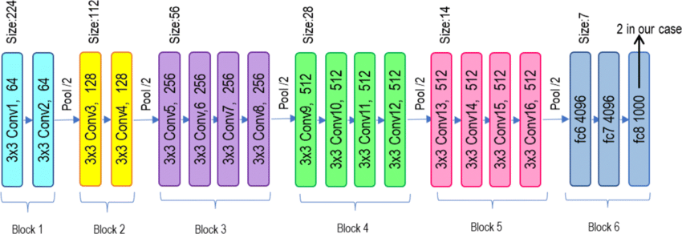
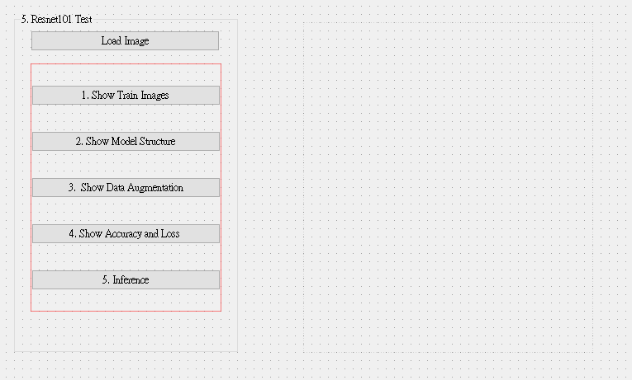
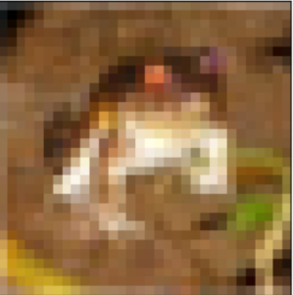
5.0 Training Cifar10 Classifier Using VGG19
Learn how to construct VGG19 and train it on Cifar10.
Environment Requirement
Python
Tensorflow / PyTorch (Can choose the one)
opencv-python
Matplotlib
Reference
https://pytorch.org/vision/0.12/generated/torchvision.models.vgg19.html(Source Code)
https://www.cs.toronto.edu/~kriz/cifar.html (Cifar10 Dataset)
GUI example
VGG19 framework

Slide 10
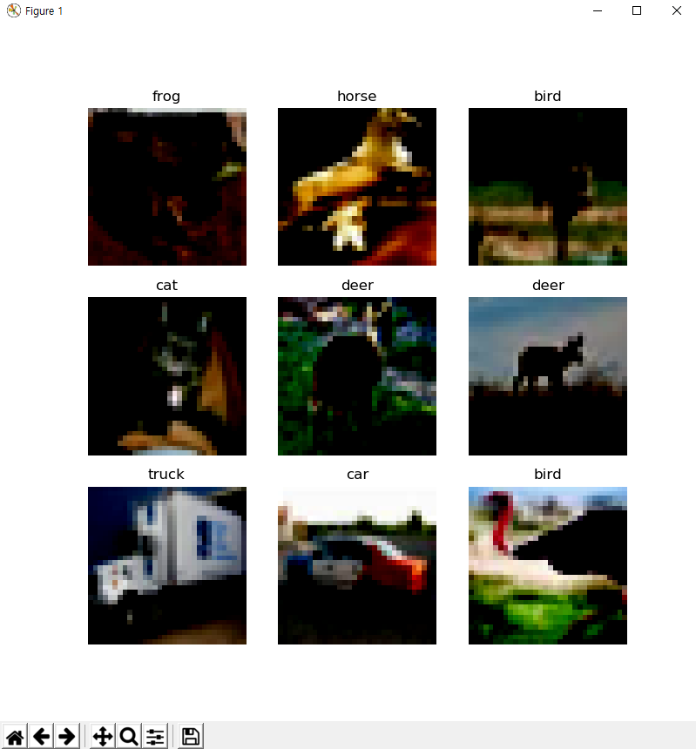
5.1 Load Cifar10 training dataset, and then show 9 Images and Labels respectively (4%)
Class
Label
0 airplane
1 automobile
2 bird
3 cat
4 deer
5 dog
6 frog
7 horse
8 ship
9 truck
Image
10 Class of CIFAR 10 Dataset
◆ Hint
Use Matplotlib 4 function
figure()
title()
Axis()
imshow()
Can refer by tutorial at the Matplotlib library official web-site
https://matplotlib.org/stable/tutorials/index.html

Slide 11
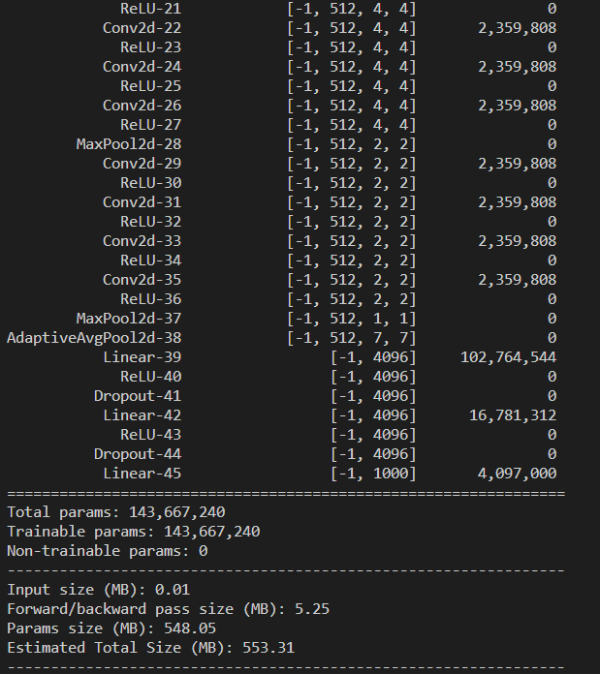
5.2 Construct and show your model structure by print out on the terminal (You can use available architecture provided by ML framework to build your model) (4%)
◆ Hint
Pytorch API
Use the two option
Summary function
from torchsummary import summary
-> import the package
summary(Model name, (Input Channel, Input Width, Input Height))
-> run the function and print on the terminal
Print function
From torchvision import models
-> import the package
model = torchvision.models.vgg19()
-> Make the mode data
Print(Model)
Can refer this web-site
https://pypi.org/project/pytorch-model-summary/
Layers List of
Model
After processing
each layer
Change of input
data type
Number of
trainable
parameters

Slide 12
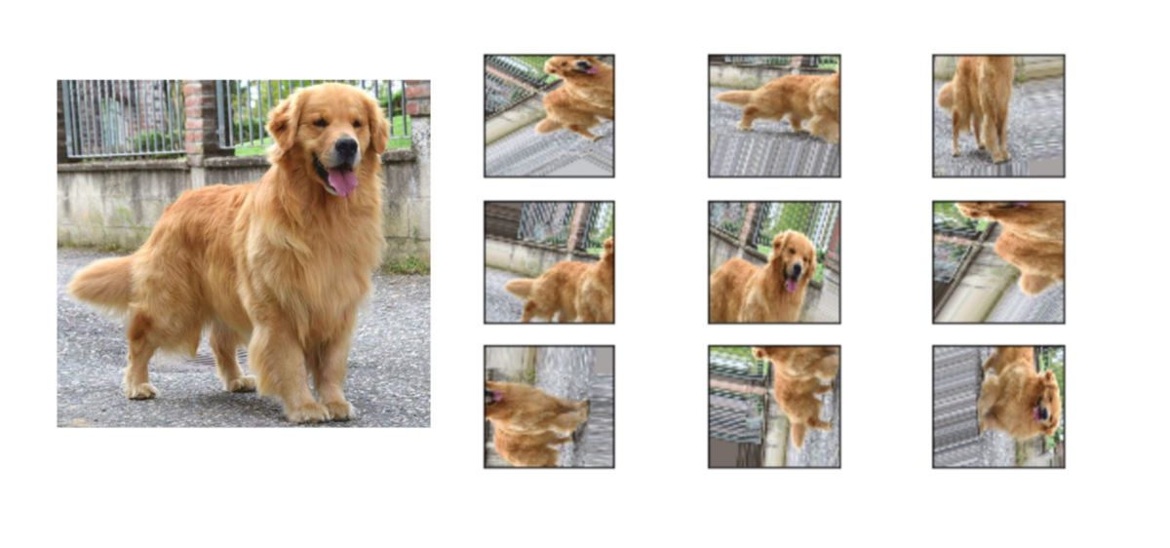
5.3 Show Data Augmentation Result (4%)
Show three kinds of augmentation methods and show the results as example.
Transforms on PIL Image and torch.*Tensor
CenterCrop(size)
ColorJitter([brightness, contrast, ...])
FiveCrop(size)
Grayscale([num_output_channels])
Pad(padding[, fill, padding_mode])
RandomAffine(degrees[, translate, scale, ...])
RandomApply(transforms[, p])
RandomCrop(size[, padding, pad_if_needed, ...])
RandomGrayscale([p])
RandomHorizontalFlip([p])
RandomPerspective([distortion_scale, p, ...])
RandomResizedCrop(size[, scale, ratio, ...])

Slide 13
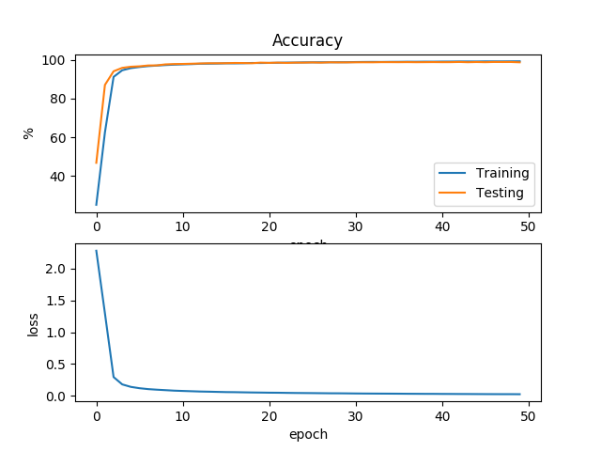
5.4 Training your model at least 30 epochs by your own computer, then save your model and take a screenshot of your training loss and accuracy. No saved images no points (4%)
◆ Hint
There are two option.
Just use the normal method(Above image used this way)
https://www.pyimagesearch.com/2021/07/19/pytorch-training-your-first-convolutional-neural-network-cnn/
2) Use tensorboard in Tensorflow API or tensorboard in pytorch
https://pytorch.org/tutorials/intermediate/tensorboard_tutorial.html
(record accuracy/loss per epoch)

Slide 14

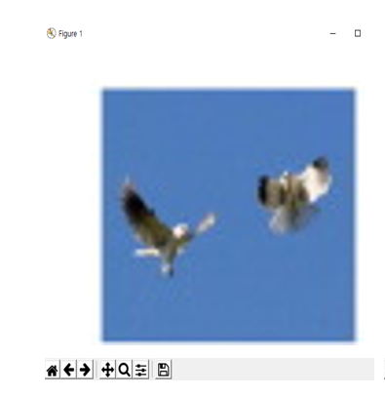

5.5 Load your model trained at 5.4, inference them and show the result image and class (4%)
1. Choose the any data
3. Show the prediction label, confidence score
Confidence = 0.98
Prediction Label: bird
2. Run Inference
◆ Hint
https://towardsdatascience.com/understanding-pytorch-with-an-example-a-step-by-step-tutorial-81fc5f8c4e8e#5017
https://pytorch.org/tutorials/
https://yanwei-liu.medium.com/pytorch-with-grad-cam-6a92a54bfaad

