Slide 1
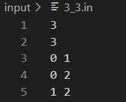

1
# of Nodes
# of Edges
b
f
Node_0 → Node_1
a
e
Node_0 → Node_2
0
c
2
Node_1 → Node_2
d
Input Edge
Generated Edge
a
b
0 → 1
1 → 0
c
d
$\left(a⊗b\right)$ $\left(c⊗d\right)$ $\left(e⊗f\right)$
0 → 2
2 → 0
e
f
1 → 2
2 → 1

Slide 2


1
# of Nodes
# of Edges
b
f
Node_0 → Node_1
a
e
Node_0 → Node_2
0
c
2
Node_1 → Node_2
d
For Node ‘0’
Flow-in Edges
$$\left(b+d\right)\left(b^{′}+d^{′}\right)$$
Flow-in Edges
Edge ‘b’ / Edge ‘d’
Flow-out Edges
Flow-out Edges
Edge ‘a’ / Edge ‘c’
$$\left(a+c\right)\left(a^{′}+c^{′}\right)$$

Slide 3
1
SAT
0
2
Result

Slide 4
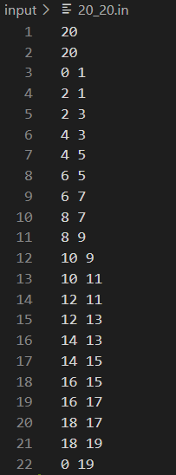
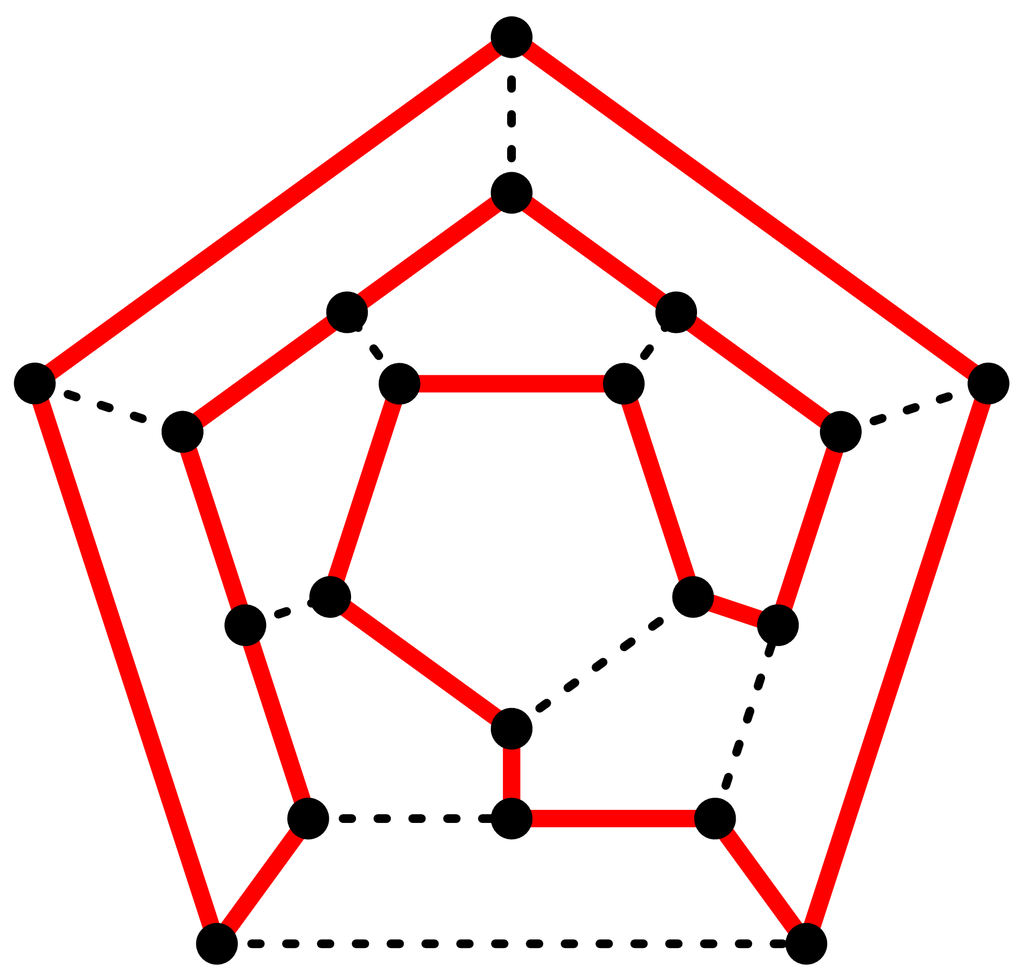
2
SAT
9
8
10
3
1
7
15
14
11
13
16
6
12
17
5
19
18
4
0

Slide 5
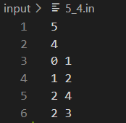
UNSAT
1
2
4
0
3
Result

Slide 6
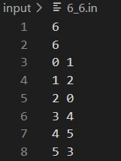
UNSAT
1
2
5
0
3
4

Slide 7
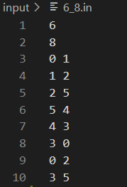
UNSAT
1
2
5
0
3
4

Slide 8
6_8

