Slide 1

Problem A : X-value
組別 : 組別 1
組員 : 電機二 陳孟宏
電機二 李彥儒

Slide 2
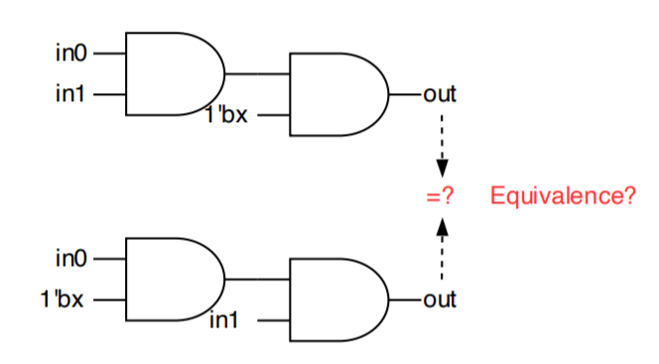
X-value Equivalence Checking
0
X
1
INPUT
X
0
1

Slide 3
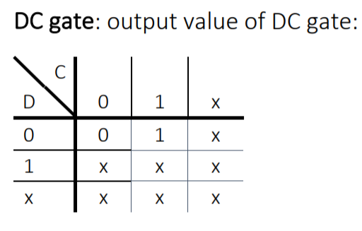
Why Has X-value
“X-value” means “Both”
i.e. The output is unstable, it is possible to be ‘0’ or ‘1’, hence, we need to use ‘x’ to represent the scenario.

Slide 4


Compatible Equivalence
(a)
(o)
(b)
(x)

Slide 5
What We Do
File Reading & Parsing
Define “X-value”
Define “_DC gate”
Modified Truth Table of Other Gates
SAT & CNF Engine Usage
Output If Circuits Be Compatible Equivalence
Test Cases Demo

Slide 6
What We Do
File Reading & Parsing
Define “X-value”
Define “_DC gate”
Modified Truth Table of Other Gates
SAT & CNF Engine Usage
Output If Circuits Be Compatible Equivalence
Test Cases Demo

Slide 7
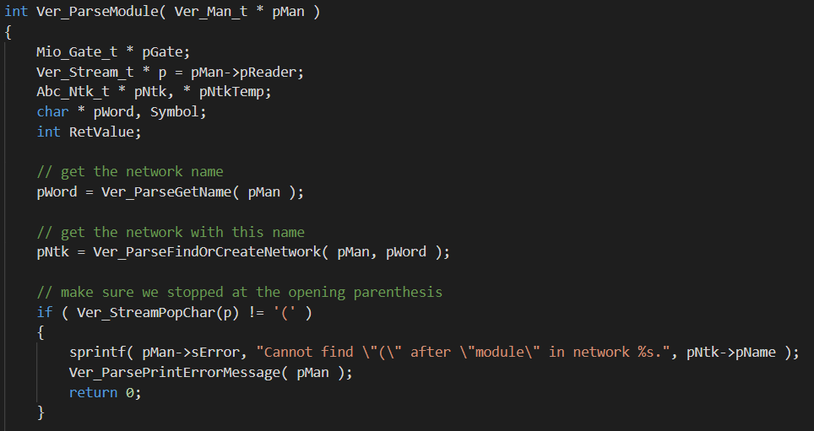
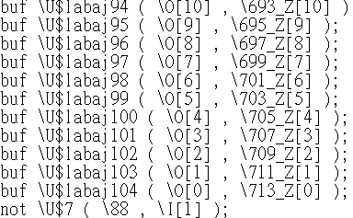
Why Parsing
src/base/ver/verCore.c
Test Cases ( gf.v )
在遇到小括號之前的字都存入pWord變數中
Test cases named every gate

Slide 8
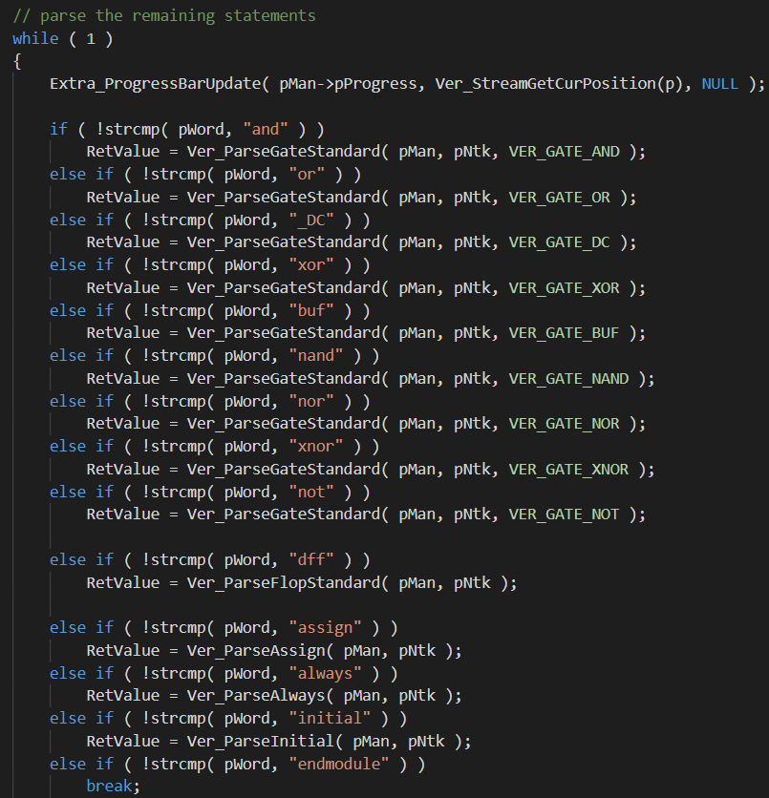
Why Parsing
Test Cases ( gf.v )
把pWord存的字跟Gate關鍵字做比較, 發現沒有parse掉名字的部分, 讀檔就會error
Test cases named every gate

Slide 9
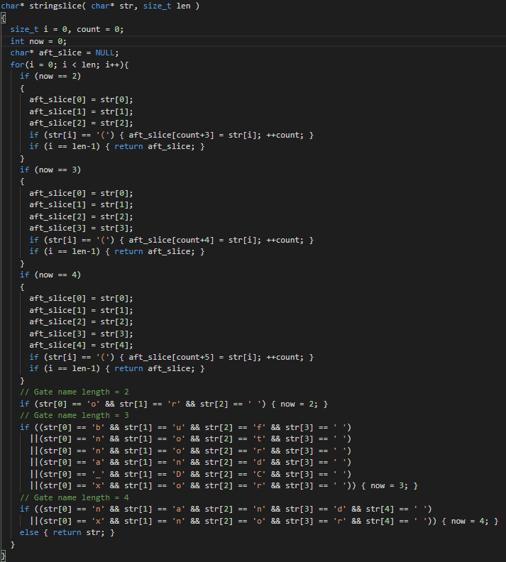
Parsing Code
base/exteda/ReadGate.c & .h ( 自己創的檔 )
定義char* stringslice(char* str, size_t len) :
讀完gate的關鍵字加上一個空格後, 停止!
直到下一次讀到 ‘ ( ‘ 後才繼續讀進來存入

Slide 10
What We Do
File Reading & Parsing
Define “X-value”
Define “_DC gate”
Modified Truth Table of Other Gates
SAT & CNF Engine Usage
Output If Circuits Be Compatible Equivalence
Test Cases Demo

Slide 11
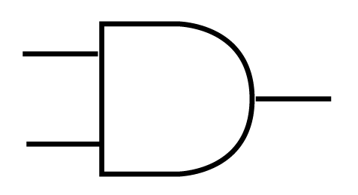
Idea
Encode Fan-in :
Decode Fan-out :
0
0b00
0b00
0
1
0b01
0b01
1
X
0b10
0b10
X
To extend the range of Boolean for ‘x’, we need 2 binary bits to encode.
Every two consecutive bits of output represent 0, 1, or X
0
0
0
0
0
= 0
0
1
0
1

Slide 12
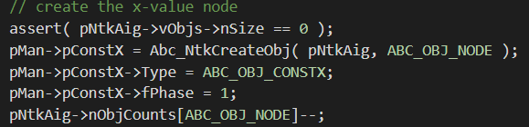
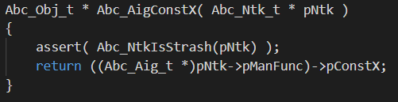
Code to Define X-value
src/base/abc/abcAig.c
原先已經有pConst1表Boolean 1,
而Abc_ObjNot( pConst1 )表Boolean0,
所以多定義一個pConstX表X-value
src/base/abc/abcAig.c

Slide 13
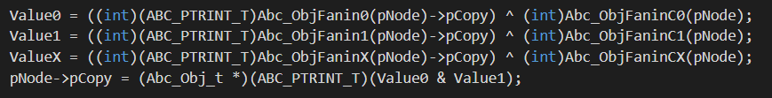
Code to Define X-value
src/base/abci/abcVerify.c
在 Simulation 的 Input Pattern,
要定義 Value = 0 及 Value = 1 的可能外,
還有 Value = X 的可能
src/base/abc/abc.h

Slide 14


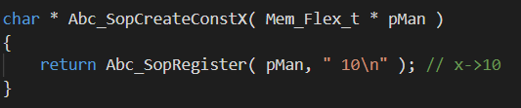
Code to Define X-value
src/base/abc/abcSop.c
定義 Constant 0, Constant 1, 和 X-value 的輸出會是之前 encode 的型態

Slide 15
What We Do
File Reading & Parsing
Define “X-value”
Define “_DC gate”
Modified Truth Table of Other Gates
SAT & CNF Engine Usage
Output If Circuits Be Compatible Equivalence
Test Cases Demo

Slide 16
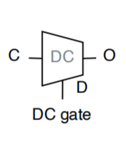
What is DC Gate

Slide 17
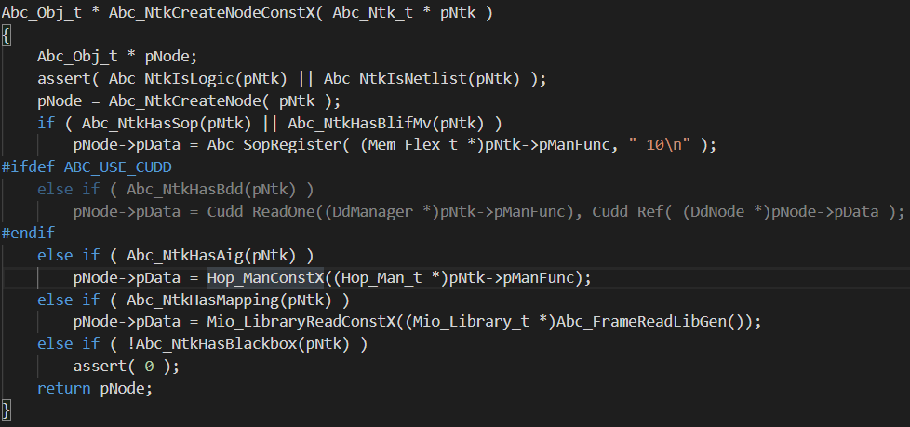
Code to Define DC Gate
建立一個X- value的 Node

Slide 18
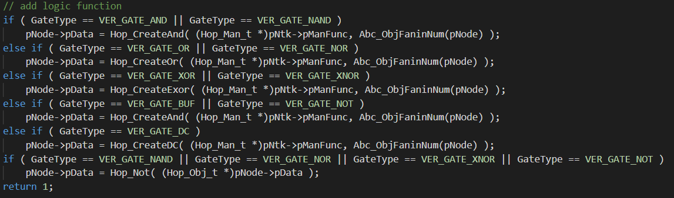
Code to Define DC Gate
將DC gate加入
邏輯閘的行列
定義 DC gate 的真值表表現

Slide 19
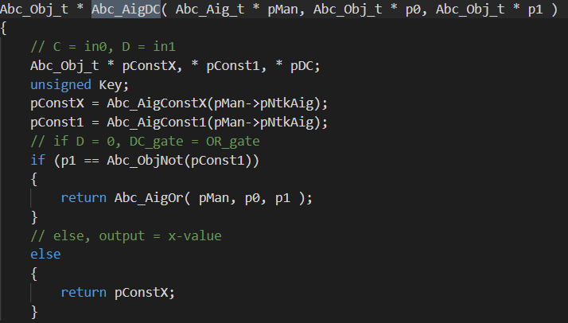
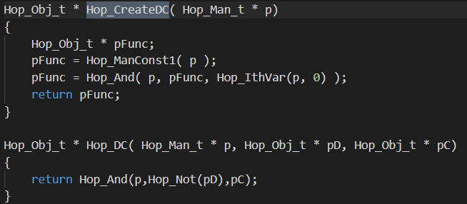
Code to Define DC Gate
定義 DC gate 輸入輸出表現
創建 DC gate

Slide 20
What We Do
File Reading & Parsing
Define “X-value”
Define “_DC gate”
Modified Truth Table of Other Gates
SAT & CNF Engine Usage
Output If Circuits Be Compatible Equivalence
Test Cases Demo

Slide 21
Modified Truth Table
AND
OR
XOR
 | 0 | 1 | X
0 | 0 | 0 | 0
1 | 0 | 1 | X
X | 0 | X | X
 | 0 | 1 | X
0 | 0 | 1 | X
1 | 1 | 1 | 1
X | X | 1 | X
 | 0 | 1 | X
0 | 0 | 1 | X
1 | 1 | 0 | X
X | X | X | X

Slide 22
Modified Truth Table
XNOR
NOR
NAND
 | 0 | 1 | X
0 | 1 | 0 | X
1 | 0 | 1 | X
X | X | X | X
 | 0 | 1 | X
0 | 1 | 0 | X
1 | 0 | 0 | 0
X | X | 0 | X
 | 0 | 1 | X
0 | 1 | 1 | 1
1 | 1 | 0 | X
X | 1 | X | X

Slide 23
Modified Truth Table
DC
BUF
NOT
 | 0 | 1 | X
0 | 1 | 0 | X
1 | 0 | 1 | X
X | X | X | X
IN | OUT
0 | 0
1 | 1
X | X
IN | OUT
0 | 1
1 | 0
X | X

Slide 24
Modified Truth Table
MUX (s=0)
MUX (s=1)
MUX(s=X)
 | 0 | 1 | X
0 | 0 | 1 | X
1 | 0 | 1 | X
X | 0 | 1 | X
 | 0 | 1 | X
0 | 0 | 0 | 0
1 | 1 | 1 | 1
X | X | X | X
 | 0 | 1 | X
0 | 0 | X | X
1 | X | 1 | X
X | X | X | X

Slide 25
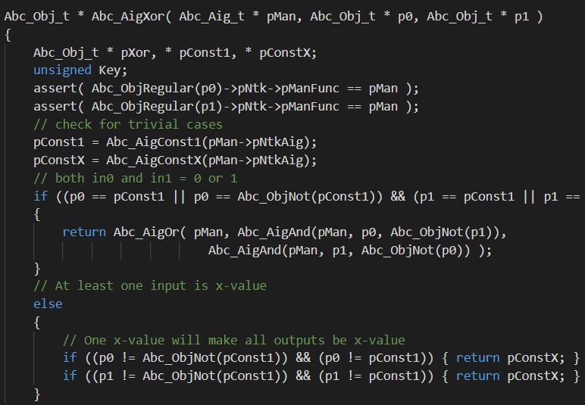
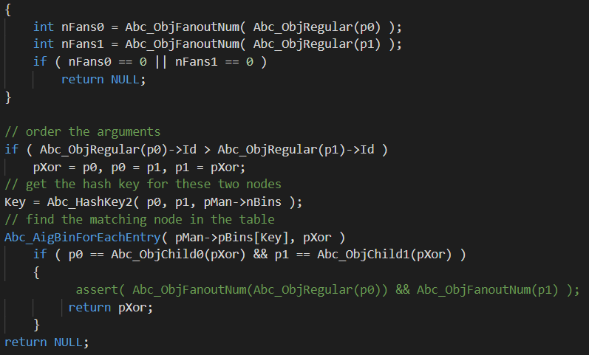
Code to Re-define Logic Gates
( 舉 XOR Gate為例 )
按照修正真值表討論Output 情形
將新的 Node重新連接

Slide 26
What We Do
File Reading & Parsing
Define “X-value”
Define “_DC gate”
Modified Truth Table of Other Gates
SAT & CNF Engine Usage
Output If Circuits Be Compatible Equivalence
Test Cases Demo

Slide 27
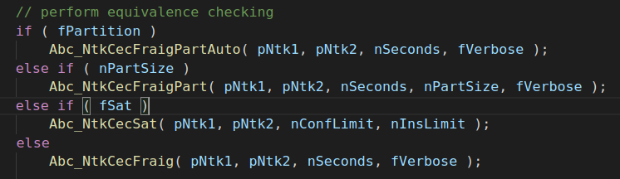
Using SAT Engine in abc

Slide 28
What We Do
File Reading & Parsing
Define “X-value”
Define “_DC gate”
Modified Truth Table of Other Gates
SAT & CNF Engine Usage
Output If Circuits Be Compatible Equivalence
Test Cases Demo

Slide 29
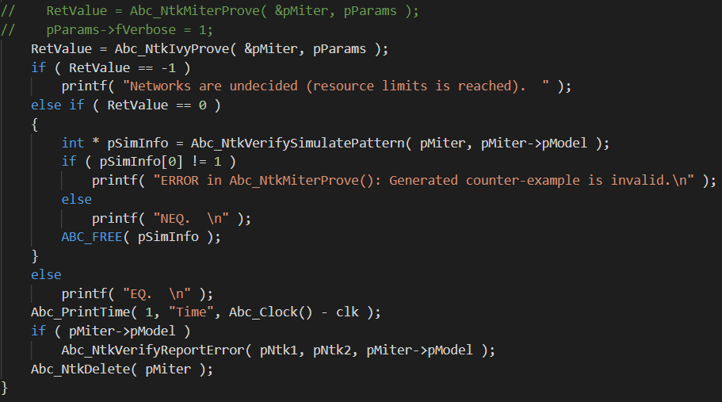
Output Message
目前只有印出”相等 (EQ)”, 或”不相等 (NEQ)”的結果, 至於列出使比較出不相等的 Input Pattern 仍再試 ><

Slide 30
What We Do
File Reading & Parsing
Define “X-value”
Define “_DC gate”
Modified Truth Table of Other Gates
SAT & CNF Engine Usage
Output If Circuits Be Compatible Equivalence
Test Cases Demo

Slide 31
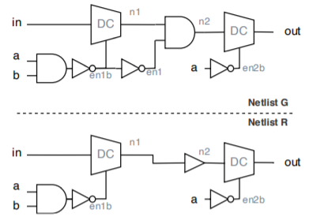
Simple Test Cases
NEQ
In | a | b | G | R
0 | 0 | 0 | X | X
0 | 0 | 1 | X | X
0 | 1 | 0 | 0 | X
0 | 1 | 1 | 0 | 0
1 | 0 | 0 | X | X
1 | 0 | 1 | X | X
1 | 1 | 0 | 0 | X
1 | 1 | 1 | 1 | 1

Slide 32
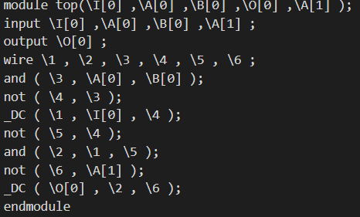
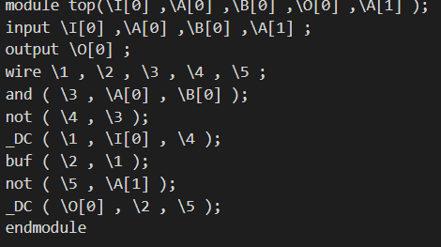
Simple Test Cases
Verilog
Verilog

Slide 33
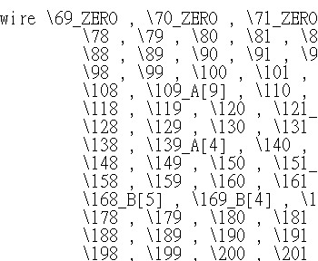
BugBugBugBugQQ
_DC & X-value Segmentation Fault
Parsing 某條 wire 的 Input 成 “wire編號”以及”常數0, 1, 或 PI”

Slide 34
Thanks for Listening

