Slide 1
Threshold Logic Synthesis
LSV Final Project
莊哲維 B07901048 陳孟宏 B07901103

Slide 2
Outline
Paper Reference
Problem Statement
Preliminaries
Methods
Results
Discussion and Summary

Slide 3
Paper Reference

Slide 4
We Reimplement
Title
Synthesis and optimization of threshold logic networks with application to nanotechnologies
Publisher
IEEE, 2004
Author
Rui Zhang, Pallav Gupta, Lin Zhong, and Niraj K. Jha
Link
https://reurl.cc/k7727G

Slide 5
Problem Statement

Slide 6
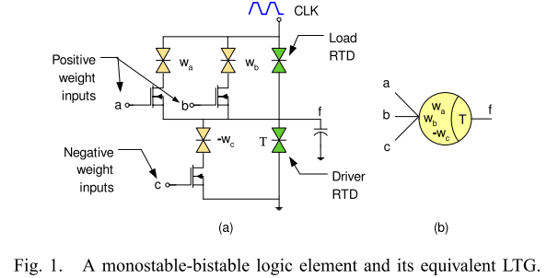
Background
In semiconduction industry, there exists a lot of nanoscale devices
While CMOS is used to implement Boolean logic, many other nanoscale devices implement threshold logic
RTD : Resonant Tunnel Diodes (諧振穿隧二極體)
QCA : Quantum Cellular Automata (量子元胞自動機)

Slide 7
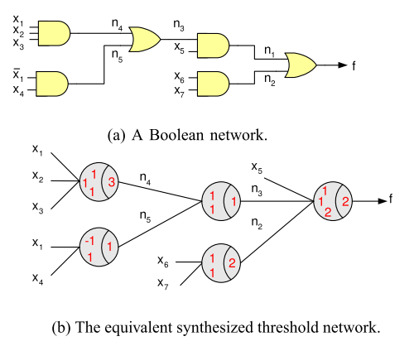
Problem Statement
Input
Given a combinational circuit “G”
can be multi-output
better to have algebraically-factored output (easy to keep the function unate)
Output
Functionally equivalent threshold network “GT”

Slide 8
Preliminaries

Slide 9
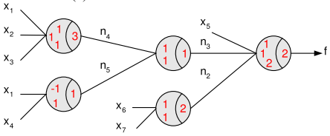

Threshold Logic
A linear threshold function “f” is a multi-input function
Each input dddddddddddddddddd is assigned a weight “w”
A fanout’s output = 1 iff the weighted sum of inputs are exceeds threshold “T”
( δ_on / δ_off : defect tolerance, default = 0 )

Slide 10
Important Properties
T
Property 1 : Only unate function ca be threshold
provide us an effcient way to identify non-threshold function
Property 2 : If function f is a threshold function, f + x, xf are also threshold function
allow us to combinie node during the algorithm
w1
w3
+
x
w2
a
b
c
2T
w1
T
w2
w3
a
x
b
c

Slide 11
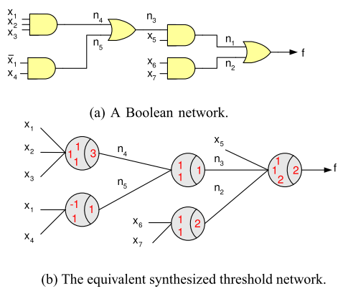
Motivation Example
E.g. Let φ = 4 → now L = 2
f = n1 + n2 → collapse
f = (n3*x5) + (x6*x7) → L = 4 == φ
(check if now “f” threshold function?) → NO
split “f” into smaller node
f = (n3*x5) + n2 ; n2 = x6*x7
collapse n3 = (x1*x2*x3) + (x1’ *x4)
(check if now “n3” threshold function?) → NO
split “n3” into smaller node
n3 = n4 + n5 ; n4 = x1*x2*x3 ; n5 = x1’ * x4
The three node { n3, n4, n5 } are threshold function
synthesize threshold network from Fig.(a) to Fig.(b)

Slide 12
Methods

Slide 13
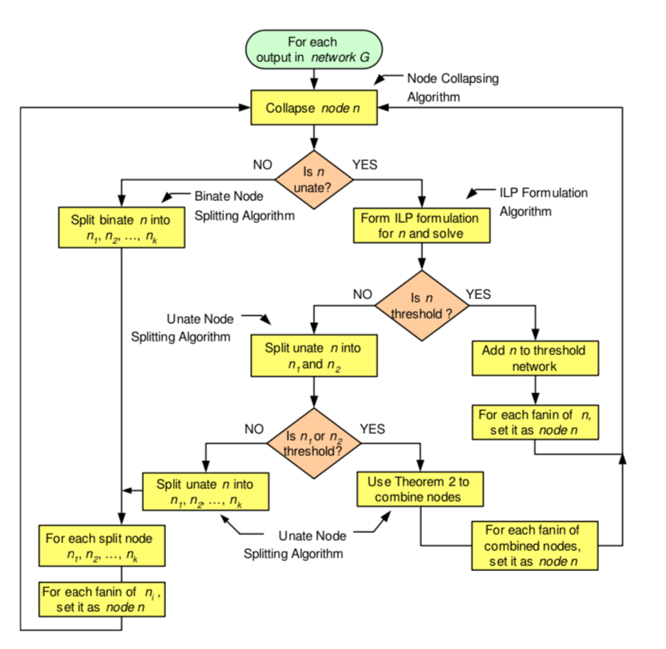
Algorithm Overview
Collapse
Collapse from output recursivly
Unateness checking
Only unate node can be threshold
Check if the function is unate
Threshold checking & gate generating
ILP based algorithm
Check if the node is threshold
Generate the weight simultaneously
Splitting
Unate splitting
Binate splitting

Slide 14
Cont'd
Collapse Update
Collapse
Collapse Update
SOP
variable list
New gate
New collapse target
New gate
New collapse target
Unateness Checking
Yes
SOP
variable list
Threshold Checking
Yes
No
No
Unate Splitting
SOP
variable list
Binate Splitting

Slide 15
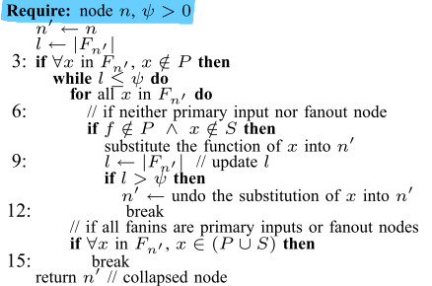
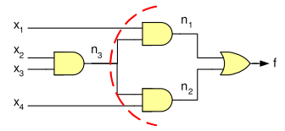
Collapse Algorithm -- Term Definition + Example
Fn → Set of fanins of node n
L → Cardinality of Fn
x(j) → The (j-th) fanin of a node
φ → Fanin restriction on a threshold gate
P → Set of PI in network G
S → Set of fanout nodes in network G
Stop collapsing’s condition
The fanin of node n are all PI / multi-fanout
The fanin of node n exceeds φ
E.g. Let φ = 4 → now L = 2
f = n1 + n2
f = (x1*n3) + n2 (L = 3 < φ)
f = (x1*n3) + (n3*x4) (L = 4 == φ)

Slide 16
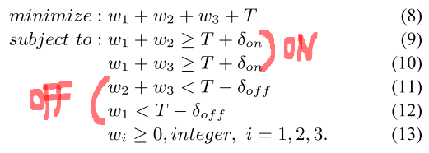
ILP Formulation Algorithm -- Example
To solve “weight” and “Threshold”
Example
→ weight = {w1, w2, w3}
→ y2 = x2’ ; y3 = x3’
ONSET = { x1y2, x1y3 } >= Threshold
OFFSET = { x1’, y2’y3’ } < Threshold
Solution for g → <2, 1, 1 ; 3>
Solution for f → <2, -1, -1 ; 1>
( ILP Formulation for function “g” )
( δ_on / δ_off : defect tolerance, default = 0 )

Slide 17


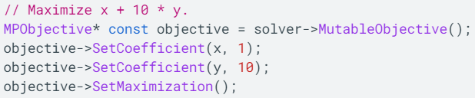
ILP Solving Tool -- Google O(peration)R(esearch)-Tools
Link → https://github.com/google/or-tools
Basic Operation (for example)
Limit the MIP solution to be “integer”
d
Set constraints
Set objective function

Slide 18
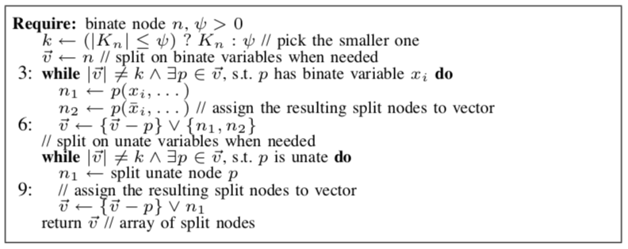
Binate Splitting
Input : A binate node
Output : Array of unate nodes
Guildline
Split on the most binate variable
Recursively doing until all new nodes generated are unate
No
Split on most binate variable
Check if each node is unate

Slide 19
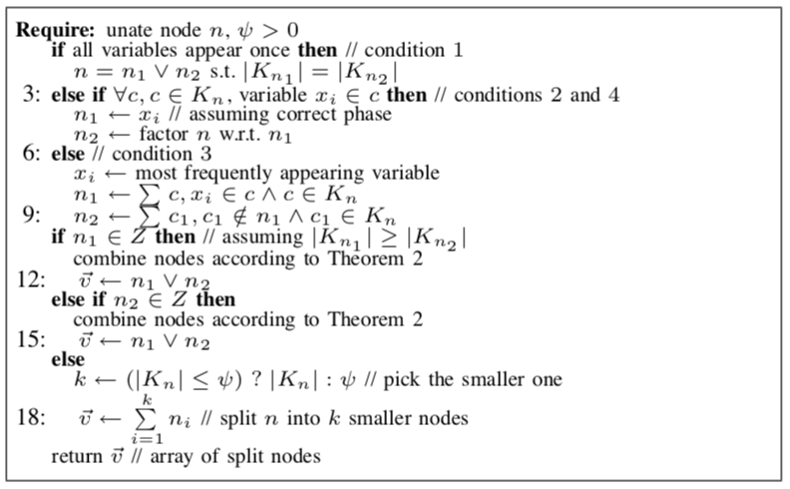
Unate Splitting
Input : A unate non-threshold node
Output : Array of unate nodes
Guildline
Split into two base on following
Once per variable
Factor
Other cases
Check if any are threshold
No : Splitting until reach maximum fanin
Yes : Combine by addition to form the new node

Slide 20
Cont'd
Case1 : ab + cd + ef → n1 = ab + cd, n2 = ef
If each variable appear once, make two node have almost equal cubes
Case2 : ab + ac + ad → n1 = a, n2 = b + c + d
If there is a common literal in all cubes, factor it out
Case3 : ab + ade + cf → n1 = ab + ade, n2 = cf
Else split on the most appearing variable
Combine using property 2
Yes
Split base on cases above
Check if any is threshold
Cube splitting
No

Slide 21
Results

Slide 22
Still Debugging…

Slide 23
Q & A

Slide 24
Thanks for Listening

