Slide 1
Wine Quality Data Set
Hongdi Li

Slide 2

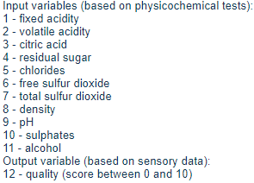
Abstract
White wine 4898
Red wine 1599

Slide 3
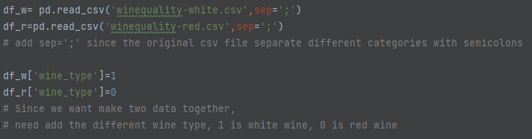
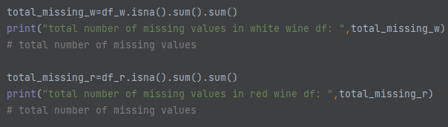
Preprocessing

Slide 4
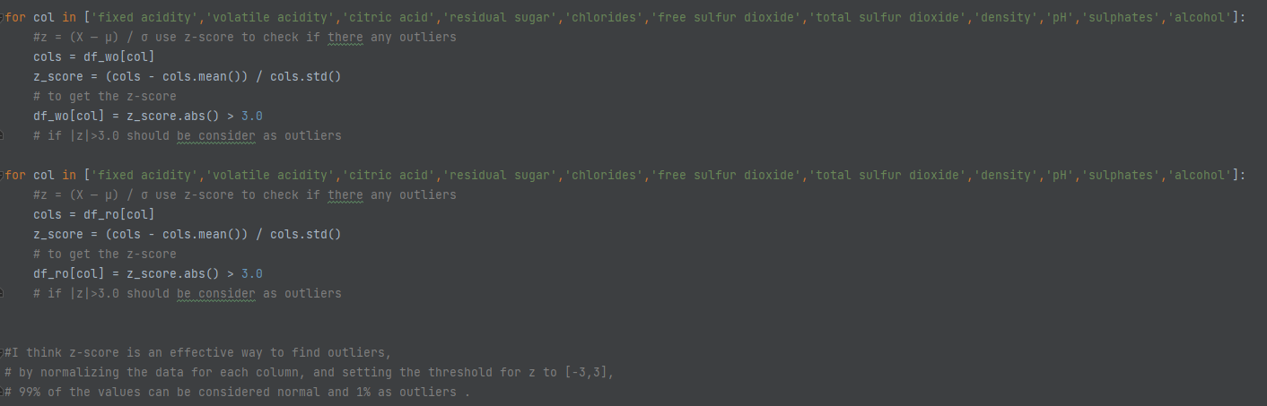
Find outliers in the dataframe except for the 'quality' column by z-score (Z = (X-μ)/σ ). I treat all data with |z|>3 as outliers, flag those data, and replace them with the mean of the column they are in.

Slide 5
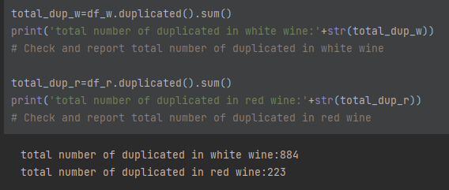

Slide 6
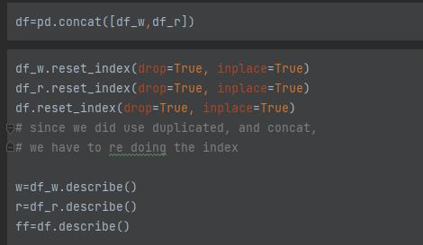
Make new DF

Slide 7
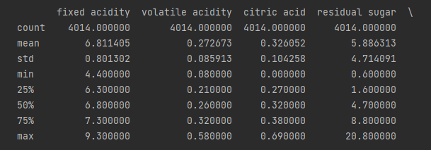
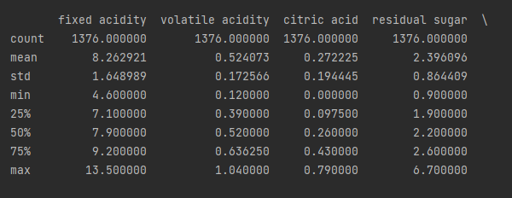
White wine
Red wine

Slide 8
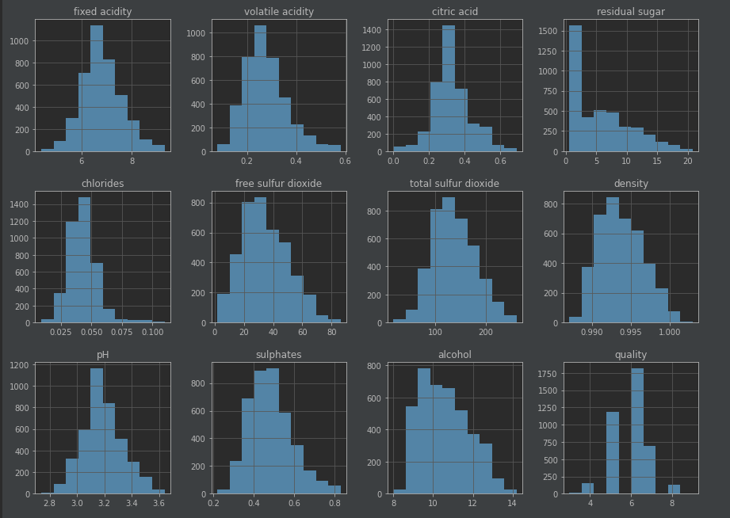
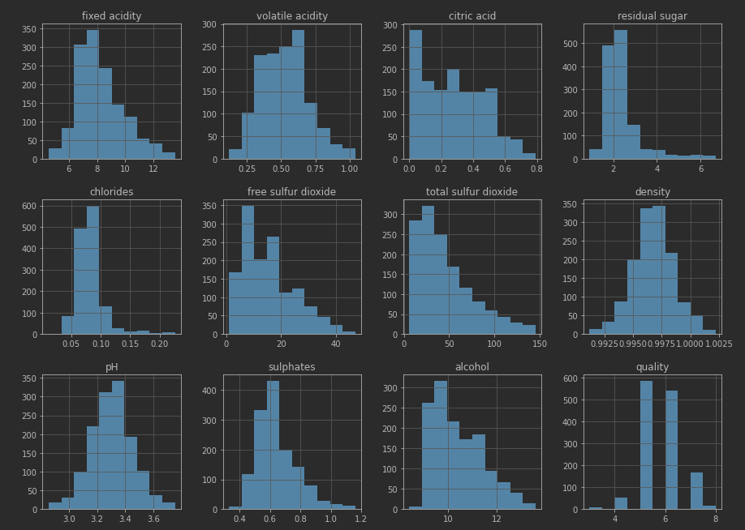
Visualization
White
Red

Slide 9
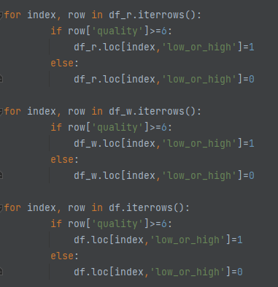
So I set 6 as the dividing line, wines with a quality less than 6 are considered inferior wines, and wines with a quality greater than 6 are considered superior wines. Similarly, I categorize the 'quality' row by row in the dataframe, and store the results in a new column "low_or_high", where 1 means good wine and 0 means bad wine.

Slide 10
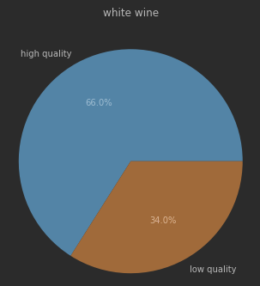
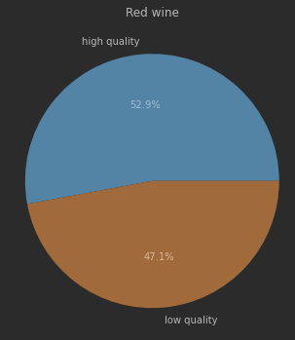
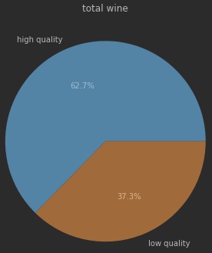
Thus, by look at the pre chart, if my model’s score less than 62.7% which means my model is totally failed in this dataset

Slide 11
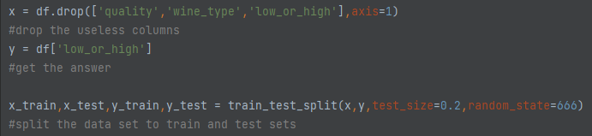
Machine learning

Slide 12
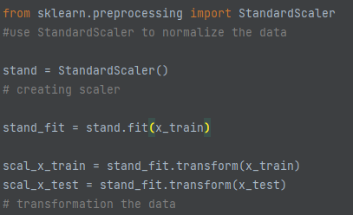
Considering the large variance in the size of the data in the dataset, I think model normalization is needed to make the model learn more efficiently. So I use StandardScaler() function to standardize the model.

Slide 13
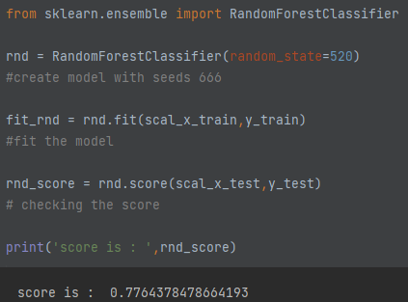

Slide 14
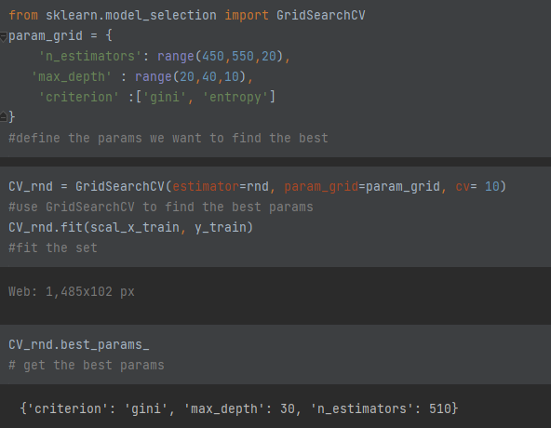
Improve
The reason to pick these range is I have tried this model many times, and I find around these number can give me a high score.
Due to my computer problem, I cannot running higher n_estimators model.

Slide 15
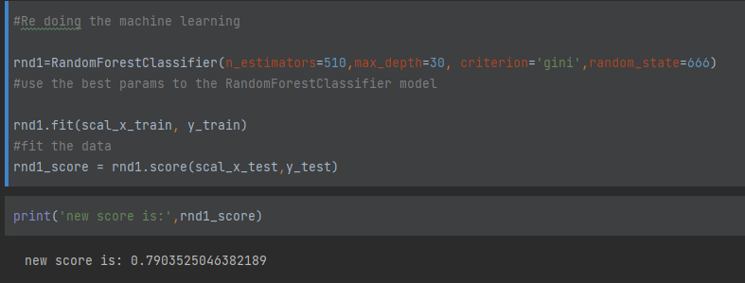

Slide 16
Future
1. Datasets is not enough
2. Duplicate rows may not need to be delete
3. Can keep working on the parameter to get a better model
4. Consider building a classification model for predict wine type

