Slide 1




Greetings
Group No. 9
Md. Rafi Sarkar
Ainul Huque
Md. Ahasanul Kabir Tahsin
Md. Hasibul Halim
Md. Rahat Sarkar

Slide 2


Overview
Our project is a user-friendly graphical calculator designed to perform basic arithmetic operations such as addition, subtraction, multiplication, and division. It features a simple and intuitive GUI with a button grid for input and a display screen for results, including support for decimal inputs and real-time output.
Group No. 9
Md. Rafi Sarkar
Ainul Huque
Md. Ahasanul Kabir Tahsin
Md. Hasibul Halim
Md. Rahat Sarkar
Notes:
Our project is a user-friendly graphical calculator designed to perform basic arithmetic operations such as addition, subtraction, multiplication, and division. It features a simple and intuitive GUI with a button grid for input and a display screen for results, including support for decimal inputs and real-time output.
Key Features:
Basic operations: +, −, ×, ÷
Decimal number support
Clear (C) functionality
Intuitive GUI with numeric/operator buttons and display screen

Slide 3

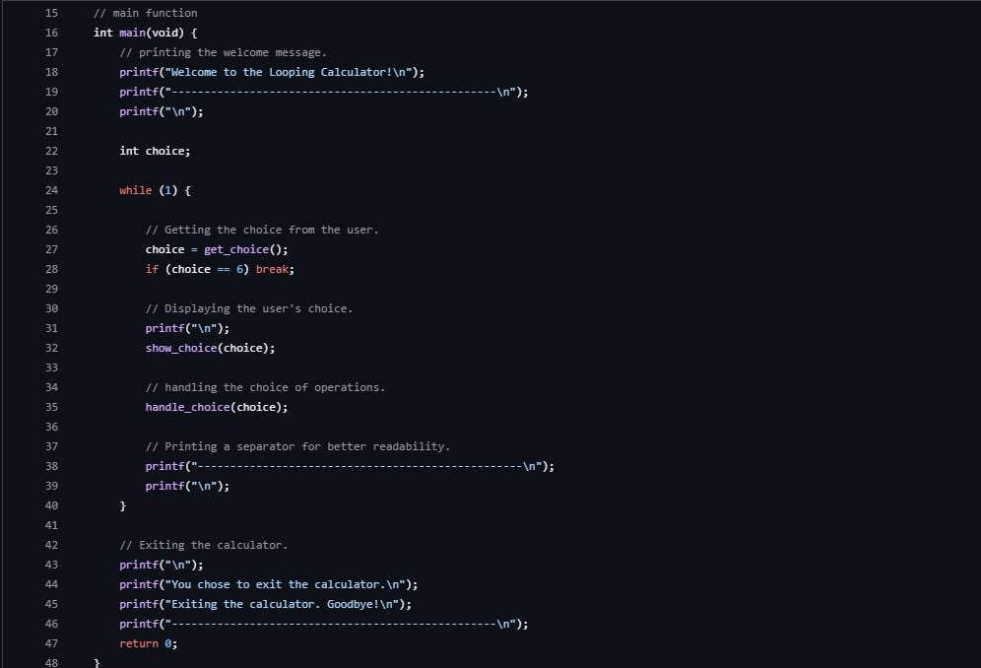
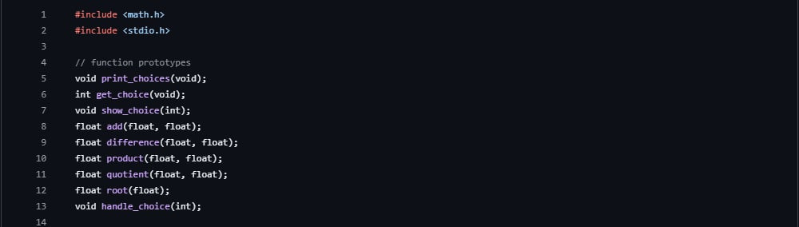


Library Headers
Backend
A
B
C
Main Function
Group No. 9
Md. Rafi Sarkar • Ainul Huque • Md. Ahasanul Kabir Tahsin
• Md. Hasibul Halim • Md. Rahat Sarkar

Slide 4
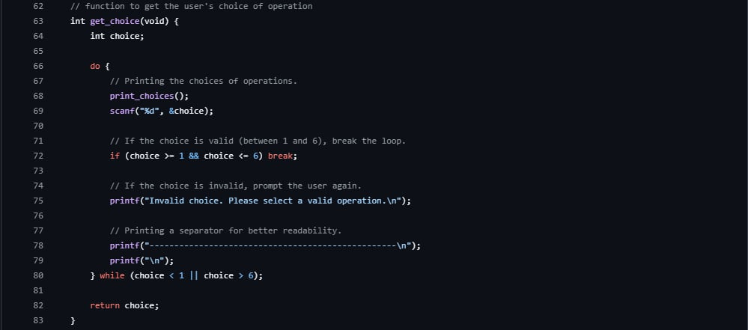
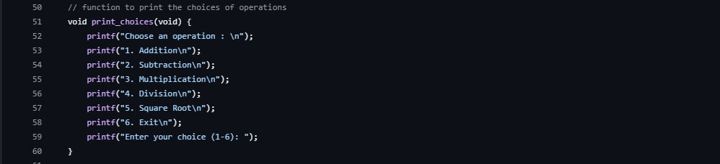
Operations
Backend
User's Choice
A
B
C
Group No. 9
Md. Rafi Sarkar • Ainul Huque • Md. Ahasanul Kabir Tahsin
• Md. Hasibul Halim • Md. Rahat Sarkar

Slide 5
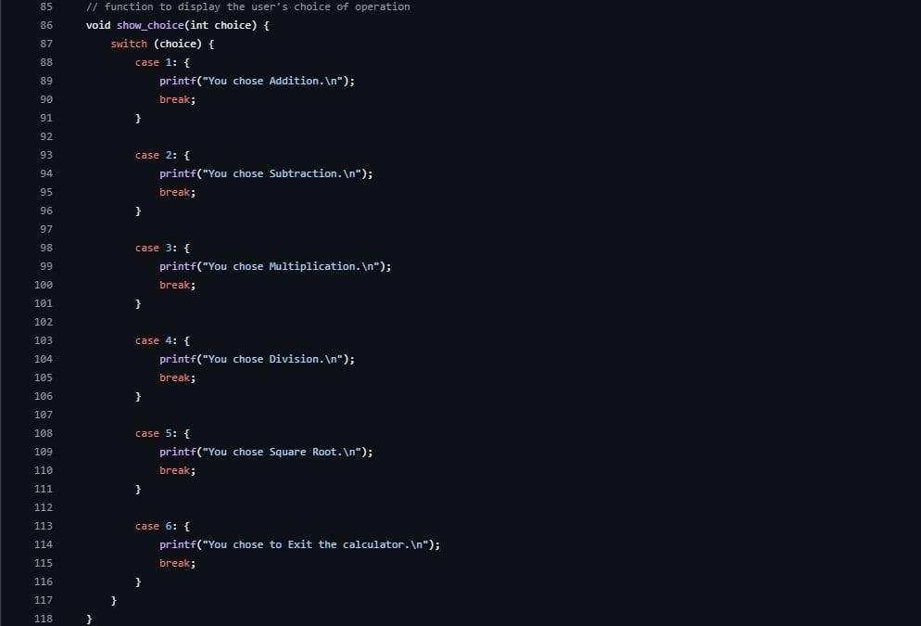
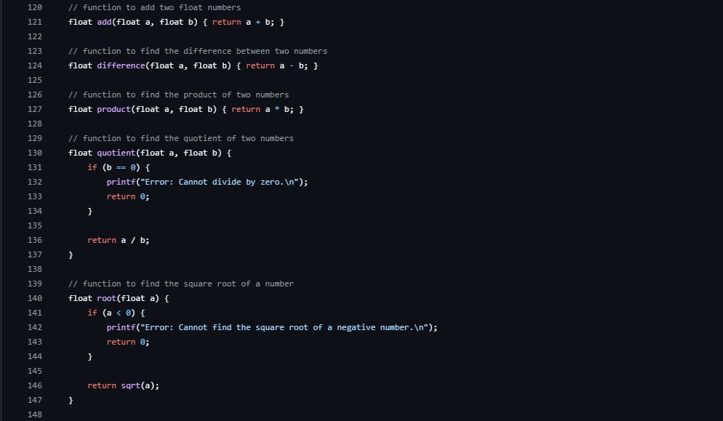
Basic Arithmetic
Backend
A
B
C
Choice Display
Group No. 9
Md. Rafi Sarkar • Ainul Huque • Md. Ahasanul Kabir Tahsin
• Md. Hasibul Halim • Md. Rahat Sarkar

Slide 6

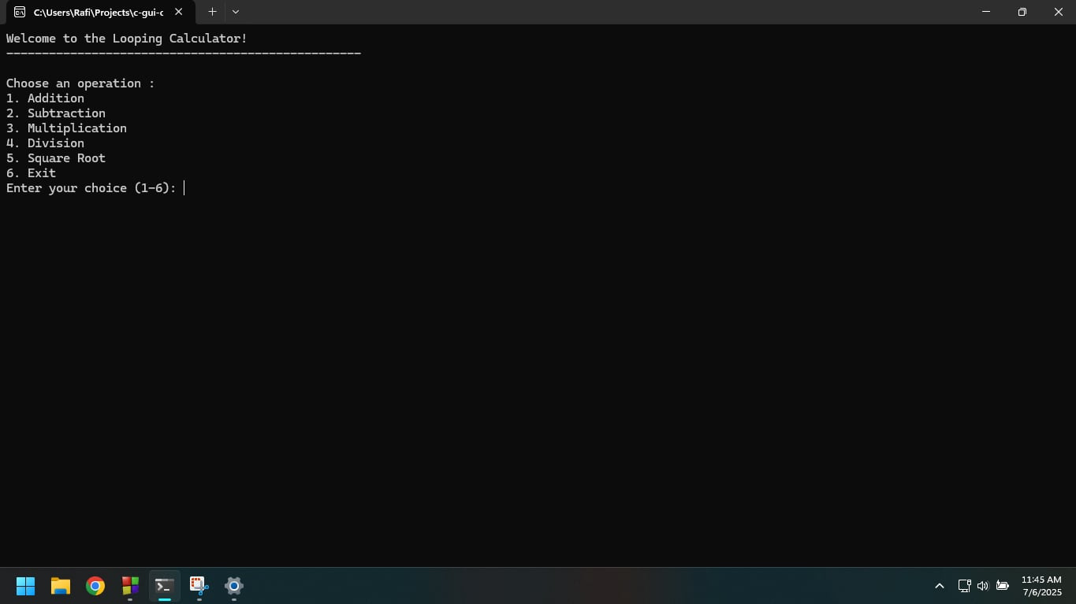
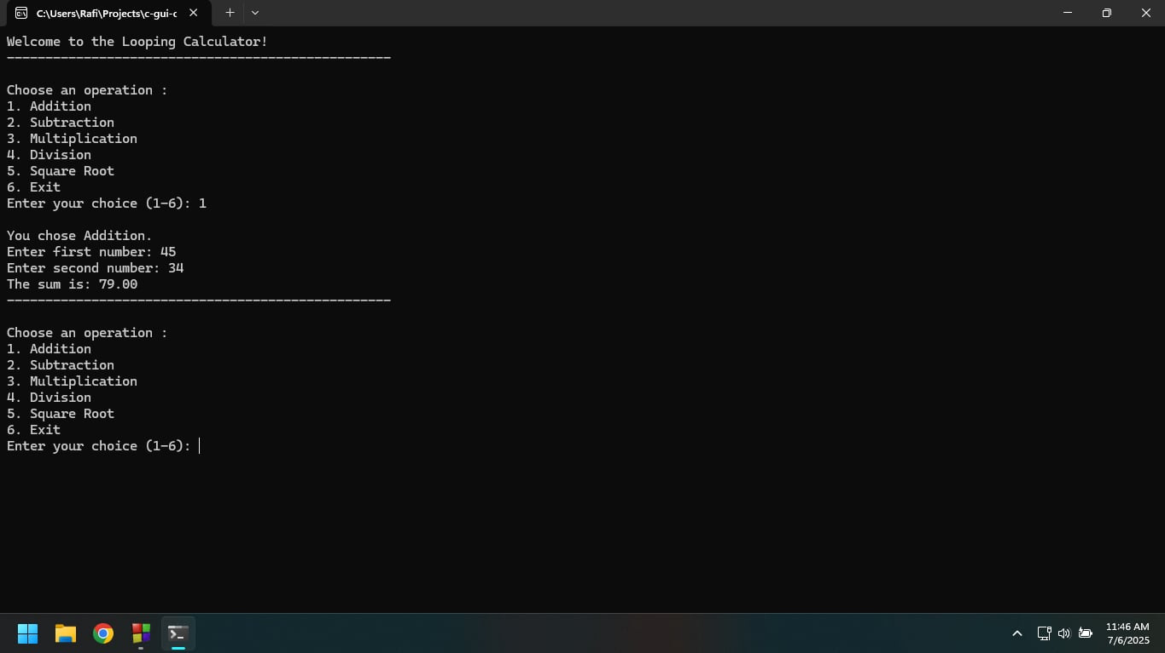
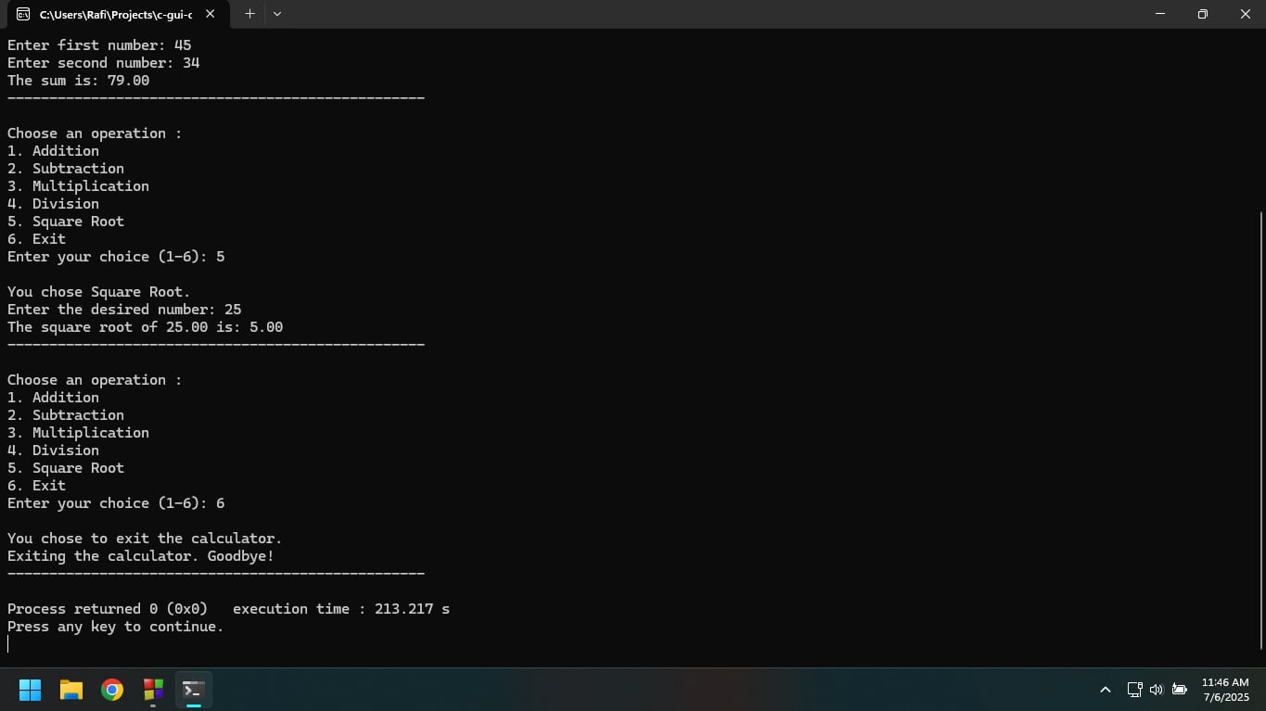
Outputs
Group No. 9
Md. Rafi Sarkar • Ainul Huque • Md. Ahasanul Kabir Tahsin
• Md. Hasibul Halim • Md. Rahat Sarkar

Slide 7
Upcomings
To improve the performance, usability, and visual appeal, we plan to introduce the following enhancements
Enhanced UI Design with modern layouts and icons
History Log for past calculations
Keyboard Input Support
Error Handling for invalid operations (e.g., division by zero)
Memory Functions (M+, M-, MR, MC)
Responsive Design for various screen sizes
Graph Plotting (optional future addition for visualizing functions)
Group No. 9
Md. Rafi Sarkar • Ainul Huque • Md. Ahasanul Kabir Tahsin
• Md. Hasibul Halim • Md. Rahat Sarkar

Slide 8
Thank you

