Slide 1
BMS Application Design
Zhehao Wang
zhehao@remap.ucla.edu
Nov 8, 2015

Slide 2
Namespace

Slide 3
Namespace – examples

Slide 4
Name components
Physical location branch contains the encrypted data gathered or aggregated at each level
In the example, “xfmr-6.dmd.inst” is referring to a specific sensor that publishes “electricity demand” data. The data type is reflected in the name components (in this case, “electricity – aggregated average”).
“User” branch keeps the list of user identities
“Read” branch keeps the list of access control groups

Slide 5
Hierarchical storage
Raw data collected, kept, and batched only at the leaf nodes.
Leaf nodes publish aggregated (min, sum, avg, etc) data at fixed time window.
Non-leaf nodes fetch the aggregated data from all of its children, and aggregate the data after all children respond.
Non-leaf nodes can publish aggregates with the same time window T; or n * T, n = 1, 2, 3...

Slide 6
Moving data across levels
Long lived interests for fixed (configured) time window

Slide 7
Signing/Verification

Slide 8
Group based access control
Example: access control at room and data type level
Each producer at room level or higher has a group for every type of data that it produces. Example group names:
“/ndn/app/bms/read/ucla/melnitz/1469A/data/”: users in this group have access to all the data in Melnitz 1469A
“/ndn/app/bms/read/ucla/melnitz/data/electricity”: users in this group have access to Melnitz Hall’s electricity data (One group name could be the prefix of another)

Slide 9
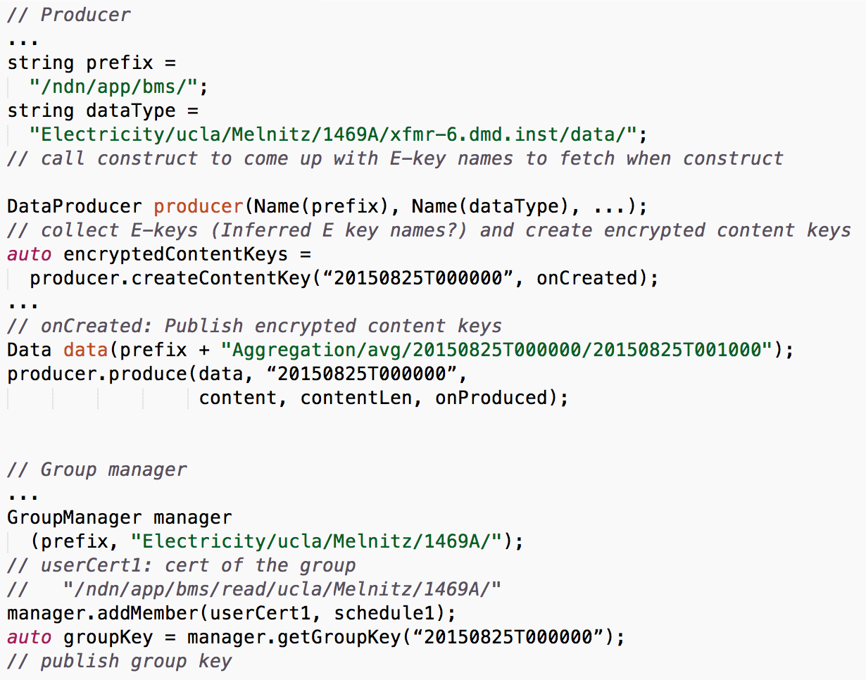
Access control – example API calls
For example, producing sensor level data; Content name
“/ndn/app/bms/ucla/Melnitz/1469A/xfmr-6.dmd.inst/data/Electricity/Aggregation/avg/20150825T000000/20150825T001000”
Notes:
Update pseudo code with jndn API, based on understanding from talk with Yingdi

Slide 10
Access control – producer data encryption
To encrypt data with the following name
“/ndn/app/bms/Electricity/ucla/Melnitz/1469A/xfmr-6.dmd.inst/data/Aggregation/avg/20150825T000000/20150825T001000”
The library would look for key names belonging to groups whose names are the data’s prefix; C-Key of this producer would be encrypted for the following group names
“/ndn/app/bms/Electricity/ucla/Melnitz/1469A/”
“/ndn/app/bms/Electricity/ucla/Melnitz/”
…
Secondary groups are members of each primary group
“/ndn/app/bms/ucla/Melnitz/1469A/”
“/ndn/app/bms/ucla/Melnitz/”

Slide 11
Access control – group relationship
Representing the group relationship from last slide

Slide 12
Group based access control – cont
Adding identities to a group
Upon receiving “group add” command data (signed by an authorized group administrator)
Group generates missing E/D-Keys based on the schedule indicated in the command data
Key storage management

Slide 13
Implementation components
(Each line is a face from parent node to child node, with child's prefix registered)

Slide 14
Implementation components - cont
BMS nodes
PyNDN applications running on mini-ndn
Three levels of BMS nodes (building, room, device); each node has its own nfd and BMS node processes; routes are statically configured
Panel-level nodes collect data from sensor gateway nodes
Browser interface for data visualization: NDN-JS

Slide 15
Current progress
Current implementation has
Gateway publisher (working on real time data)
BMS nodes running in mini-ndn
Todo
Group based access control
Resume connection to real data

Slide 16
Thanks

Slide 17
Design Addons
Parent nodes could keep subsampled raw data. (Express interest with certain timestamp range excluded)
Parent nodes could keep a full copy of recent data.
If needed, parent nodes could be configured to calculate aggregates from specific nodes in its subtree, and publish the data under
/<prefix>/data/power/aggregation/<encoded_list_of_node_names>/min/0/10
Command data verification (node commands, group commands): verify that a command comes from an identity authorized to give this command

