Slide 1
Masked face Recognition using CNN
By
Kaiser Alam Samrat (1620572642)
Mehedi Rahman (1620647042)

Slide 2
The Problem
Facial recognition solutions identify a person by forming a unique code built on algorithms from multiple points on a person’s face.
During this pandemic, it is mandatory and necessary to wear masks.
When a person wears a mask, many of these key points are not visible.
Due to less number of visible features of a face, it is hard to identify the person.

Slide 3
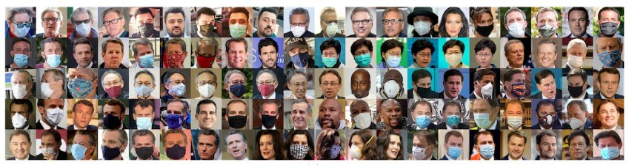
Dataset
We made our own dataset by collecting the pictures of different celebrities wearing mask .
Our final dataset contains images of 97 people.

Slide 4
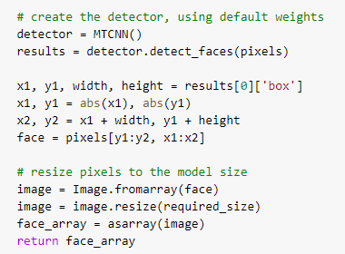
AppRoach
We used Google Colab for training.
MTCNN: We used Multi-task Cascaded Convolutional Neural Networks for detecting faces from the photos.

Slide 5
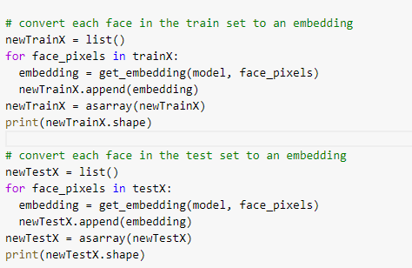
APPROACH
FaceNet: We used FaceNet to extract the features of a face. The FaceNet is used to extract high-quality features from faces, called face embeddings, that can then be used to train a face identification system.
We used SVM with linear kernel for Classification.

Slide 6
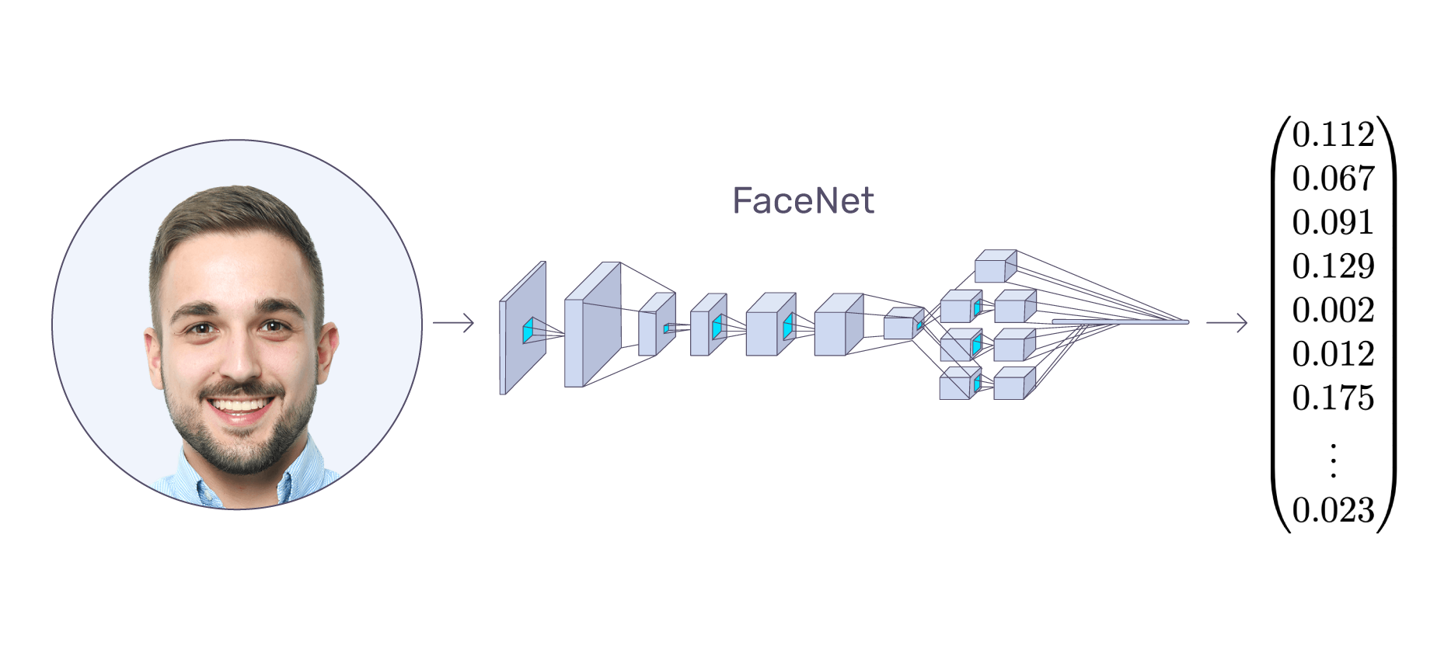
FaceNet:

Slide 7
Facenet
A face embedding is a vector that represents the features extracted from the face.
FaceNet takes a person’s face and compresses it into a vector of 128 numbers which represent the most important features of a face.
This embedded vector be compared with the vectors generated for other masked faces.

Slide 8
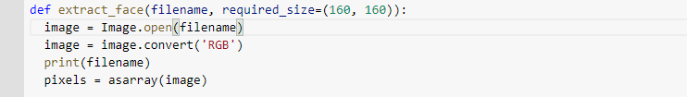
Data manipulation
Keras FaceNet pre-trained model expects square color size as input with the shape of 160*160.
We used PIL library to resize the image of the face to the required size 160*160.

Slide 9

Data manipulation
Sometimes MTCNN face detector returns a negative pixel index, we solved this by taking the absolute value of the coordinates.

Slide 10
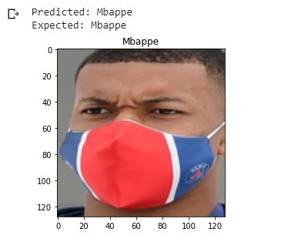
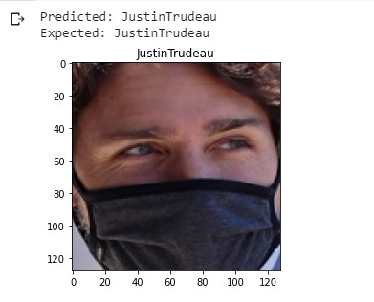
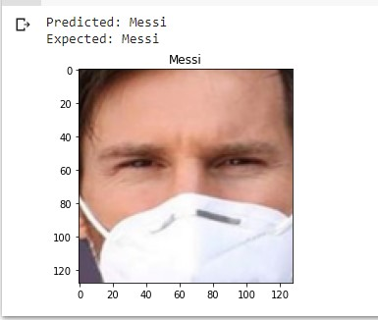
RESULT
The test accuracy is around 89.583 %.

Slide 11
Future work
Our main problem is, we worked on a small dataset , in future we will try to take an existing face dataset and mask the faces using OpenCv.
We will try to use other classifiers like Softmax classifier instead of the SVM to see how it would work on masked face dataset.

Slide 12
Learning Curve
We learned how FaceNet extract the important features from the masked face.
How MTCNN can detect face from an image.
How face embeddings can be used to distinguish different person identity.
Using cloud tools like Google Colab to train deep learning models.

Slide 13
Thank you

