Slide 1
Project : Bridge Between Investor And Business People
Using Web Development
Project Structure
project/
│── index.html (Home page)
│── investor.html (Investor form & list)
│── business.html (Business form & list)
│── style.css (Styling)
│── app.js (Firebase + Logic)
│── firebase-config.js (Your Firebase config)

Slide 2
🔹 index.html (Landing Page)
<!DOCTYPE html>
<html lang="en">
<head>
<meta charset="UTF-8">
<meta name="viewport" content="width=device-width, initial-scale=1.0">
<title>Bridge Between Investor & Business People</title>
<link rel="stylesheet" href="style.css">
</head>
<body>
<header>
<h1>Bridge Between Investors & Entrepreneurs</h1>
<nav>
<a href="investor.html">For Investors</a>
<a href="business.html">For Business People</a>
</nav>
</header>

Slide 3
<main>
<section>
<h2>About the Platform</h2>
<p>
This platform connects investors with entrepreneurs.
Investors can find great business ideas, while business owners
can attract the right investment for their ventures.
</p>
</section>
</main>
<footer>
<p>© 2025 Bridge Platform | All Rights Reserved</p>
</footer>
</body>
</html>

Slide 4
🔹 investor.html
<!DOCTYPE html>
<html lang="en">
<head>
<meta charset="UTF-8">
<meta name="viewport" content="width=device-width, initial-scale=1.0">
<title>Investor Form</title>
<link rel="stylesheet" href="style.css">
</head>
<body>
<header>
<h1>Investor Registration</h1>
<a href="index.html">⬅ Back</a>
</header>

Slide 5
<main>
<form id="investorForm">
<input type="text" id="name" placeholder="Full Name" required>
<input type="email" id="email" placeholder="Email" required>
<input type="text" id="investment" placeholder="Investment Amount" required>
<button type="submit">Register</button>
</form>
<h2>Available Business Ideas</h2>
<ul id="businessList"></ul>
</main>
<script src="firebase-config.js"></script>
<script src="app.js"></script>
</body>
</html>

Slide 6
🔹 business.html
<!DOCTYPE html>
<html lang="en">
<head>
<meta charset="UTF-8">
<meta name="viewport" content="width=device-width, initial-scale=1.0">
<title>Business Registration</title>
<link rel="stylesheet" href="style.css">
</head>
<body>
<header>
<h1>Entrepreneur Registration</h1>
<a href="index.html">⬅ Back</a>
</header>

Slide 7
<main>
<form id="businessForm">
<input type="text" id="bname" placeholder="Business Name" required>
<input type="email" id="bemail" placeholder="Email" required>
<textarea id="idea" placeholder="Business Idea" required></textarea>
<button type="submit">Submit</button>
</form>
<h2>Interested Investors</h2>
<ul id="investorList"></ul>
</main>
<script src="firebase-config.js"></script>
<script src="app.js"></script>
</body>
</html>

Slide 8
🔹 style.css
body {
font-family: Arial, sans-serif;
margin: 0; padding: 0;
background: #f9f9f9;
color: #333;
}
header {
background: #222;
color: white;
padding: 15px;
text-align: center;
}
header a {
color: yellow;
margin-left: 15px;
text-decoration: none;
}

Slide 9
form {
display: flex;
flex-direction: column;
max-width: 400px;
margin: 20px auto;
background: white;
padding: 20px;
border-radius: 10px;
box-shadow: 0 2px 6px rgba(0,0,0,0.1);
}
form input, form textarea, form button {
margin: 10px 0;
padding: 10px;
border-radius: 6px;
border: 1px solid #ccc;
}
button {
background: #007bff;
color: white;
border: none;
cursor: pointer;
}

Slide 10
button:hover {
background: #0056b3;
}
ul {
max-width: 500px;
margin: 20px auto;
padding: 0;
list-style: none;
}
ul li {
background: #fff;
margin: 8px 0;
padding: 10px;
border-radius: 6px;
box-shadow: 0 1px 4px rgba(0,0,0,0.1);
}

Slide 11
🔹 firebase-config.js
// Replace with your Firebase config
const firebaseConfig = {
apiKey: "YOUR_API_KEY",
authDomain: "YOUR_APP.firebaseapp.com",
projectId: "YOUR_PROJECT_ID",
storageBucket: "YOUR_APP.appspot.com",
messagingSenderId: "YOUR_SENDER_ID",
appId: "YOUR_APP_ID",
databaseURL: "https://YOUR_PROJECT.firebaseio.com"
};
// Initialize Firebase
firebase.initializeApp(firebaseConfig);
const db = firebase.firestore();

Slide 12
🔹 app.js
// ============ Investor Form ==============
const investorForm = document.getElementById("investorForm");
if (investorForm) {
investorForm.addEventListener("submit", async (e) => {
e.preventDefault();
const name = document.getElementById("name").value;
const email = document.getElementById("email").value;
const investment = document.getElementById("investment").value;
await db.collection("investors").add({ name, email, investment });
alert("Investor Registered Successfully!");
investorForm.reset();
});
// Load Business Ideas
db.collection("businesses").onSnapshot(snapshot => {
const list = document.getElementById("businessList");
list.innerHTML = "";
snapshot.forEach(doc => {
const data = doc.data();
list.innerHTML += `<li><strong>${data.bname}</strong>: ${data.idea} <br> Contact: ${data.bemail}</li>`;
});
});
}

Slide 13
// ============ Business Form ==============
const businessForm = document.getElementById("businessForm");
if (businessForm) {
businessForm.addEventListener("submit", async (e) => {
e.preventDefault();
const bname = document.getElementById("bname").value;
const bemail = document.getElementById("bemail").value;
const idea = document.getElementById("idea").value;
await db.collection("businesses").add({ bname, bemail, idea });
alert("Business Idea Submitted!");
businessForm.reset();
});
// Load Investors
db.collection("investors").onSnapshot(snapshot => {
const list = document.getElementById("investorList");
list.innerHTML = "";
snapshot.forEach(doc => {
const data = doc.data();
list.innerHTML += `<li><strong>${data.name}</strong> wants to invest ${data.investment} <br> Contact: ${data.email}</li>`;
});
});
}

Slide 14
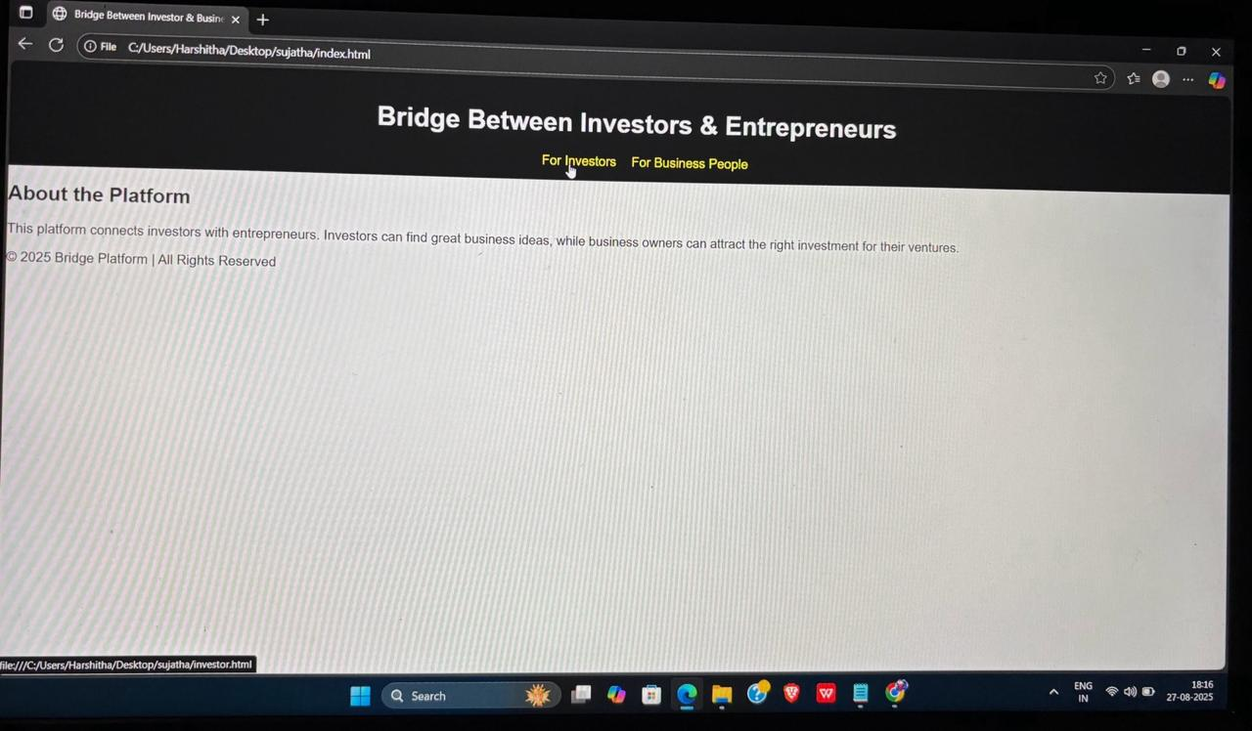
output

Slide 15
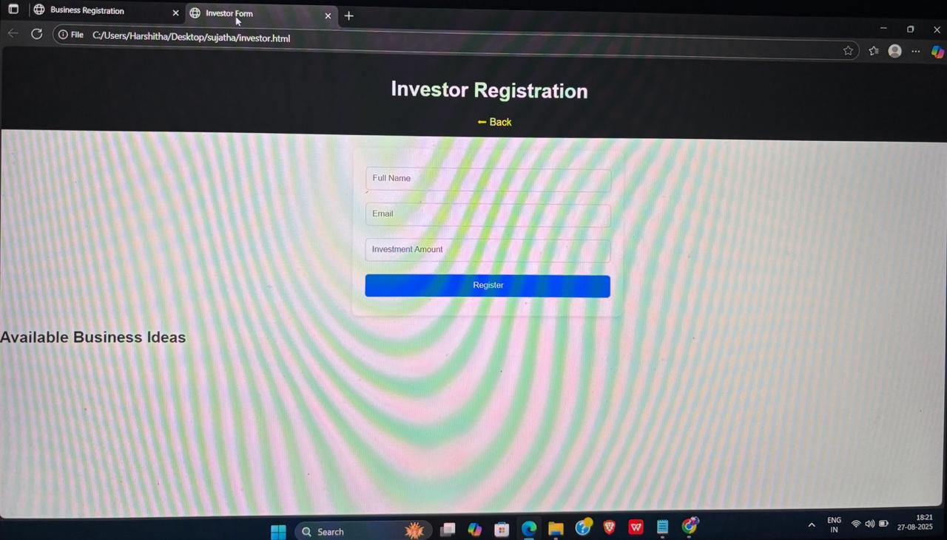

Slide 16
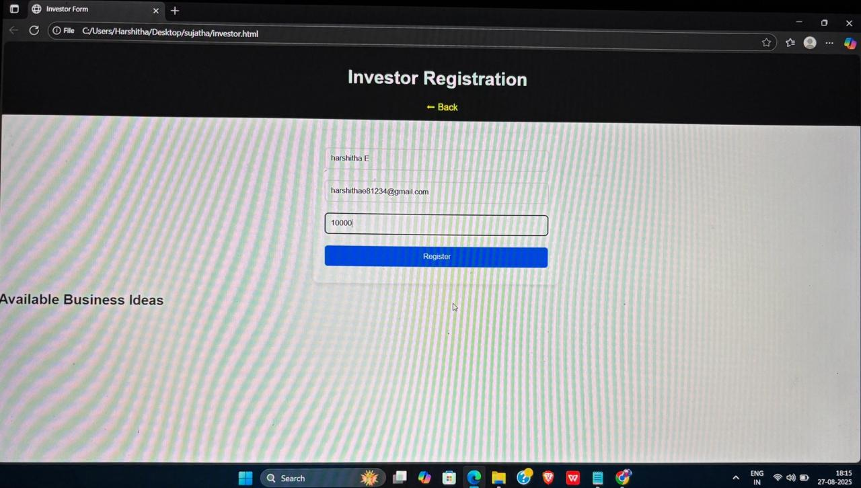

Slide 17
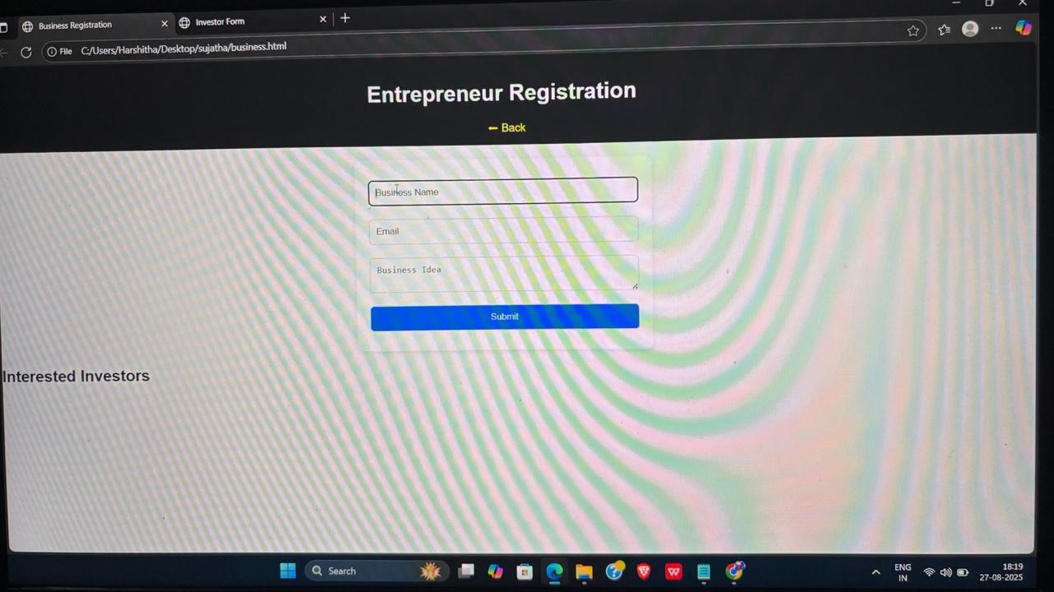

Slide 18
