Slide 1
Project : Sports Buddy Using Web
Development
Sports Buddy Project Code (Web Version)
<!DOCTYPE html>
<html lang="en">
<head>
<meta charset="UTF-8">
<meta name="viewport" content="width=device-width, initial-scale=1.0">
<title>Sports Buddy</title>
<link rel="stylesheet" href="styles.css">
<script type="module" src="app.js" defer></script>
</head>
<body>
<header>
<h1>Sports Buddy</h1>
<nav>
<button id="showLogin">Login</button>
<button id="showRegister">Register</button>
<button id="logout" style="display:none;">Logout</button>
</nav>
</header>

Slide 2
<main>
<!-- Register -->
<section id="registerSection" class="hidden">
<h2>Register</h2>
<form id="registerForm">
<input type="email" id="regEmail" placeholder="Email" required>
<input type="password" id="regPassword" placeholder="Password" required>
<button type="submit">Register</button>
</form>
</section>
<!-- Login -->
<section id="loginSection" class="hidden">
<h2>Login</h2>
<form id="loginForm">
<input type="email" id="loginEmail" placeholder="Email" required>
<input type="password" id="loginPassword" placeholder="Password" required>
<button type="submit">Login</button>
</form>
</section>

Slide 3
<!-- Dashboard -->
<section id="dashboard" class="hidden">
<h2>Welcome to Sports Buddy</h2>
<div id="userActions">
<h3>Add Sports Event</h3>
<form id="eventForm">
<input type="text" id="sportName" placeholder="Sport Name" required>
<input type="text" id="city" placeholder="City" required>
<input type="datetime-local" id="eventTime" required>
<button type="submit">Add Event</button>
</form>
<h3>Your Events</h3>
<ul id="eventList"></ul>
</div>
</section>
</main>
</body>
</html>

Slide 4
CSS (styles.css)
body {
font-family: Arial, sans-serif;
margin: 0;
background: #f4f6f8;
}
header {
background: #222;
color: white;
padding: 15px;
display: flex;
justify-content: space-between;
}
nav button {
margin-left: 10px;
padding: 8px 14px;
border: none;
border-radius: 5px;
background: #007bff;
color: white;
cursor: pointer;
}

Slide 5
.hidden {
display: none;
}
main {
padding: 20px;
}
form {
margin: 10px 0;
}
input, button {
padding: 10px;
margin: 5px 0;
width: 100%;
}
#eventList li {
background: #fff;
margin: 8px 0;
padding: 10px;
border-radius: 5px;
display: flex;
justify-content: space-between;
}

Slide 6
JavaScript (app.js)
// Import Firebase
import { initializeApp } from "https://www.gstatic.com/firebasejs/10.7.1/firebase-app.js";
import { getAuth, createUserWithEmailAndPassword, signInWithEmailAndPassword, signOut } from
"https://www.gstatic.com/firebasejs/10.7.1/firebase-auth.js";
import { getFirestore, collection, addDoc, getDocs, deleteDoc, doc } from "https://www.gstatic.com/firebasejs/
10.7.1/firebase-firestore.js";
// Firebase Config (replace with your own Firebase credentials)
const firebaseConfig = {
apiKey: "YOUR_API_KEY",
authDomain: "YOUR_PROJECT.firebaseapp.com",
projectId: "YOUR_PROJECT_ID",
storageBucket: "YOUR_PROJECT.appspot.com",
messagingSenderId: "XXXXXXX",
appId: "YOUR_APP_ID"
};
// Init Firebase
const app = initializeApp(firebaseConfig);
const auth = getAuth(app);
const db = getFirestore(app);

Slide 7
// UI Elements
const registerSection = document.getElementById("registerSection");
const loginSection = document.getElementById("loginSection");
const dashboard = document.getElementById("dashboard");
document.getElementById("showRegister").onclick = () => {
registerSection.classList.remove("hidden");
loginSection.classList.add("hidden");
};
Document.getElementById("showLogin").onclick = () => {
loginSection.classList.remove("hidden");
registerSection.classList.add("hidden");
};

Slide 8
// Register
document.getElementById("registerForm").addEventListener("submit", async (e) => {
e.preventDefault();
const email = document.getElementById("regEmail").value;
const password = document.getElementById("regPassword").value;
try {
await createUserWithEmailAndPassword(auth, email, password);
alert("Registration Successful!");
registerSection.classList.add("hidden");
dashboard.classList.remove("hidden");
} catch (err) {
alert(err.message);
}
});

Slide 9
// Login
document.getElementById("loginForm").addEventListener("submit", async (e) => {
e.preventDefault();
const email = document.getElementById("loginEmail").value;
const password = document.getElementById("loginPassword").value;
try {
await signInWithEmailAndPassword(auth, email, password);
alert("Login Successful!");
loginSection.classList.add("hidden");
dashboard.classList.remove("hidden");
loadEvents();
} catch (err) {
alert(err.message);
}
});

Slide 10
// Logout
document.getElementById("logout").onclick = async () => {
await signOut(auth);
dashboard.classList.add("hidden");
loginSection.classList.remove("hidden");
};
// Add Event
document.getElementById("eventForm").addEventListener("submit", async (e) => {
e.preventDefault();
const sportName = document.getElementById("sportName").value;
const city = document.getElementById("city").value;
const eventTime = document.getElementById("eventTime").value;
try {
await addDoc(collection(db, "events"), { sportName, city, eventTime });
alert("Event Added!");
loadEvents();
} catch (err) {
alert(err.message);
}
});

Slide 11
// Load Events
async function loadEvents() {
const eventList = document.getElementById("eventList");
eventList.innerHTML = "";
const querySnapshot = await getDocs(collection(db, "events"));
querySnapshot.forEach((docSnap) => {
const li = document.createElement("li");
li.textContent = `${docSnap.data().sportName} in ${docSnap.data().city} at ${docSnap.data().eventTime}`;
// Delete Button
const delBtn = document.createElement("button");
delBtn.textContent = "Delete";
delBtn.onclick = async () => {
await deleteDoc(doc(db, "events", docSnap.id));
loadEvents();
};
li.appendChild(delBtn);
eventList.appendChild(li);
});
}

Slide 12
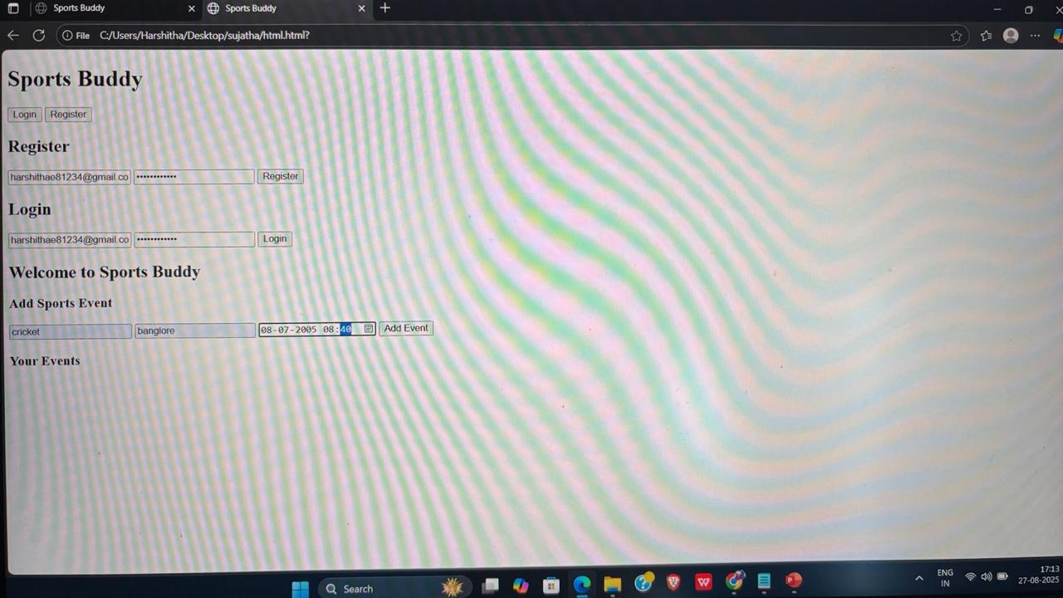
output

