Slide 1
Unit 4 Writing

Slide 2
Writing tasks
Write the first draft:
a. Write on the topic “My favorite restaurant”.
b. Focus on the reasons why this is your favorite restaurant.
c. Write an introductory paragraph, a concluding paragraph and three body paragraphs.
d. Put different reasons in different body paragraphs.
e. Make an outline before you write the essay.
· Introductory paragraph
· Body paragraphs
Body paragraph 1 (Reason 1: explanation; examples)
Body paragraph 2 (Reason 2: explanation; examples)
Body paragraph 3 (Reason 3: explanation; examples)
· Concluding paragraph

Slide 3
General patten of an essay
General statements (backgroud/hook)
Thesis statement (your main idea)
Introductory paragraph
Body paragraphs
Body paragraph 1 (Reason 1: explanation; examples)
Body paragraph 2 (Reason 2: explanation; examples)
Body paragraph 3 (Reason 3: explanation; examples)
Concluding paragraph
(restatement or summary of the main points; final comment)

Slide 4
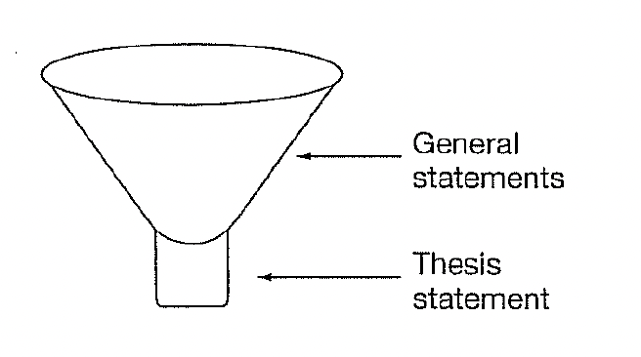
Introductory paragraph
Funnel introduction
General information/overall comments of topic
As a lead-in to attract readers’ attention.
Narrow down and state the specific topic

Slide 5
Introduction: general statement(s)
1. As a local resident of Hong Kong, I have tried lots of foods in different restaurants from different countries and regions.
2. Studying and living in Guangzhou, an international city, we have a variety of choice when it comes to different restaurants which provide us with a diverse range of dishes, from local cuisine to exotic food.

Slide 6
Introduction: thesis statement
However, my favorite restaurant is the Cheesecake Factory.
Among all the choices, the one that I like the most is…
- You can also consider listing subdivisions of the main topic to better inform your readers about the overall structure of your essay
There are three reasons why I am so keen of this resteraunt: they not only provide you with their excellent service, but they also offer a variety of food and drinks.
My preference for this resteraunt lies in both the excellent service they provide and the variety of food they offer.

Slide 7
Body paragraph
Topic sentence
Explanation
Examples
(Concluding sentence)
A topic sentence should be the main idea of a paragraph, and it should be put at the beginning of a paragraph
In our case, the topic sentence should be…?

Slide 8
Is this a good body paragraph?
The Cheesecake Factory is an American restaurant that mainly serves steak, burgers, linguine and cheesecakes of course. When I had the meal at the Cheesecake Factory for the first time, I was really surprised at the quantity of their dishes. However, what really impressed me was their excellent service. You can hardly notice customers raise their hands to ask for services, since the waiters or waitresses are told to serve the customers wholeheartedly and required to respond to customers’ needs voluntarily.

Slide 9
Body paragraph 1
What impressed me at the Cheesecake Factory was their excellent service (topic sentence). You can hardly notice customers raise their hands to ask for services, since the waiters or waitresses are told to serve the customers wholeheartedly and (are) required to respond to customers’ needs voluntarily (example).
The first reason why I like this restaurant so much is their great service (topic sentence). Whenever you raise your hand to ask for services, they will always respond to your needs immediately (example 1). Moreover, you can always see a big smile on their face when they talk to you (example 2). Their kind attitude always cheers me up, making me want to visit the place again and again (concluding sentence).

Slide 10
Connecting body paragraphs
Body Paragraph 2:
Moreover, Cheesecake Factory offers customers different tastes of steak, like rare, medium, and well-done. Every time I eat there with my friends, I don't have to worry about their different preferences.
Body paragraph 3:
In addition, the beverages at Cheesecake Factory are also a significant bonus for customers. You can enjoy different kinds of classic cocktails, such as Long Island, Mojito, Martini, and Margarita. I don't drink, but I like the marvelous bartending show by the skillful bartenders.

Slide 11
Concluding paragraph
Summarize the previous paragraphs/call for action
If you wish to enjoy the classic Western beverages, foods, and desserts, go to the Cheesecake Factory in Hong Kong. There they offer you the best service at affordable prices.
Cheesecake Factory is such a wonderful resteruant where you can get to taste a wide range of high-qualitied foods (2rd reason). Their great service also makes them a must-go place on your list (1st reason). Therefore, I highly recommend you go visit the place sometime in the future (suggestion)

