Slide 1
Tuberculosis Data Science Project
Michael Harris
June 28, 2018

Slide 2
What is your Problem AND WhO IS ThE end User?
TB is the ninth leading cause of death worldwide and the leading cause from a single infectious agent, ranking above HIV/AIDS. In 2016, there were an estimated 1.3 million TB deaths among HIV-negative people (down from 1.7 million in 2000) and an additional 374 000 deaths among HIV-positive people. An estimated 10.4 million people fell ill with TB in 2016: 90% were adults, 65% were male, 10% were people living with HIV (74% in Africa) and 56% were in five countries: India, Indonesia, China, the Philippines and Pakistan.
Diagnosis difficult and slow
Limited therapeutic options
World Health Organization TB Report 2017

Slide 3


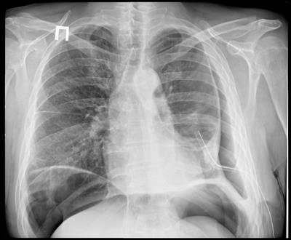
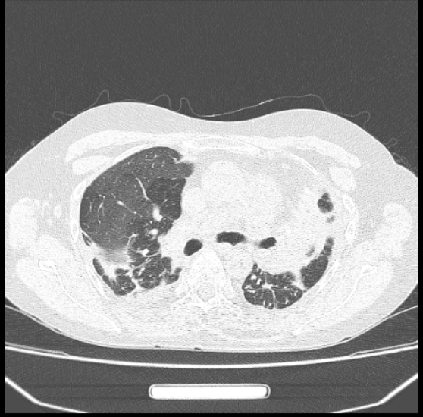
TB Portals DATASET
1200+ TB patient cases in database
75% MDR or XDR-TB, 9 countries
Clinical data
Patient information
DST results
Outcome
Treatment history
Comorbidities
Mtb genomic data
890+ whole genome sequences
Lineage classification
Drug-resistance conferring SNPs
Imaging data
1000+ chest X-ray and CT images
Radiologist annotations
ACGCTGGCTCGAGATTGAGCGAGGCGAGATC…
1200+ TB patient cases in database
75% MDR or XDR-TB, 9 countries
1200+ TB patient cases in database
75% MDR or XDR-TB, 9 countries
Cases include:
ACGCTGGCTCGAGATTGAGCGAGGCGAGATC…
Cases include:
ACGCTGGCTCGAGATTGAGCGAGGCGAGATC…
Clinical data
Patient information
DST results
Outcome
Treatment history
Comorbidities
Mtb genomic data
650+ whole genome sequences
Lineage classification
Drug-resistance conferring SNPs
Imaging data
1000+ chest X-ray and CT images
Radiologist annotations
Clinical data
Patient information
DST results
Outcome
Treatment history
Comorbidities
Mtb genomic data
650+ whole genome sequences
Lineage classification
Drug-resistance conferring SNPs
Imaging data
1000+ chest X-ray and CT images
Radiologist annotations

Slide 4
Research QUESTIONS
Can patient outcome be predicted using TB Portals data (clinical + genomic)?
What are the relationships between genomic SNPs causing drug resistance?
What is the minimum set of genomic SNPs needed to predict drug resistance? (feature selection)
Are there clusters or subgroups of patients with different disease characteristics?

Slide 5
Challenges
Large multi-faceted dataset; many possible questions
Real-world clinical data; missing and incomplete data
Time

Slide 6
Plan of Action
Data Wrangling, Exploration, Visualization : June, early July
Predictive Models and Clustering: mid July - August

