Slide 1

NHSC Breaches in Compliance Ellie Park
What is the NHSC?
What is a breach in compliance?
Project goal
Who care?
Project Specifics
Data exploration

Slide 2

What is the National Health Service Corps?
National Health Service Corps (NHSC)
Health Providers (doctors, nurses, dentists, etc.)
Loan repayment or scholarship
Serve in a high need area for a set number of years
Budget: $310 Million
Currently over 10,000 recipients in service
Program Requirements
Must serve continuously for the set number of years
May change sites
May take a suspension
If not on duty or on a suspension, in breach of contract

Slide 3
What is a breach in contract?
Breach in Contract:
How it can end:
Break in service, anytime that a participant is not working at an approved site or on an approved suspension. Reasons: lost job, moved to an unapproved site, lost license, etc.
Return to compliance
Go work at approved site
Suspension: Maternity, Active Military, or Medical
Fail to return to compliance
Default: Repay the award plus penalties
Waiver: Contract compliance is impossible

Slide 4
Project Goal
Gain a basic understanding of contract breaches in the NHSC. Answer fundamental questions about who is breaching their contract, how frequently these breaches occur
Descriptive Analysis
How frequently do providers breach their contracts?
How long do these gaps in compliance typically last?
How do gaps in compliance end?
Cluster Analysis
Form groups of participants who are breaching their contracts – unsupervised learning
Are there patterns?

Slide 5

Who cares?
Why this matters:
We know very little currently.
Prevention of future breaches in contract
Who this matters to:
BHW: Division of Participant Support and Compliance
BHW: Division of External Affairs
BHW: Division of Business Operations
Anyone who works with contract compliance

Slide 6
Project Specifics
Datasets
Breaks
Site Assignments
Challenges
Messy data
Overly broad research question
Next Steps
Finish cleaning the data
Answer the pre-defined exploratory data questions
Defaults
Suspensions
General Participant Data
Job change
Perform cluster analysis
Present results to stakeholders

Slide 7
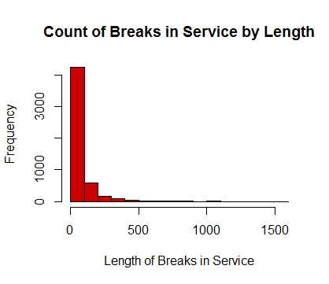
Exploratory Data Analysis
Mean of break length: 83.5
Median of break length: 62

