Slide 1
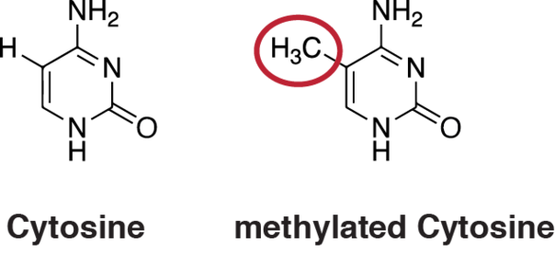
DNA Methylation
Faith Pangilinan
NHGRI/NIH
What is it?
A chemical ”mark” (A, C, G, T)
Heritable!
Why is it important?
Regulates gene expression – how much, which tissues
Important for cellular stability (cancer)
What can influence it?
Circulating folate
MTHFR 677C>T genotype

Slide 2

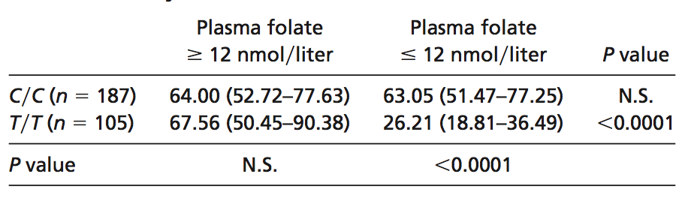
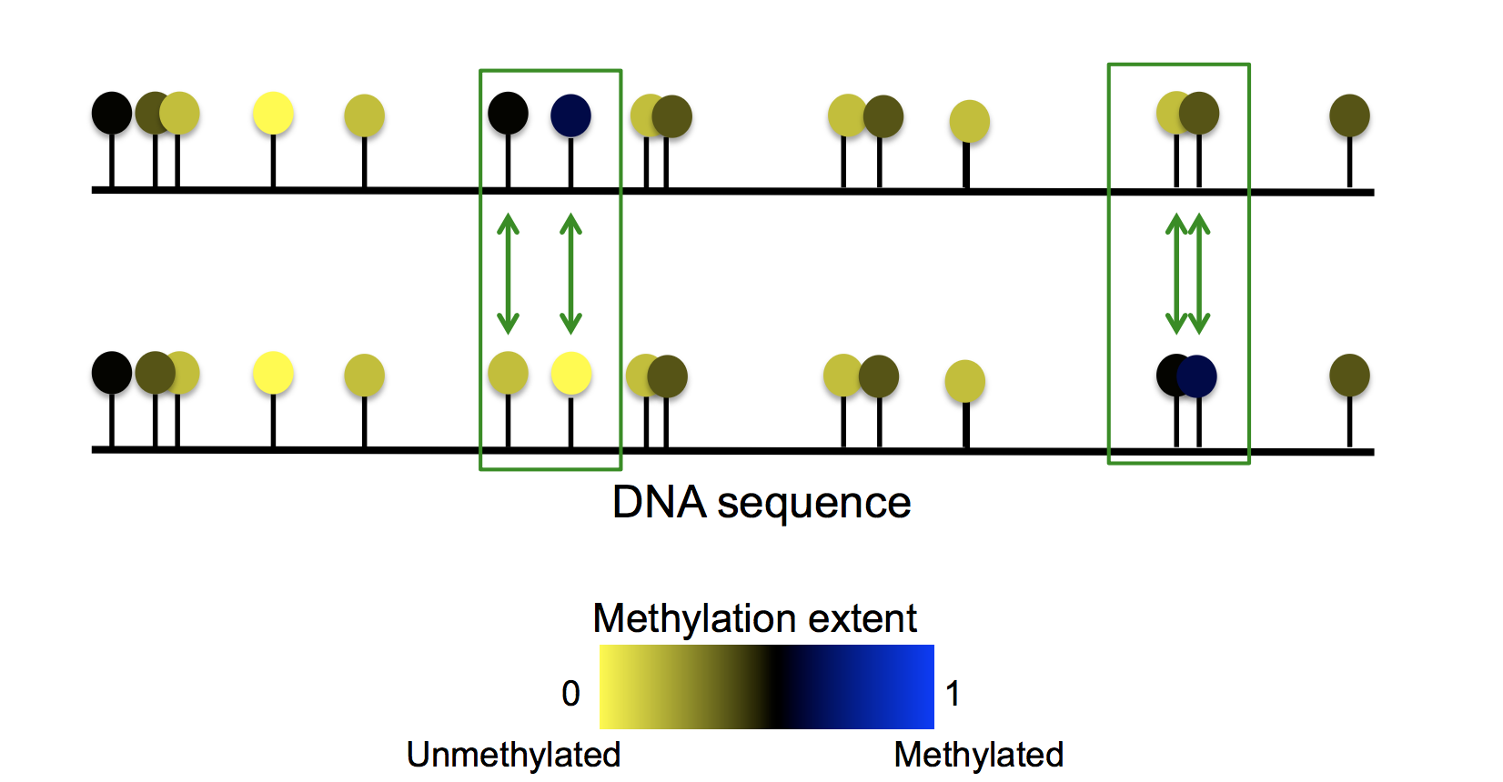
Influences on DNA Methylation
Globally:
Is it happening?
Table 2: Genomic DNA methylation status (ng mCyt/ug DNA)
Friso 2002
Locus-specific:
Where is it happening?
450,000 loci

Slide 3
Influences on DNA Methylation
Question: Do people with different MTHFR 667C>T genotype and folate status show differences in locus-specific DNA methylation levels?
 | High folate levels | Low folate levels
CC | n = 14 | n = 9 | 23 CC
TT | n = 13 | n = 8 | 21 TT
 | 27 High folate | 17 Low folate | 44 TOTAL
450K
loci

Slide 4
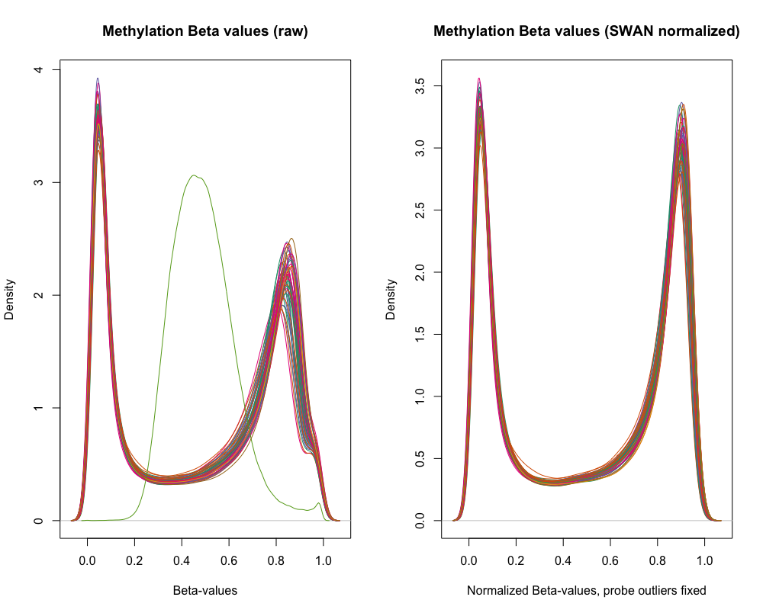
Data preparation and cleaning: generate β-values
44 participants (high/low folate & CC/TT genotype) x 450K methylation measures
R-packages: minfi, maxprobes

Slide 5
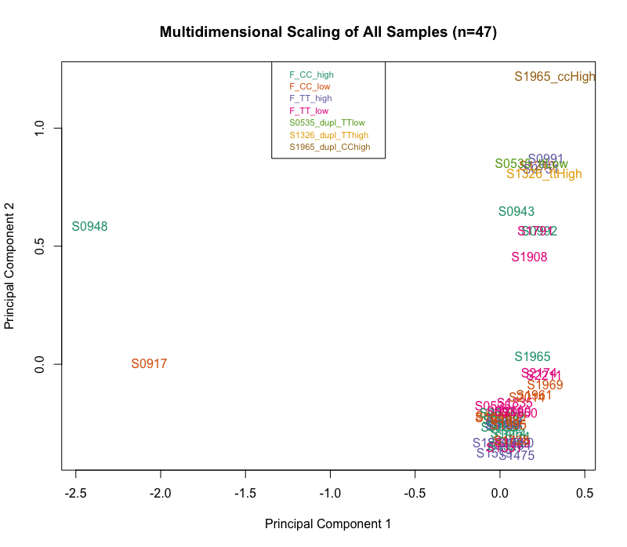
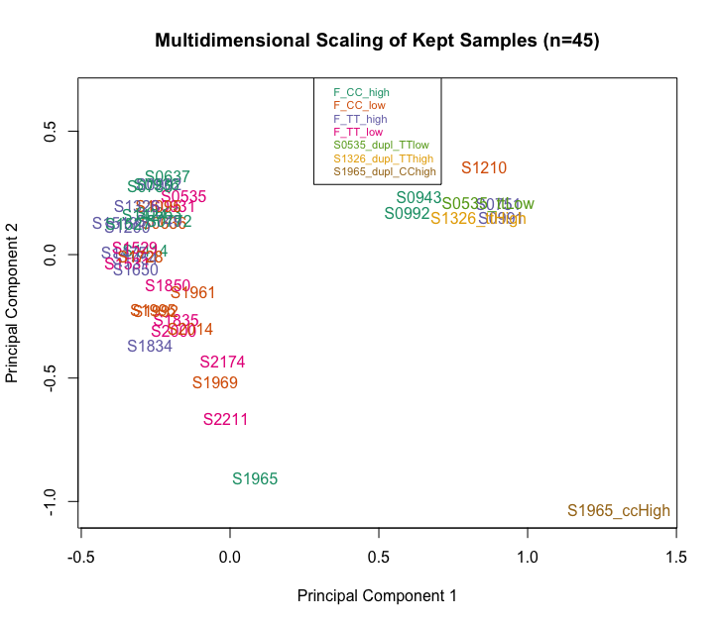
Data preparation and cleaning: Quality Control
PLOTS: PCA of beta-values for methylation loci in the top 5% of genes
Initial plot:
Exclude 2 outliers
Second plot:
Exclude additional outlier
Third plot:
Check duplicates
R-package: limma

Slide 6
Data preparation and cleaning: Batch effects
PLOTS: PCA of beta-values for methylation loci in the top 5% of genes
R-packages: limma, sva

Slide 7
Data Analysis
PCA First Look: Comparing the extremes
CC – high folate vs TT – low folate
FUTURE DIRECTIONS
Look for global differences between groups
PCA, heat map
Look for which methylation loci most differentiate genotype/folate status groups
Random Forest
Evaluate site-specific differences in methylation
R package: SVA
Look for influence of locus-specific methylation on gene expression
10 samples have transcriptome data
R-package: limma

