Slide 1
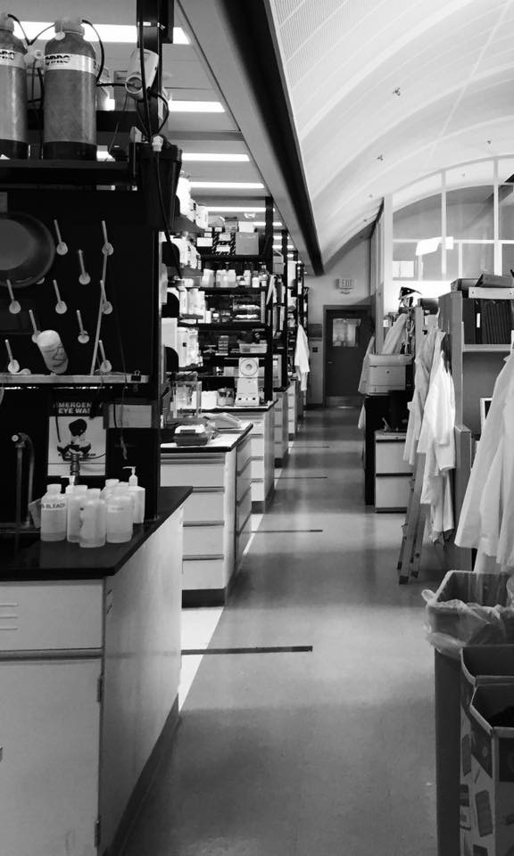
Midway Capstone Status DSCoLab 2018 Faith Pangilinan, Staff Scientist National Human Genome Research Institute National Institutes of Health

Slide 2
Folate / Vitamin B12 Metabolic Pathway
Diet
folates
deoxyuridylate
dUMP
dihydrofolate
MATa1
DHFR
purines
methionine
THF
TS
SAM
10-formyl THF
MTHFD1
TCII
B12
SAH
MS
5,10-methylene THF
SAHH
MTRR
homocysteine
MTHFR
thymidylate
dTMP
CBS
cystathionine
5- methyl THF
DNA
Methylation
Methylation
Reactions
DNA synthesis

Slide 3
Folate / Vitamin B12 Metabolic Pathway – the question
Diet
folates
deoxyuridylate
dUMP
dihydrofolate
MATa1
DHFR
purines
methionine
THF
TS
SAM
10-formyl THF
What about site-specific DNA methylation?
MTHFD1
TCII
B12
SAH
MS
5,10-methylene THF
SAHH
MTRR
rs1801133
CC
CT
TT
homocysteine
MTHFR
thymidylate
dTMP
CBS
(global)
cystathionine
5- methyl THF
DNA
Methylation
Methylation
Reactions
DNA synthesis

Slide 4
Folate / Vitamin B12 Metabolic Pathway – dataset description
36 participants
Diet
high or low
folates
deoxyuridylate
dUMP
dihydrofolate
MATa1
DHFR
purines
methionine
THF
TS
SAM
10-formyl THF
MTHFD1
TCII
B12
SAH
MS
5,10-methylene THF
SAHH
MTRR
rs1801133
CC
CT
TT
~450,000 DNA sites
measured for
methylation
(0 < beta < 1)
homocysteine
MTHFR
thymidylate
dTMP
CBS
cystathionine
5- methyl THF
DNA
Methylation
Methylation
Reactions
DNA synthesis

Slide 5
Is your approach supervised or unsupervised?
Preliminary analyses were performed by a predecessor
Unsupervised: PCA and Random Forest analyses

Slide 6
What challenges do you see?
Cleaning the data - a much bigger job than I initially anticipated!
Generation of beta values from raw data
minfi
Initial analyses – unsupervised methods
Subsequent analyses – more variables…

Slide 7
Folate / Vitamin B12 Metabolic Pathway – dataset description
36 participants
Diet
high or low
folates
deoxyuridylate
dUMP
dihydrofolate
MATa1
DHFR
purines
methionine
THF
TS
SAM
10-formyl THF
MTHFD1
GLOBAL GENE
EXPRESSION
TCII
B12
SAH
MS
5,10-methylene THF
SAHH
MTRR
rs1801133
CC
CT
TT
~450,000 DNA sites
measured for
methylation
(0 < beta < 1)
homocysteine
MTHFR
thymidylate
dTMP
CBS
cystathionine
5- methyl THF
DNA
Methylation
Methylation
Reactions
DNA synthesis

Slide 8
Plan of action
Data Cleaning
Process the raw datafiles to produce measures of site-specific DNA methylation
Learn minfi workflow (tutorial?)
minfi = R package to process raw iDAT files
signal normalization
normalize beta-value distribution
Exclude methylation sites that overlap with genetic variants (these interfere with the methylation signal)
Data Analysis
Use PCA, Random Forest to ask whether/how OCM affects site-specific DNA methylation

