Slide 1

FACTORS IMPACTING THE RATE OF RISK SCORE CHANGES OVER TIME COMPARING MEDICARE ADVANTAGE VS TRADITIONAL MEDICARE ENROLLEES
Jacquelyne T. Ivery MPH, RPH, PHARMD
Centers for Medicare & Medicaid Services Division of Encounter Data and Risk Adjustment Operations.
August 2, 2018

Slide 2
AGENDA
Problem and potential end user
Description of datasets
Variables of interest and predicted distribution
Supervised vs unsupervised approach
Target variable in a supervised study
Challenges experienced and steps to resolve
Plan of action - Gantt chart

Slide 3
DISCUSSION
Problems to resolve
Data used give counts and dates for pull
Data cleaning/prep/new variables
EDA findings – analysis
How EDA/problem determine modeling approach
TA assistance
New questions
Plans e.g. further modeling/how will findings support work/manager feedback

Slide 4
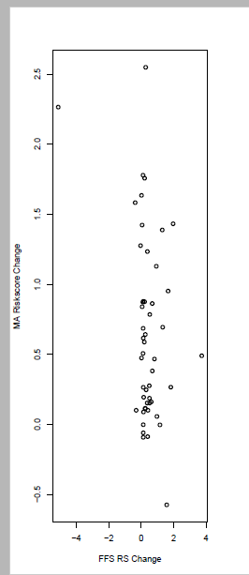
SCATTERPLOT
nearZeroVar
freqRatio percentUnique zeroVar nzv
mars_dif : 1 ( 96 FALSE FALSE )
ffs_dif : 3 ( 84 FALSE FALSE )

Slide 5
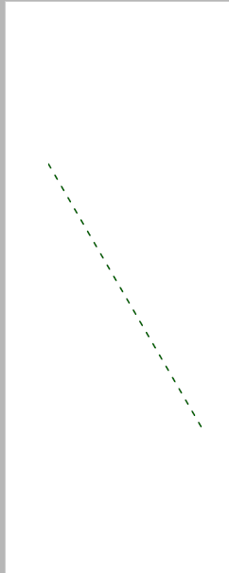
REGRESSION STATS
Residuals:
Min 1Q Median 3Q Max
-0.9968 -0.5032 -0.1066 0.5045 1.8674
Coefficients:
Estimate Std. Error t value Pr(>|t|)
(Intercept) 0.73671 0.09594 7.679 6.76e-10 ***
ffs_dif -0.19985 0.08508 -2.349 0.023 *
---
Signif. codes: 0 ‘***’ 0.001 ‘**’ 0.01 ‘*’ 0.05 ‘.’ 0.1 ‘ ’ 1
Residual standard error: 0.6316 on 48 degrees of freedom
Multiple R-squared: 0.1031, Adjusted R-squared: 0.08441
F-statistic: 5.517 on 1 and 48 DF, p-value: 0.02299

Slide 6
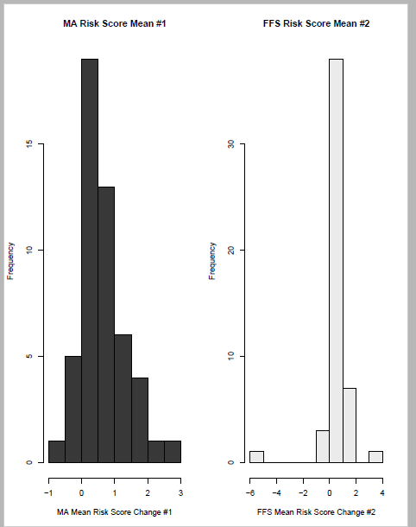
RISK SCORE CHANGE MEAN MA VS FFS

Slide 7
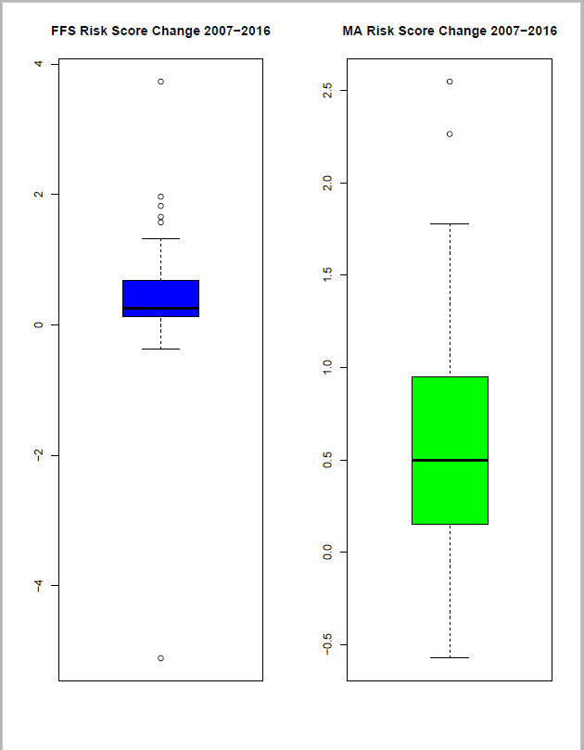
RISK SCORE CHANGE BOXPLOT MA vs FFS

Slide 8
NEXT STEPS
PCA – to focus on most efficient predictor variables
Regression analysis- supervised learning w/ Random Forest
Putting all components together in [R]

