Slide 1
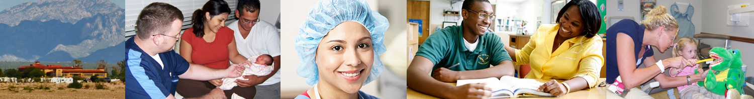

HHS CoLab Capstone Presentation HRSA’s CHGME Participants: Where are they?
July 31, 2018
Robin Streeter National Center for Health Workforce Analysis (NCHWA)
Bureau of Health Workforce (BHW)
Health Resources and Services Administration (HRSA)

Slide 2
HHS CoLab Capstone Project
Motivation: HRSA leadership seeks insight into whether HRSA-funded trainees practice in areas of geographic, economic, or medical vulnerability
Objective: Pilot a set of tools to examine the “where”
Children’s Hospitals Graduate Medical Education (CHGME) program
CHGME funding supports pediatric residencies
Capstone questions:
In what counties are AY 2016-2017 CHGME participants practicing?
What are the characteristics of populations in these counties?
Socio-economic characteristics
Provider-to-population ratios
HRSA designated shortage areas

Slide 3
Data Sources
HRSA: National Provider Identifiers (NPIs) for CHGME participants
n = 12,280 (Academic Year 2016 – 2017; approx. 85 percent complete)
CMS: Provider practice locations from National Plan and Provider Enumeration System (NPPES) [publicly available]
Provider level data (June 2018)
HRSA: Area Health Resources Files (AHRF) [publicly available]
County level data (2015)
Number of pediatricians, total population, population demographics
Create indicators of health care vulnerability
Additional data sets (Fall 2018)
American Medical Association: Physician Master File
IQVIA: OneKey (commercial dataset with health provider information)

Slide 4
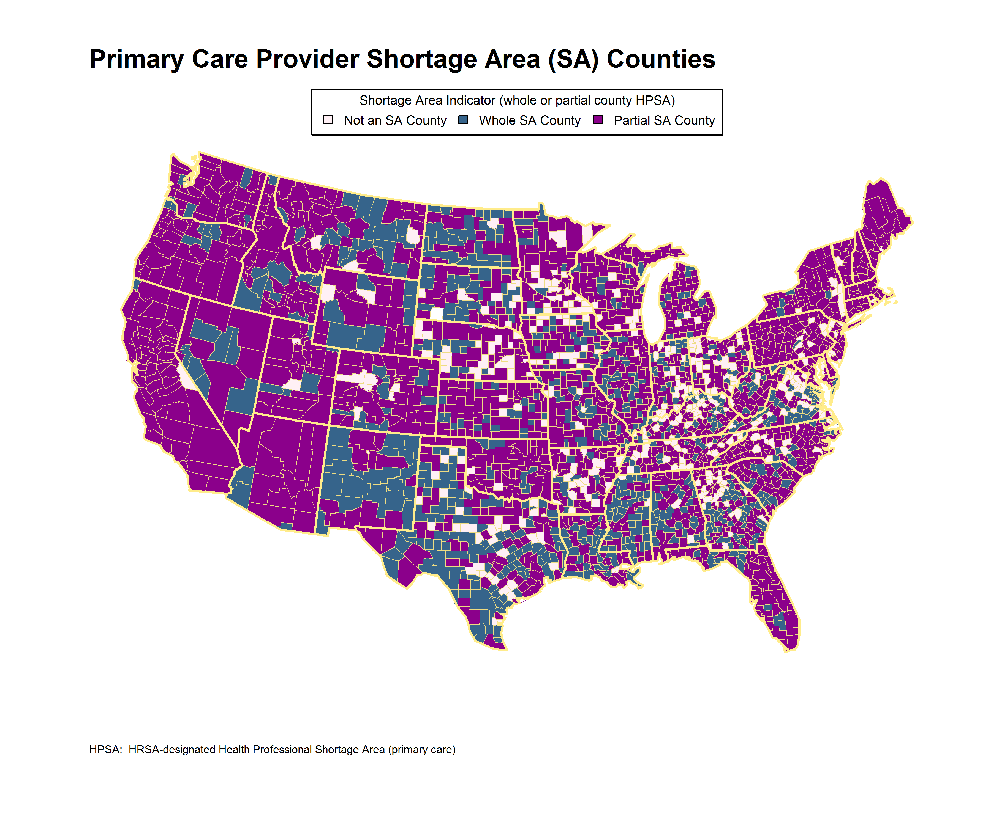
86 percent of counties are whole county or partial county primary care HPSAs Not shown: Alaska, Hawaii

Slide 5
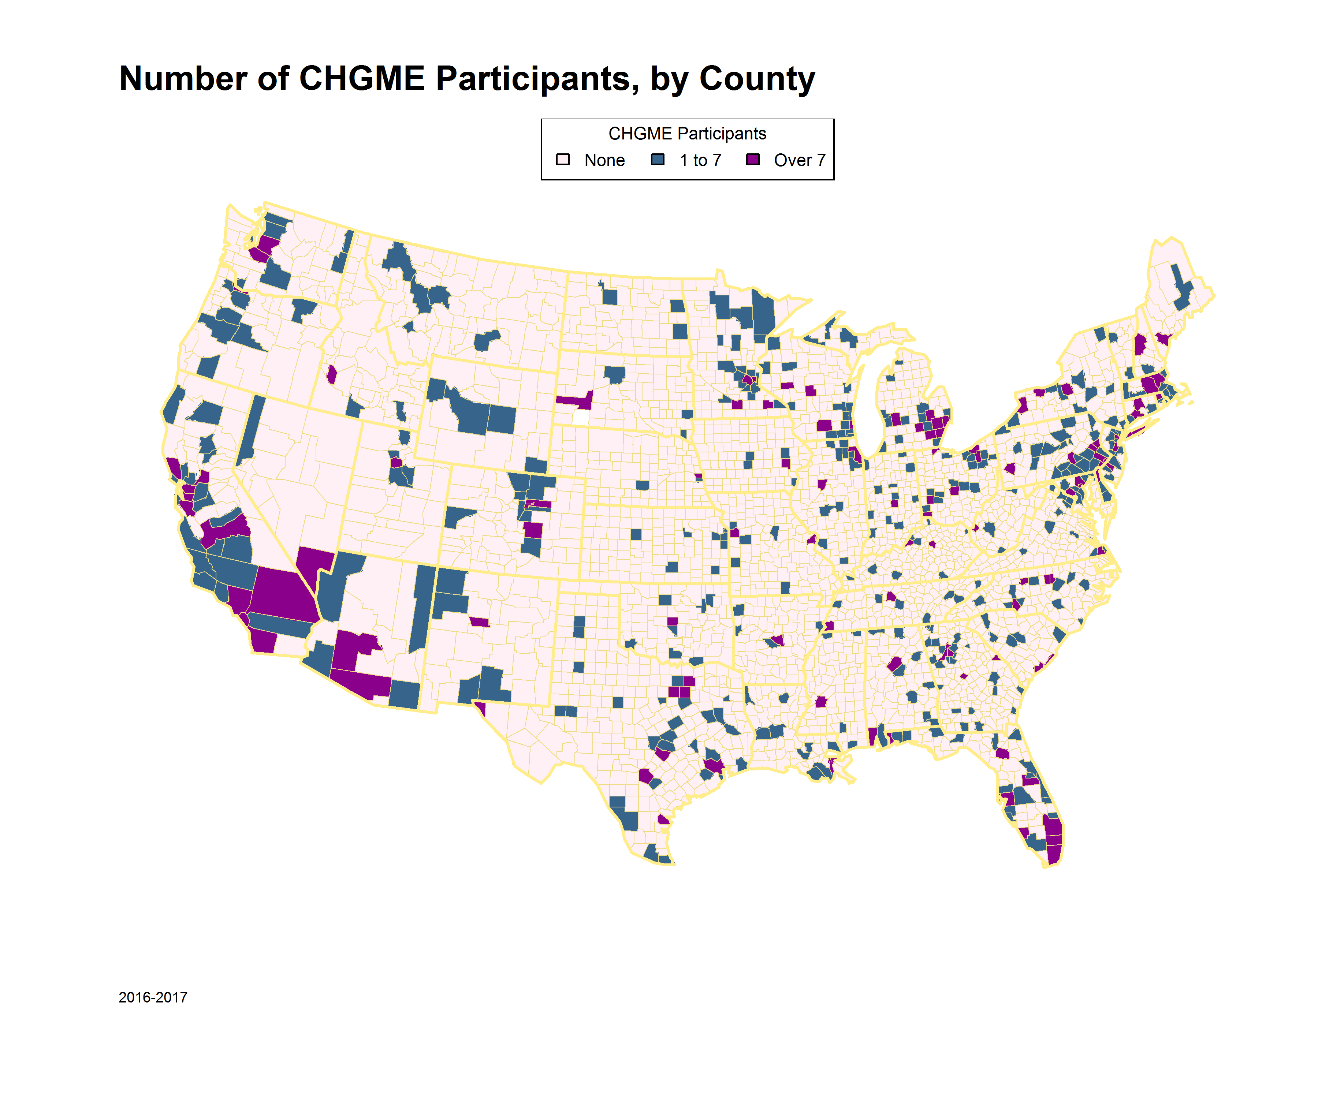
CHGME participants practice in 519 US counties, including Alaska and Hawaii (not shown)
Total US counties: 3,142

Slide 6
Preliminary findings (519 CHGME practice counties)
Vulnerability Characteristic | CHGME Practice Counties
Median household income < national household median | 60 %
Low employment indicator (ERS; < 65 % adults employed) | 10 %
SNAP enrollment > national county median | 47 %
Low education indicator (ERS; > 20 % adults lack high school diploma) | 8 %
Rurality (ERS; RUCA code = 7, 8, 9; small town or rural area) | 3 %
Diversity (majority minority counties; percent white < 50 %) | 8 %
Primary care HPSA (whole or partial county) | 86 %
Pediatricians:Medicaid-eligible children < national county median | 5 %
One or more vulnerability characteristic | 93 %
Challenges
Curse of dimensionality: Indicators reflect inter-related characteristics
Fix: Deeper dives with new coLab tools ☺
NPI data: Limited collection by HRSA; quality of reporting to NPPES
Fix: HRSA’s data collection is improving; link to other data sources to augment NPPES data
Geocoding: Incorrect or missing zip codes; non-unique geographies; appropriate unit of analysis
Fix: Refine geocoding; develop service area models

Slide 7
Next steps
Develop methods to examine care delivery areas by census tract
Link and characterize contiguous census tracts
Explore, using new tools:
Participant clustering, adjusting for underlying likelihood
Principal component analyses, using underlying measures (not indicators)
Decision trees
Expand to include AY 2017-2018 CHGME data when available
Include participant characteristics from HRSA and commercial datasets
Expand to other HRSA workforce programs
**************
Do these findings suggest different ways of identifying underserved areas or areas with vulnerable populations?
Classify county features to assess underserved areas and areas with vulnerable populations (older/younger, poorer, more ethnically/racially diverse, … )

