Slide 1
MASTER IN ICT FOR DEVELOPMENT AND SOCIAL GOOD • A.Y. 2025–2026
Mapping the EdTech Landscape in
Sub-Saharan Africa and MENA
Bridging Macro Assessment, the UNESCO 6-Pillars Framework, and Grassroots Realities
PROJECT PURPOSE (30-SECOND PITCH):
An open-access diagnostic observatory and decision rubric to prevent the misallocation of EdTech capital in the Global South by reconciling macro benchmarks (OECD PISA), open development APIs, and practitioner ground truth.
Candidate: Master Degree Candidate | Academic Reviewer: Prof. Elisa Bignante | UniTO · COREP · Impactskills
Notes:
[TIMING: 0:00 - 0:30 | 30 SECONDS]
PRESENTER SCRIPT:
"Good morning, Professor Bignante and colleagues. My Master's final project addresses a systemic flaw in international digital education: the tendency to transpose monolithic, high-income technology benchmarks onto low-resource environments. Over the next 10 minutes, I will present our problem diagnosis, theoretical framing, 3-tier triangulated methodology, our live dashboard, country artefact, and decision rubric."

Slide 2
1. STATE OF EDUCATION & TECHNOLOGY
Divergent Crises: Acute Foundational Scarcity in SSA vs. Saturation Without Pedagogy in MENA
Included VC & World Bank data show why monolithic global policies misdirect regional investments.
SUB-SAHARAN AFRICA: FOUNDATIONAL CRISIS
87% Learning Poverty Rate
Children unable to read simple text by age 10
<3% Global EdTech VC Share
Severe underfunding (Included VC analysis)
42% Rural Electrification
Fixed broadband stands at only 2.48% (median 0.56%)
MENA REGION: THE SATURATION PARADOX
100% Device Saturation
Universal electricity & near-100% internet access
Top Tier Student AI Drafting Adoption
High offloading to generative AI for schoolwork
>35% Teacher Guidance Deficit
School rules lag adoption -> leisure distraction
Master in ICT for Development and Social Good (UniTO / COREP) | Draft Presentation | Slide 2 of 14
Notes:
[TIMING: 0:30 - 1:30 | 60 SECONDS]
PRESENTER SCRIPT:
"In Sub-Saharan Africa, World Bank data reveals learning poverty at a staggering 87%—nearly 9 in 10 children cannot read a simple sentence by age 10. UNESCO estimates an acute deficit of 15 million qualified teachers by 2030. Yet, as Michelle Jideofor's analysis for Included VC highlights, less than 3% of global EdTech venture capital reaches Africa. Traditional Silicon Valley VC models fail because low household purchasing power and infrastructural hurdles require longer runways and infrastructure-level investment.
Conversely, our PISA 2025 dataset reveals the 'MENA Paradox'. In Gulf economies, electricity and devices are virtually 100% saturated. Students are among the highest global adopters of generative AI. Yet, there is a guidance deficit exceeding 35 percentage points: teachers are not trained to integrate AI, resulting in heavy leisure displacement and cognitive offloading."

Slide 3
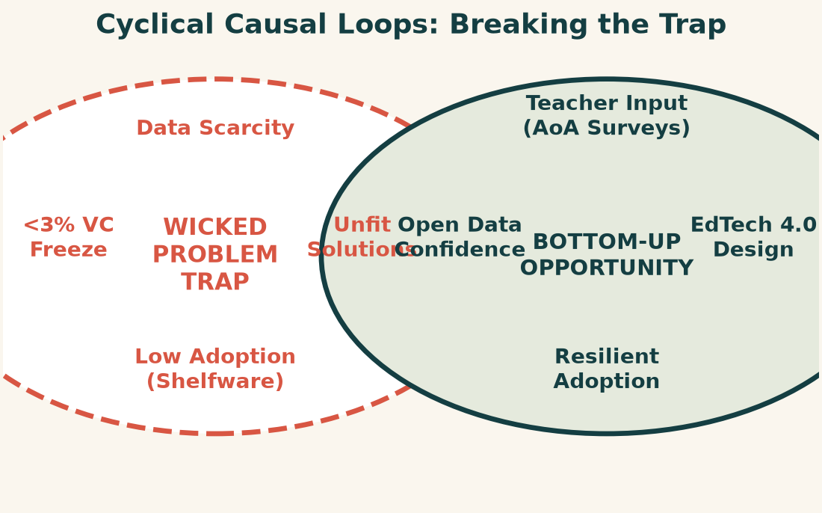
2. PROBLEM FRAMING
The Cyclical Causal Feedback Loop: Wicked Problem vs. Bottom-Up Opportunity
How structural data scarcity paralyzes EdTech design—and how participatory planning breaks the cycle.
STRATEGIC TAKEAWAY
Breaking the Trap
• The Wicked Trap: Data scarcity obscures classroom realities -> vendors build cloud SaaS -> solutions fail -> donors freeze capital.
• The Opportunity: Bottom-up planning centers teacher constraints and offline architectures before buying software.
• Our Contribution: Bridging macro open APIs with Alliance of Alliances (AoA) ground surveys to create actionable, data-informed investment roadmaps.
Master in ICT for Development and Social Good (UniTO / COREP) | Draft Presentation | Slide 3 of 14
Notes:
[TIMING: 1:30 - 2:30 | 60 SECONDS]
PRESENTER SCRIPT:
"On the left is the 'Wicked Problem Loop': Because developing educational systems suffer from severe data scarcity, international donors and startups build blind solutions—often importing high-bandwidth cloud software. These tools fail in off-grid classrooms. As tablets gather dust in locked cupboards, donors see zero return on investment, cementing skepticism and keeping venture funding below 3%.
However, on the right is the 'Bottom-Up Opportunity': When we anchor planning in participatory ground-truthing—such as the UNESCO Alliance of Alliances teacher surveys—we capture real constraints: intermittent power, shared mobile phones, and language barriers. This enables context-first design, creating resilient field adoption."

Slide 4
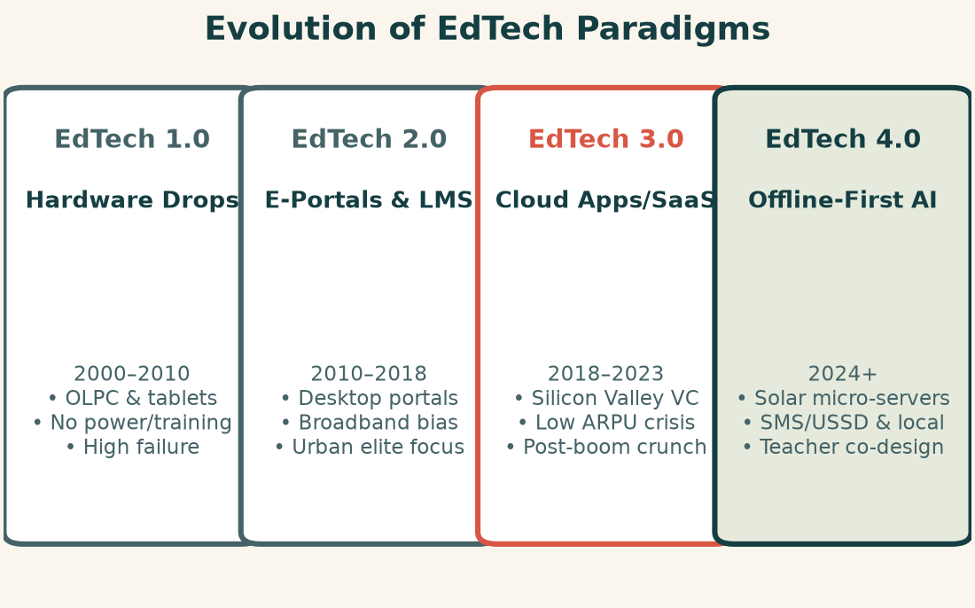
3. CONCEPTUAL EVOLUTION
Paradigm Shift: The Four Generations of Educational Technology to EdTech 4.0
Sustainable digital transformation requires shifting from top-down device distribution to human-centric, offline-first AI.
PARADIGM SHIFT
Defining EdTech 4.0
• Context-Aware Architecture: Designs for intermittent solar micro-grids, SMS channels, and local caching.
• Pedagogy Over Hardware: Treats teachers as co-designers, reversing the 20-year legacy of unused devices.
• Human-Centric AI: Leverages lightweight, localized AI for teacher assistance and differentiated instruction, avoiding unguided student offloading.
Master in ICT for Development and Social Good (UniTO / COREP) | Draft Presentation | Slide 4 of 14
Notes:
[TIMING: 2:30 - 3:30 | 60 SECONDS]
PRESENTER SCRIPT:
"To understand why so many EdTech interventions fail, we trace the four generations of educational technology:
EdTech 1.0 (2000–2010) was defined by 'Hardware Drops'—initiatives like One Laptop Per Child, distributed without electricity or teacher training.
EdTech 2.0 (2010–2018) brought E-Learning Portals and LMS platforms, assuming broadband that excluded rural schools.
EdTech 3.0 (2018–2023) brought the cloud and mobile app boom, but Silicon Valley SaaS models cannot survive on African ARPU levels.
We are now entering EdTech 4.0: Context-aware, hybrid, and human-centric. EdTech 4.0 uses offline-first caching, solar micro-servers, SMS channels, and local-language AI tutors to empower teachers."

Slide 5
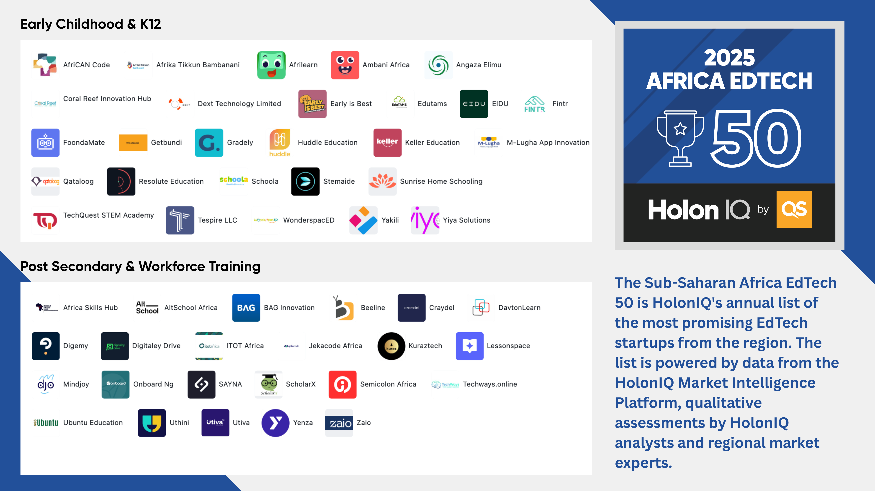
3. MARKET REALITY
HolonIQ 2025 Africa EdTech 50: Grounding Supply in Ecosystem Realities
Official market intelligence reveals subsector demand, geographic concentration, and post-VC resilience.
HOLONIQ 2025 BREAKDOWN
Subsector & Hub Dynamics
• 50% K-12 Dominance: Acute demand for foundational learning and curriculum-aligned STEM tools.
• 33% Workforce & Upskilling: Bootcamps and vocational training bridging the youth employment mismatch.
• Geographic Concentration: Nigeria (34%) and South Africa (28%) anchor the ecosystem; Kenya & Ghana emerging.
• Post-VC Crunch Shift: Transition from growth-at-all-costs to operational sustainability and low-data delivery.
Master in ICT for Development and Social Good (UniTO / COREP) | Draft Presentation | Slide 5 of 14
Notes:
[TIMING: 3:30 - 4:30 | 60 SECONDS]
PRESENTER SCRIPT:
"On the left is the newly released 2025 Africa EdTech 50 Market Map from HolonIQ:
- 50% of top startups focus on K-12 foundational learning, directly reflecting the 87% learning poverty crisis.
- 33% focus on workforce upskilling, driven by severe youth unemployment.
- 62% of ventures are concentrated in just two markets: Nigeria (34%) and South Africa (28%), though Kenya and Ghana are decentralizing the landscape.
- Most importantly, post-2023 funding contractions have forced African startups to pivot toward operational resilience, low-data delivery (WhatsApp, SMS), and institutional B2B stability."

Slide 6
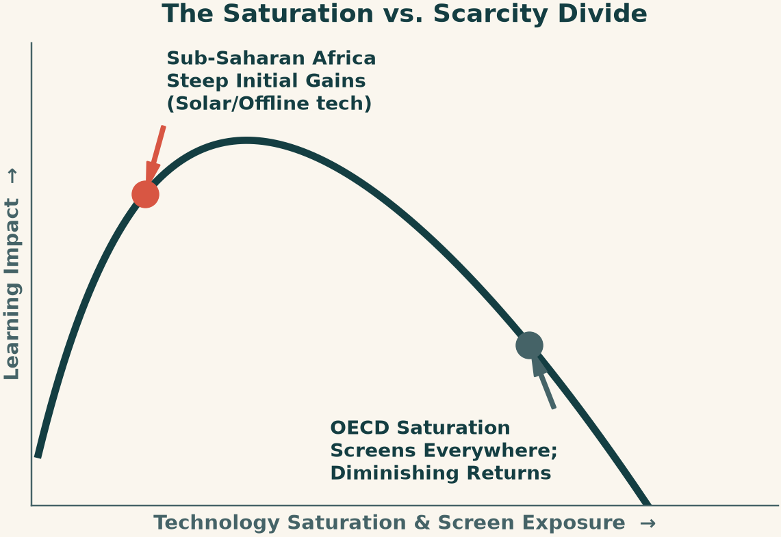
3. EPISTEMOLOGICAL CRITIQUE
The Inverted-U Hypothesis: Why Transposing OECD Metrics Misleads African Policy
Device saturation causes distraction in high-income contexts, but steep positive gains in resource-scarce schools.
THE FOUR SYSTEMIC BIASES
Flaws in Global Comparative Data
• 1. Transposition Fallacy: Assuming tech adoption tools work identically across all economic settings.
• 2. Saturation vs. Scarcity: OECD screen distraction vs. SSA high marginal return on single devices.
• 3. MENA Hardware Trap: 100% saturation + AI adoption without teacher pedagogy induces distraction.
• 4. Survivorship Bias: PISA measures only enrolled 15-year-olds; 30–50% of SSA youth are out of school.
Master in ICT for Development and Social Good (UniTO / COREP) | Draft Presentation | Slide 6 of 14
Notes:
[TIMING: 4:30 - 5:30 | 60 SECONDS]
PRESENTER SCRIPT:
"The main point to notice on this slide is the curve on the left: the Inverted-U Hypothesis.
In high-income OECD economies, screen exposure has surpassed the saturation threshold. More time on devices correlates negatively with PISA test scores due to social media, multitasking, and AI cognitive offloading.
However, Sub-Saharan Africa is on the steep initial slope of that curve. Access to a single solar tablet or digitized library creates transformative learning gains. If an African ministry follows OECD advice to 'limit screen time', it is prescribing digital austerity to classrooms that are starving for basic textbooks!
Furthermore, PISA suffers from severe Survivorship Bias: it samples only enrolled 15-year-olds at grade 7 or above, completely ignoring the 30 to 50% of African youth out of school."

Slide 7
4. ICT TOOLS & METHODS
A 3-Tier Triangulated Architecture Reconciles Macro, Meso, and Micro Evidence
Combining OECD benchmark datasets, a 69-country automated open-API engine, and practitioner field instruments.
MACRO ASSESSMENT
Tier 1: Macro Benchmark Engine
OECD PISA 2025 AI Dashboard
• Analyzes 85 school systems globally.
• Focus on MENA: UAE, Qatar, Jordan, Morocco, Saudi Arabia.
• 10 analytical domains: AI drafting vs learning, screen distraction, equity divides.
MESO OPEN-API PIPELINE
Tier 2: Meso 6-Pillars Pipeline
Automated Python Open-API Engine
• Custom pipeline (fetch_6pillars_pipeline.py) querying World Bank, UIS, and ITU APIs.
• 69 countries (48 SSA, 21 MENA) across 2015–2024.
• 20+ live indicators structured into UNESCO's 6 Pillars.
MICRO GROUND TRUTH
Tier 3: Micro Ground Truth
Alliance of Alliances Field Surveys
• Instruments co-framed with UNESCO Global Education Coalition.
• Captures lived classroom bottlenecks: rural load-shedding, device fragility, teacher digital anxiety.
• Validates startup unit economics.
Master in ICT for Development and Social Good (UniTO / COREP) | Draft Presentation | Slide 7 of 14
Notes:
[TIMING: 5:30 - 6:30 | 60 SECONDS]
PRESENTER SCRIPT:
"To bridge the gap between global theory and local realities, we deploy a three-tiered triangulated methodology:
Tier 1 is our Macro Benchmark Engine, evaluating OECD PISA 2025 AI tables across 85 educational systems, focusing on MENA.
Tier 2 is our Meso 6-Pillars Open Data Pipeline. We engineered an automated, disk-cached Python pipeline querying the World Bank, UNESCO UIS, and ITU across 69 nations (48 SSA and 21 MENA).
Tier 3 is our Micro Ground-Truth Layer, incorporating UNESCO Global Education Coalition / Alliance of Alliances teacher and startup survey instruments.
This ensures our policy recommendations are never based on macro assumptions alone, but validated by real teachers and founders."

Slide 8
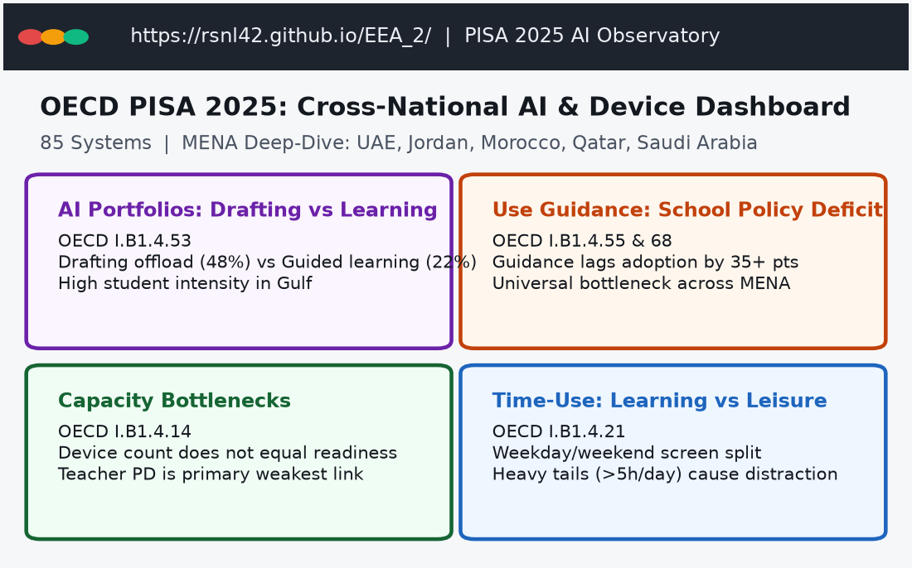
4. MACRO EXPLORER IN ACTION
The Live PISA 2025 AI & Device Observatory (`EEA_2`)
Public client-side observatory (https://rsnl42.github.io/EEA_2/) exploring 85 school systems across 10 analytical domains.
CORE DASHBOARD MODULES
Key PISA 2025 Findings
• AI Drafting vs. Learning: Students frequently use generative AI to draft text (homework offloading) rather than for deeper concept learning.
• The School Guidance Deficit: Across Gulf systems, student AI adoption outpaces school guidelines by over 35 percentage points.
• Capacity Bottlenecks: Richer schools report higher teacher digital readiness, but device counts alone show no correlation with pedagogical quality.
• Zero Server Overhead: Hosted purely on GitHub Pages; static, lightweight, and accessible to low-bandwidth researchers.
Master in ICT for Development and Social Good (UniTO / COREP) | Draft Presentation | Slide 8 of 14
Notes:
[TIMING: 6:30 - 7:30 | 60 SECONDS]
PRESENTER SCRIPT:
"On the left is a direct view of our live web explorer, EEA_2, accessible at https://rsnl42.github.io/EEA_2/. Built purely with client-side architecture on GitHub Pages, it requires no backend server, no login, and runs seamlessly in low-bandwidth environments.
Notice the four primary research modules:
1. AI Portfolios: Revealing that students in MENA use AI primarily to draft assignments—an offloading mechanism—rather than to learn concepts.
2. Use Guidance: Quantifying the dangerous 35-percentage-point guidance lag in schools.
3. Capacity Bottlenecks: Breaking down why raw device counts do not correlate with pedagogical success.
4. Time-Use: Mapping student leisure distraction tails exceeding 5 to 7 hours per day."

Slide 9
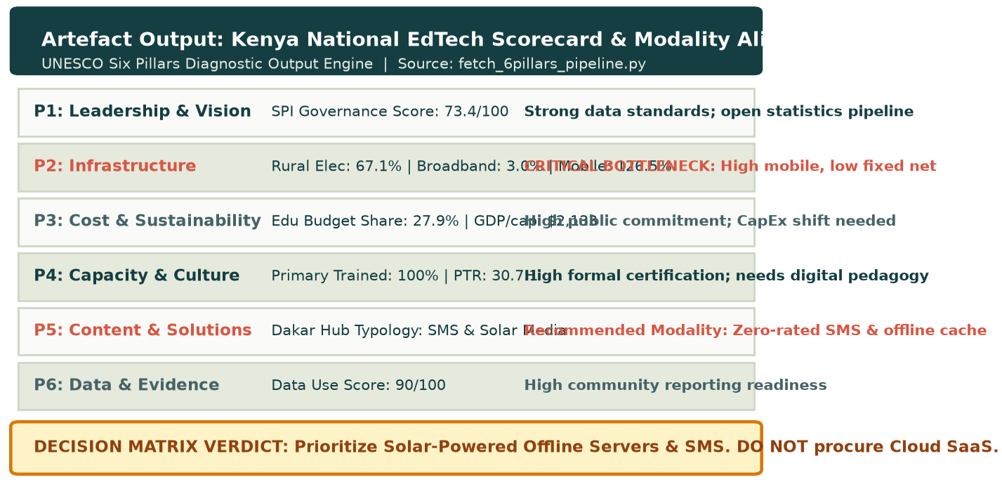
5. TANGIBLE ARTEFACT OUTPUT
Country Diagnostic Scorecard: Kenya 6-Pillars Modality Alignment
Sample country deliverable showing how empirical pipeline metrics translate directly into actionable policy decisions.
ARTEFACT VALUE PATHS
How Stakeholders Use It
• Ministries of Education: Prevents capital misallocation (e.g. Kenya: 67% rural power & 3% broadband -> buy offline servers, NOT cloud SaaS).
• Multilateral Donors: Pinpoints exact rate-limiting bottlenecks (e.g. high teacher certification but missing digital pedagogy).
• EdTech Innovators: Guides product design to verified classroom constraints (SMS micro-learning, zero-rated WhatsApp, offline caching).
• Component B Delivered: Replicable across all 69 countries using our open Python pipeline engine.
Master in ICT for Development and Social Good (UniTO / COREP) | Draft Presentation | Slide 9 of 14
Notes:
[TIMING: 7:30 - 8:30 | 60 SECONDS]
PRESENTER SCRIPT:
"Here is a concrete sample of what our project deliverable produces: a 6-Pillars Diagnostic Scorecard and Modality Alignment Rubric for Kenya.
On the left, you see the actual output from our Python engine:
- In Pillar 2, Kenya has 67% rural electricity and 126% mobile penetration, but only 3% fixed broadband.
- In Pillar 3, government commitment is high with 28% of the budget allocated to education.
- In Pillar 4, 100% of primary teachers are formally certified, but lack digital pedagogical training.
Our alignment matrix translates these numbers into a clear policy verdict: Kenya must NOT procure cloud SaaS platforms. Instead, capital should be directed to solar-powered offline servers and SMS micro-learning channels."

Slide 10
6. FEASIBILITY & REFLEXIVE LEARNING
Navigating Technical Boundaries, Data Lag, and Ethical Reflexivity
Critical reflection on project execution, data asymmetries, and researcher positionality.
DEMONSTRATED FEASIBILITY
What Is Built and Verified
• Complete 69-country panel generated and cached.
• EEA_2 web application live on GitHub Pages.
• Conceptual and epistemological critique finalized.
• Executable by an individual researcher-developer.
TECHNICAL & DATA LIMITS
Operational Bottlenecks
• Official UN/UIS data carries a 1- to 3-year publication lag.
• Rural teacher ICT metrics remain sparse.
• Client-side static architecture prevents complex real-time regression modeling on the web.
REFLEXIVE & ETHICAL LEARNING
Principles for Digital Development
• Data Sovereignty: Preventing digital extractivism by keeping all tools open-access.
• AI Ethics: Strict compliance with UniTO Guidelines §26 (AI used exclusively for syntax/debugging).
• Avoiding deficit stigmatization of low-infrastructure systems.
Master in ICT for Development and Social Good (UniTO / COREP) | Draft Presentation | Slide 10 of 14
Notes:
[TIMING: 8:30 - 9:15 | 45 SECONDS]
PRESENTER SCRIPT:
"Following Slide 4 of the Project Clinic, feasibility and self-awareness are critical:
Feasibility is fully demonstrated: our data pipeline is written, all 69 country profiles are generated, and the interactive web application is live.
In terms of constraints, we acknowledge that international databases carry a 1- to 3-year publication delay, and rural pedagogical indicators have significant missing data. We mitigated this by caching indicators locally and cross-referencing with project-level multilateral data.
Ethically, we strictly uphold the Principles for Digital Development. All outputs are open-access to counteract 'digital extractivism'. Furthermore, in full compliance with UniTO Final Project Guidelines Section 26, generative AI was utilized strictly for syntax debugging; all conceptual interpretations represent my own scholarly work."

Slide 11
7. NEXT STEPS & FEEDBACK REQUEST
Roadmap Toward Graduation and Targeted Questions for the Commission
Structured delivery schedule leading to the December 10–11 Master Defense and specific clinic feedback areas.
DELIVERY MILESTONES
Roadmap to Graduation
• 13 Nov 2026: Submission of First Full Master Thesis Draft to Reviewer.
• 20 Nov 2026: Receipt of Reviewer feedback and revision cycle.
• 25 Nov 2026: Field Ground-Truthing with Dakar EdTech Hub & AoA contacts.
• 30 Nov 2026 (23:59 CET): Final submission of Project and repositories.
• 10–11 Dec 2026: Official Master Thesis Defense and Public Presentation.
CLINIC FEEDBACK REQUEST
Targeted Questions for Reviewers
1. Composite Pillar Weighting: Should foundational infrastructure (Pillar 2) and teacher capacity (Pillar 4) carry heavier weighting coefficients when computing aggregate national digital readiness scores?
2. Triangulating Qualitative Survey Data: What is the most effective visualization method to juxtapose qualitative AoA teacher quotes alongside macro World Bank indicators in the final document?
3. Framing the MENA-SSA Contrast: How can we best frame MENA findings as a constructive cautionary case without oversimplifying internal variations across the Arab region?
Master in ICT for Development and Social Good (UniTO / COREP) | Draft Presentation | Slide 11 of 14
Notes:
[TIMING: 9:15 - 10:00 | 45 SECONDS]
PRESENTER SCRIPT:
"To conclude, our timeline is firmly on schedule toward our December graduation defense.
To help strengthen our final submission on November 30th, I would particularly welcome Professor Bignante and the Commission's guidance on three specific questions:
1. First, on composite weighting across UNESCO's Six Pillars;
2. Second, on the optimal visual synthesis between macro API data and qualitative teacher survey quotes; and
3. Third, on refining our comparative framing of MENA as a diagnostic cautionary model for Sub-Saharan planners.
Thank you very much for your time and guidance. I look forward to your feedback and opening the floor to discussion."

Slide 12
BACKUP SLIDE A — EPISTEMOLOGICAL FRAMEWORK
Detailed Analysis: The Four Biases in International Educational Metrics
Deconstructing the systemic flaws of applying high-income benchmarks to Global South environments.
Systemic Bias | Underlying Fallacy / Metric Assumption | Global South Ground Reality | Policy Failure Risk
1. Transposition Fallacy | Adoption and utility of digital tools are invariant to socio-economic infrastructure. | Tools designed for 100Mbps cloud ecosystems fail in off-grid classrooms with intermittent 2G/3G. | Procuring cloud-only LMS and proprietary SaaS that become unusable shelfware.
2. Saturation vs. Scarcity | Linear negative correlation between student screen time and cognitive test scores. | High-income OECD has reached saturation; rural SSA is at zero. A single device yields steep positive gains. | Prescribing 'screen-time austerity' in environments starved of basic educational textbooks and media.
3. MENA Hardware Trap | Procuring devices and high-speed internet will automatically uplift learning outcomes. | Near 100% device penetration and high AI usage with severe teacher pedagogical guidance deficits. | High device use induces leisure distraction, homework offloading, and stagnant academic achievement.
4. PISA Survivorship Bias | Sampling 15-year-olds in formal schooling (grade 7+) reflects national adolescent readiness. | 30% to 50% of secondary-school-age adolescents in SSA are out of school (UNESCO UIS). | Directing national budgets exclusively to elite urban schools while the most vulnerable remain invisible.
Master in ICT for Development and Social Good (UniTO / COREP) | Draft Presentation | Slide 12 of 14
Notes:
[BACKUP SLIDE A: EPISTEMOLOGICAL MATRIX]
KEY REBUTTAL POINTS:
- Inverted-U hypothesis: The negative correlation between screens and test scores in OECD studies is a product of cognitive saturation and distraction, NOT inherent toxicity. In Africa, digital readers provide steep positive marginal utility.
- MENA empirical evidence confirms that capital expenditure (CapEx) without teacher capacity expenditure (OpEx) is doomed.
- PISA measures only the enrolled secondary elite, rendering the 30–50% of out-of-school youth invisible.

Slide 13
BACKUP SLIDE B — TECHNICAL PIPELINE & ARCHITECTURE
Data Engineering: Automated Open-API Ingestion and Client-Side Delivery
How the Python pipeline and GitHub Pages dashboard achieve high reproducibility and resilience.
DATA INGESTION & APIS
Multi-Source API Queries
• World Bank Indicators API: GDP, rural/urban electricity, primary/secondary completion, SPI statistical index.
• UNESCO Institute for Statistics (UIS): Pupil-teacher ratios, trained teacher percentages.
• International Telecommunication Union (ITU): Mobile/fixed broadband subscriptions, internet penetration.
• World Bank Projects API: 237 active digital education loans totaling billions in investments.
CACHING & RESILIENCY ENGINE
fetch_6pillars_pipeline.py
• Disk-Based Caching: Stored under data/raw to survive network drops and rate limits during batch queries.
• Normalization Engine: Cleans country ISO codes, aligns regional aggregates across 48 SSA and 21 MENA nations.
• Output Artefacts: Generates indicators_timeseries.csv, latest_country_profiles_6pillars.csv, and pillar_regional_benchmarks.csv.
CLIENT-SIDE OBSERVATORY
EEA_2 Static Web Explorer
• Static GitHub Pages Hosting: Pure HTML5/JavaScript frontend with zero backend server dependency.
• Embedded Data Model: Loads pre-processed JSON/CSV data asynchronously; instant filtering across 85 countries.
• Resilient Deployment: Can be cloned, run locally on low-cost hardware, or cached in offline educational servers.
Master in ICT for Development and Social Good (UniTO / COREP) | Draft Presentation | Slide 13 of 14
Notes:
[BACKUP SLIDE B: TECHNICAL ARCHITECTURE]
KEY REBUTTAL POINTS:
- The entire pipeline is open-source Python, disk-cached under data/raw to handle API rate limiting and connection timeouts.
- The web explorer is static client-side on GitHub Pages, ensuring zero recurring server hosting costs and the ability to run offline on local educational servers.

Slide 14
BACKUP SLIDE C — DEFENSE Q&A STRATEGY
Anticipated Examiner Challenges & Structured Academic Rebuttals
Prepared speaking strategies for the online graduation defense in front of the Master's Commission.
CHALLENGE 1: PISA IN AFRICA
Why use PISA if it is biased against Sub-Saharan Africa?
Rebuttal: 'PISA is utilized not as a normative standard for Africa, but as a critical diagnostic baseline. First, it provides deep empirical data for MENA. Second, it quantitatively demonstrates that hardware saturation and unguided AI adoption do NOT equate to improved learning, establishing an urgent warning against repetitive hardware procurement.'
CHALLENGE 2: TRIANGULATION
How do AoA surveys complement macro World Bank APIs?
Rebuttal: 'World Bank APIs effectively track physical and financial capital—grid electricity, broadband connections, and loan commitments. But UNESCO's Six Pillars mandate evaluating participatory culture, parental attitudes, and teacher pedagogical confidence. These human factors are invisible to macro APIs and require ground-level survey instruments.'
CHALLENGE 3: POLICY ACTIONABILITY
What makes this deliverable actionable for a ministry?
Rebuttal: 'Rather than generic recommendations, the toolkit provides bottleneck-specific guidance. For instance, if a country has achieved 75% electricity but only 20% connectivity, the rubric advises against costly cloud LMS contracts and guides capital toward solar-powered offline servers and localized Open Educational Resources.'
Master in ICT for Development and Social Good (UniTO / COREP) | Draft Presentation | Slide 14 of 14
Notes:
[BACKUP SLIDE C: DEFENSE Q&A STRATEGY]
USE THIS SLIDE TO GUIDE YOUR LIVE Q&A PERFORMANCE (PER SLIDE 17 IN PROFESSOR'S DECK):
- Remember Slide 17 advice: Listen to the full question, pause, give a direct answer, then provide the brief explanation.
- Use the recommended phrases: 'Based on the work so far...', 'This has not been tested yet; the next step would be...', 'That is a valuable point to consider in the final revision.'
- Distinguish clearly between empirical findings (what the data proves) and theoretical critique (what the frameworks suggest).

