Slide 1
Stage 3 Material Optimization
Factorial-v1 results, physics interpretation, and readiness audit
18 material triplets 72 million primary events
16 Sobol sites × 2 replicas
Objective total junction QPs
Outcome: technically complete; promising screen; not yet a final material decision
Reviewed 13 August 2026
1

Slide 2
Why minimize quasiparticle generation?
1 Energy deposition
2 Phonon cascade
3 Correlated qubit damage
Ionizing radiation, stress-release events, or injected athermal phonons deposit energy into the cryogenic chip substrate.
Athermal acoustic phonons propagate anisotropically, scatter, decay, and repeatedly encounter device interfaces.
Pair-breaking phonons create nonequilibrium QPs in superconducting structures. QPs shorten T₁ and can correlate errors across many qubits.
Stage 3 asks which realizable layer triplet redirects or downconverts phonon energy before it reaches the Al junctions.
Context: Martinis, npj Quantum Information 7, 90 (2021); Wilen et al., Nature Communications 13, 6425 (2022).
2

Slide 3
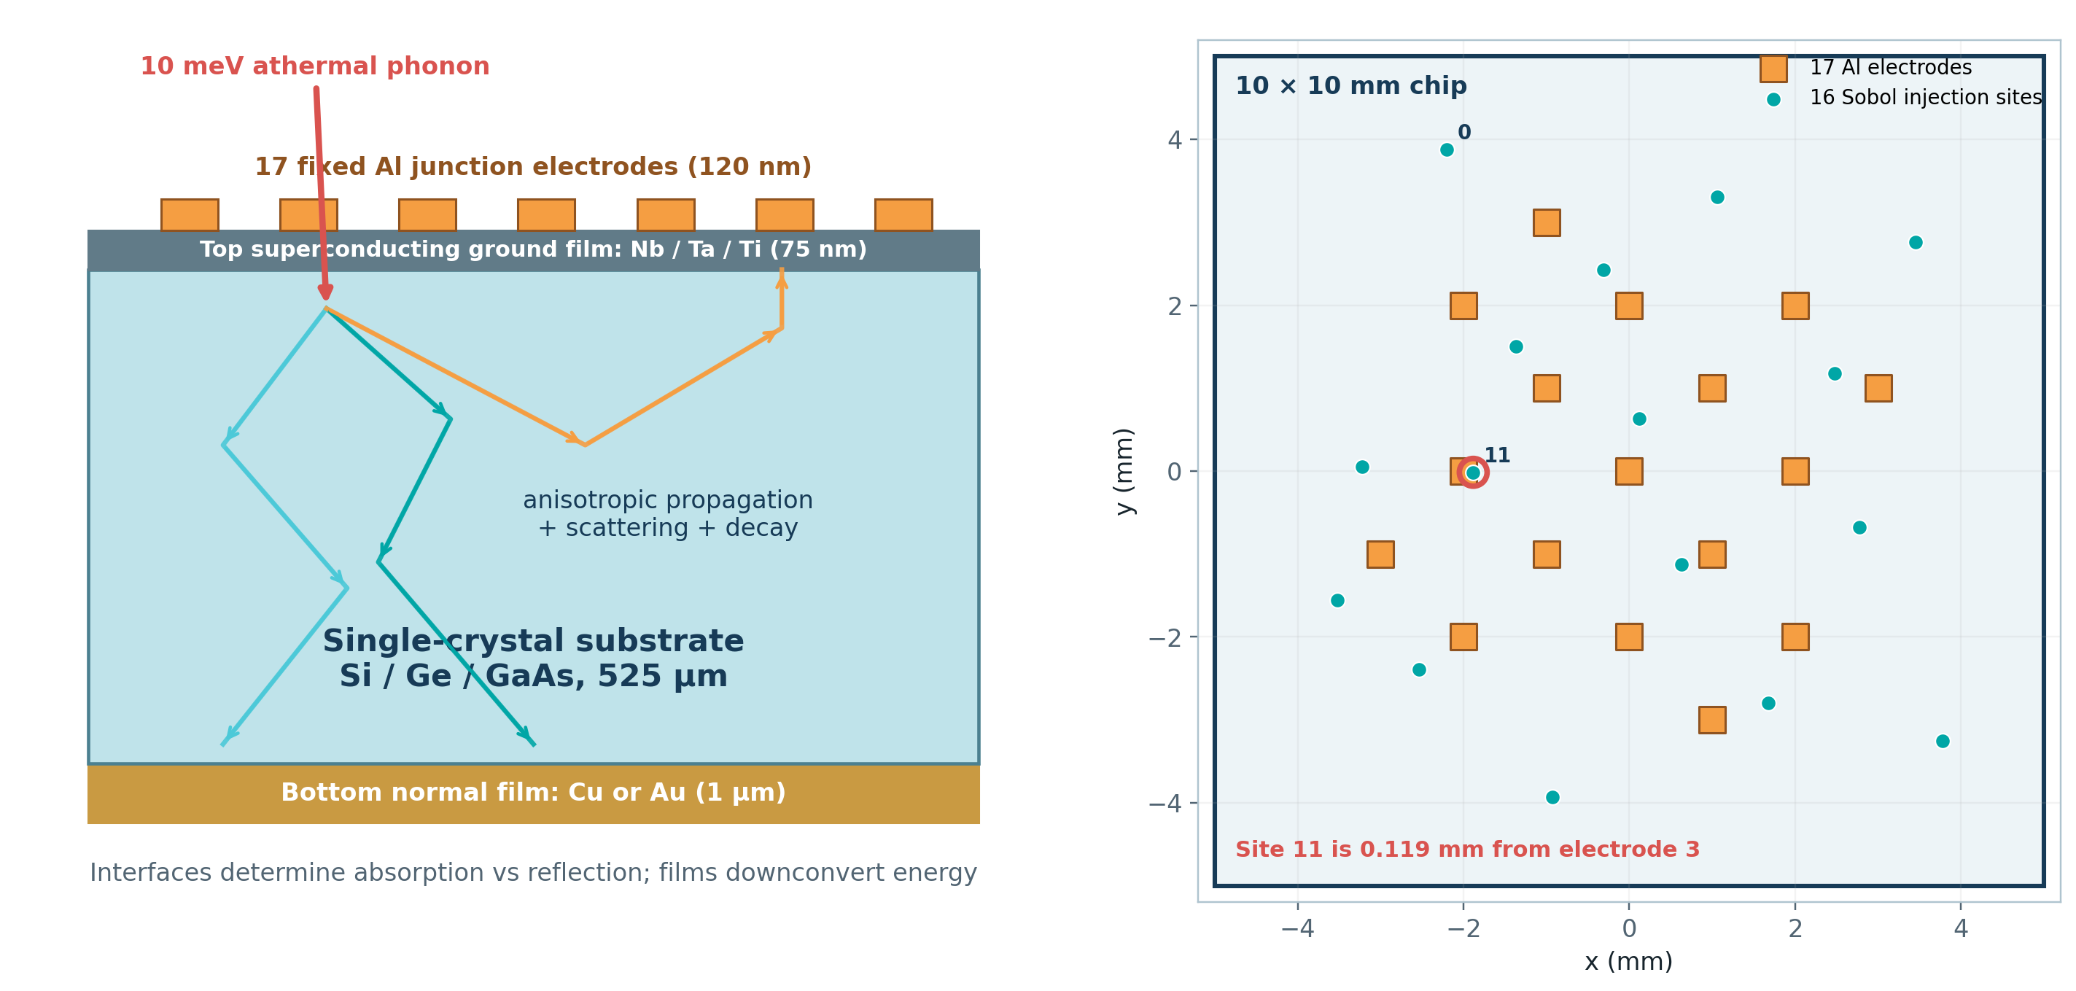
What was simulated
Cross-section and top-view geometry
Illustration generated from stage3_config.yaml and the SQLite-recorded Sobol scenario; vertical thicknesses are schematic.
3

Slide 4
Energy protocol: a deliberate all-films-active regime
38.2 µeV < 382 µeV < 10,000 µeV
tracking cutoff Al junction pair threshold injected phonon
cutoff 38.2 µeV
Ti 2Δ 122 µeV
Al 2Δ 382 µeV
Ta 2Δ 1400 µeV
Nb 2Δ 3076.8 µeV
gun 10000 µeV
What this guarantees
What remains junction-only
Interpretation boundary
All three top films can compete for incident phonons; the comparison stays in one qualitative absorption regime.
The Junction hit filter records energy at the 17 Al junction footprints—not QPs generated in the ground plane.
These results describe 10 meV injection. They do not directly predict the former 1 meV protocol.
G4CMP transport context: Agnese et al., arXiv:2302.05998 / FERMILAB-PUB-23-065-ND.
4

Slide 5
Campaign workflow and data contract
1
2
3
4
5
6
Candidate
Resolver
Scenario
Geant4/G4CMP
Proof + ledger
Score
substrate + top + bottom
density, tensor, native lattice, interfaces
16 sites × 2 replicas 125k events each
32 guarded sub-runs per candidate
marker, material check, SQLite identities
Σ junction QPs / 4M primaries
Common comparison block
Strict completeness
Current search method
Same ordered sites and nominal seed bank for every material triplet
A partial site set is never scored and a missing result is never zero
Exhaustive 18-cell factorial; no Bayesian surrogate is needed yet
5

Slide 6
Artifact audit: the recorded campaign is complete
18 / 18
576 / 576
576
0
trials successful
sub-runs successful
macros + hits + markers + logs
score mismatches
• All candidates use the same ordered scenario and seed map
• Runtime logs match the intended substrate and Geant4 density
• Generated lattice files preserve every native field except derived vL/vT
• Independent rescoring reproduces every SQLite total
• CSV rebuilt byte-for-byte from the current single-campaign ledger
• Each candidate: 32 × 125,000 = 4,000,000 primaries
• Total executed: 72,000,000 primaries
• Correction: the database contains 576 sub-runs, not 288
Audit details: STAGE3_FACTORIAL_V1_RESULTS_REVIEW.md
6

Slide 7
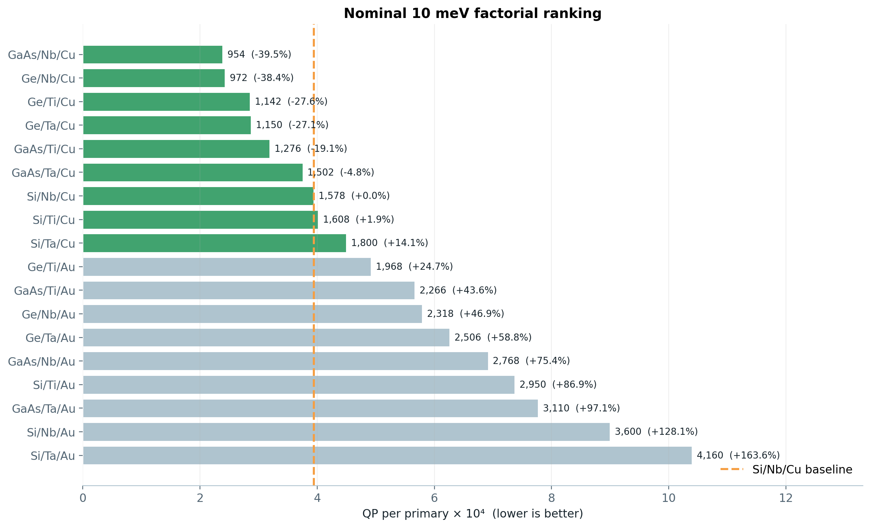
Nominal ranking
Green bars use Cu; gray bars use Au
Percentages are relative to Si/Nb/Cu. The printed Poisson z values are not used as confidence intervals here.
7

Slide 8
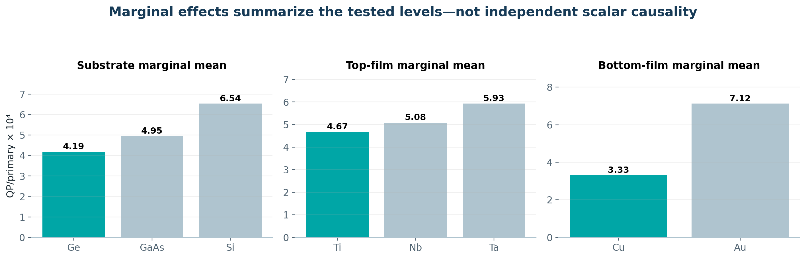
Factor-level interpretation
Strongest robust signal
Substrate screen
Causal caution
Au is worse than Cu in all 9 matched comparisons; mean yield is 2.14× higher.
Ge and GaAs beat Si in all 6 matched film combinations.
Each material changes several linked properties; this is not scalar-parameter sensitivity analysis.
8

Slide 9
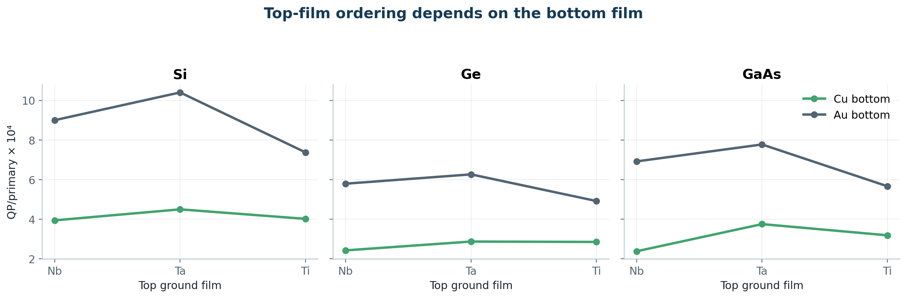
The top-film effect is context dependent
Nb is best with Cu for all three substrates; Ti is best with Au for all three. A single global “best top film” does not exist in this model.
This interaction can arise from gap, lifetime, sound speed, density, and interface absorption moving together.
9

Slide 10
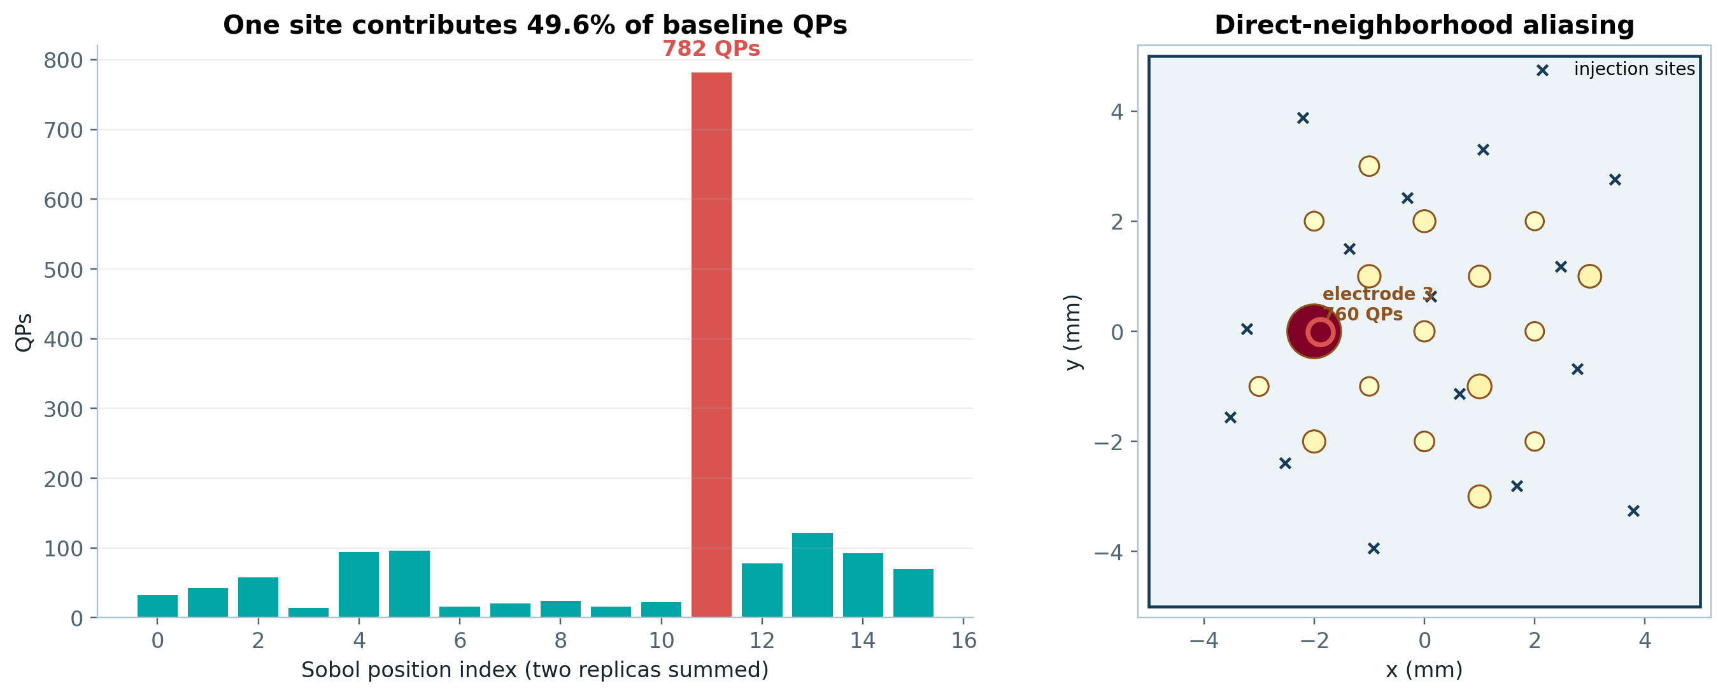
Why 16 → 32 → 64 position convergence cannot be skipped
Position 11
Winner gap
Decision
782 / 1578 baseline QPs = 49.6%
GaAs/Nb/Cu beats Ge/Nb/Cu by only 18 QPs
Treat GaAs and Ge as tied until nested convergence
10

Slide 11
Implementation review: what must change before new campaigns
BLOCKER 1 — incomplete cache identity
BLOCKER 2 — unfiltered reporting
The cache omits the catalog, interface code, macro template, and several resolved film values. Changing Ta lifetime 0.0227 → 0.040 ns changes the macro but not the current cache payload. Lifetime brackets can silently return nominal results.
stage3_report.py reads every observation in the ledger. Once 32/64-position or lifetime-bracket trials are added, one CSV can mix incompatible contracts unless campaign/contract/fidelity filters are required.
Model caveat
Threshold mismatch
Input uncertainty
Effective AMM reproduces 0.795/0.745/0.736 by construction. It is calibrated plumbing, not independent interface-physics validation.
Bottom gapThreshold is 180 µeV, while the Al gap is 191 µeV. The local normal-film model uses this termination scale. Prefer 191 µeV unless 180 is explicitly calibrated.
Au lifetime is unsourced; Ta/Ti are supplied estimates. Low/nominal/high brackets are required before materials claims.
These issues do not erase factorial-v1: its actual macros and outputs were audited directly. They do block trustworthy reuse and extension.
11

Slide 12
Recommended next sequence
• 1 Archive factorial-v1 as nominal / 10 meV / 16 sites / 2 replicas
• 2 Fix cache identity; add cache-invalidation regression tests
• 3 Add campaign + contract + fidelity filters to the report
• 4 Resolve bottom threshold: 191 µeV recommended
• 5 Run nested 32-site finalists + one Au control
• 6 Extend surviving candidates to 64 sites
• 7 Add seed banks / replicas and matched-block uncertainty
• 8 Run low / nominal / high lifetime brackets
• 9 Test alternate or measured interface physics
• 10 Confirm finalists at high event fidelity
Only expand to Bayesian optimization when the candidate space becomes larger than an exhaustive budget.
12

Slide 13
Take-home message
The run is real, complete, and reproducible.
Cu-bottom candidates are consistently favored in the implemented model.
GaAs/Nb/Cu is the nominal winner—but effectively tied with Ge/Nb/Cu.
Fix cache/report identity, then establish spatial, lifetime, interface, and high-fidelity stability before selecting a material stack.
13

Slide 14
Appendix: scope and sources
Objective scope
Artifact scope
Claim scope
Sum of rounded Edep/ΔAl for positive top-surface hits, assigned to the nearest of 17 electrodes and normalized by all primaries. Not PLE, peak-QP, or time-resolved correlated damage.
SQLite: 18 trial rows + 576 sub-run rows. CSV: 18-row per-trial projection. Runs: exact macros, native configs, hit files, markers, and logs.
A model-dependent screening result for a 10 meV phonon source and the fixed 17-electrode geometry—not an experimentally validated material ranking.
Agnese et al., G4CMP: Condensed Matter Physics Simulation Using the Geant4 Toolkit, arXiv:2302.05998. Martinis, Saving superconducting quantum processors from decay and correlated errors generated by gamma and cosmic rays, npj Quantum Information 7, 90 (2021). McEwen et al., Resolving catastrophic error bursts from cosmic rays in large arrays of superconducting qubits, Nature Physics 18, 107–111 (2022). Wilen et al., Phonon downconversion to suppress correlated errors in superconducting qubits, Nature Communications 13, 6425 (2022).
Full numerical audit and ranking: STAGE3_FACTORIAL_V1_RESULTS_REVIEW.md
14

