Slide 1

Horseheads Youth Lacrosse Club

Slide 2
The Board of Directors
Jennifer Landon - Treasurer
Amy Kelly- Secretary
Pete Cook/Jason Neubauer
Jill Stevens
Jennifer Woodworth
Joe Kostolansky
Tom Gill
Jennifer Guzylak
Wendy Christmas – girls’ coordinator
All nine seats have an equal vote.

Slide 3
Club Financial Information
The club became incorporated in 2007 and gained non-profit status in 2008
We have focused on growing lacrosse in the community and planned our expenditures accordingly. Significant expenses for this year include paying for the use of the fields at the Holding Point and paying the district for field use for our home play date. All of our teams will also play in the Lax by the Lake Tournament
We have made sure that our coaches are Level I certified through the US lacrosse coaches education program and we will provided coaches with first aide training on the AED machines. All coaches must have a current US Lacrosse membership.
We feel that it’s important to maintain modest savings to accommodate any future opportunities.

Slide 4
Our Mission
To build and share a love for Lacrosse; one stick, one pass, and one experience at a time!

Slide 5
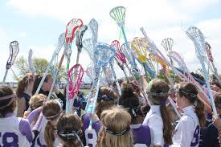
Our Goal
This is a developmental program
To develop skills, abilities, sportsmanship , teamwork and a love of the game in all players

Slide 6
Support Your Child’s Team Positively
Parents can be a good “teammate” too
Recognize that players, coaches and officials make mistakes
Support what you can control like effort and hustle. You can’t control a bad call
Source: Lacrosse Magazine March 2014

Slide 7
Code of Conduct
Players, coaches, officials, parents and spectators are to conduct themselves in a manner that "Honors the Game" and demonstrates respect to other players, coaches, officials, parents, spectators and fans.
  This was agreed to as part of your registration
The essential elements in this "Code of Conduct" are HONESTY and INTEGRITY. Those who conduct themselves in a manner that reflects these elements will bring credit to the sport of lacrosse, themselves, their team, and our organization.

Slide 8
Players should always demonstrate positive behavior and respect toward teammates, opponents, coaches, officials, parents and spectators.
Coaches, players, parents, and spectators are expected to demonstrate the utmost respect for officials and reinforce that respect to players/teammates.

Slide 9
Grievances or misunderstandings between coaches, officials or any other parties involved with the sport should be communicated through the proper channels and procedures, never on or about the field of play in view of spectators or participants.
      24 hour rule
Spectators involved with the game must never permit anyone to openly or maliciously criticize, badger, harass or threaten an official, coach, player or opponent.

Slide 10
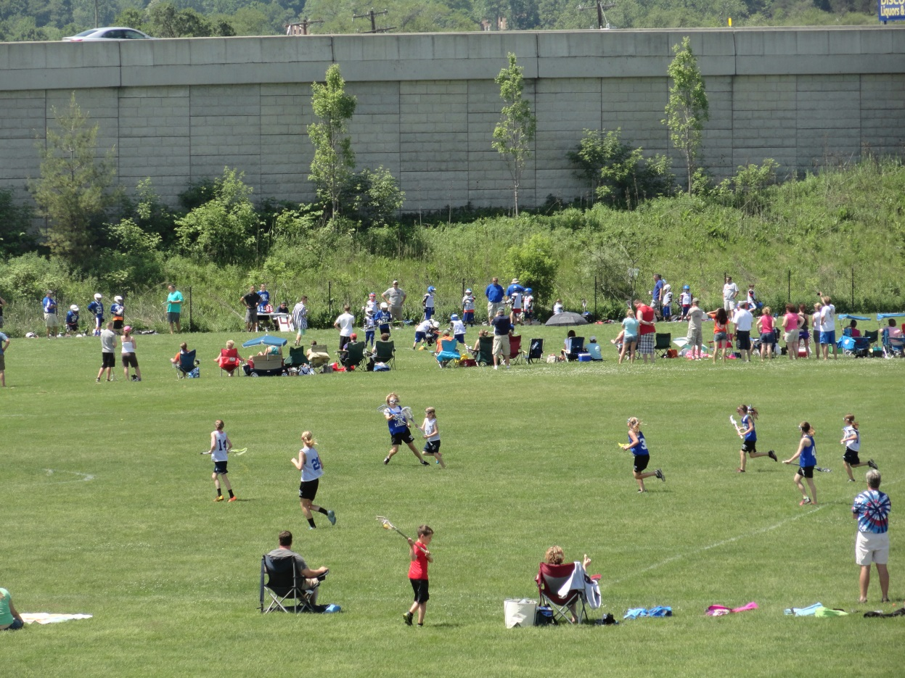
HELP!!!!
Help will be required throughout the season in various areas such as concession and game setup. Please pay attention to your e-mail and don’t hesitate to volunteer.

Slide 11
ITEMS OF INFORMATION
Team parents will serve as a link between parents, players and coaches. We need one team parent for all teams
Raffle tickets- specific information is in each envelope. Completed ticket stubs can be turned in at the shed (mailbox). Please encourage your patrons to write legibly and include their address. ALL STUBS MUST BE TURNED IN BY APRIL 30th!!!

Slide 12
Housekeeping Items
All players need to wear a mouthpiece any time that they are on the field.
Players on the 3/4 and 5 /6 teams need to wear an athletic cup any time they are on the field.
Players on the 1/2 team who play in the goal will also need to wear an athletic cup.

Slide 13
Housekeeping Items
ALL Girls need to wear goggles and a mouthguard anytime that they are on the playing field. Gloves are optional.
If you need to borrow equipment, you will be able to pick it up on at the shed prior to your first practice. Requires $75 deposit

Slide 14
Teams & Coaches Boys
K - 2 - John Park- Coach
¾ - Shane Lese – Coach
        - Mark L’Amoureaux -coach
5/6 - Mik Karabaich– Coach
- Geoff Crossley - Coach
        - Eric Winkky – Coach
        - Doug Jacobs - Coach

Slide 15
TEAMS & COACHES GIRLS
K – 2 - – Coach
3-4 - Katie Lowe
5/6 -Jennifer Guzylak - Coach
- Bruce May
- Mike Saglibene
- Greg Stevens

Slide 16
Practice and Games - Girls
Practices will start as soon as the weather cooperates. You will be contacted by your coach.
All teams will practice at the Holding Point.
^{5/6} team will practice Tuesday Thursday and Friday at 5:45
The K-2 and 3-4 teams will practice Tuesday and Thursday
The schedule will be posted on the website ASAP.
This is not finalized and could be subject to change

Slide 17
Practices and Games -Boys
Boys’ K-1/2 and 3/4 teams: Practices will be held at the Holding Point field at 5:45
    K-2 team will be in the cage on Monday and Wednesday
    3-4 team will practice Monday and Wednesday @ Town Hall West.
    5-6 team will practice @ Town Hall East Monday, Wednesday and Friday
Practice will be held RAIN or SHINE, the only time we won’t play is if there is lightning.
We have games scheduled with teams from the Finger Lakes league. The schedule will be posted on the website ASAP.
Working on scheduling games with Ithaca and Corning teams.
Please remember that all scheduled games are tentative!

Slide 18
Two-Sport Athletes
We encourage kids to try as many sports as they wish and have as many opportunities as they can.
Conflicts arise – communicate with your coach

Slide 19
Post-Season Play
The season is tentatively scheduled to end on June 6th. After that, tournament teams may be available.
Possibly 2-3 tournaments into July
Selection process
Entry fees not covered by registration already paid

Slide 20
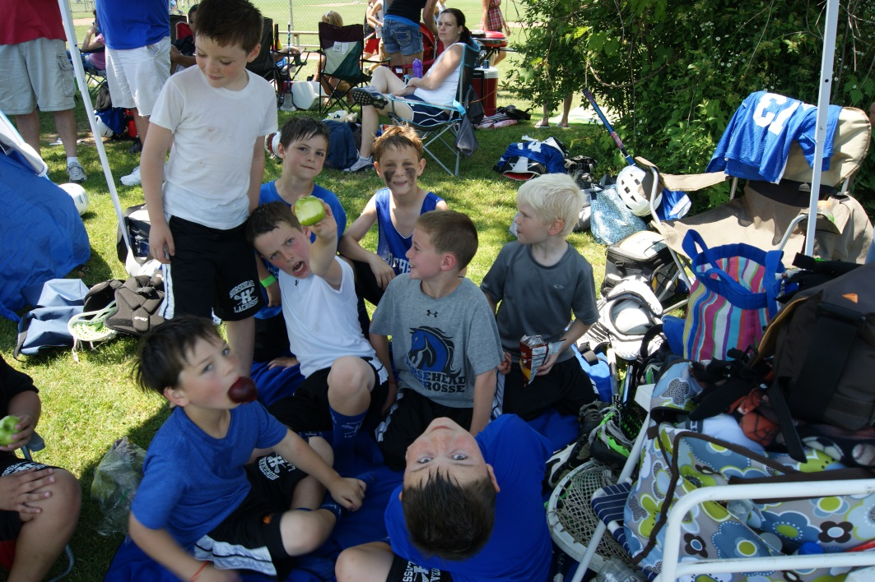
Website
www.horseheadsyouthlacrosse.org
All information can be viewed and downloaded from the website including the schedule, order forms, and fundraiser information. Deadlines are non-negotiable!!
Contact links to all coaches and the Board of Directors

