Slide 1
Text Classification Competition
Team Name:
Virginia DS
Team Members:
Huanzhen Hu NetID: hh21@illinois.edu
Ying Zhang NetID: ying12@illinois.edu

Slide 2
Introduction
Tweet (Sarcasm vs Non-Sarcasm)
5000 training data
1800 testing
Machine Learning Model
BERT-Based Model
Neural-Network-Based Model

Slide 3
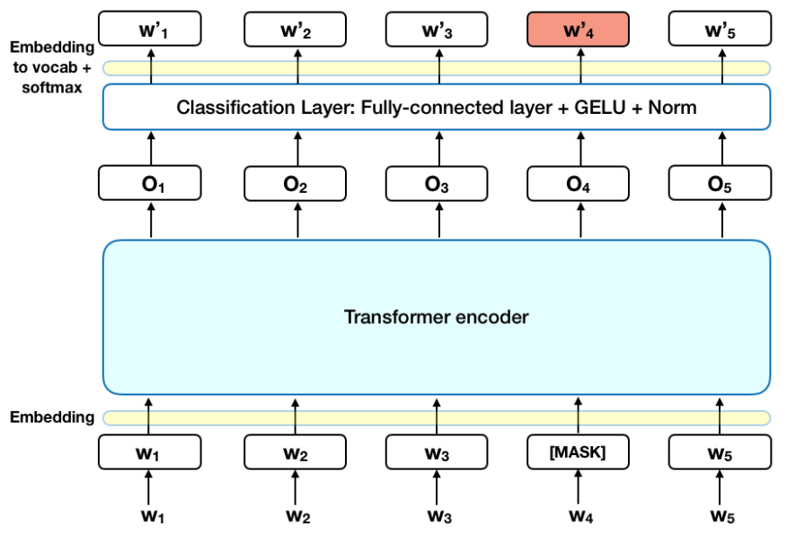
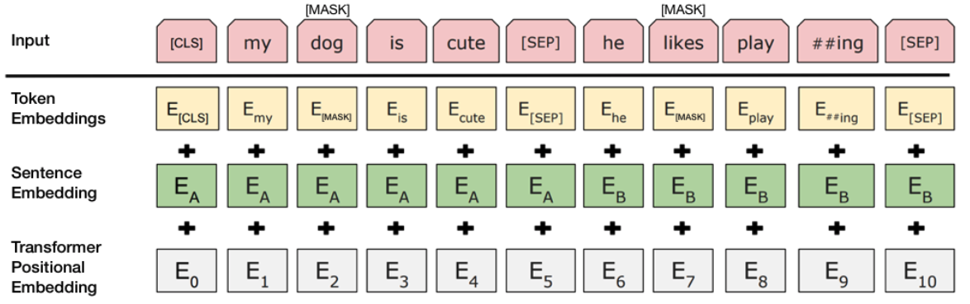
Introduction of BERT
A transformer-based model for NLP pre-training developed by Google in 2018
Two training strategies:
  Masked LM (MLM)
  Next Sentence Prediction (NSP)
https://towardsdatascience.com/bert-explained-state-of-the-art-language-model-for-nlp-f8b21a9b6270

Slide 4
BERT-Base-Uncased Model
No difference between upper case and lower case (English = english)
A smaller model that consist with 12-layer, 768-hidden, 12-heads and 110M parameters
More for fine-tuned tasks rather than masked language modeling or sentence prediction. (Suitable for our classification purpose)
https://huggingface.co/bert-base-uncased

Slide 5
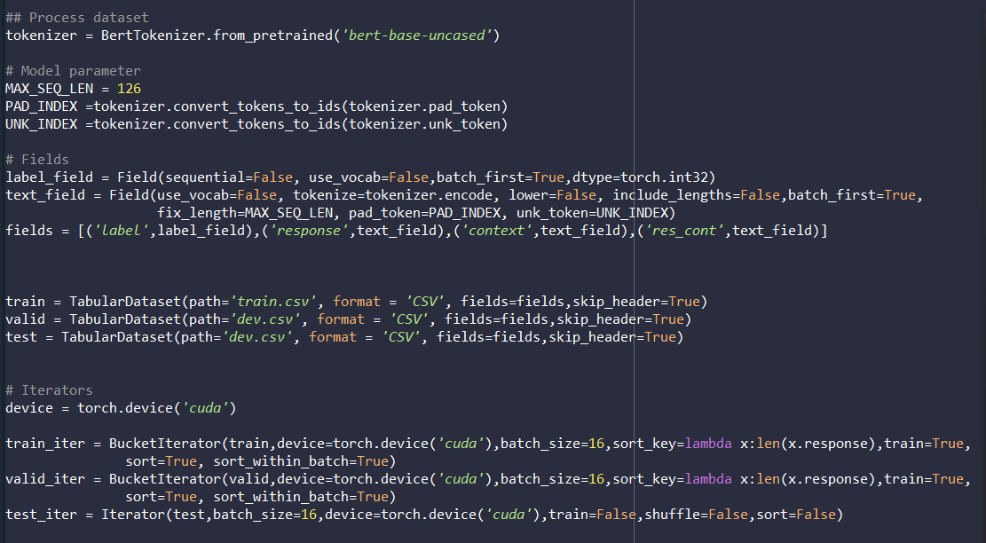
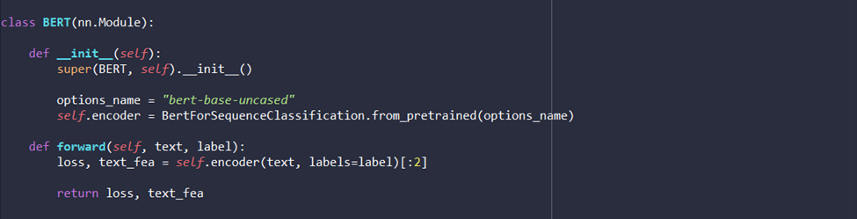
Method
Data Preprocess and Preparation
  Divided training data into 3 parts:
    Train = 4000
    Validation = test = 1000
  Tokenizer = bert-base=uncased
  Batch_size = 16
  Run in GPU
2. Model Building
  Base BERT model was implemented

Slide 6
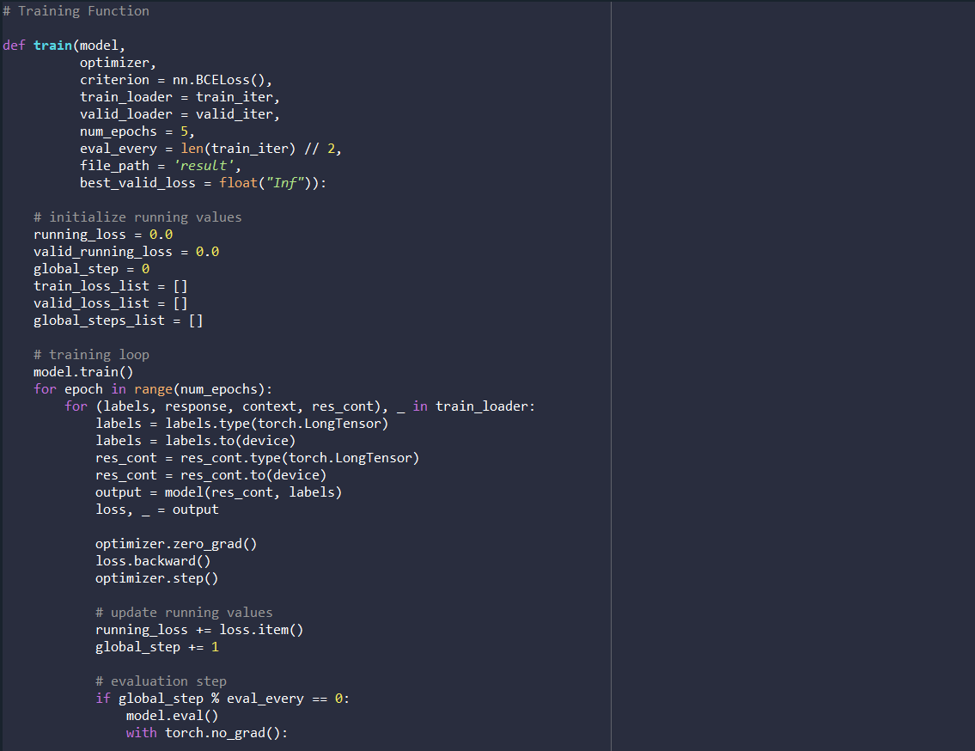
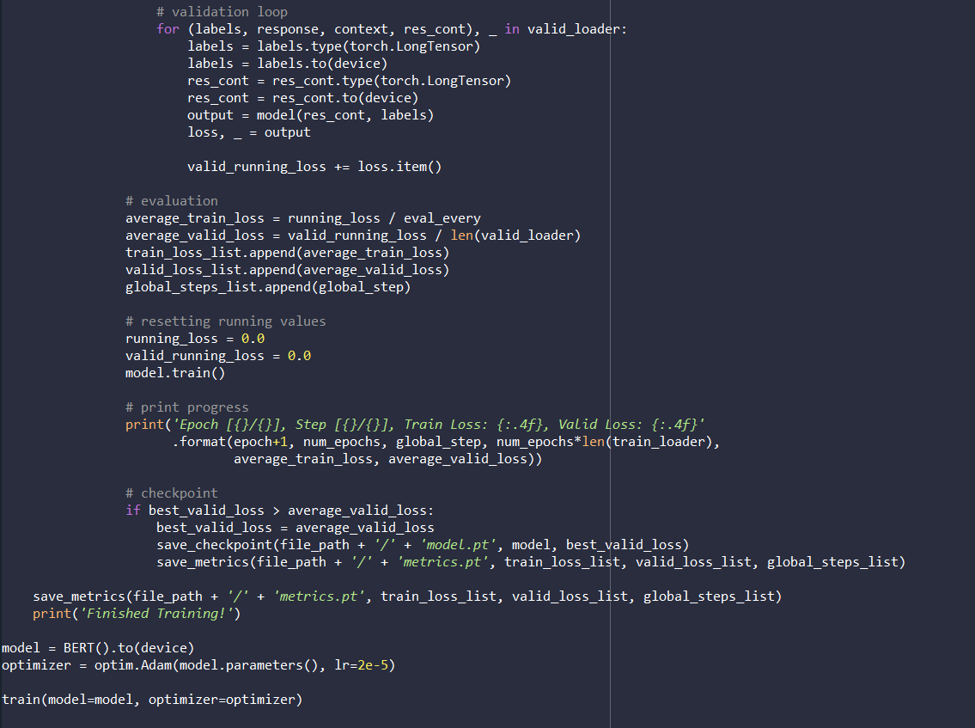
Method (continuous)
3. Training
  Optimizer = Adam
  5 epochs
  Only saved the best optimizer

Slide 7
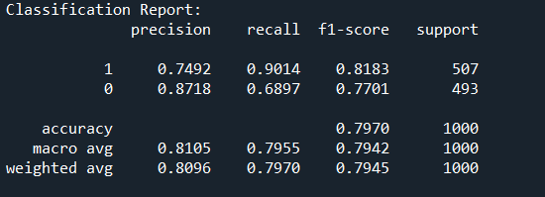
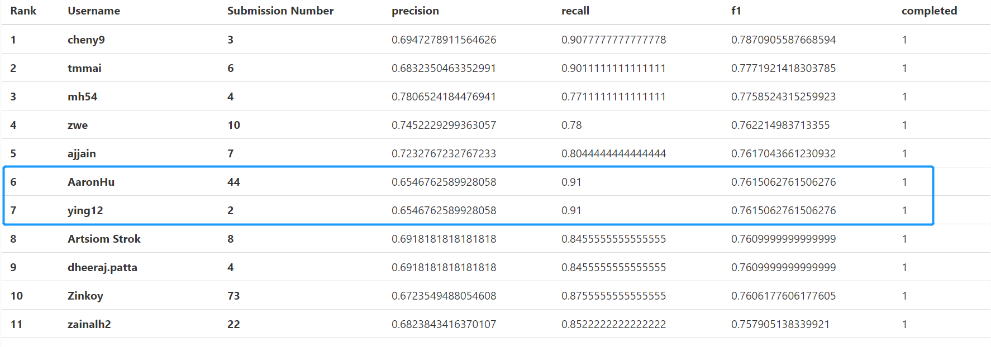
Result – Top 10 on the Leaderboard

Slide 8
Comparison with Other Methods
BERT WIN!!!

