Slide 1

Thunder the Robot
Panhandle STEM Conference July 23-24, 2018
Presented by: H. Paul Haiduk Computer Science Coordinator West Texas A&M University
hhaiduk@wtamu.edu

Slide 2
Presented by H. Paul Haiduk hhaiduk@wtamu.edu
Computer Science Program Coordinator
School of Engineering, Computer Science and Mathematics
West Texas A&M University
Canyon, TX
(806) 651-2450

Slide 3
So . . . if you wish to work along with this presentation, proceed to
https://github.com/HHaiduk/thunder
Windows users: Use https download to download thunder-setup.exe. Click on that file to start the install process. When the dialog prompts you, simply click Install to accept the default installation location. If you do not have administrative access to your OS, then download thunder-win-portable.zip, extract contents – creates a folder named Thunder-win-portable inside of which is the executable Thunder.exe.
Mac users: Use https download to download the file ThunderMAC.app.zip. Extract contents of the zip file somewhere and then copy Thunder.app to your Applications directory.
Linux users: Use https download to download the file ThunderLINUXsetup. Ensure that the file is executable. Execute it to complete the installation. Default installation location is /opt/Thunder.

Slide 4
And . . . If you want the examples
Use https download to download the file thunder-master.zip You should extract contents of the zip file to some location that you will know about. The extraction process will create the directory/folder thunder-master.

Slide 5
Attribution to Richard Pattis
Karel the Robot circa 1981 for the seminal book Karel the Robot.
The word robot comes from the Czech word robota, meaning drudgery or slave-like labor. It was first used to describe fabricated workers in a fictional 1920’s play by Czech author Karel Capek called Rossum’s Universal Robots. According to Pattis, the name Karel the Robot was derived from that early fictional concept and author.
The work as presented today is motivated by the desire to keep alive one of the most profound concepts in computing and one from which literally hundreds of H. Paul Haiduk’s students have begun their journey into that facet of computational thinking called algorithmic thinking.
Original version of the software written in Pascal and was designed to lead students into the world of Pascal programming. Subsequent versions have been focused on C++ and also Java.

Slide 6
Thunder the Robot
Named so to recognize the mascot for WTAMU . . . a buffalo named Thunder.
Designed to be a “gentle” introduction to the art of algorithmic thinking and programming
Designed to be a gentle introduction to text-based programming with syntax very similar to Python syntax
Written in Java with a “look and feel” designed to be essentially the same in Linux, Mac and Windows – any platform that supports the Java Virtual Machine
Subsequent work planned to render software completely platform independent by use of JavaScript and HTML 5.
Next slide is the GUI for Thunder . . .

Slide 7
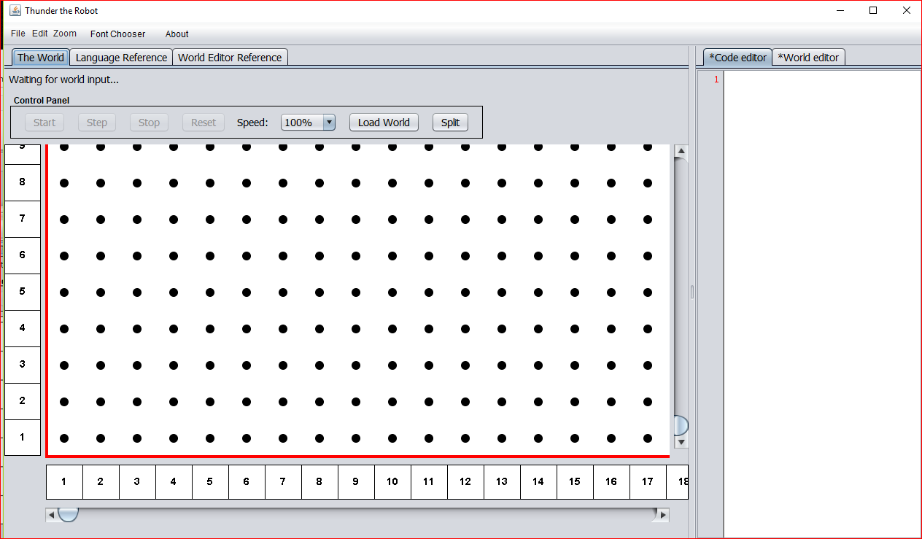

Slide 8
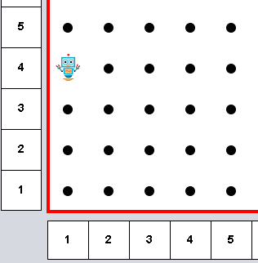
Thunder’s World from the “origin”
Dots represent intersection of streets and avenues
The robot is located at first avenue and fourth street
Think of north/south orientation as the Avenues while the streets are east/west
The robot is facing south.
This world is finite with 1,000 avenues and 1,000 streets
Think x = avenue and y = street

Slide 9
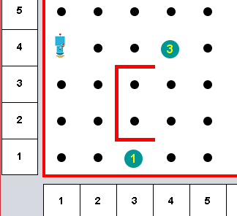
Thunder’s World (more)
World is bordered with impenetrable walls
We may build more walls in the world to pose challenges to the robot’s travel – these walls are placed between streets and/or avenues. Also note that these interior walls are also impenetrable
We may place beepers (little devices that emit a sound) at intersections. Note that the robot must be immediately over the beeper to “hear” its sound.

Slide 10
Thunder’s builtin capabilities
move -- exactly one block in direction Thunder is facing -- this can cause Thunder to explode if it strikes a wall. Note that Thunder can only move north, east, south or west.
turnleft -- rotate left exactly 90º -- Thunder can always accomplish this no matter where it is located
pickbeeper – pick up one beeper and place it in a “virtual” beeper bag – this may cause a runtime failure if there is no beeper to pick up
putbeeper – retrieve a beeper from the “virtual” beeper bag and place it at the current intersection – this may cause a runtime failure if there is no beeper in the beeper bag
turnoff – this instruction may be executed at any time and terminates the program in which it exists – the instruction must terminate any given Thunder program
Consider these the primitives of the language supporting the robot

Slide 11
Thunder’s sensors
front_is_clear
front_is_blocked
left_is_clear
left_is_blocked
right_is_clear
right_is_blocked
Wall detection tests

Slide 12
Thunder’s sensors
next_to_a_beeper
not_next_to_a_beeper
any_beepers_in_beeper_bag
no_beepers_in_beeper_bag
Beeper detection tests

Slide 13
Thunder’s sensors
facing_north
not_facing_north
facing_south
not_facing_south
facing_east
not_facing_east
facing_west
not_facing_west
Direction detection tests

Slide 14
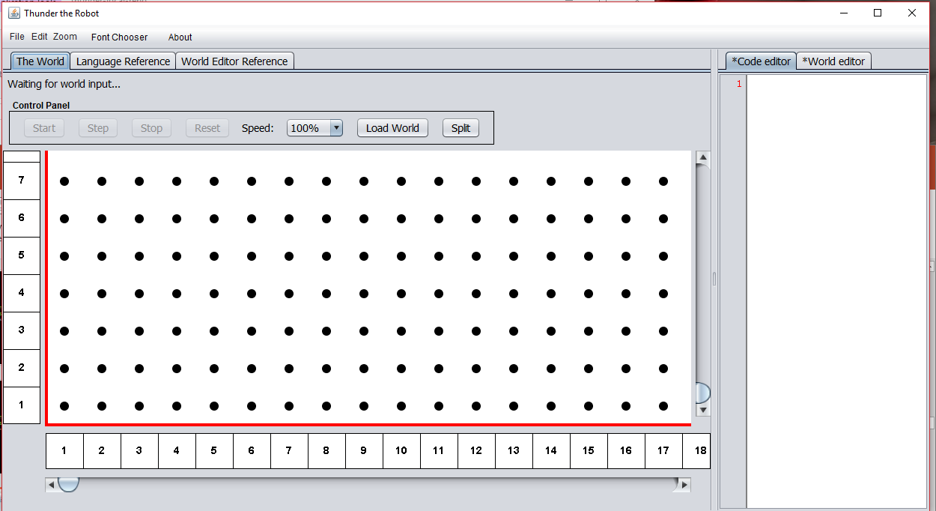

Slide 15
Simple Thunder world
First we must create the world in which Thunder will operate.
Click on the World Editor tab in the application and enter/edit the text to appear as: ROBOT 1 1 E 0
This directs the application to “draw” Thunder at 1st Avenue and 1st Street, facing East, with 0 beepers in the beeper bag.
Next, click the Load World button in the Control Panel to cause that initial scenario to be displayed. Please note positioning Thunder in the world is the only manual coding required for the world builder. Creation of walls and beepers can all be accomplished with a mouse in real time.

Slide 16
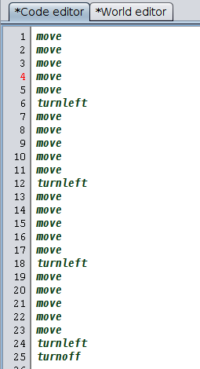
Simple Thunder program
Traverse a path that is five by five and turn off.
To avoid typing this in, first Split the editor pane away from the application pane and click File/Open Source File and navigate to the directory/folder thunder-master and load program01.thunder
One should also File/Open World File and load program01.world.
One can than launch the program by clicking Start in the Control Panel or single-step through the program with Step.

Slide 17
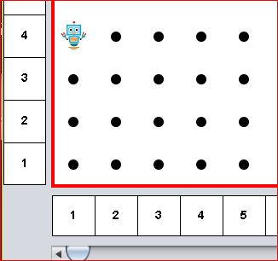
What happens if we program Thunder to move when a wall is blocking movement?
# given Thunder at 1st and 4th
# facing south
move
move
move
move
move

Slide 18
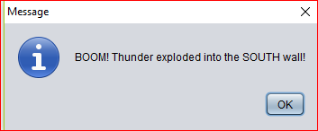
An impossible situation . .
Why? The wall is impenetrable – the robot is destructible!

Slide 19
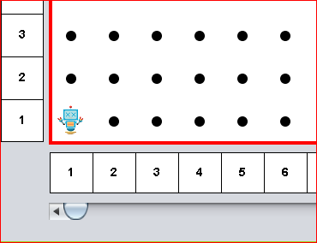
Thunder has exploded!!
Well . . . at least its brain has!

Slide 20
Control Structures
Each Thunder the Robot instruction must be on a separate line. A sequence of one or more Thunder the Robot instructions that are all indented the same number of spaces compose a block of code.
<instruction> refers to any of the five primitive instructions, conditional branching or iteration instructions, or a user defined instruction.
Thus, a block appears as: <instruction> <instruction> ... <instruction>
Sequence or “block”

Slide 21
Control Structures
Conditional branching refers to the ability of a program to alter it's flow of execution based on the result of the evaluation of a conditional. The three types of conditional branching instructions in Thunder the Robot are if and if/else and if/elif/else. In the below examples, <test> refers to one of the eighteen conditionals or sensor tests presented previously. Each <test> evaluation results in true or false.
if <test>: <block>
if <test>: <block> else: <block>
Conditional or selection
NOTE that the controlled blocks are “opened” by placing a colon ( : ) immediately after the <test>
We say that the colon “opens” a scope of control. Yes, this is very Python like (by design)
if <test>:
<block>
elif <test>:
<block>
...
elif <test>:
<block>
else:
<block>

Slide 22
Control Structures
Iteration refers to the ability of a program to repeat an instruction (or block of instructions) repeatedly. The two types of iteration instructions are the definite and indefinite.
Definite iteration is supported by the do <pos_number> where <pos_number> must be an unsigned integer greater than zero.
do <pos_number>:
<block>
Indefinite iteration means that the number of iterations can vary from none to many with termination controlled by some <test>.
while <test>:
<block>
NOTE: that the do repetition is the only place in the Thunder the Robot language where counting is possible.
Iteration repetition looping
Again note the colon ( : ) “opens” the scope of control

Slide 23
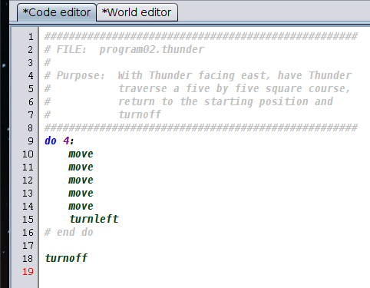
Using definite repetition
And adding comments to enhance readability
See program02.thunder
Comments? The symbol # begins a comment with the remainder of the line considered the comment. Comments are ignored by the interpreter.
This program assumes the world configuration of program01.world

Slide 24
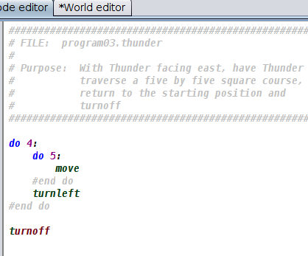
And refining a bit more
See program03.thunder
This program also assumes the world configuration of program01.world

Slide 25
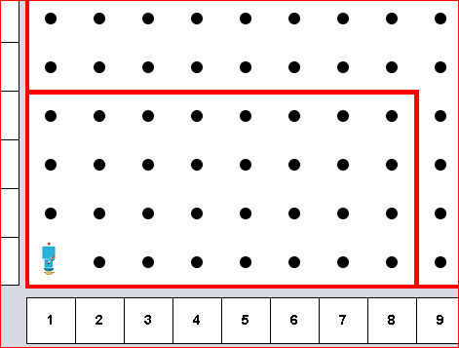
Using indefinite iteration
Yes, if we knew that the boundaries were fixed and would remain the same, we could solve this similarly to the five by five.
We can simply edit our previous program to fit the new config-uration. However, we have to edit our program for each different world configuration. We would like to arrive at a more general solution that would work for any rectangular world configuration.

Slide 26
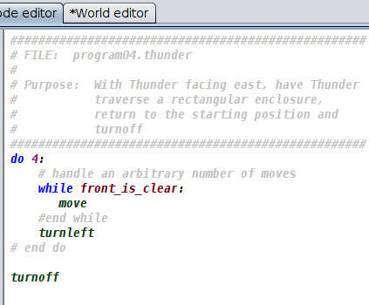
Using indefinite iteration
We have a problem similar to the previous one EXCEPT that we now have constraints (walls) that we cannot penetrate AND we do not know in advance how big the enclosure is.
See program04.thunder
This program assumes the world configuration of program04.world

Slide 27
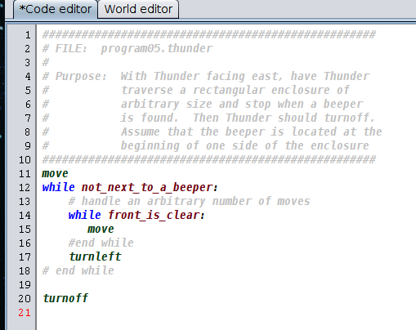
Using indefinite iteration
Now lets change the problem up just a bit. We want Thunder to walk around the enclosure until a beeper is found. Then Thunder is to turnoff. Assume that the beeper is at the beginning of one of the sides of the enclosure.
See program05.thunder and program05.world

Slide 28
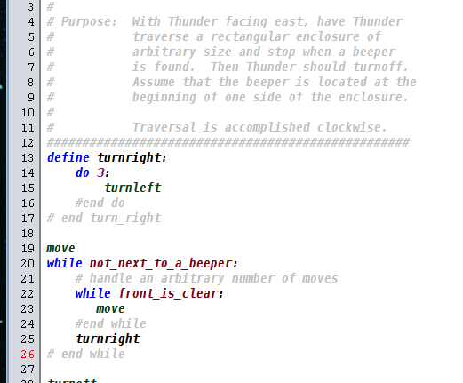
Introducing procedural abstraction
Now lets change the problem up just a bit. We want Thunder to walk around the enclosure until a beeper is found. Then Thunder is to turnoff. Assume that the beeper is at the beginning of one of the sides of the enclosure. However, instead of completing the course counter clockwise, we want to navigate the course clockwise.
Problem!! Thunder does not know how to turn right. We can define a new instruction, however.
See program06.thunder and program06.world

Slide 29
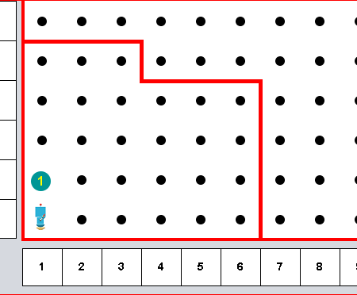
A challenging problem
Navigate an enclosure that has irregular shape and stop when on top of a beeper.
See program07.world
Issues:
Cannot collide with a wall
Must navigate around walls that fall away from us
Strategy:
How do we follow the wall?
One strategy is to always follow the wall to the right

Slide 30
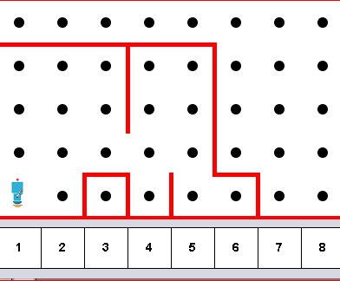
Let’s add some more complexity to world
See program07a.world

Slide 31
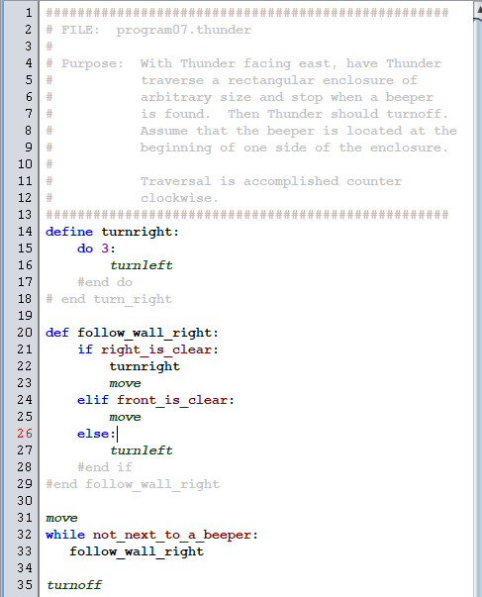
Follow wall to the right
See program07.thunder

Slide 32
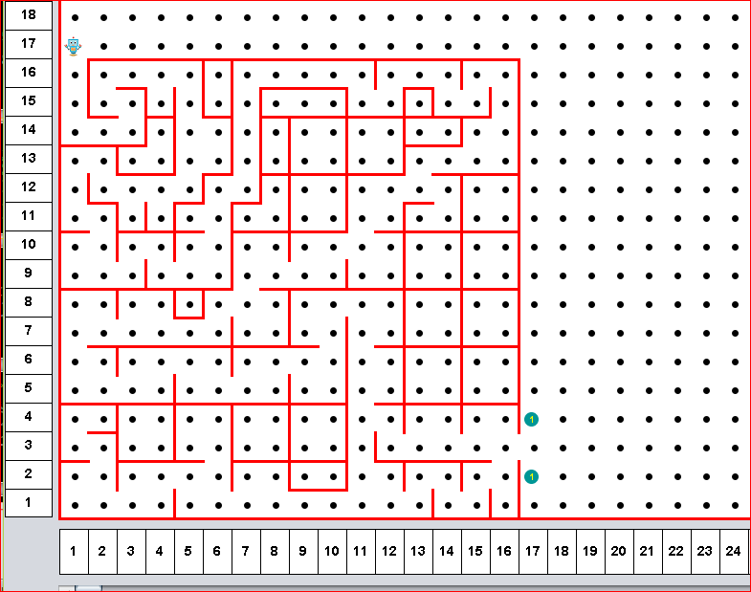
follow_wall_right good for navigating a maze
Assume that there are NO islands in the maze
Assume that we place a beeper to the right of the single exit from the maze
Assume that we position Thunder so that it is at the entrance
See mazeBig.world

Slide 33
How about cleaning trash from an enclosed park?
An enclosed “park” of arbitrary length and arbitrary width ( avenues and streets) contains scattered piles of beepers. It is Thunder’s responsibility to start in the southwest corner of the park facing east and sweep by street and clean up all the piles of beepers.
Once all the beepers are cleaned up, they are to be deposited in the northeast corner of the park.
Then Thunder is to return to the southwest corner, face east and turn off.
See cleanTrash.thunder and trash1.world and trash2.world

Slide 34
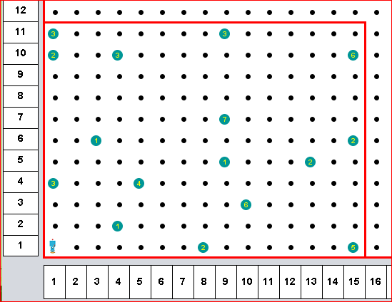

Slide 35
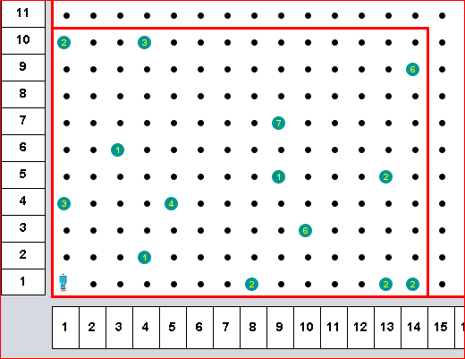

Slide 36
How about “sorting” into ascending order the heights of columns of beepers
See Sort.thunder and Sort.world
Givens:
“stacks” of beepers of arbitrary height from zero to many
Each vertical position of the “stacks” is represented by a single beeper at an intersection
Arbitrary number of “stacks”
“stacks” are bounded on east and west by a wall that is at minimum at least one unit higher than the height of the tallest “stack” of beepers
“stacks” of beepers are guaranteed to exist in a situation in which there is an empty “stack” on the west and the east of the “stacks” to be considered
Thunder is to start the sort by facing east at 1st Avenue and 1st Street and is to return to the “home” position at 1st Avenue and 1st Street.
Solution was developed under constraint that the “main” logic is to drive what happens including turning off.

Slide 37
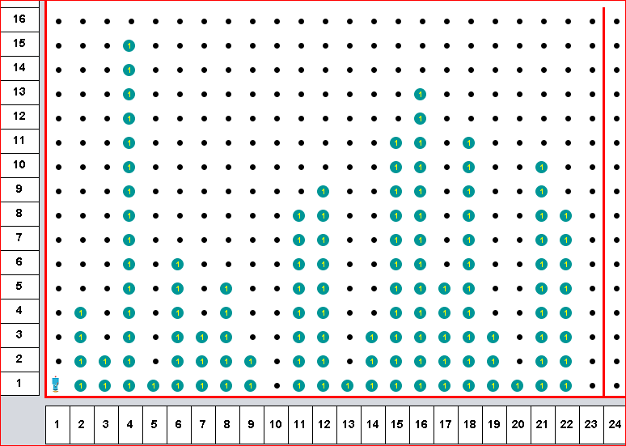

Slide 38
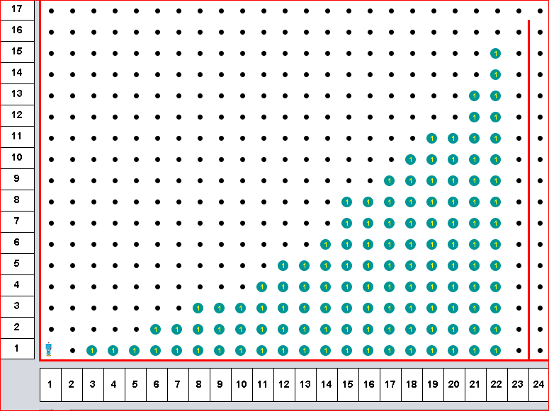

Slide 39
Iteration vs. Recursion
Iteration
Recursion
def face_east: while not_facing_east: turnleft #end while # end face_east
def face_east: if not_facing_east: turnleft face_east #end if # end face_east

Slide 40
That’s all . . . . .
Questions?
Comments?
Observations?
Presented by:
H. Paul Haiduk Computer Science Coordinator West Texas A&M University hhaiduk@wtamu.edu
Presentation available on github @ https://github.com/HHaiduk/thunder

Slide 41
The End

