Slide 1
Aspirations in Computing
Panhandle STEM Conference, July 23-24, 2018
Presented by: H. Paul Haiduk Computer Science Coordinator Regional Coordinator West Texas A&M University Panhandle Plains Community
hhaiduk@wtamu.edu Aspirations in Computing

Slide 2
Let’s Look at Some Facts
Source: NCWIT -- https://www.ncwit.org/resources/numbers

Slide 3
Crisis in Talent . . .
Number of U.S. computing-related job openings expected by 2026 – 3.5 million or 3,500,000
Percent of these jobs that could be filled by U.S. computing bachelor’s degree recipients by 2026 – 17%
Simple arithmetic yields nearly 3 million computing jobs will go begging for bachelor’s degree holders
Market place opportunities in computing at an all-time high – simple micro-economics in action means very high salaries for a very limited supply of properly trained talent irrespective of gender, race, etc.

Slide 4
Crisis in gender . . .
2017 demographics for women in the workforce
57% of professional occupations held by women
26% of professional computing occupations held by women
17% of Fortune 500 Chief Information Officer (CIO) positions held by women

Slide 5
Crisis in gender . . .
2017 demographics for women taking AP exams
56% of AP test takers were female
47% of math AP test takers were female
23% of Computer Science AP test takers were female

Slide 6
Crisis in gender . . .
2016 demographics for bachelor’s degrees earned
57% of the all recipients were female
19% of Computer and Information Sciences recipients were female
18% of Computer Science recipients were female contrasted with 37% in 1985

Slide 7
Crisis in gender/ethnicity . . .
2017 demographics for women in computing workforce – remember 26% total
3% were African-American vs. 12.7% of entire workforce
5% were Asian
1% were Hispanic vs. 17.1% of entire workforce

Slide 8
2018 reality check . . .
At WTAMU percentage of female students remains overall below 10%
At WTAMU most CS students have contract in hand by summer between junior and senior year AND 99% of all graduates have job immediately upon graduation
All CS students are aggressively recruited beginning in their freshman year by the likes of Bank of America, BMC Software, CA Technologies, CGI, Experian, Fidelity Investments, Google, IBM, Texas Instruments, Visa, etc. Female students are super-aggressively recruited.
Summer internships offering $25 to $35 an hour for 10 to 12 weeks including housing for the duration and transportation to/from, especially for more distant locations.
Starting salaries for 2018 graduates appear to be ranging $75K to $90K and better with signing bonuses of $5K to $10K

Slide 9
What can you do and what resources are available?

Slide 10

NCWIT
Only non-profit focused on women’s participation in computing
Community of over 1100 universities, companies, non-profits, and government organizations
Notes:
The National Center for Women & IT, or NCWIT, is the only national non-profit focused on women’s participation in computing across the entire ecosystem.
a community of over 1100 universities, companies, non-profits, and government organizations nationwide working to increase girls’ and women’s meaningful participation in computing.
NCWIT equips change leaders with resources (promising practices, statistics) to help them take action in recruiting, retaining, and advancing women in tech from K–12 and higher education through industry and entrepreneurial careers.

Slide 11
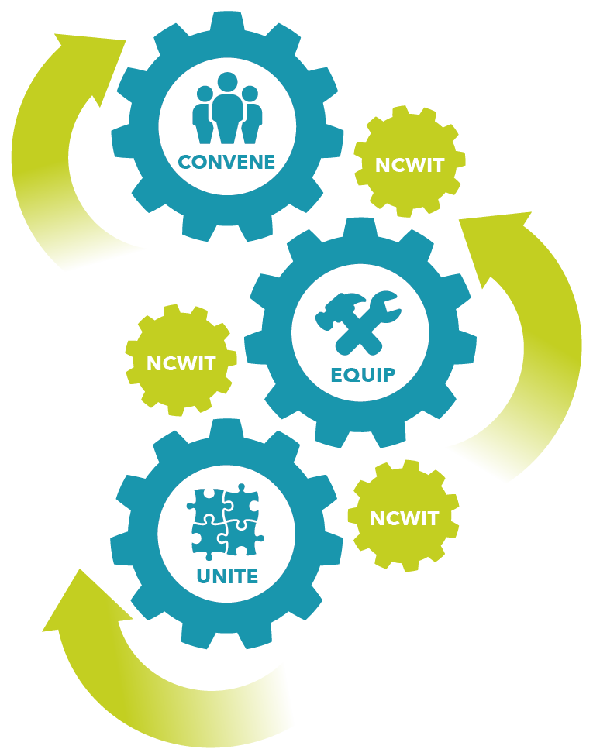
NCWIT – Change Leaders
NCWIT was established in 2004, with support from the National Science Foundation, with a mission to significantly increase girls’ and women’s meaningful participation in computing.
Notes:
Established in 2004 with help from the National Science Foundation
Mission to significantly increase girls’ and womens’ participation
At it’s core, NCWIT convenes, equips, and unites change leaders

Slide 12
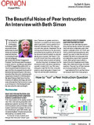

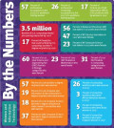
NCWIT - Equips
NCWIT provides free, online research-based resources
Reform at every level and every audience
Helps implement change, raise awareness, and reach out to critical populations.
https://www.ncwit.org/resources
Notes:
NCWIT provides free, online research-based resources for reform at every level to help individuals implement change, raise awareness, and reach out to critical populations.
These resources are frequently cited by national media outlets and widely distributed through outreach events and members’ networks.

Slide 13

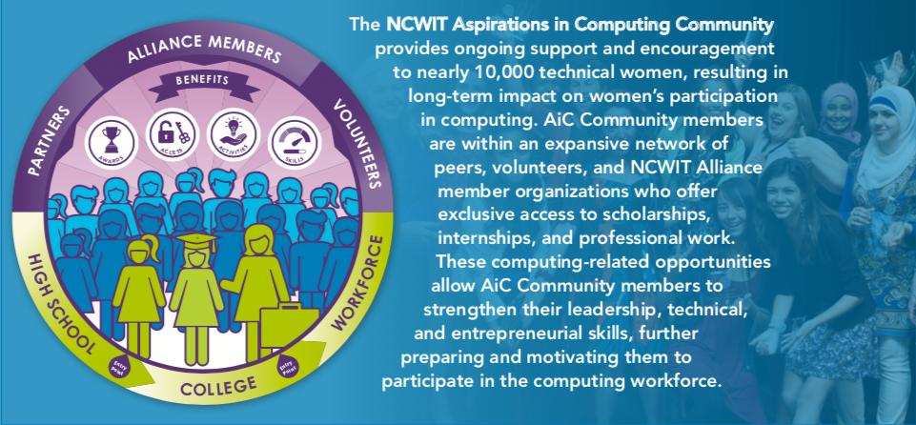
A Community of Support

Slide 14
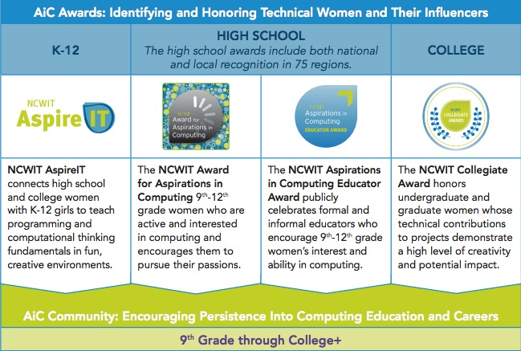
The AiC Journey

Slide 15
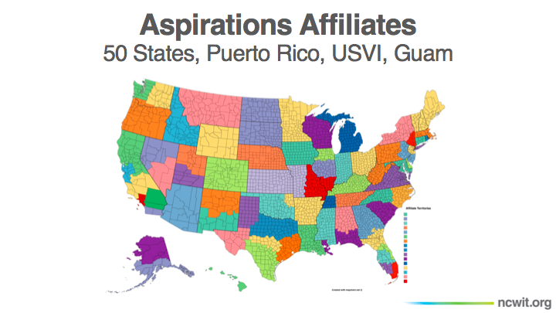

Slide 16
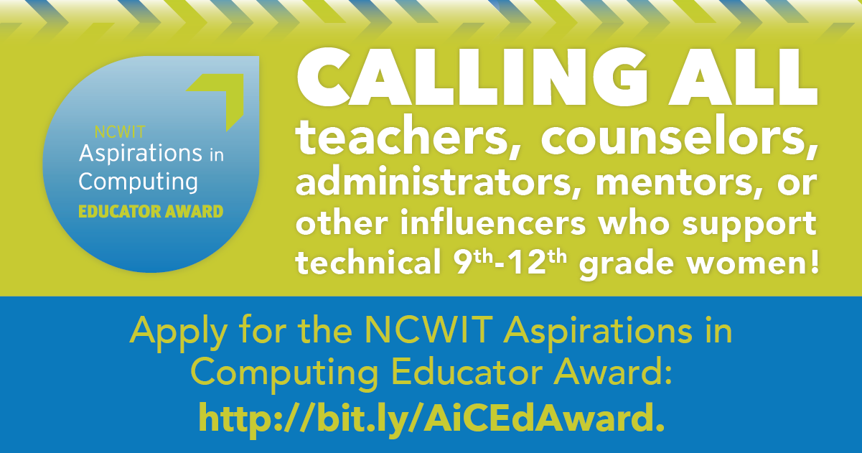

Slide 17
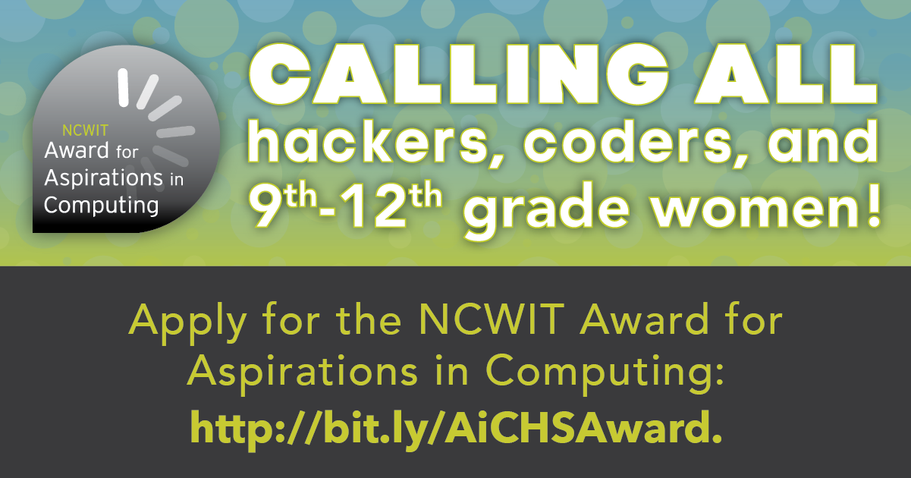

Slide 18
Process and where you can make a difference
Starting Sept. 1, applications open for high school girls ages 15 up. Please note that this initiative is for “aspirations” – meaning some demonstrated desire to be in computing. We know that many girls have financial challenges, little family support, etc. Do they demonstrate real aspirations to , perhaps, be the first family member to go to university?
Your help in guiding them through the process can make the difference. And your willingness to give them a recommendation.
Applications close in October or November. Then applications are reviewed with winners and runners up selected
Similar process for teachers, counselors, etc.

Slide 19
And then in spring – Awards Ceremony
In past held on WTAMU campus in conjunction with a technology outreach event – sometime February through early April
YOU can make a profound difference in the lives of these girls!
Resources

Slide 20

https://www.aspirations.org/aspirations-community/texas-panhandle-plains
Named after TPWD region designation – includes all of Regions 16 and 17

Slide 21
That’s all . . . . .
Questions?
Comments?
Observations?
Presented by:
H. Paul Haiduk Computer Science Coordinator West Texas A&M University hhaiduk@wtamu.edu
Presentation available on github -- https://github.com/HHaiduk/thunder

