Slide 1
SCRATCH with a dash of Python
Panhandle STEM Conference – July 23-24, 2018 Presented by:
H. Paul Haiduk David Kossey Computer Science Coordinator Computer Science/Robotics/Math West Texas A&M University West Texas High School hhaiduk@wtamu.edu david.kossey@pspcisd.net

Slide 2
Objectives
Introduce participants to use of a “block-based” approach to implementing algorithms
Participants will be able to use Computational Thinking to solve problems
Participants will be able to apply Computer Science Principals to write simple/complex programs
But . . . First things first. Navigate your browser to https://scratch.mit.edu and join if you have not already done so. Otherwise, login so that we can begin our work together.

Slide 3
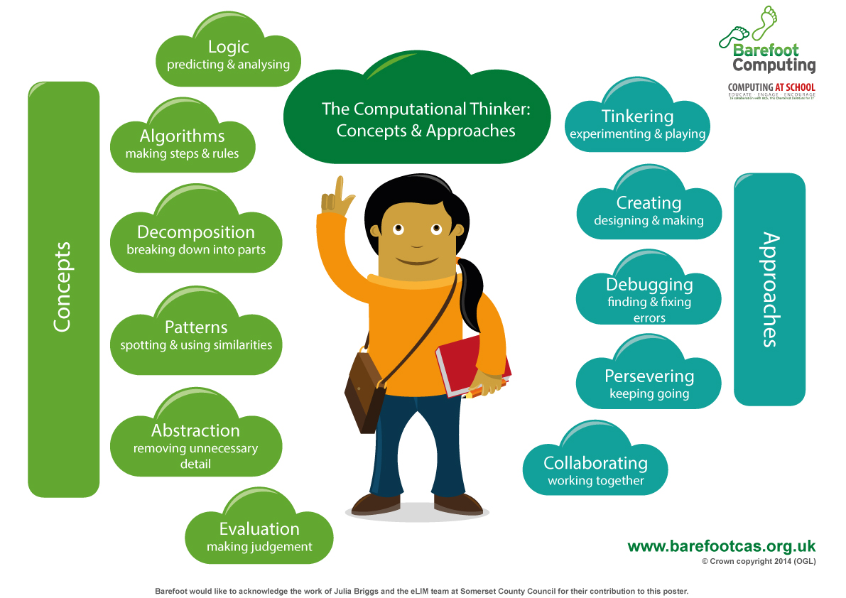
Computational Thinking

Slide 4
Computational Thinking Definition
Computational Thinking is the thought processes involved in formulation of problems and their solutions so that the solutions are represented in a form that can be effectivity carried out by an information-processing agent (Cuny, Snyder, Wing, 2010)

Slide 5
Programming Control Structure
Sequence of Steps
Selection/decision/IF statement
Repetition/loop/iteration

Slide 6
Learning to program: Difficulties for beginners
Syntax errors
struggle for hours to fix syntax errors
Loose confidence
Frustrating experience
Run away & never come back if possible!

Slide 7
Why start with block-based?
Visual Programming Tools like Scratch & Trinket use drag-and-drop programming and enable us to master programming concepts.
Programs are always ready to run since there are no syntax errors. In other words, they enable us to focus on the logic first & build confidence.
Following is a meaningful approach:
Scratch→ Trinket (Block/Text Based)→Text based Thunder the Robot → Text based Python

Slide 8
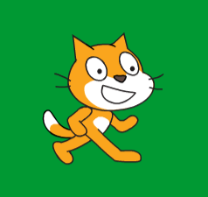
What is Scratch
Scratch is a visual programming environment where you design/create your interactive stories, games & animations. While Scratch has been designed with a typical 3rd or 4th grader in mind, people of all ages can use it to learn the basics of programming in an enjoyable way!
Scratch involves drag and drop of various blocks together to write programs & such an environment enables the users to focus on the logic & enjoy the learning experience

Slide 9
What is Scratch
Unlike most Python/Java development environments, there is NO free-form typing, so there are no syntax errors!
Scratch is not limited to young people though - people of all ages with no programming experience can enjoy its simplicity and learn the basics of programming!

Slide 10
Getting Started!
Home: http://scratch.mit.edu/
Each object in Scratch is called a sprite. Default sprite is a cat.
The background for the sprite is called Stage OR backdrop.
Scripts can be dragged and placed/appended on to the grey workspace (towards right). Each group of scripts is run by double-clicking the first block of script OR by triggering the event.
New sprites and backdrops can be added. Each sprite and backdrop is associated with respective sequence of scripts.

Slide 11
Getting Started!
Home: http://scratch.mit.edu/
Each object in Scratch is called a sprite. Default sprite is a cat.
The background for the sprite is called Stage OR backdrop.
Scripts can be dragged and placed/appended on to the grey workspace (towards right). Each group of scripts is run by double-clicking the first block of script OR by triggering the event.
New sprites and backdrops can be added. Each sprite and backdrop is associated with respective sequence of scripts.

Slide 12
Getting Started!
Some other Scratch educator resources:
Visit the ScratchEd website, a community of educators that help each other learn and use Scratch. You can find lessons, activities, project ideas, or simply have your questions answered by a friendly fellow educator.
Creative Computing Workshop is a free online workshop where you can learn more about using Scratch and supporting computational thinking.
Scratch Day is a worldwide network of gatherings, where Scratchers meet up, share projects and experiences, and learn more about Scratch. Great for kids and adults!
The book Learn to Program With Scratch: A Visual Introduction to programming with Games, Art, Science, and Math © 2014 by No Starch Press – in 7th printing

Slide 13
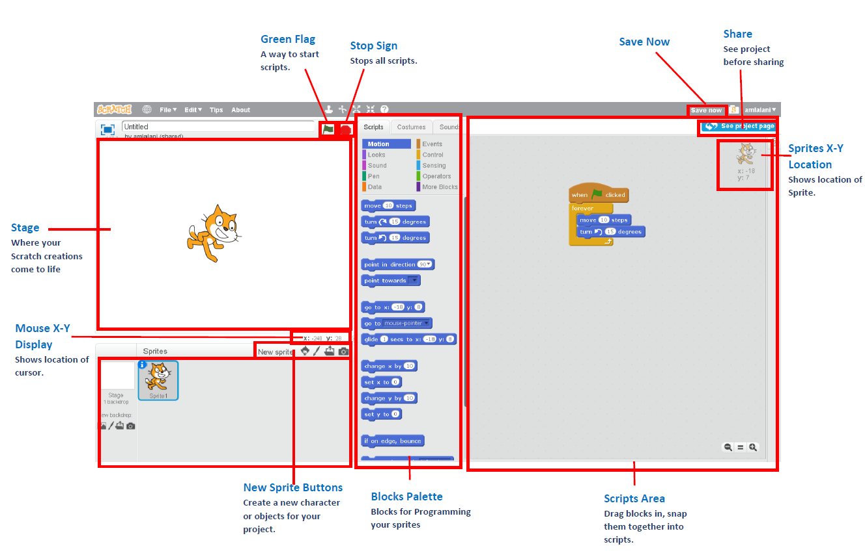
SCRATCH INTERFACE

Slide 14
Variables
A program can work with a value, e.g. 1, 3.14, “Hello World!”
Variables - instead of working with a specific value, we give a name to the value and manipulate the value by referencing the name.
Variables are one of the most powerful features of programming languages. Allowing us to store and manipulate information.

Slide 15
Types of Variable
Every variable has a data type: a classification identifying what kind of information it contains–such as floats, integers, or strings.
Common Data Types:
int: integer
float: floating point number (numbers with decimals)
str: string (text)

Slide 16
Variables
Examples:
message = “Hello World!”
n = 17
pi = 3.1415926535

Slide 17
Variable Names & Keywords
Conventions for naming your variable:
Descriptive: document what the variable is used for
Begins with a letter: preferred to use lower case letter
Use underscore to separate multiple words - e.g. first_name, heart_rate (called snake case)
Try to be concise: variable names can be arbitrary long though it harms the readability of the program
Do not use reserved words (Keywords), e.g. and, break, else, if.
Notes:
Note that naming conventions are language specific (snake vs camel, etc).

Slide 18
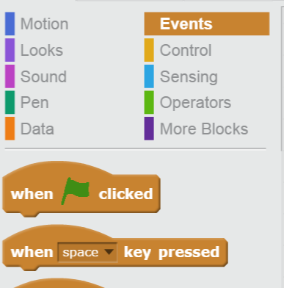
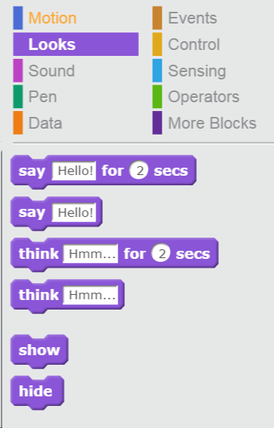
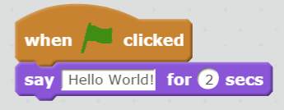
Hello World on Scratch

Slide 19
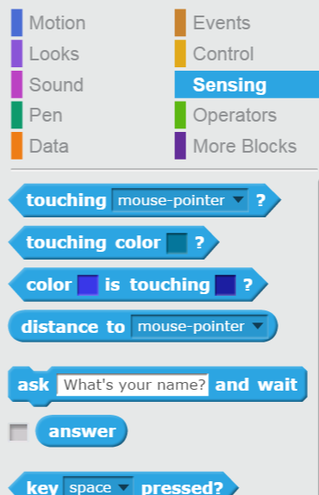
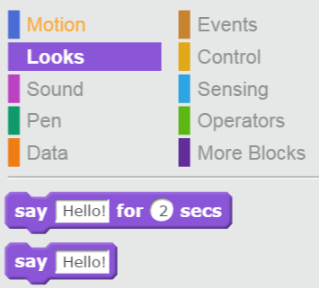
Hello Name on Scratch

Slide 20
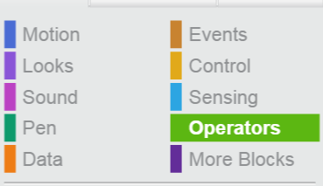
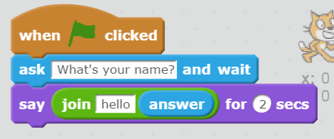
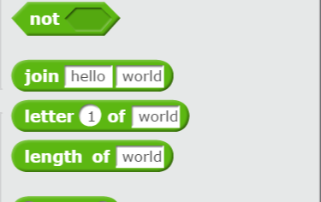
Hello Name on Scratch

Slide 21
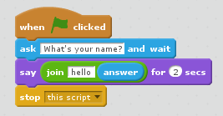
Hello to you in Scratch

Slide 22
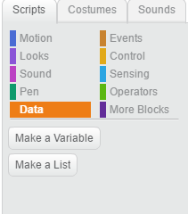
Making Variables
To make a variable, go to the “Data” menu and select “Make a Variable”
Enter the name of your variable in the pop up window.
Press Enter!

Slide 23
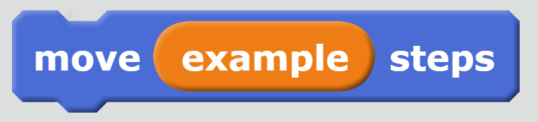
Using Variables
To use a variable in a program
Navigate to the “Data” tab
Grab the orange block with your variable’s name on it
Place the orange block anywhere in your program that you would normally use a value

Slide 24
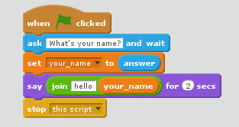
Say Hello to your_name

Slide 25
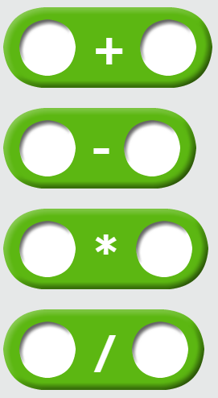
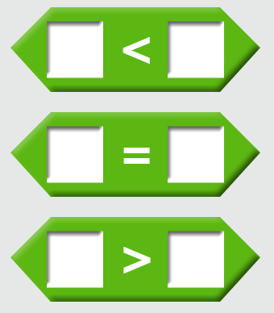
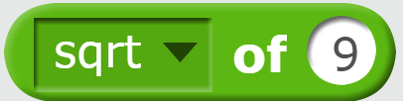
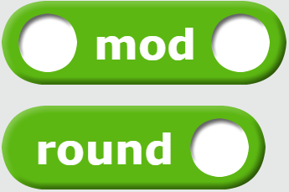
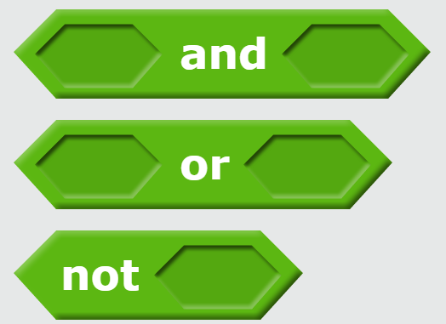
Operators
Operators are the constructs which can manipulate values or values of variables or expressions (operands).
Types of Operators
Arithmetic Operators
Relational (Comparison) Operators
Assignment Operators
Logical Operators
Membership Operators
Identity Operators
Notes:
Not all of the operators listed are directly available in scratch.

Slide 26
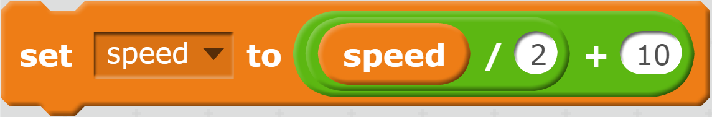
Expressions
Now let's try to combine variables and operators:
An expression is a combination of values, operators, variables, and expressions that evaluates to a single value.
For example: If speed is 50, what does ((speed / 2) + 10) evaluate to?
This is an
expression.

Slide 27
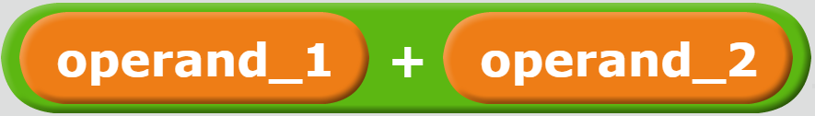
Operators vs Operands
operator: special symbol represents computation
operand: values/variables/expressions the operator is applied to
Operands can be fixed values, variables or even expressions!
OPERATOR

Slide 28
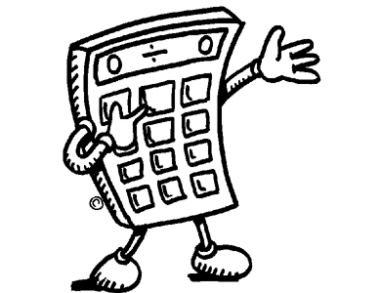

Arithmetic Operators
Arithmetic Operators work like normal arithmetic.
When evaluated, they return values.
Notes:
Image from: http://www.clipartbest.com/clipart-RcAKk57cL

Slide 29
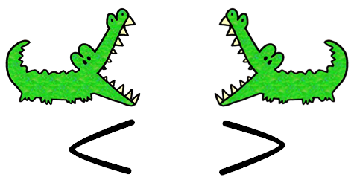
Comparison Operators
Comparison Operators are either true or false, depending on the operands.
Notes:
Image from: http://www.clipartbest.com/clipart-4T9LKEBXc

Slide 30

Your turn!
Make a Scratch program that converts temperatures from Fahrenheit to Celsius.
$$T_{C}={(T}_{F} −32) ∗\frac{5}{9}$$

Slide 31
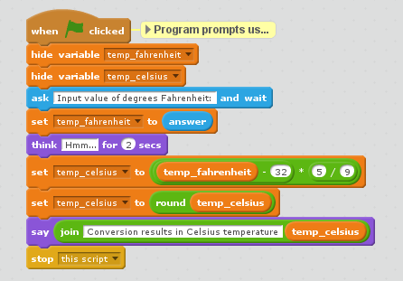
Notes:
Stored in F_to_C.sb

Slide 32
Decisions
We often must write our programs to behave differently depending upon conditions
If the number is zero print ‘zero’, otherwise, print ‘not zero’
Is number equal to zero?
Yes
No
print ‘zero’
print ‘not zero’
Notes:
Each trainer will introduce themselves. Name, CS connections/background, and any k-12 experience/outreach

Slide 33
Conditionals
Common conditionals
< less than
<= less than or equal
> greater than
>= greater than or equal to
== equal
!= not equal
Notes:
It is important to emphasize that the comparison operator ‘==‘ is different than the assignment operator ‘=‘, as this is a common source of confusion for beginning programmers, and in python getting the two flipped will often result in strange behavior rather than an error.

Slide 34
Examples
If n is assigned a value of 10…
n < 10 is False
n <= 10 is True
n > 5 is True
n >= 5 is True
n == 10 is True
n != 10 is False

Slide 35
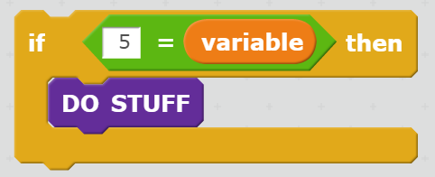
If Statement
If the conditional is true, the program will execute the statements in the “DO STUFF” section.
Otherwise, nothing will happen.
CONDITIONAL EXPRESSION
Executable Statements

Slide 36
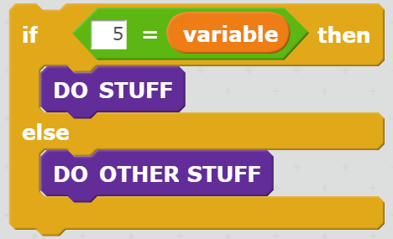
If/Else Statement
Much like the if statement, except now if the condition is false, the “DO OTHER STUFF” block is executed.
Under all circumstances, exactly one of the code blocks will execute, either “DO STUFF”, or “DO OTHER STUFF”

Slide 37
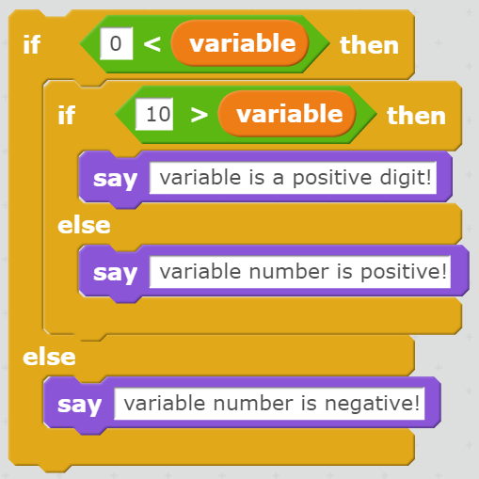
Nested If Statements
If statements and if/else statements can be nested, to give more complex behavior.
What does the program on the right say if variable is:
-7
15
4

Slide 38
Looping
We often want to repeat an action
Example
print an asterisk 10 times
counter = 1
while counter <= 10
True
print(‘*’)
counter += 1
False
…

Slide 39
For Loop
Looping in a range is so common, there is a “For” loop
One use of a For loop is executing a certain number of times

Slide 40

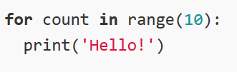
Looping with Scratch
What do you think the following code will do?
Compare the block based to text based coding.
Caution: Scratch displays “Hello” 10 times in same spot – Python displays “Hello” on 10 lines vertically
*Index for block based starts at 1. However, for text based, it starts at 0.
Notes:
Mention that we do not have to add one each time to increase count. If participants don’t notice, point to the need for
colon and to indent when working with text based programming.

Slide 41
For Loop
The for loop below starts with counter taking on the values 1 up to BUT NOT INCLUDING 11 with a step size of 1
for counter in range(1, 11, 1):
print('*')

Slide 42
Difference between for loops and repeat until loops
Repeat until loops use a condition to determine the number of steps
-Example, repeat until you are tired, do pushups
-NOTE: The Scratch repeat until tests the condition before entering the block it controls Thus, it is really a while loop BUT condition is reversed
NOTE: Python has no repeat until – it does, however, have a while
For loops have a set number of steps
-Example, you must do 10 pushups

Slide 43
Repeat Until/While Loop Application
In a loop, continually request numbers as input and then print them as long as they are even
Example output: What is your number? 4 4 What is your number? 2 2 What is your number? 3 You entered an odd number.
Notes:
Giving example output often clears up confusion about the problem statement!

Slide 44
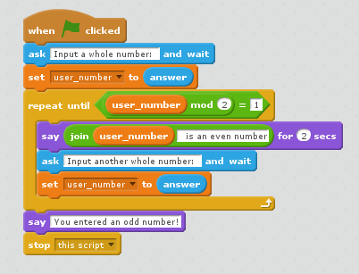
While Loop Application – Solution (Blocks)

Slide 45
While Loop Application – Solution (Text)
user_number = int(input('Enter a whole number: '))
while user_number % 2 == 0:
print( user_number, 'is an even number')
user_number = int(input('Enter another whole number: '))
#end while
print('You entered an odd number!')

Slide 46
Common Problems
An ”infinite loop” occurs when a while loop goes forever and never meets the condition to stop!
If you accidentally initialize a variable to something that does not pass the condition, it will not enter the loop
i = 1 while i < 10: print(i)
#end while
i = 11 while i < 10: print(i)
i += 1
#end while
Notes:
The first example will print 1 forever since i is not changing (being incremented) within the loop. The second example won’t print anything at all.

Slide 47
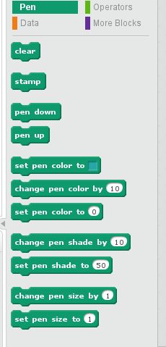
Trinket – Shapes with Turtle
We can use the blocks within pen to create shapes.
Notes:
Spend a few minutes to help participants feel comfortable with the blocks within turtle. Blocks such as, shape, move, turn, pen, and fill.

Slide 48
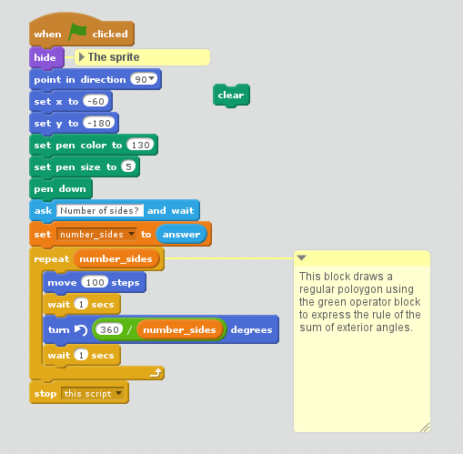
Scratch – Regular Polygon Application
Write a program that takes in the number of sides (greater or equal to 3) in a regular polygon and creates the corresponding regular polygon. For example, if you input a 4, your pen should draw a square.
Notes:
Have participants verbalize what each block is doing.

Slide 49
Lists
Arrays in Python are referred as Lists, and are slightly different from other traditional programming languages such as C or Java
A List is a sequence of values in Python, where in the sequence the values can be of various data types.
For example:
[10, 20, 30, 40] list of integers
['Club', 'Spade', 'Diamond', 'Heart'] list of strings
[‘h. paul’, 12345, 26, ‘WTAMU’] list of integers & strings
NOTE: Python lists can be of any type, so you can mix e.g. integers, strings, etc in lists.
Notes:
Arrays are only one data type. Lists in python can have any datatype in the same list.

Slide 50
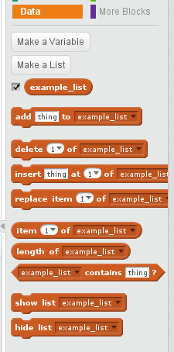
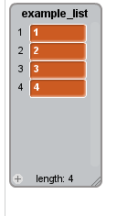
Lists Block/Text Based
To create a list in Python, simply enclose the elements (separated by comma) in square brakets
To create a list in Scratch, Make a List and then go to stage and click the + on length to get number of elements desired and fill in values.
For example: [1, 2, 3, 4]
Notes:
If you want to add more items when using trinket, click on the tool icon and drag additional items within the list.

Slide 51
Accessing Elements of a List
Traversing a list visits each value in a list in order.
We can also visit a specific element(s) within a list in order to use the value or modify the value

Slide 52

Accessing an element in a list
We can visit/modifty any element in list by specifying index (text based starts at 0 and block based starts at 1):
In Scratch, we create the list example_list, expand its length to four elements manually, enter the values, and then can display the first value in list with:
For example: example_list= ['cheddar', 'swiss', 'gouda‘, ‘limburger’]
print(example_list[0])
Notes:
Remind participants that text based starts the index at 0 and block starts at 1. Also, -1 will give you the last element of the list.

Slide 53
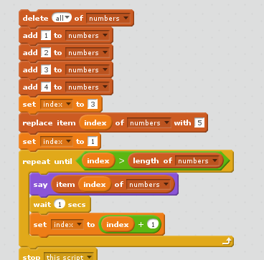
Modifying an element of a list
We can visit/modifty any element in list by specifying index:
For example: numbers = [1, 2, 3, 4]
numbers[2] = 5
print(numbers)
Notes:
Note that the third position in the list is index 2 in the text-based example since the indexing starts at 0.

Slide 54
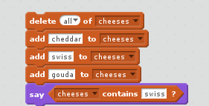
Finding an element within a list
Operator | Description
in | Evaluates to true if it finds a value in the specified sequence and false otherwise.
not in | Evaluates to true if it does not finds a value in the specified sequence and false otherwise.
cheeses = ['cheddar', 'swiss', 'gouda']
print(‘swiss’ in cheeses)
The output of these would be true since ’swiss’ is in the cheeses list.
Notes:
Both case and whitespace matter! ‘Swiss’ or ‘swiss ‘ would not work.

Slide 55

When working with List
The index of First Element in a list is 0 for text based and 1 for block based.
Use function len(list name) returns the number of elements in the list.
Use function range(n) returns a list of Indices from 0 to n-1, where n is length of the list.
Use listname.reverse() to reverse the elements within the list (text based only)
Use listname.sort() to sort the elements in ascending order (text based only)
Notes:
To find the last value in the list, use -1
Print(list name[-1]) will print the last element in the lsit

Slide 56
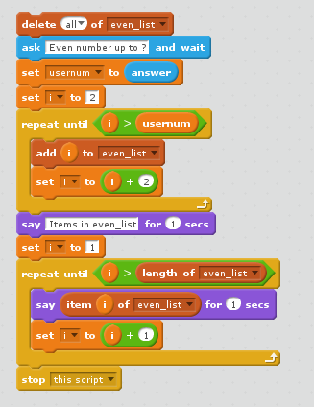
Exploring Lists
Take a number and store in a list only even numbers up to the number provided by the user. NOTE: Code for Scratch uses variable even_list.
#Python code
even_list = [ ]
usernum = int(input('Even number up to ?'))
for i in range(2, usernum+1, 2):
even_list.append(i)
#end for
print('Items in even_list')
print(even_list)
Notes:
Extension: modify the program to take two parameters, the first would be number up to and the second would be the desired multiples (2, 3, 4, etc).

Slide 57
Procedural Abstraction
One programming skill is “decomposition”.
Break a larger problem down into smaller problems
Example:
Write a program that takes a number as input and if the number is an integer print if the number is ‘zero’, ‘less than zero’, or ‘greater than zero’
Notes:
Each trainer will introduce themselves. Name, CS connections/background, and any k-12 experience/outreach

Slide 58
Sample problem
We can decompose the example and solve each part
Example:
Print if the number is ‘zero’, ‘less than zero’, or ‘greater than zero’
Take a number as input
If the number is an integer…
Print if the number is ‘zero’, ‘less than zero’, or ‘greater than zero’

Slide 59
Print if the number is ‘zero’…
Can take one part of the problem and further decompose that part
This decomposition now resembles computer pseudocode
Can write this part of the program as a “procedure”
If the number is zero…
Print number ‘is zero’
else if the number is less than zero…
Print number ‘is less than zero’
else…
Print number ‘is greater than zero’

Slide 60
Why procedures?
Can write parts of the program
Useful when the whole program is too big to grasp at one time
Allows us to test pieces of the program before building on those pieces
Allows us to reduce redundancy by creating functions that get called multiple times

Slide 61
Procedures/Functions in Python
Create a function in Python using the def keyword
def is followed by the function name
Parameters, if any, follow the function name
The body is indented following the definition

Slide 62
Defining a Procedure(Text)
def relative_to_zero(num):
if num > 0:
print(num, “is greater than zero”)
elif num < 0:
print(num, “is less than zero”)
else:
print(num, “is zero”)
#end if
#end relative_to_zero

Slide 63
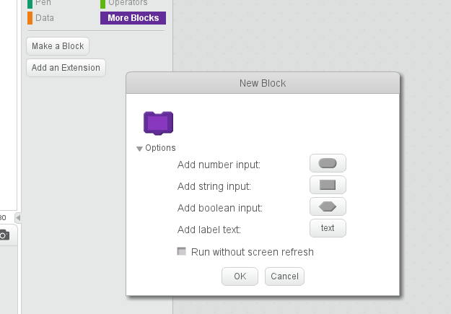
Defining the procedure in Scratch

Slide 64
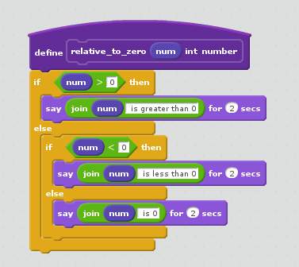
The procedure in Scratch

Slide 65
The Python program testing relative_to_zero procedure
#!/usr/bin/env python3
def relative_to_zero(num): if num > 0: print(num, "is greater than zero") elif num < 0: print(num, "is less than zero") else: print(num, "is zero") #end if #end relative_to_zero
# main program starts here answer = 'Y'
while answer in ['y', 'Y']: user_num = int(input("Please input an integer number ")) relative_to_zero(user_num) answer = input("Do you wish to input another number? <y,Y> ") #end while

Slide 66
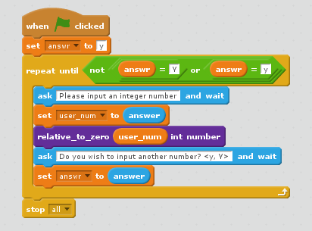
The Scratch program testing relative_to_zero procedure

Slide 67
NOTE: No functions in Scratch
There is no function defining mechanism in Scratch 2.0 – the current version of Scratch
There appears to be no function defining mechanism in Scratch 3.0 – although there are many voices requesting such.

Slide 68
That’s all . . . . .
Questions?
Comments?
Observations?
Presented by:
H. Paul Haiduk David Kossey Computer Science Coordinator Computer Science/Robotics/Math West Texas A&M University West Texas High School hhaiduk@wtamu.edu david.kossey@pspcisd.net
Presentation available on github @ https://github.com/HHaiduk/thunder

