Slide 1
Data Center Hosting Maps

Slide 2
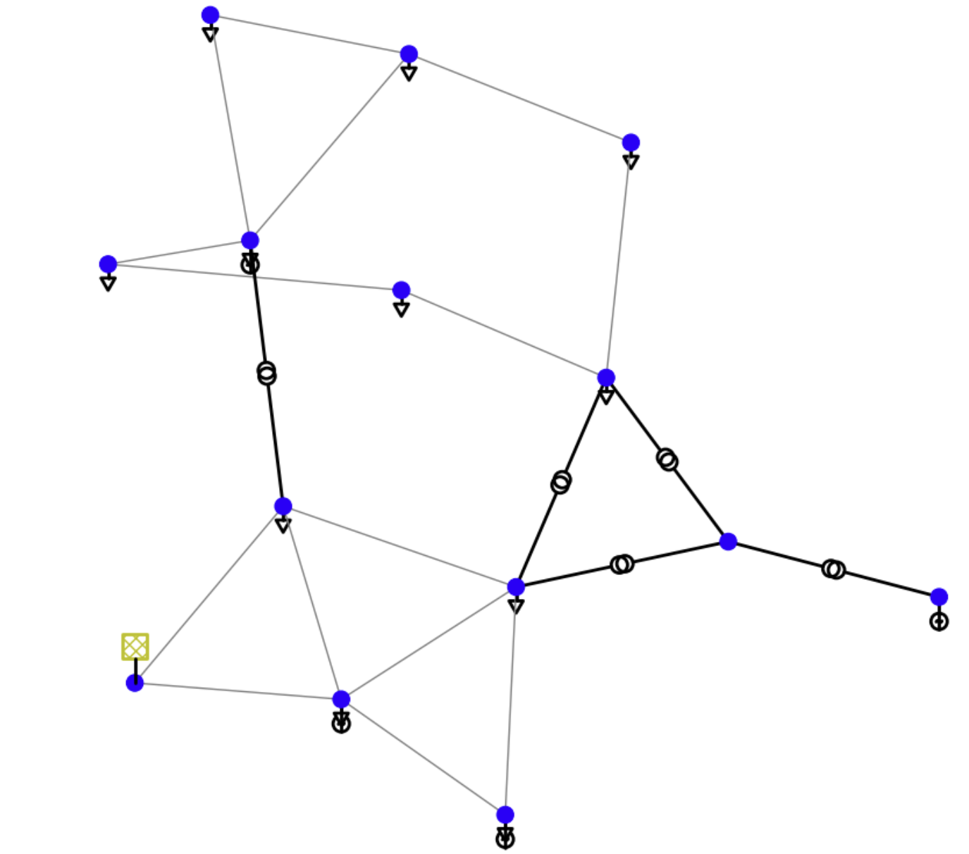
11
13
12
R20
R10
14
8
9
13
R0
Start with a simple grid – IEEE14
7
5
10
R60
9
11
R30
12
R40
10
2
R50
8
4
4
1
R70
6
1
6
4
0
3
7
3
3
R80
1
0
0
5
R100
2
2
R90

Slide 3
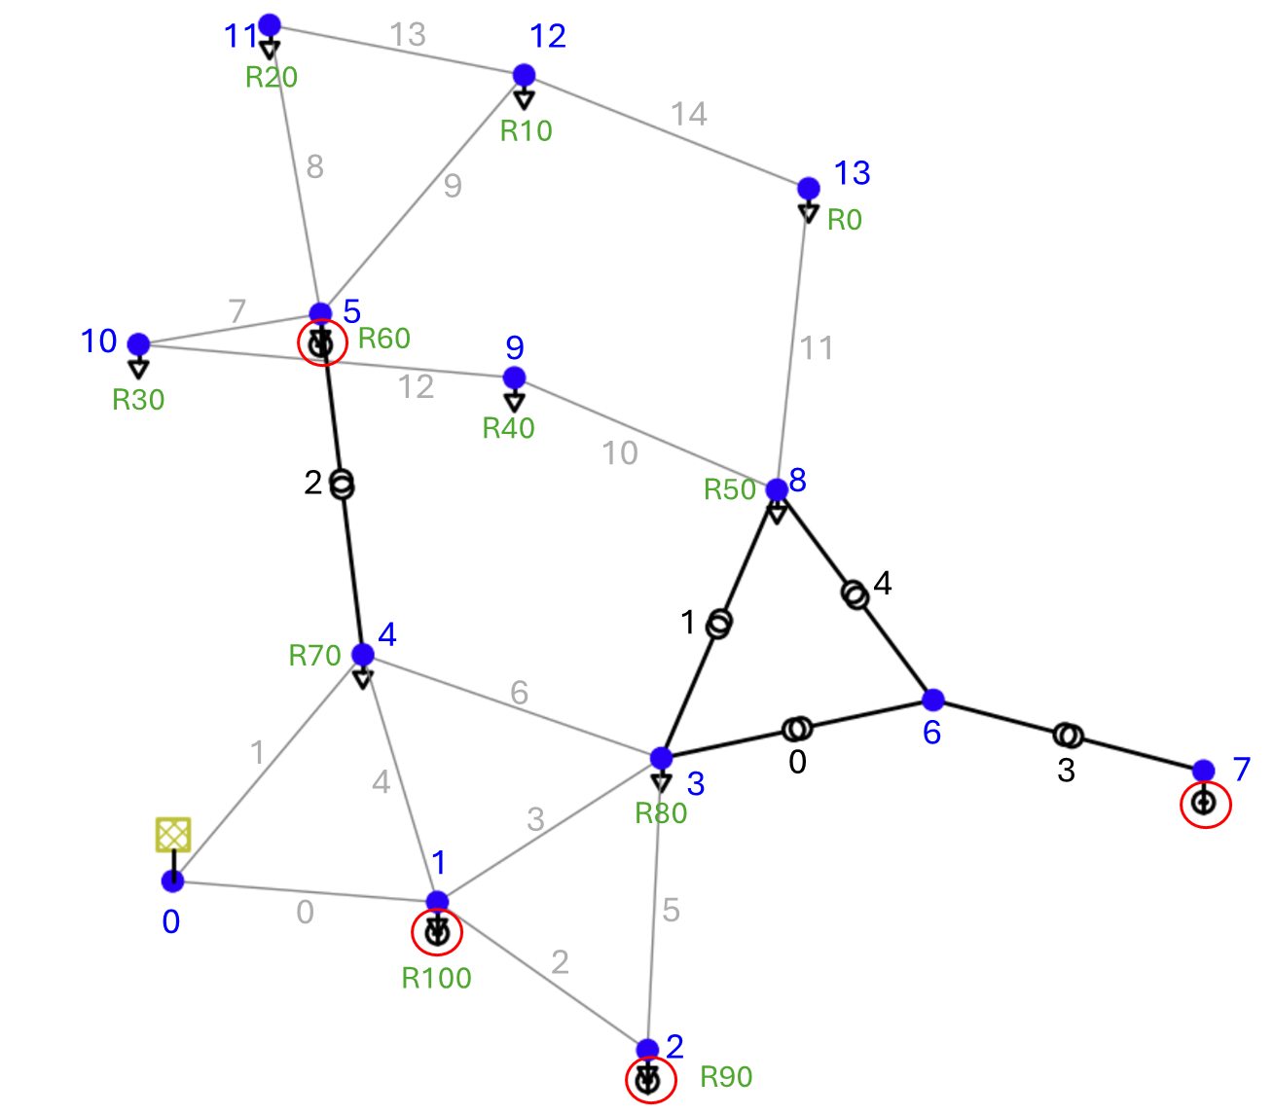
Let’s start with a simple grid
CASE 14
bus (14 elements)
load (11 elements)
gen (4 elements)
shunt (1 element)
ext_grid (1 element)
line (15 elements)
trafo (5 elements)
poly_cost (5 elements)

Slide 4
Let’s start with a simple grid
LOADS - PQ:
bus | p_mw | q_mvar
1 | 21.7 | 12.7
2 | 94.2 | 19.0
3 | 47.8 | -3.9
4 | 7.6 | 1.6
5 | 11.2 | 7.5
8 | 29.5 | 16.6
9 | 9.0 | 5.8
10 | 3.5 | 1.8
11 | 6.1 | 1.6
12 | 13.5 | 5.8
13 | 14.9 | 5.0
259.0
73.5

Slide 5
Let’s start with a simple grid
1. Perform a simple generator dispatch by maxing out the first three generators and setting the fourth one as the slack.
GENS-PV:
bus | p_mw | vm_pu
1 | 140.0 | 1.045
2 | 100.0 | 1.045
5 | 100.0 | 1.045
7 | 0.0 | 1.045
slack
2. Disconnect from external grid

Slide 6
Power flow analysis

Slide 7
Power flow analysis - Generation
net.res_gen
p_mw | q_mvar | va_degree | vm_pu
140.000000 | 17.690003 | 17.807919 | 1.045
100.000000 | 33.365044 | 15.616964 | 1.045
100.000000 | -3.429587 | 16.407703 | 1.045
-74.102238 | 19.972079 | 0.000000 | 1.045
265.9 | 73.5
slack

Slide 8
Power flow analysis - Loads
net.res_load
bus | p_mw | q_mvar
1 | 21.7 | 12.7
2 | 94.2 | 19.0
3 | 47.8 | -3.9
4 | 7.6 | 1.6
5 | 11.2 | 7.5
8 | 29.5 | 16.6
9 | 9.0 | 5.8
10 | 3.5 | 1.8
11 | 6.1 | 1.6
12 | 13.5 | 5.8
13 | 14.9 | 5.0
259.0
73.5

Slide 9
Power flow analysis - Buses
net.res_bus
vm_pu | va_degree | p_mw | q_mvar
1.040134 | 17.204662 | 0.000000 | 0.000000
1.045000 | 17.807919 | -118.300000 | -4.990003
1.045000 | 15.616964 | -5.800000 | -14.365044
1.008926 | 13.679667 | 47.800000 | -3.900000
1.014580 | 15.004135 | 7.600000 | 1.600000
1.045000 | 16.407703 | -88.800000 | 10.929587
1.019019 | 7.040958 | 0.000000 | 0.000000
1.045000 | 0.000000 | 74.102238 | -19.972079
1.004872 | 8.025036 | 29.500000 | -2.585581
1.001280 | 9.218494 | 9.000000 | 5.800000
1.015944 | 12.673283 | 3.500000 | 1.800000
1.028384 | 14.972474 | 6.100000 | 1.600000
1.018440 | 14.378380 | 13.500000 | 5.800000
0.989930 | 9.721839 | 14.900000 | 5.000000

Slide 10
Power flow analysis
P_load = 259.0
P_gen = 265.89776200123043
P_shunt = 0.0
P_loss = 6.8977620322135085
***************************
Q_load = 73.5
Q_gen = 67.59753784629007
Q_shunt = -19.185580553825712
Q_loss = 13.283118503284038

Slide 11
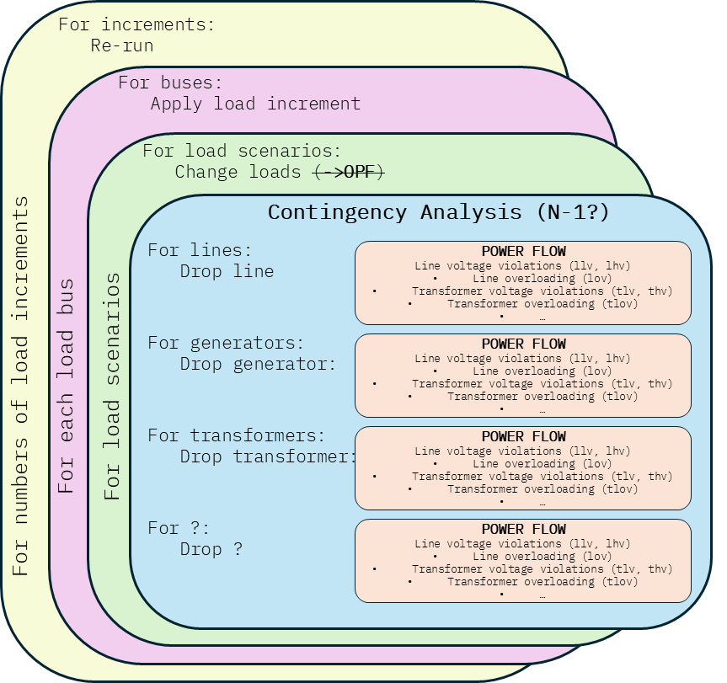
Data Center Hosting Maps Algo
Notes:
5 x 24 x 11 x 15 = 20,000 PF
5 x 24 x 11 ~ 1200 PF

Slide 12
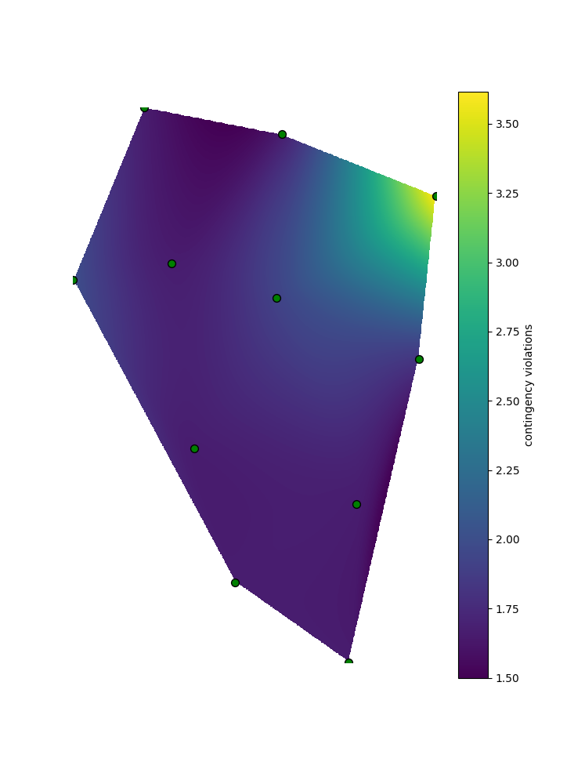
4 MW new load
11
13
12
R20
R10
14
8
9
13
R0
7
5
10
R60
9
11
R30
12
R40
10
2
R50
8
4
4
1
R70
6
1
6
4
0
3
7
3
3
R80
1
0
0
5
R100
2
2
R90

Slide 13
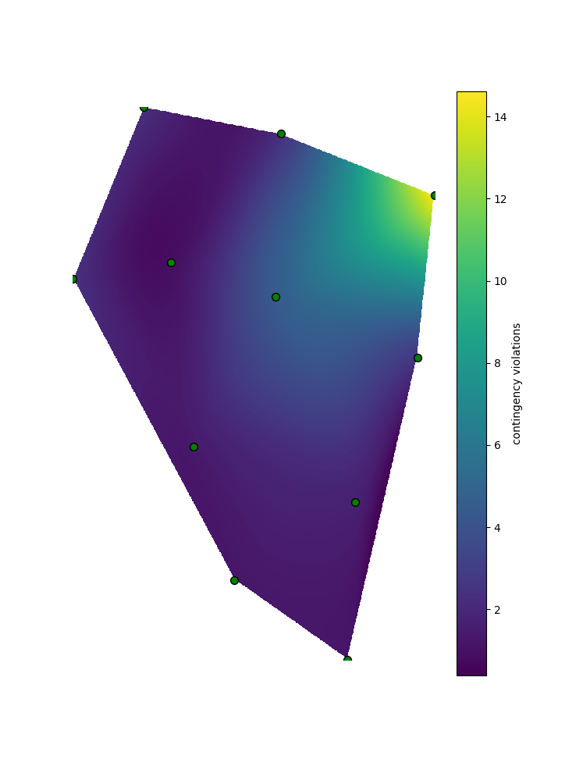
20 MW new load
11
13
12
R20
R10
14
8
9
13
R0
7
5
10
R60
9
11
R30
12
R40
10
2
R50
8
4
4
1
R70
6
1
6
4
0
3
7
3
3
R80
1
0
0
5
R100
2
2
R90

Slide 14
11
13
12
R20
R10
14
8
9
13
R0
7
5
10
R60
9
11
R30
12
R40
10
2
R50
8
4
4
1
R70
6
1
6
4
0
3
7
3
3
R80
1
0
0
5
R100
2
2
R90

Slide 15
Data Center Hosting Maps
For increments:
Re-run
For buses:
Apply load increment
For load scenarios:
Change loads (->OPF)
Contingency Analysis (N-1?)
For lines:
Drop line
For generators:
Drop generator:
For transformers:
Drop transformer:
For ?:
Drop ?
POWER FLOW
Line voltage violations (llv, lhv)
Line overloading (lov)
Transformer voltage violations (tlv, thv)
Transformer overloading (tlov)
…
POWER FLOW
Line voltage violations (llv, lhv)
Line overloading (lov)
Transformer voltage violations (tlv, thv)
Transformer overloading (tlov)
…
For numbers of load increments
For each load bus
For load scenarios
POWER FLOW
Line voltage violations (llv, lhv)
Line overloading (lov)
Transformer voltage violations (tlv, thv)
Transformer overloading (tlov)
…
POWER FLOW
Line voltage violations (llv, lhv)
Line overloading (lov)
Transformer voltage violations (tlv, thv)
Transformer overloading (tlov)
…

Slide 16
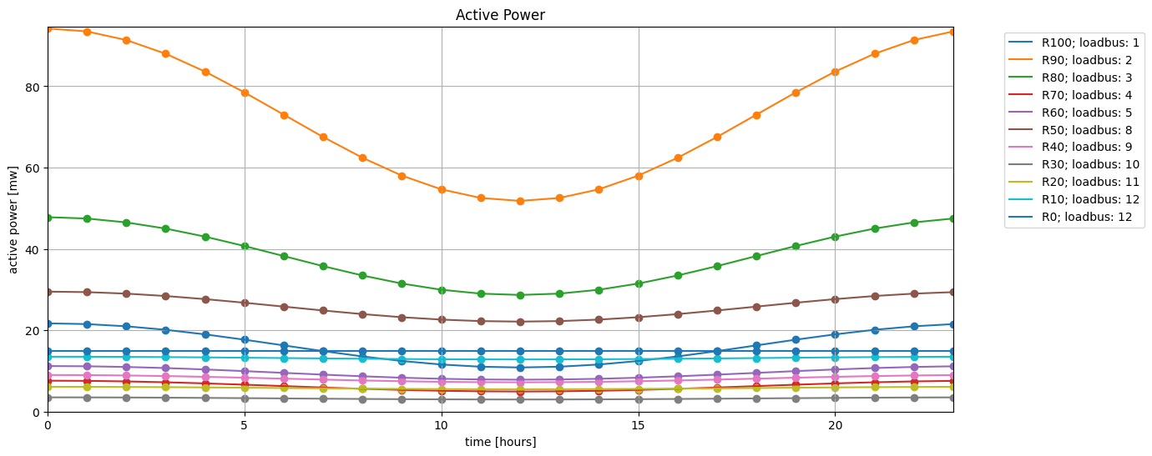
Load Scenarios

Slide 17
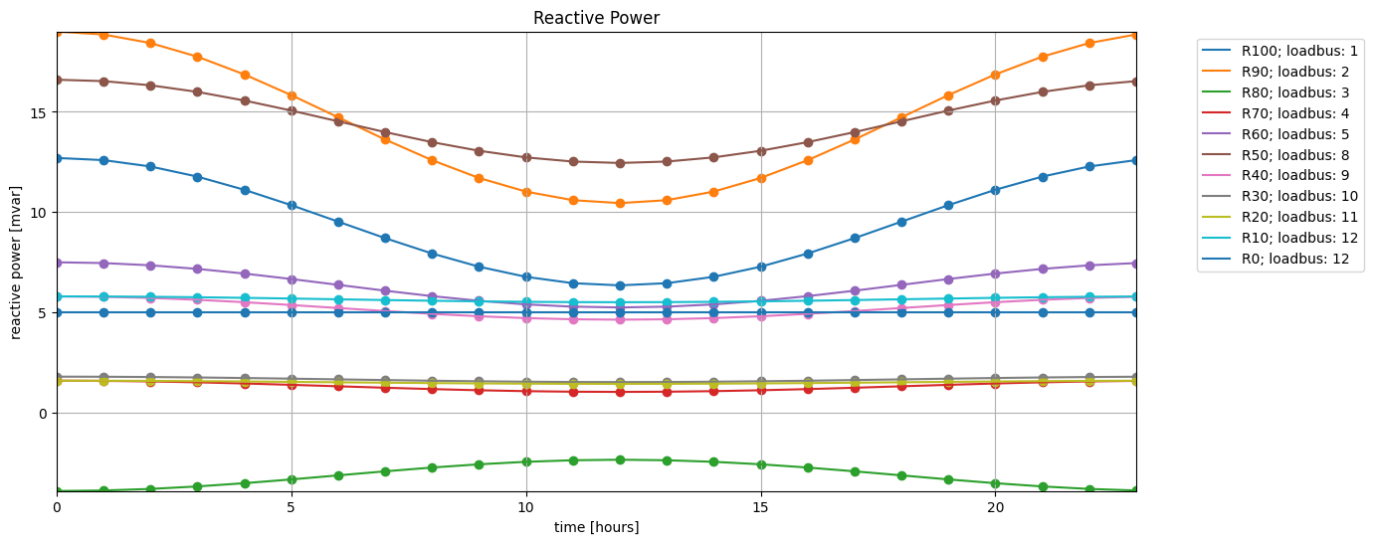
Load Scenarios

Slide 19
11
13
12
R20
R10
14
8
9
13
R0
7
5
10
R60
9
11
R30
12
R40
10
2
R50
8
4
4
1
R70
6
1
6
4
0
3
7
3
3
R80
1
0
0
5
R100
2
2
R90

Slide 20
11
13
12
R20
R10
14
8
9
13
R0
7
5
10
R60
9
11
R30
12
R40
10
2
R50
8
4
4
1
R70
6
1
6
4
0
3
7
3
3
R80
1
0
0
5
R100
2
2
R90

Slide 21
Adding 1 mw – Numbers of contingency violations
load id | low voltage | high voltage | overloading
0 | 1 | 0 | 0
1 | 1 | 0 | 0
2 | 1 | 0 | 0
3 | 1 | 0 | 0
4 | 1 | 0 | 0
5 | 2 | 0 | 0
6 | 2 | 0 | 0
7 | 2 | 0 | 0
8 | 2 | 0 | 0
9 | 2 | 0 | 0
10 | 2 | 0 | 0

