Slide 1

Verkennen

Slide 2
Data (Inlezen)
#### Data ################
# To get started we're load the training data and convert it
# from JSON to a DataFrame
json <- fromJSON(file='train.json')
# final data
train <- as.data.frame(do.call("rbind",
lapply(json, process_row)))
# factor to character
train <-
train %>%
mutate_if(is.factor,as.character)

Slide 3
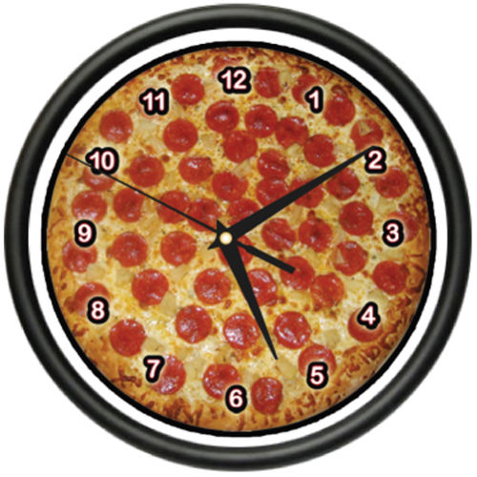

Data (Verrijking)

Slide 4
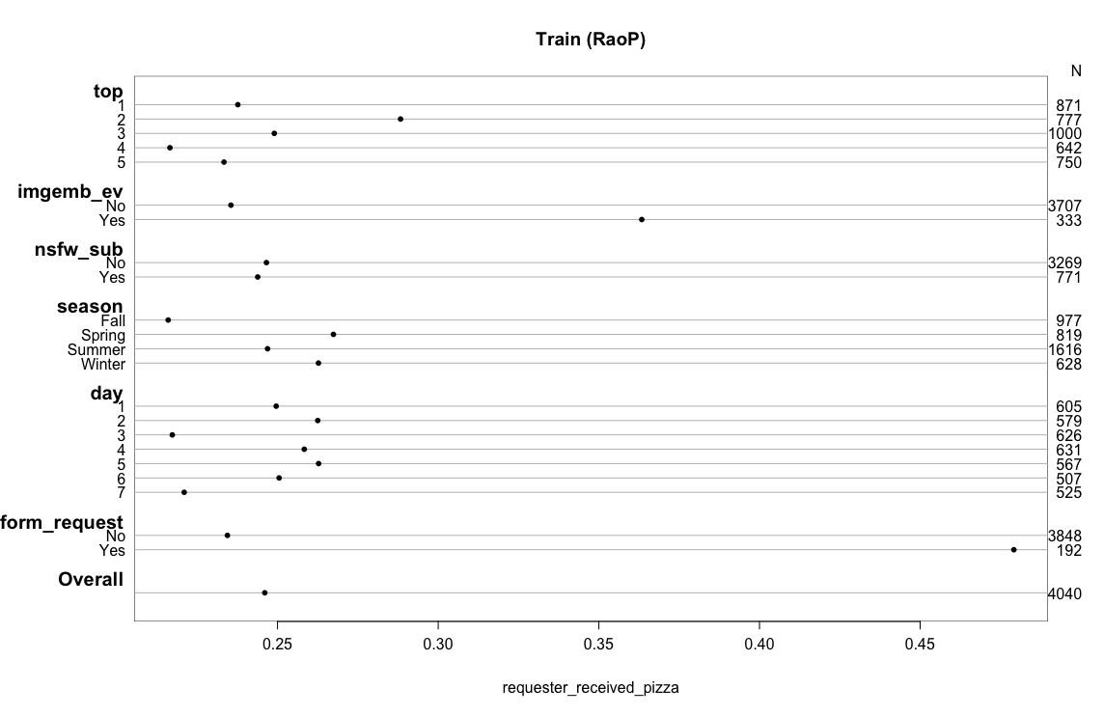
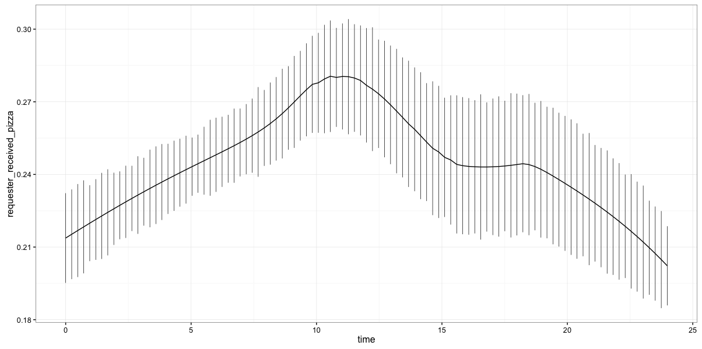
Univariaat

Slide 5
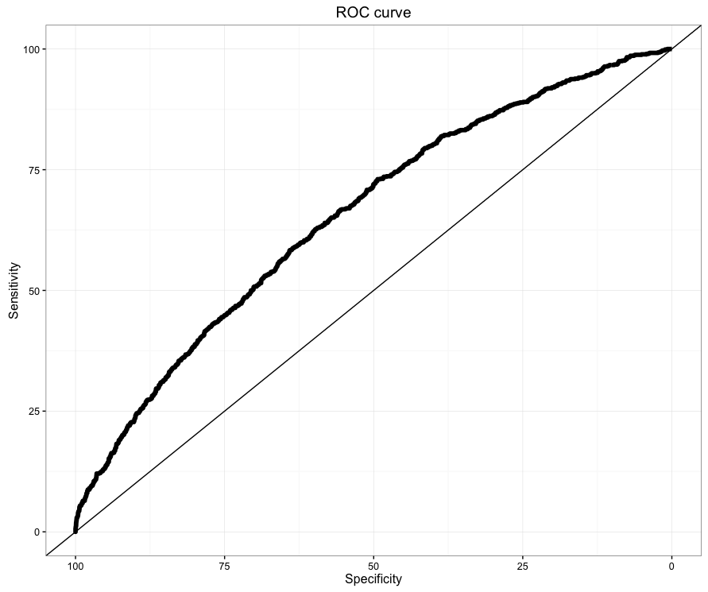
Multivariaat

Slide 6
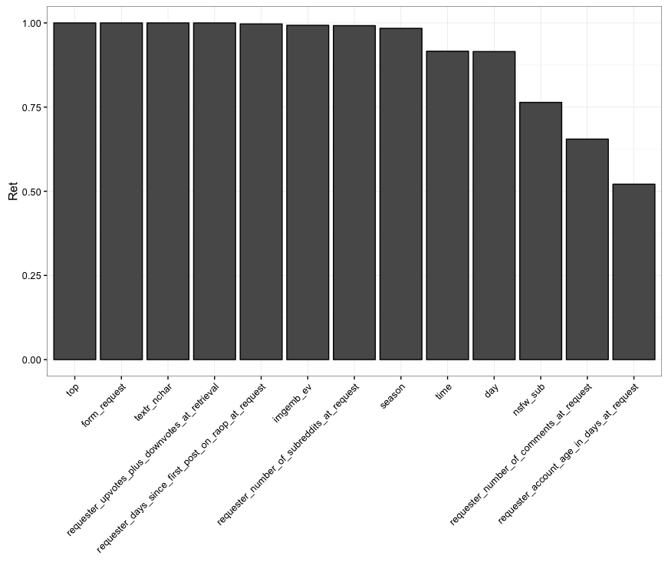
Reductie

Slide 7
Bootstrap
Index | origineel | training | test | optimisme | gecorigeerd | n
Dxy | 0.310 | 0.324 | 0.296 | 0.028 | 0.282 | 1000
R2 | 0.088 | 0.096 | 0.080 | 0.016 | 0.072 | 1000
Intercept | 0,000 | 0,000 | -0.098 | 0.098 | -0.098 | 1000
Slope | 1,000 | 1,000 | 0.907 | 0.093 | 0.907 | 1000
Emax | 0,000 | 0,000 | 0.040 | 0.040 | 0.040 | 1000
D | 0.060 | 0.066 | 0.055 | 0.011 | 0.049 | 1000
U | 0,000 | 0,000 | 0.001 | -0.001 | 0.001 | 1000
Q | 0.061 | 0.067 | 0.055 | 0.012 | 0.049 | 1000
B | 0.174 | 0.173 | 0.175 | -0.002 | 0.176 | 1000
g | 0.649 | 0.684 | 0.618 | 0.066 | 0.583 | 1000
gp | 0.116 | 0.121 | 0.111 | 0.010 | 0.105 | 1000
C | 0.655 | 0.662 | 0.648 | 0.014 | 0.641 | 1000

Slide 8
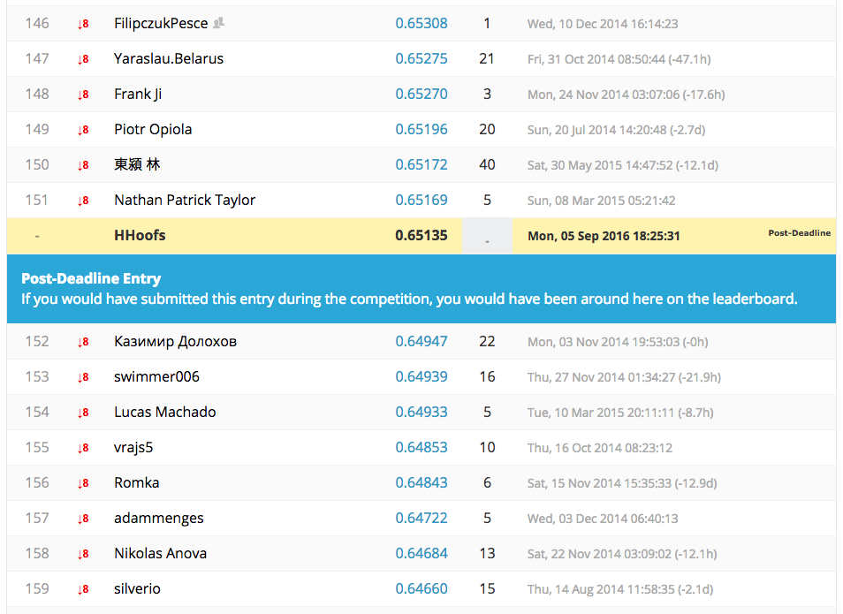
Extern

