Slide 1
ANZ Virtual Internship
By Helena Hook
hln.hook@gmail.com
November 2020

Slide 2
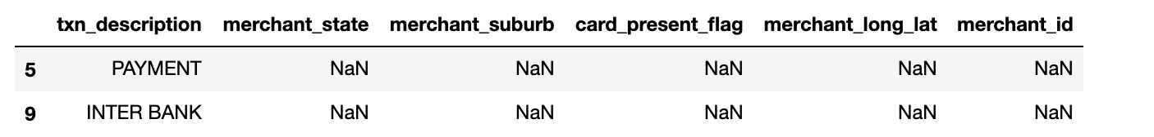
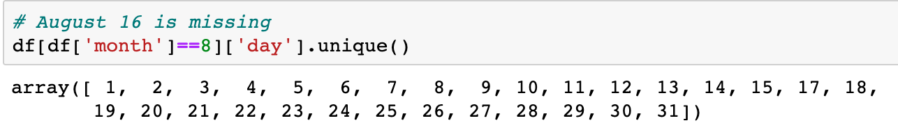
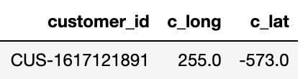
Data preparation
Some records contain NaN values due to transactions type (missing merchant details)
Missing transactions for August 16th
One customer had out of bounds longitude and latitude

Slide 3
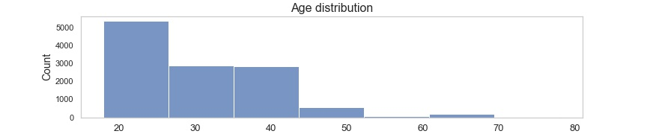
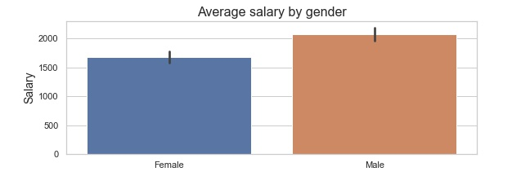
Overall insights
75% of customers are between age 18 and 38, median age 28.
Average salary
Female: 1679 AUD
Male: 2077 AUD

Slide 4
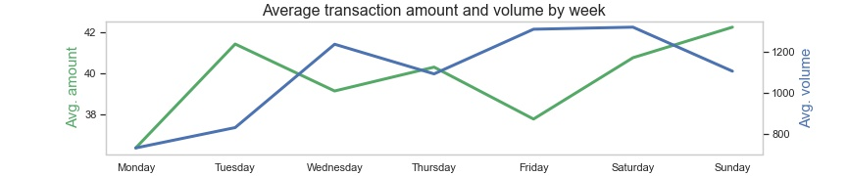
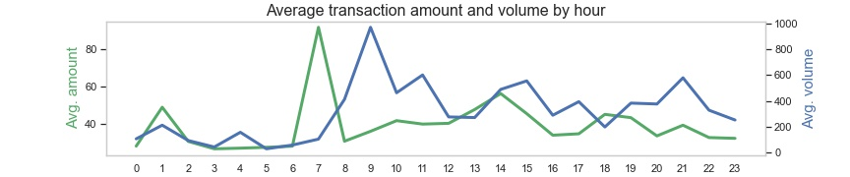
Overall insights
Average purchase transaction(POS/SALES-POS) amount is 39.8 AUD
Average number of transactions per customer each month 27 AUD

Slide 5
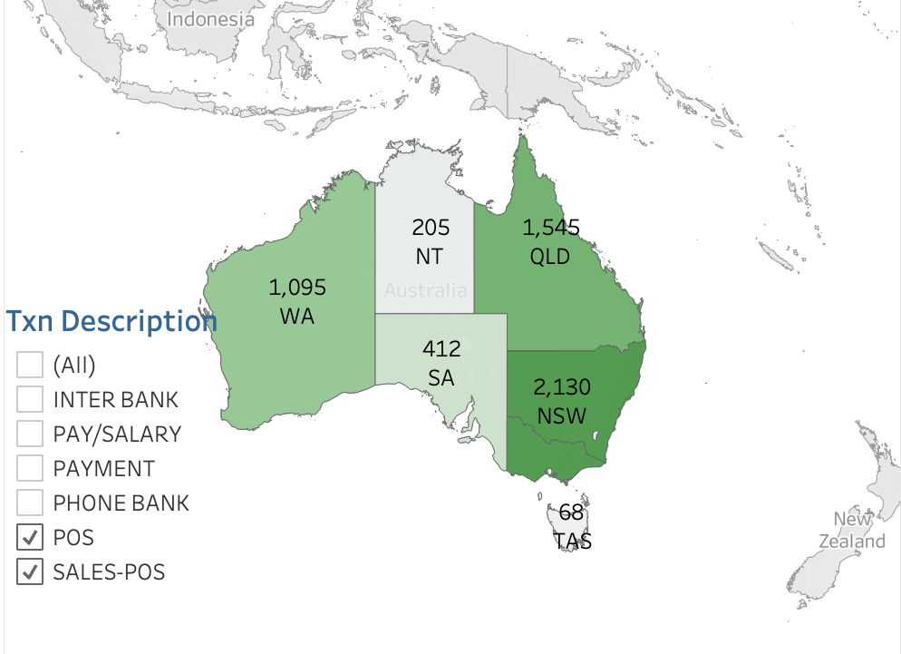
Number of purchase transactions per state

