Slide 1

Deadlock Detection in Distributed Databases
Knapp, E. (1987). Deadlock detection in distributed databases. ACM Computing Surveys (CSUR), 19(4), 303-328.
Presented by Hugo Huipet

Slide 2
Contribution of the Paper
Uniform model of DDBS
The fundamental principles that Deadlock Detection schemes are based upon
A hierarchy of deadlock models
A survey of deadlock detection algorithms
Correctness proofs for such algorithms

Slide 3
Deadlock
Result of competition for resources: i.e. DB transactions
Whole Problem:
DL Prevention
DL Avoidance
DL Detection
DL Resolution

Slide 4
Deadlock Problem
“Situation in which each transaction is blocked by another one and only with external intervention can be unblocked”
Concurrency Control
Coordination of the actions of parallel processes (like shared data access)
Model main component: TRANSACTION
sequence of operations that access a shared database (read or write)
Scheduler
Main part of the DBS that controls the relative order of operations

Slide 5
Deadlock Centralized vs Distributed
Centralized
Resource
Locking
Two-phase locking
Multi version schedulers
Lock conversion
Communication
Multigranularity locking

Slide 6
Deadlock Centralized vs Distributed
Distributed
Previous problems + (distributed nature problems)
Harder, collaboration required
Transactions → sub transactions
Interwoven resource and communication models

Slide 7
Database Model
N sites connected by a communication network
Network is assumed reliable and fully connected
Each site = some portion of DB (DBS centralized)
M transactions running
1 Controller per site, manager of transactions’ resource requests
Transactions between sites managed by transactions agents

Slide 8
Database Model
Transaction Agents
Processes
They handle the request/release of resources
Idle / Executing (res)
Passive objects in deadlock detection
At most one transaction agent per transaction at each site
More powerful than TAs
Know the identity of processes that are waiting for
Blocked / Executing (msgs)
Active objects in deadlock detection (when blocked can still perform other tasks)
No restriction in number of processes

Slide 9
Specification of Deadlock Problem
WFG (transaction Wait-for-Graph): Model for resource requests
Vertices → transaction agents/process
Directed edges = blocking relations
Vertex with outgoing edges is idle (TA) / blocked (Process)
Cyclic structure = DEADLOCK
Correctness:
A deadlock must be detected eventually.
If a deadlock is detected it MUST exist (no phantom DL & no spontaneous aborts)

Slide 10
Specification of Deadlock Problem

Slide 11
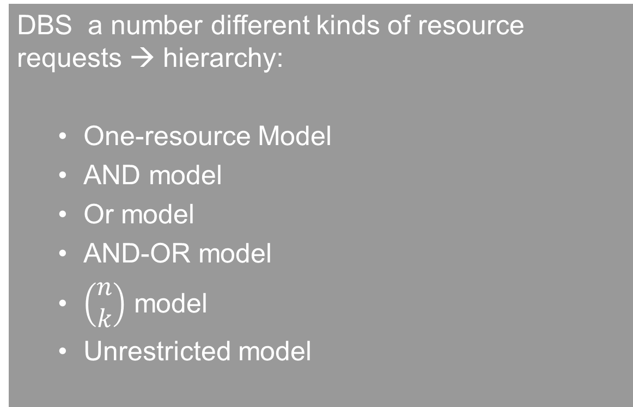
Models of Deadlock
DBS a number different kinds of resource requests → hierarchy:
One-resource Model
AND model
Or model
AND-OR model
$\left(\begin{matrix}n \\ k\end{matrix}\right)$ model
Unrestricted model

Slide 12
Models of Deadlock
One-resource Model
At most one OUTSTANDING resource request at a time
DLD → finding cycle in WFG
AND model
Transactions can request a set of resources, blocked until have ALL resources
DLD → finding cycle in WFG
Both can’t detect if TA/P don’t belong to cycle but still DL by it

Slide 13
Models of Deadlock
OR model
A request for numerous resources is satisfied by granting any resource
DLD → finding a Knot (Cycles are not enough) or a process can only reach DL processes
All process in a set are blocked
Dependent set of each process is also in the same set
No grant message in transit between processes
AND-OR model
Generalization of AND & OR models
DLD → repeated application of OR model (because a DL is stable = once in DL stays there)
Not very efficient

Slide 14
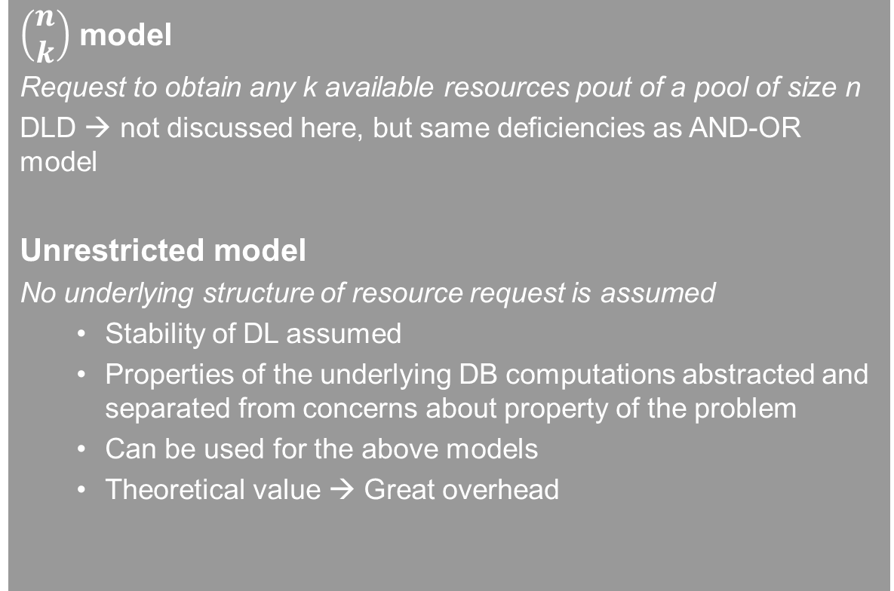
Models of Deadlock
$\left(\begin{matrix}n \\ k\end{matrix}\right)$ model
Request to obtain any k available resources pout of a pool of size n
DLD → not discussed here, but same deficiencies as AND-OR model
Unrestricted model
No underlying structure of resource request is assumed
Stability of DL assumed
Properties of the underlying DB computations abstracted and separated from concerns about property of the problem
Can be used for the above models
Theoretical value → Great overhead

Slide 15
Classes of Distributed Deadlock Detection Algorithms
Path-Pushing Algorithms
Edge Chasing Algorithms
Diffusing Computations
Global State Detection

Slide 16
Classes of Distributed Deadlock Detection Algorithms
Path-Pushing Algorithms
Notion of explicit global WFG
Each site sends its WFG to neighbors in order to build the global WFG and one site can announce DL or no DL
Incorrect (Phantoms and not detecting)
Freeze the underlying computation
Edge Chasing Algorithms
Presence of cycle verified by propagating probes along the graph
Nice feature: executing process can discard the probes.
Blocked processes propagate the probe by their outgoing edges

Slide 17
Classes of Distributed Deadlock Detection Algorithms
Diffusing Computations
Activated by a transaction manager that suspect a deadlock
Superimposed on the underlying database computation
WFG implicit never built explicitly
They grow by sending queries and shrinks by receiving replies.
The computation terminates IF it the root returns to the neutral state (by shrinking messages)

Slide 18
Classes of Distributed Deadlock Detection Algorithms
Global State Detection
Notion: a Consistent Global state that can be determined without temporarily suspending the underlying computation
The state of the system is a WFG, and schedules are sequences of WFG transformations
A transaction is deadlocked if its deadlocked in a WFG at time t
By propagating markers along the channel of the system obtain a SNAPSHOT that can be examined OFF-LINE

Slide 19
THANKS

