Slide 1













ews
N
N
G
G
N
N
rasp

Slide 2



Slide 3
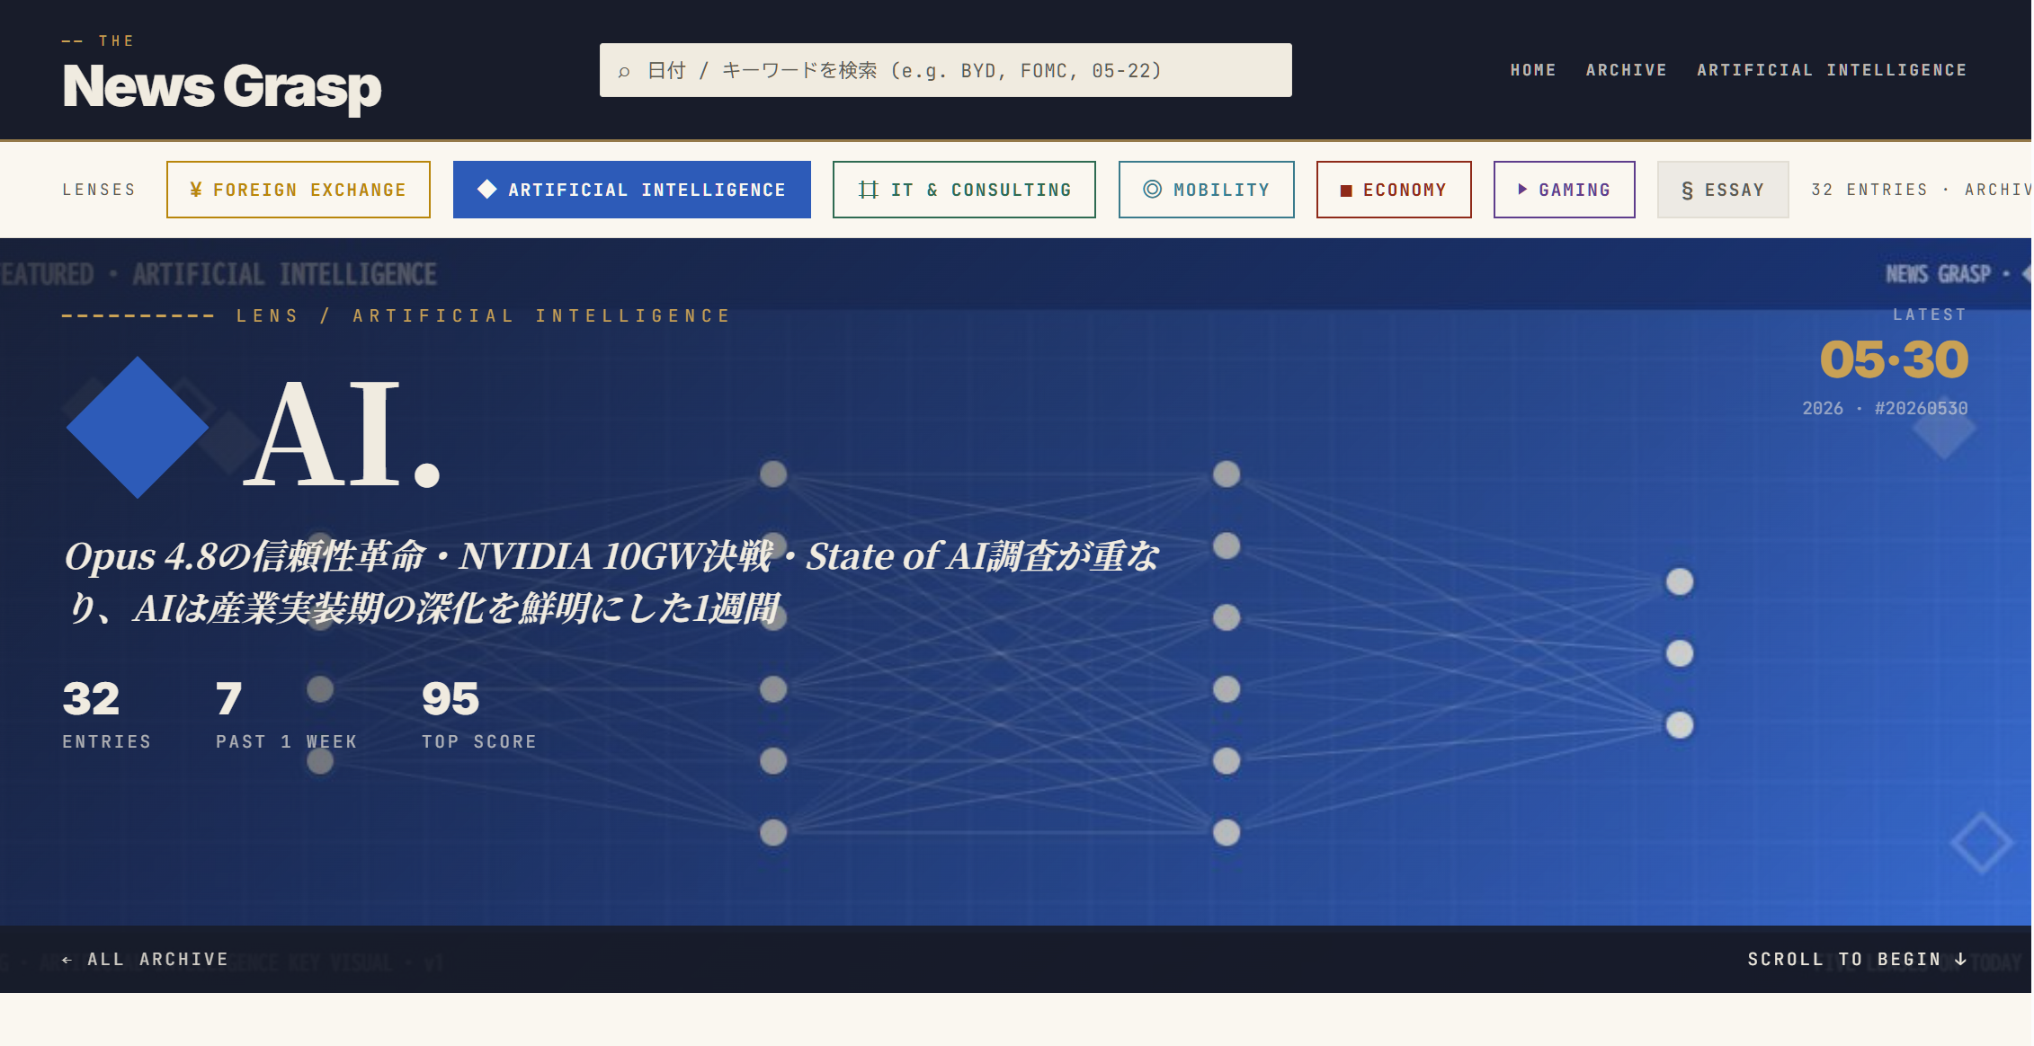

Slide 4

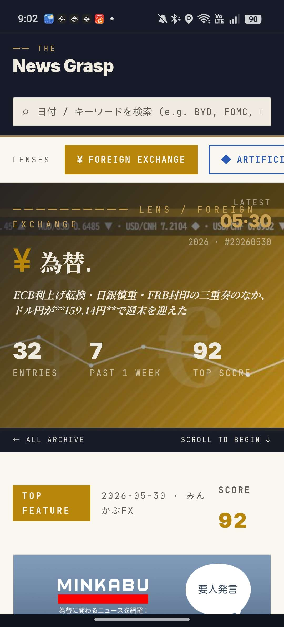


Slide 6
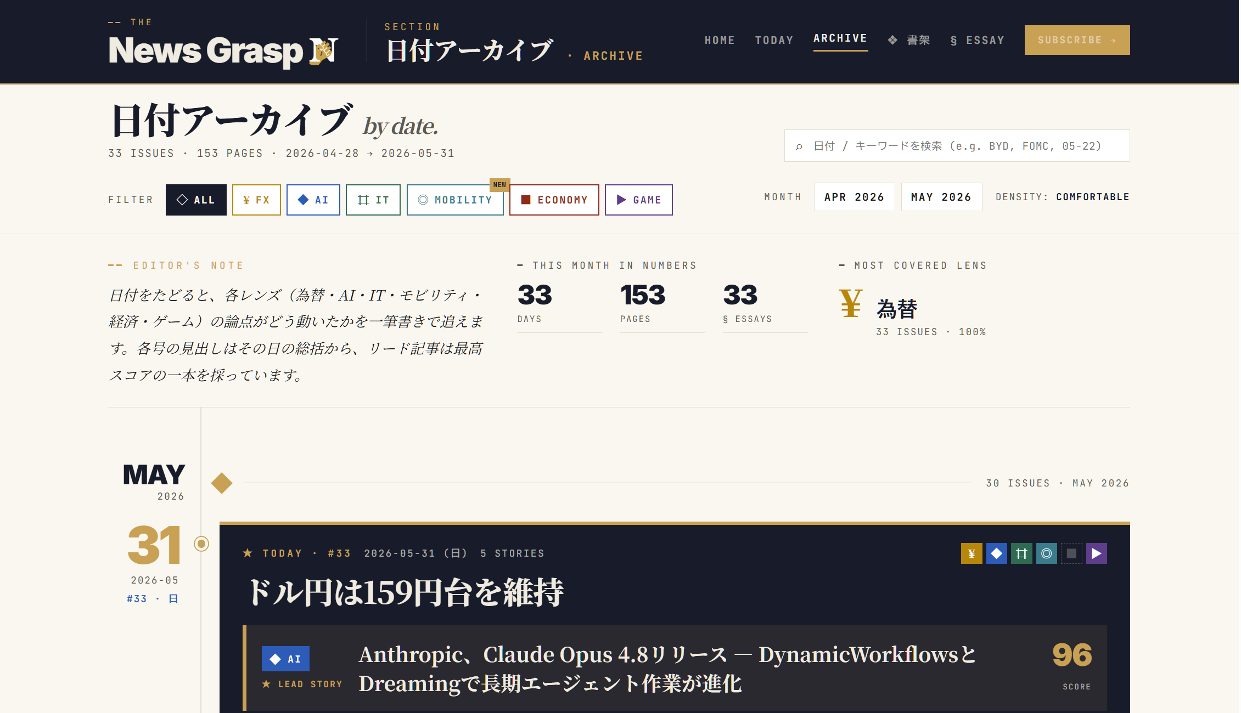

Slide 7

DIGEST

Slide 8

DIGEST

Slide 9
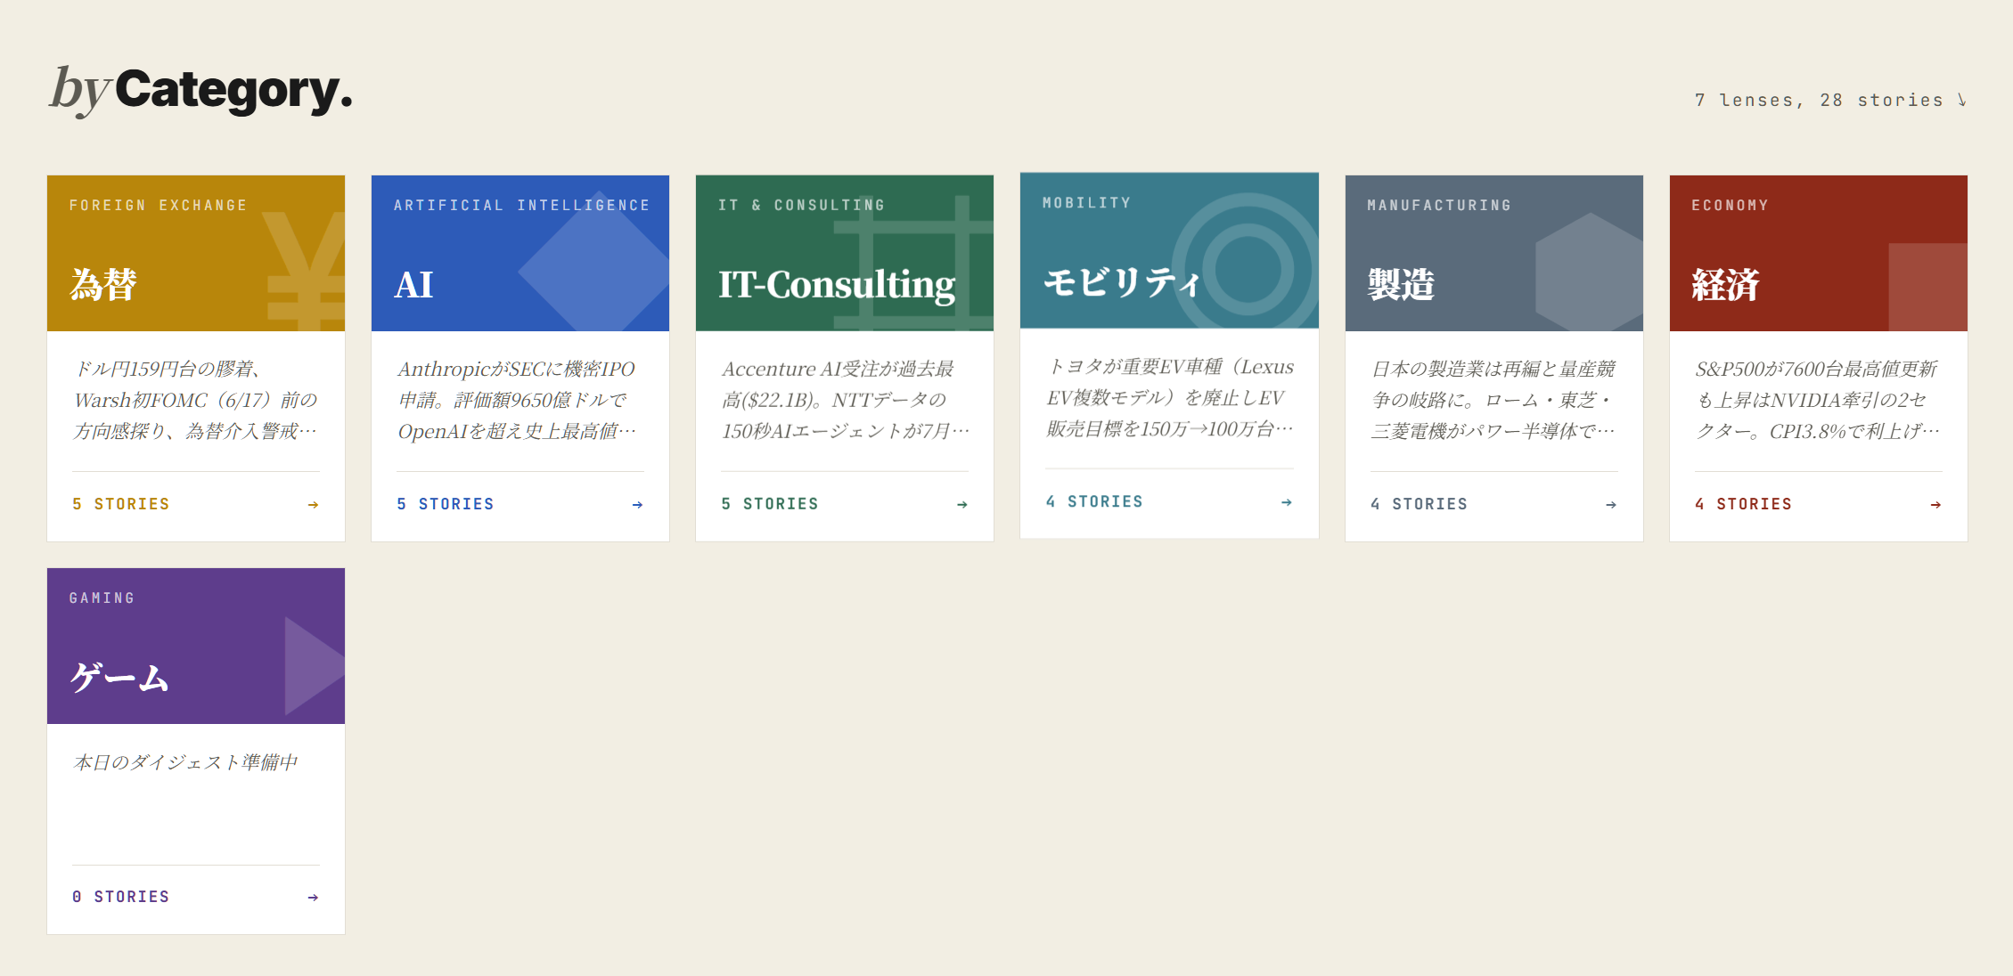

Slide 11


