Slide 1

FAKE OR TRUE NEWS?
- HIGYNA BHAVIN SHAH (BT22CSA038)
-SYEDA SAMIYAH ZEHRA RIZVI(BT22CSA022)
Notes:
Photo by Minh Pham on Unsplash

Slide 2


PROBLEM STATEMENT
PREDICTING WHETHER A GIVEN NEWS IS TRUE OR FAKE, SHOWING THE FREQUENCY OF FAKE NEWS ARTICLES IN RESPECTIVE MONTHS AND THE MOST FREQUENTLY USED WORDS IN THE FAKE NEWS
Notes:
Photo by James Yarema on Unsplash

Slide 3
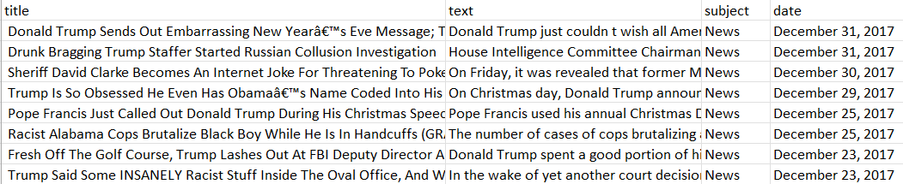
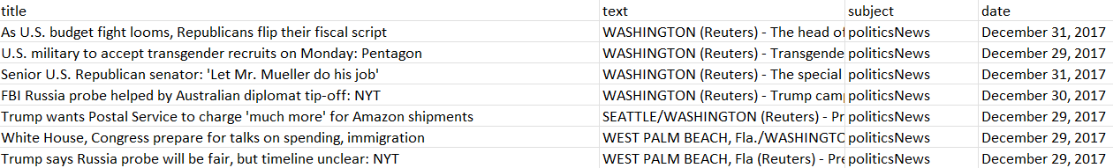
DATASETS
01
Fake news
02
True News
This dataset contains 4 columns –
Title, text, subject, date and 23502 rows
Containing the title, text, subject and date of the respective fake news
This dataset contains 4 columns-
Title, text, subject, date and 23417 rows
Containing the title, text, subject, and date of the respective true news
Notes:
Photo by James Yarema on Unsplash

Slide 4
DATASET HANDLING
01
A wordcloud object with a brain shaped mask that contains the most frequently used words in the true news dataset is generated in the form of an image .
02
A bar plot of the release date and frequency of fake news in the months of a particular year showing in what year and what month maximum fake news is generated
03
An extra column named ‘class’ is added in both datasets assigned 0 for fake news and 1 for true news and the two are merged into a third dataset dropping subject, title, and date.
04
This merged dataset is cleaned and special characters and unnecessary strings are removed
05
The data is trained and tested for 25%
Notes:
Photo by James Yarema on Unsplash

Slide 5
MODEL TRAINING ALGORITHMS
LINEAR REGRESSION
DECISION TREE
RANDOM FOREST
Notes:
Photo by Carl Raw on Unsplash
Photo by Adrian Deweerdt on Unsplash

Slide 6
Vectorization
Training
We transform the data into numeric values and then apply the logistic regression model to train and test
We fit the vectorized training ‘text’ column onto the training ‘class’ column using the LogisticRegression( )
LOGISTIC
REGRESSION
Testing
Classification Report
A score is calculated for vectorized testing ‘text’ column and testing ‘class’ column-the testing data
A prediction is carried out on the test data using the trained LR model and a classification report is made.
Notes:
<a href='https://www.freepik.com/photos/technology-woman'>Technology woman photo created by freepik - www.freepik.com</a>
Photo by Minh Pham on Unsplash

Slide 7
Vectorization
Training
We transform the data into numeric values and then apply the logistic regression model to train and test
A Decision Tree Classifier is trained on the training data using fit( ) method
DECISION
TREE
CLASSIFICATION
Testing
Validation
A score is calculated for vectorized testing ‘text’ column and testing ‘class’ column-the testing data and a classification report is made
We train a Decision Tree Classifier with each value of a set and evaluate the model’s accuracy on that validation set.

Slide 8
Vectorization
Training
We transform the data into numeric values and then apply the logistic regression model to train and test
A Decision Tree Classifier is trained on the training data using fit( ) method
RANDOM
FOREST
CLASSIFIER
Testing
Validation
A score is calculated for vectorized testing ‘text’ column and testing ‘class’ column-the testing data and a classification report is made
We use OOB accuracy to validate. It provides a measure of the model’s generalization performance without the need for separate validation set

Slide 9
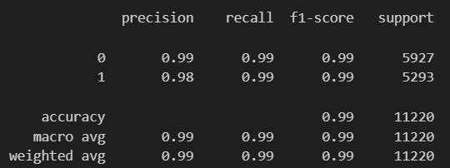
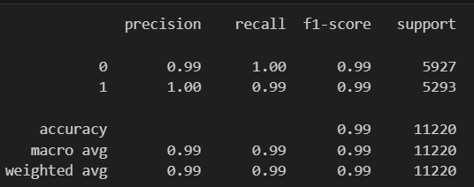
RESULTS AND DISCUSSION
Logistic Regression classification report
Decision Tree Classifier report

Slide 10
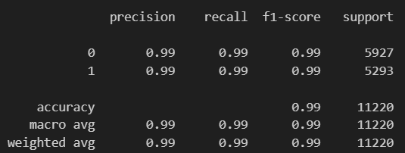
CONTINUED
Random Forest Classifier report
Manual testing:

Slide 11
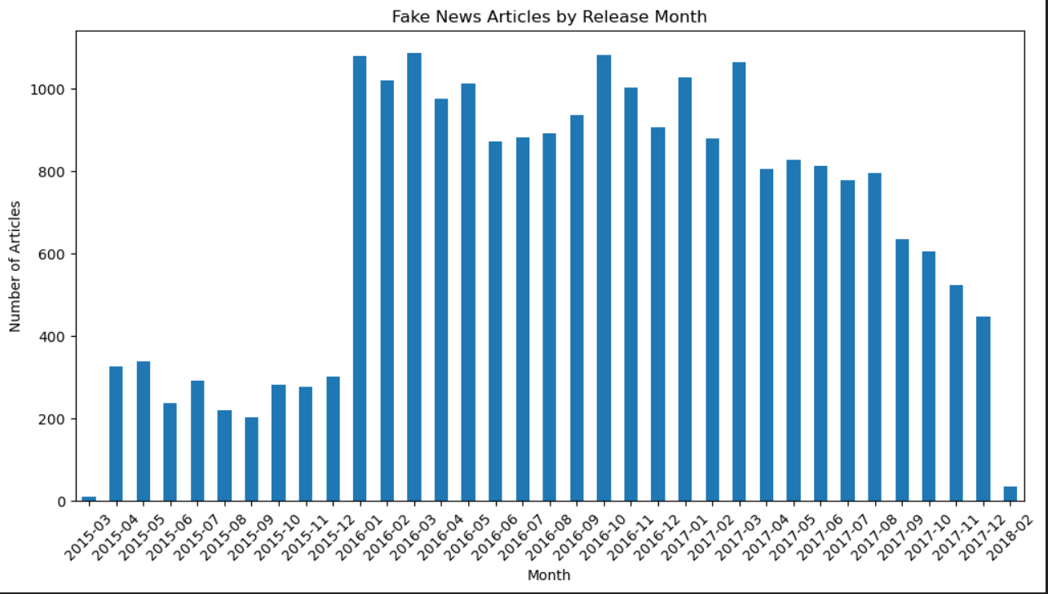
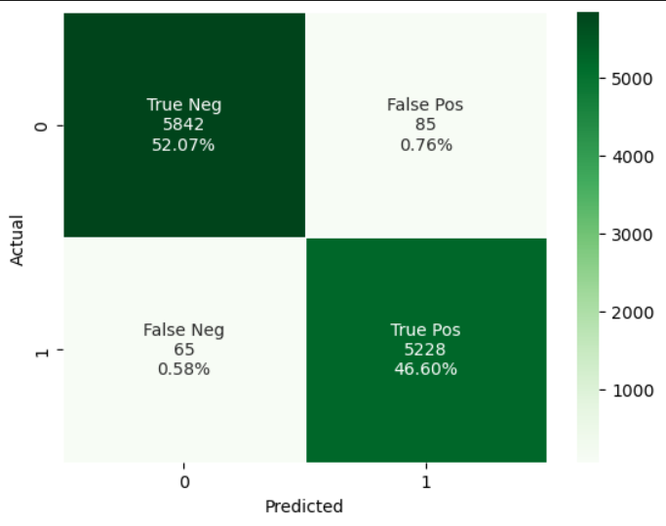
CONTINUED
FREQUENCY OF FAKE NEWS IN RELEASE MONTH
CONFUSION MATRIX(USING THE LOGISTIC REGRESSION ALGORITHM)

