Slide 1
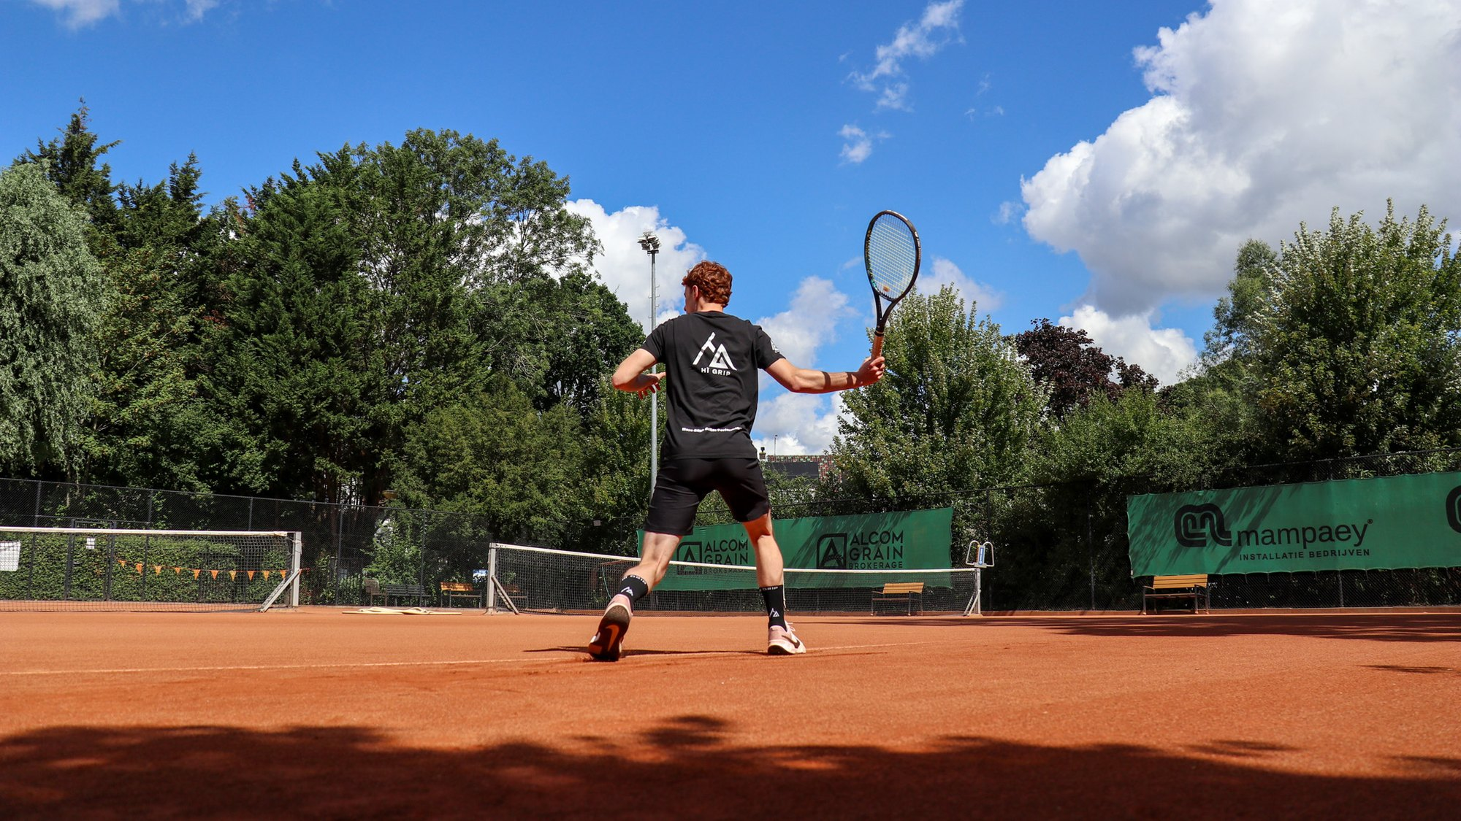
KEEP GOING WHEN OTHERS STOP
OWN PHOTO
INVESTMENT PITCH 2026
MORE GRIP, BETTER PERFORMANCE
LARS · TIGO · TIMO
Notes:
Open short and with energy. We are Lars, Tigo and Timo. Slogan: More grip, better performance. Goal of this pitch: €50,000 to keep growing.
PHOTO: OWN. Drive > Content B2C > Sporten > TENNIS > Zwart 2.0 (IMG_4143).

Slide 2
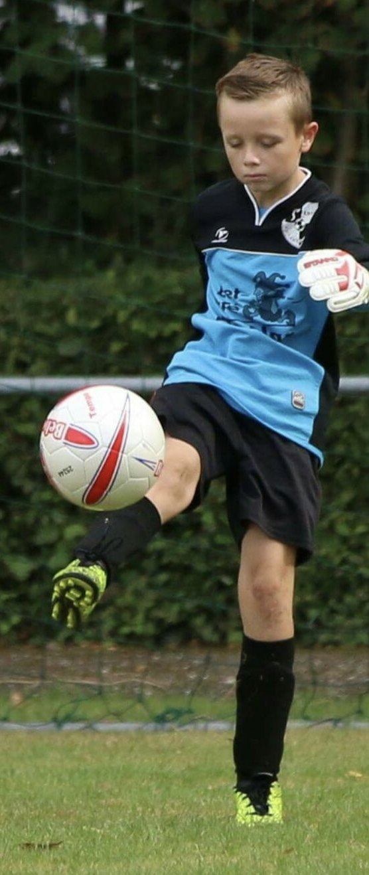
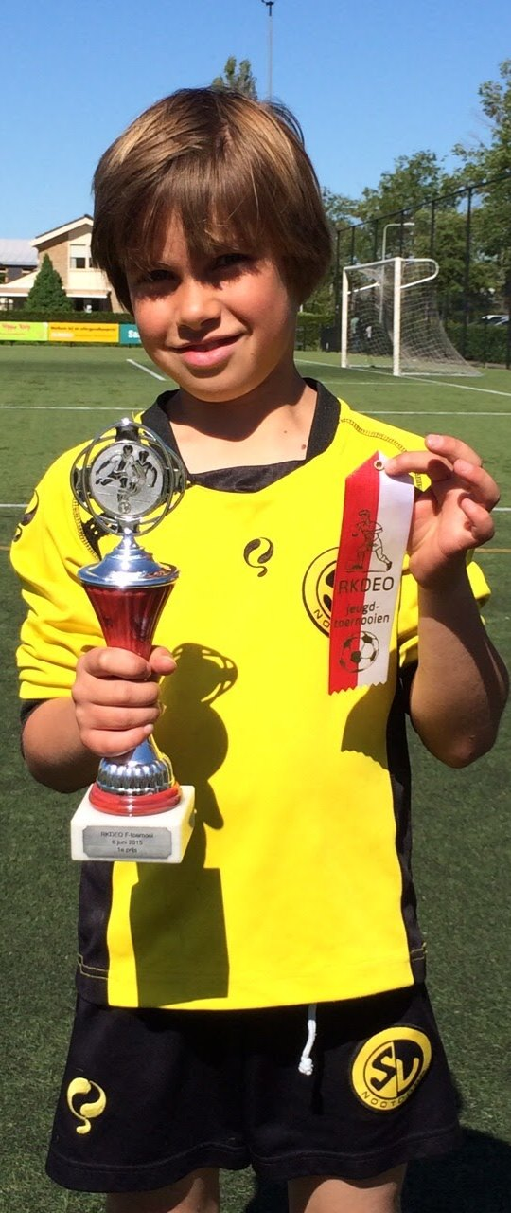
WHY WE BUILD THIS
OWN PHOTO
01
WE PLAY SPORTS OURSELVES
02
SLIPPING COSTS CONFIDENCE
03
SO WE BUILT GRIP
Notes:
The personal story: how it started and why we build this. Tell in your own words how you felt your feet slip in sports shoes and why that became a product. The three points are a proposal; adapt them to your real origin. The three founders build HÏ Grip alongside their studies.
PHOTO: OWN. Drive > Over Ons: TIGO JONG and TIMO JONG (childhood photos). Lars is still missing: add a youth photo of Lars, or a photo of the three together.

Slide 3
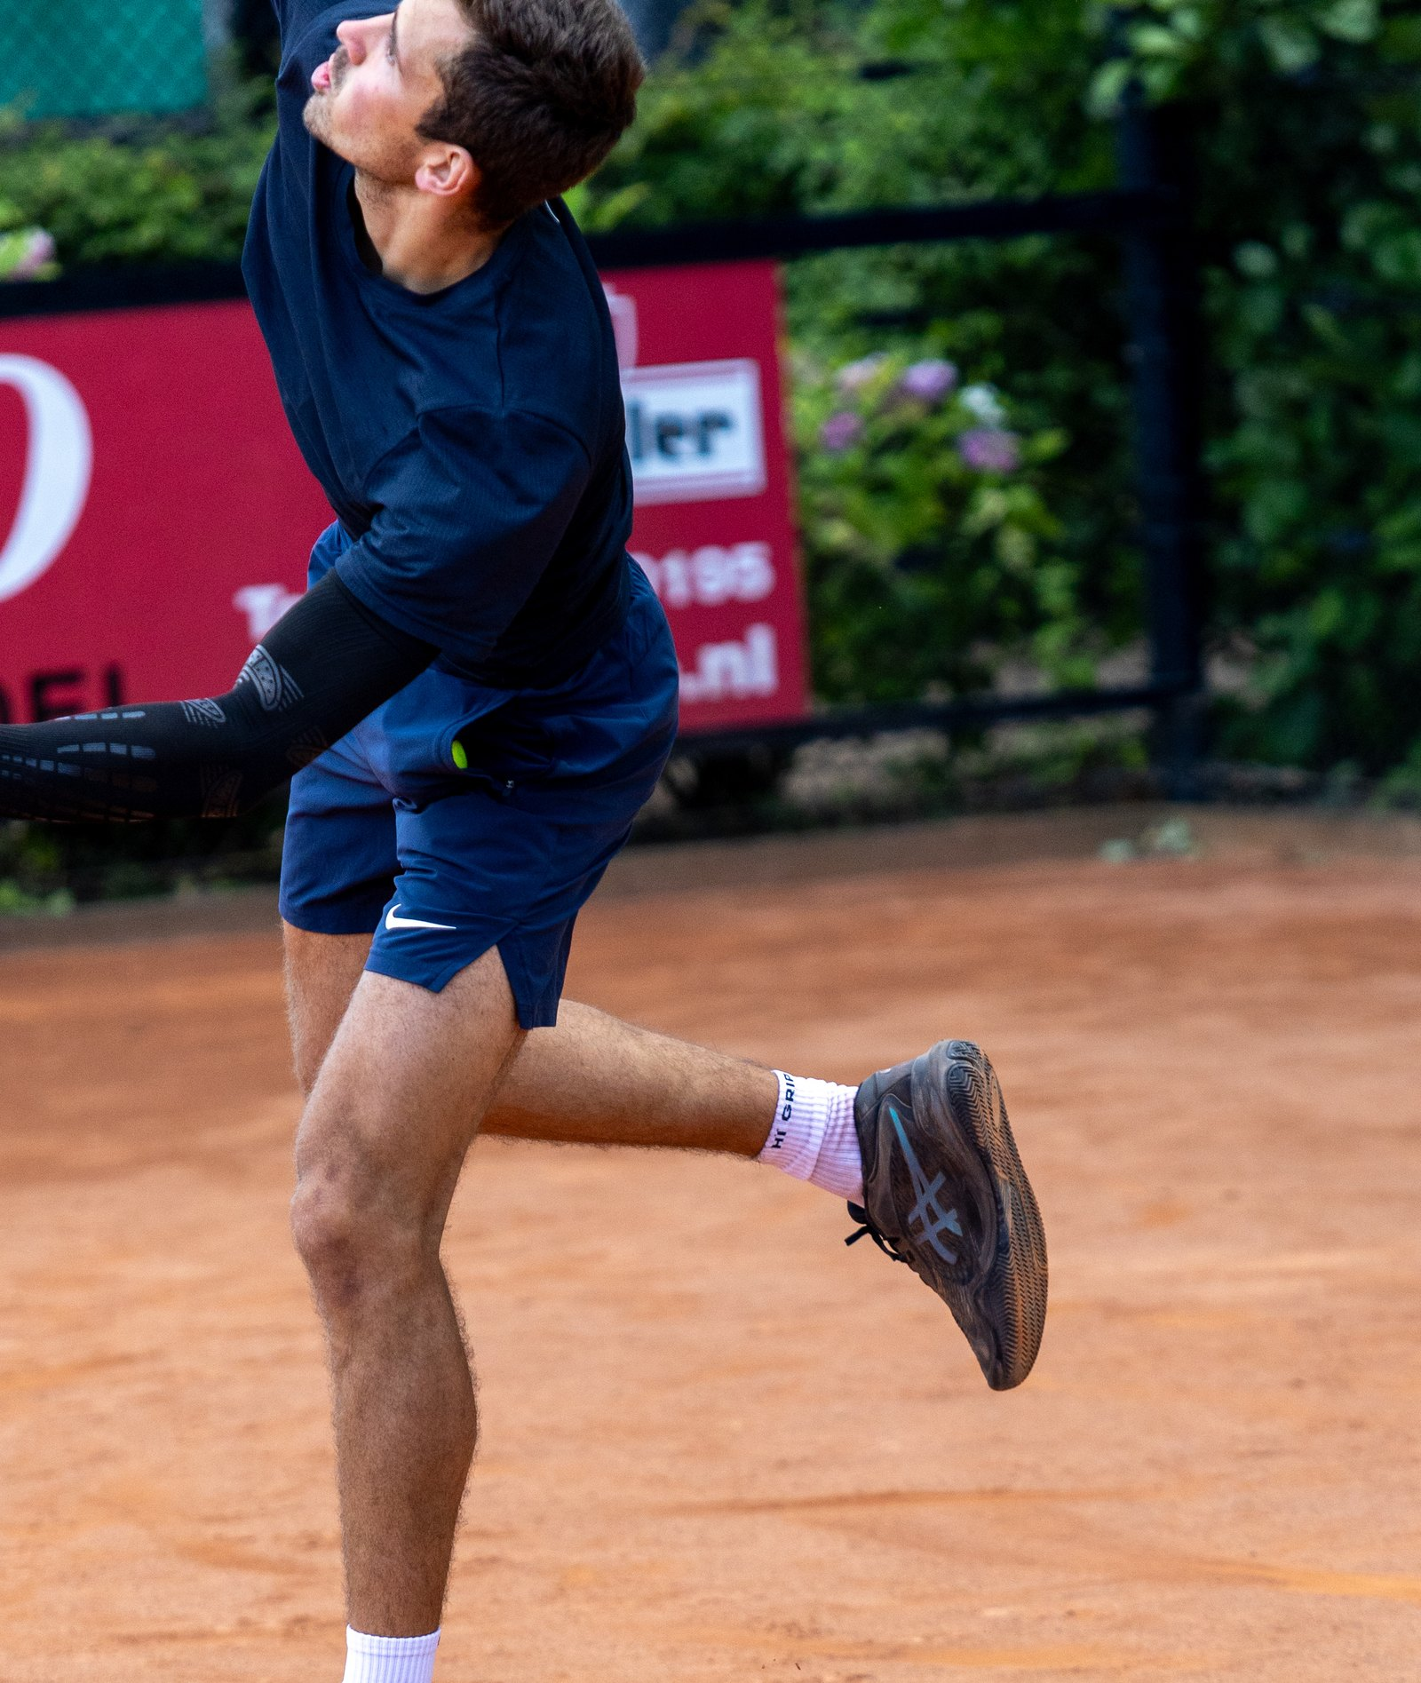
ATHLETES KEEP SLIPPING
OWN PHOTO
20–60%
ATHLETES WITH BLISTERS
5.3M
SPORTS INJURIES NL, 2023
13%
FOOTBALL INJURIES: ANKLE
Notes:
The problem in three numbers. 20–60% of athletes get blisters during training or matches. 5.3 million sports injuries in the Netherlands (2023). 13% of all football injuries are ankle injuries. Also: 5–30% of athletes get shin splints during intensive training. The chain we tell: bad gear, then pain and injury, then structural underperformance. Never 100%.
PHOTO: OWN. Drive > Campagnes / Events > FOTO'S TVB OPEN 2026 (KC8A0054-2). Shoot a stronger pain image yourselves (slipping foot, blister); stock search term: 'foot slipping inside sports shoe close up'.

Slide 4
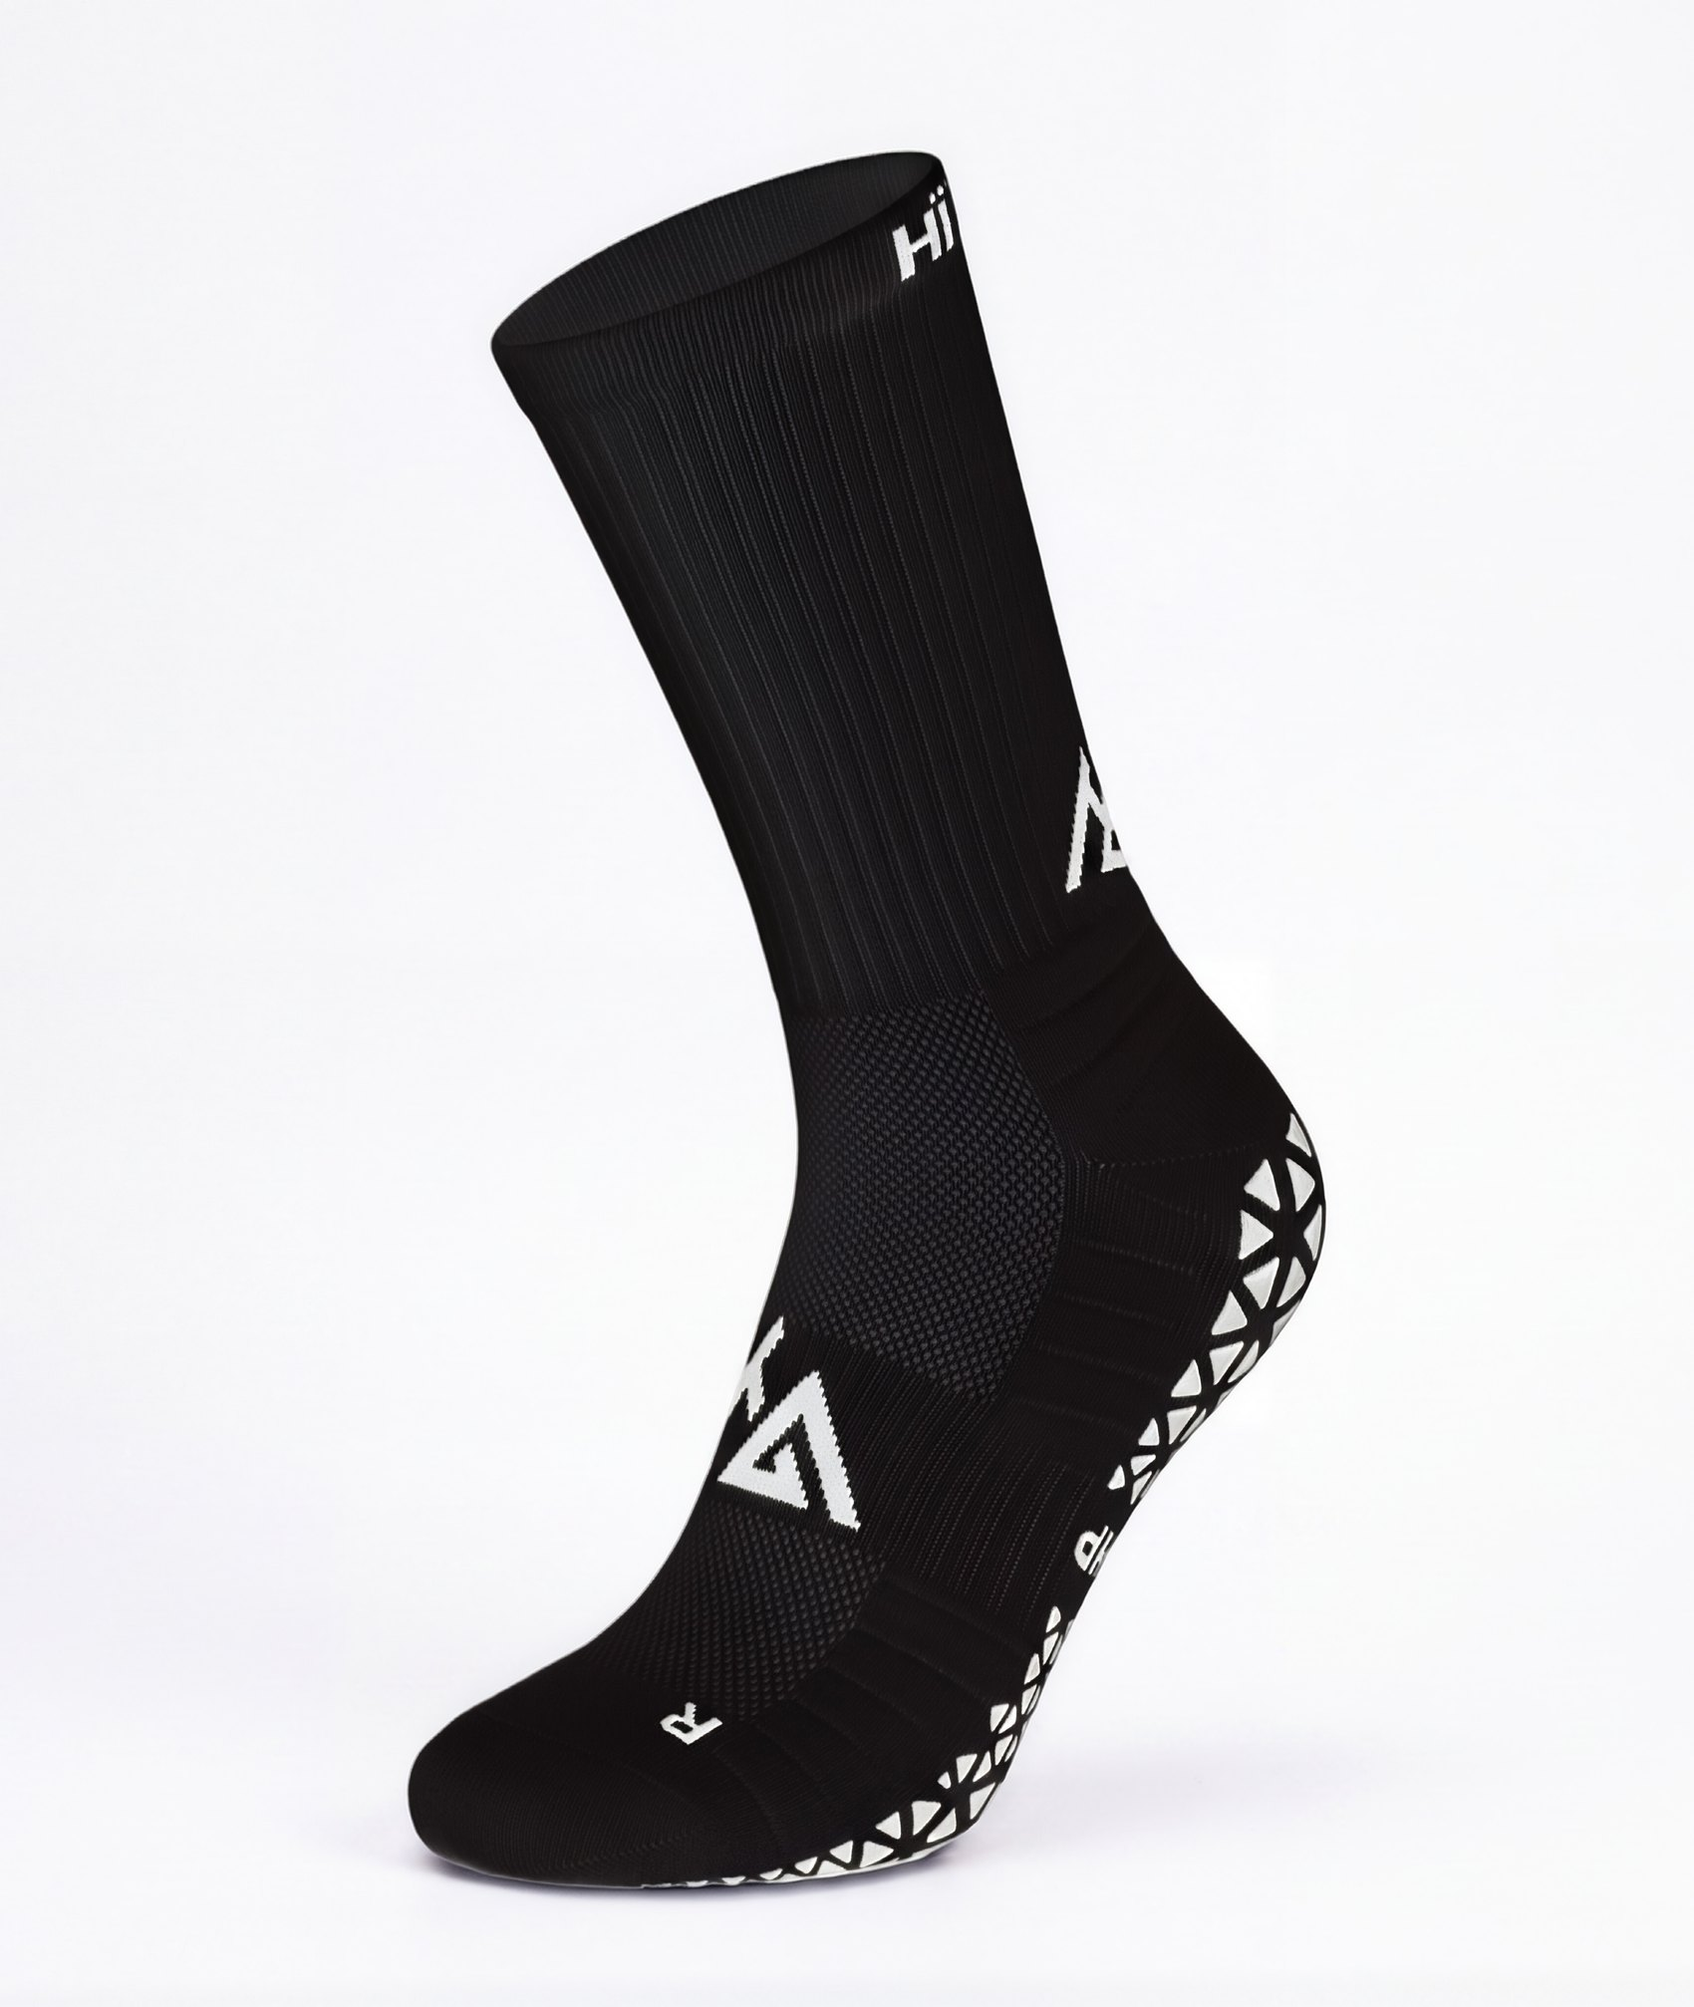
WE GIVE YOU GRIP
OWN PHOTO
01
INNOVATION
STANDING STILL IS FALLING BEHIND
02
COMFORT
PERFORM FOR LONGER
03
CONFIDENCE
IN YOUR GEAR
Notes:
Our three pillars. Innovation: standing still is falling behind. Comfort: the reason athletes can perform for a long time. Confidence: in wearing the right materials. Mission: gear should never be an obstacle to success. Vision: in 10 years the standard in performance sportswear.
PHOTO: OWN. Drive > Productfoto's > PERFORMANCE GRIP SOCKS 2.0 (Zwart voorkant). Also available: white, 3-pack and 5-pack.

Slide 5
PROVEN: 95% MORE GRIP
0.60
1.17
+95%
REGULAR SOCKS
GRIP SOCKS
MORE GRIP
Scientifically shown: grip socks raise the static friction coefficient from 0.60 to 1.17 (Apps et al. 2022, Journal of Sports Sciences).
Notes:
Friction coefficient 0.60 for regular socks versus 1.17 for grip socks: 1.17 divided by 0.60 is 1.95, so 95% more grip. Mind the wording: this is research on grip socks in general (Apps et al. 2022, Journal of Sports Sciences, doi 10.1080/02640414.2022.2080163), not a test of the HÏ Grip sock itself. So never say 'HÏ Grip tested'. Friedl et al. 2023 shows mixed evidence; only the +9.3% utilised traction when braking is citable.
PHOTO: No photo: deliberately a typographic slide. If you want an image: a close-up of a sock gripping inside a shoe.

Slide 6
THE TRACTION IS ALREADY THERE
3000+
10+
€22,000+
ATHLETES WEAR HÏ GRIP
B2B PARTNERS
REVENUE
OWN PHOTO
Screenshots of Instagram and TikTok posts from customers and athletes wearing HÏ Grip
Notes:
Three numbers: 3000+ athletes wear HÏ Grip, 10+ B2B partners, €22,000+ revenue. Profit: €12,000+. Channels: HÏ Grip Business, clubwear, pilates, retail. Review score 4.6 on Trustpilot (17 reviews on 3 September) may be mentioned, always with the source. The 3000+ was confirmed by Lars (15 September); never use the old 1,500+ again.
PHOTO: OWN needed. Screenshots or a mockup of Instagram and TikTok posts from customers (user generated content).

Slide 7
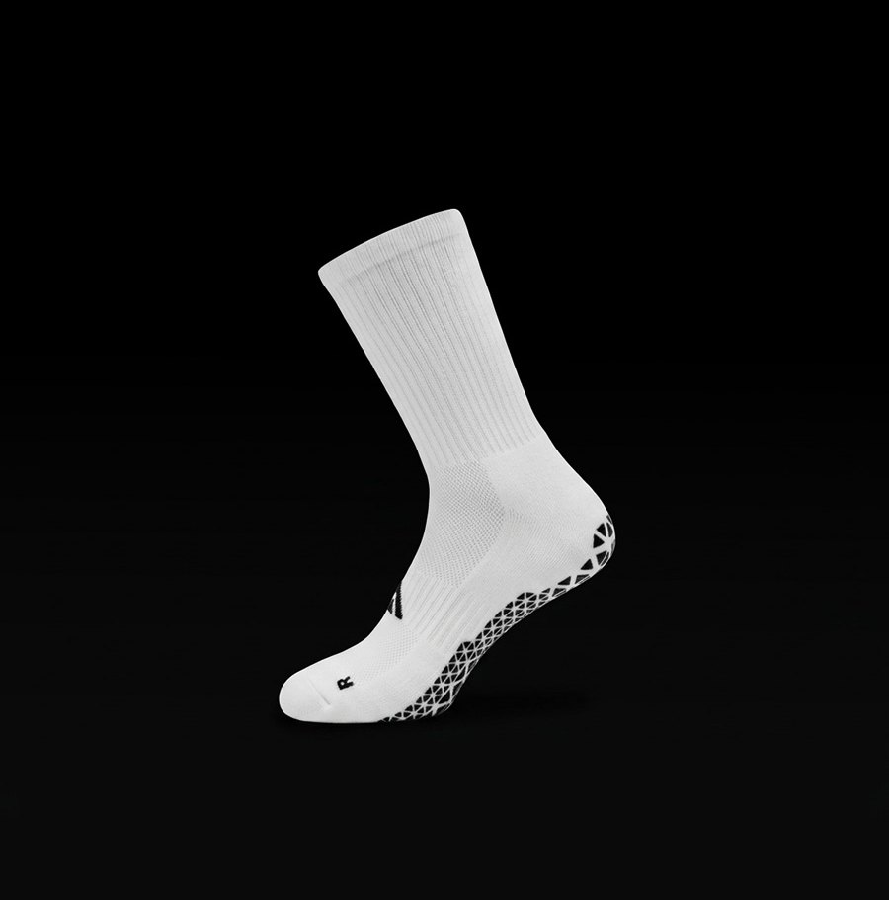
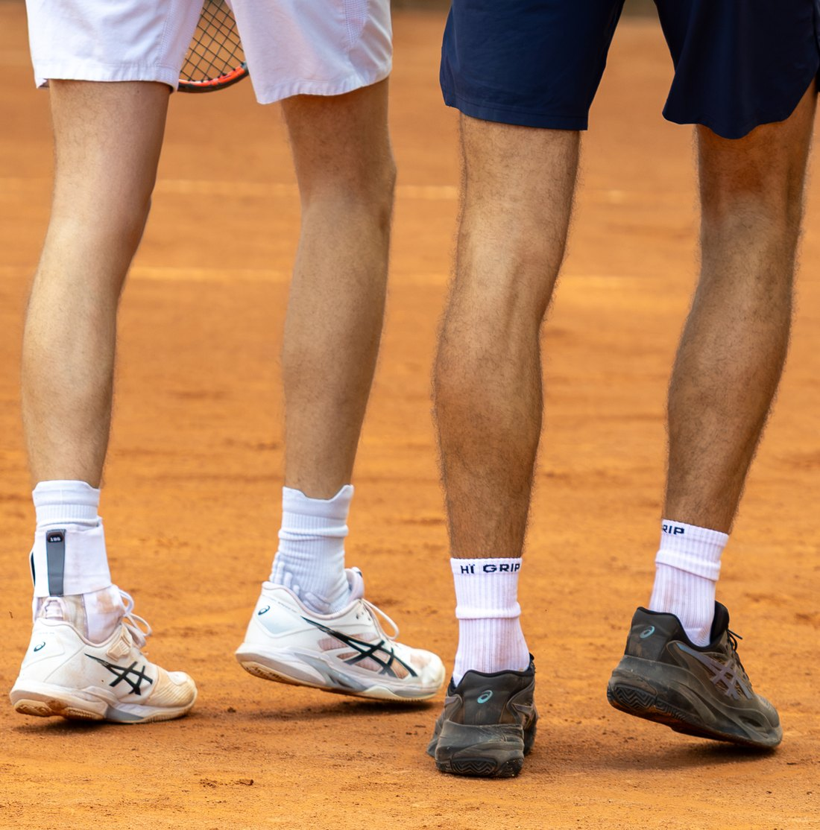
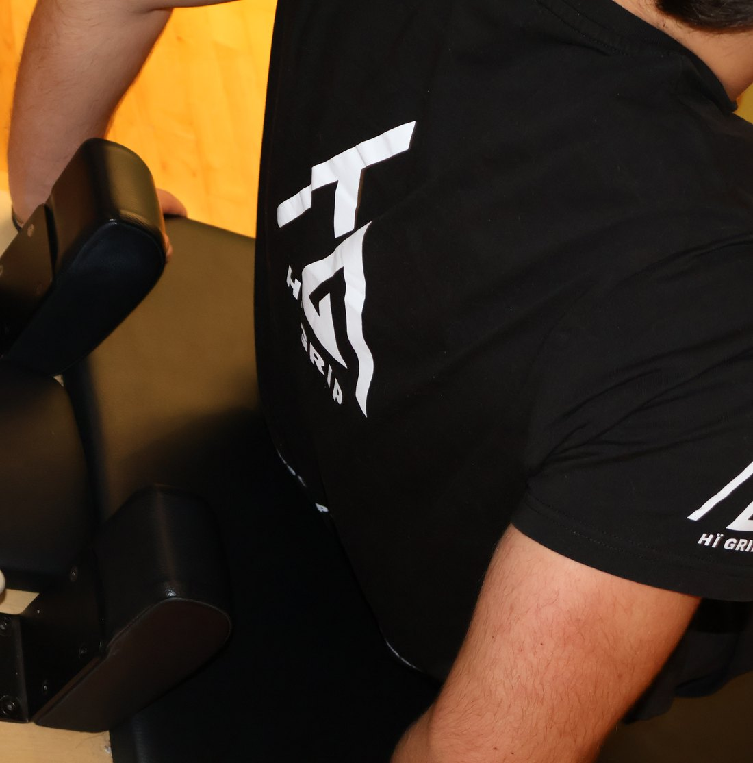
THEY ALREADY WEAR US
OWN PHOTO
OWN PHOTO
OWN PHOTO
RETAIL
CLUBS
GYMS
Sport2000
Concordia · Spirit · Lyra
SYTH · MyHealthClub
Notes:
Our B2B partners in three groups. Retail: Sport2000 Naaldwijk and Sport2000 Nootdorp. Clubs: Concordia Delft, V.V. Spirit, V.V. Lyra De Lier. Gyms: SYTH and MyHealthClub. 10+ organisations in total; be careful with this number, it has not been counted exactly.
PHOTO: OWN. Retail: product photo on black background (Productfoto's). Clubs: TVB Open (KC8A0061); there are no photos of the partner clubs themselves yet. Gyms: OVER ONS PILATES. Replace with images at the real partners (with their permission).

Slide 8
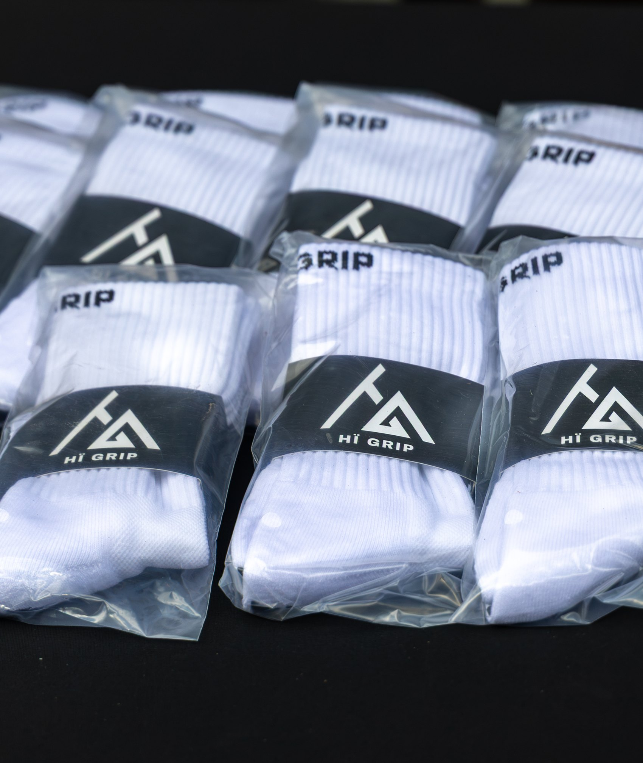
HEALTHY MARGINS
OWN PHOTO
65.9%
GROSS MARGIN [CHECK]
€17.95
SELLING PRICE 2.0
€58,780
POT. PROFIT [CHECK]
Notes:
Performance Grip Socks 2.0. Selling price €17.95 incl. VAT (webshop and retail recommended price are equal, decision Lars 2 October). [CHECK] The gross margin of 65.9% and the potential profit of €58,780 come from the old pitch, calculated with a selling price of €17.99 and a cost price of €5.77. Verify both against the current price and cost before the pitch, then remove the CHECK labels from the slide.
PHOTO: OWN. Drive > TVB Open 2026 (KC8A0031): packaged socks. For a real production photo: ask the supplier or shoot a packing photo.

Slide 9
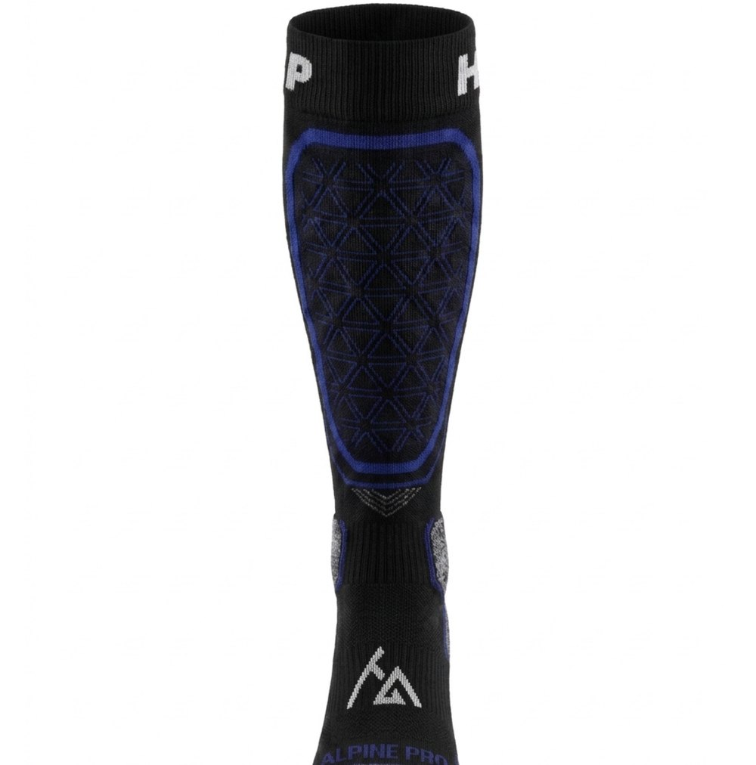
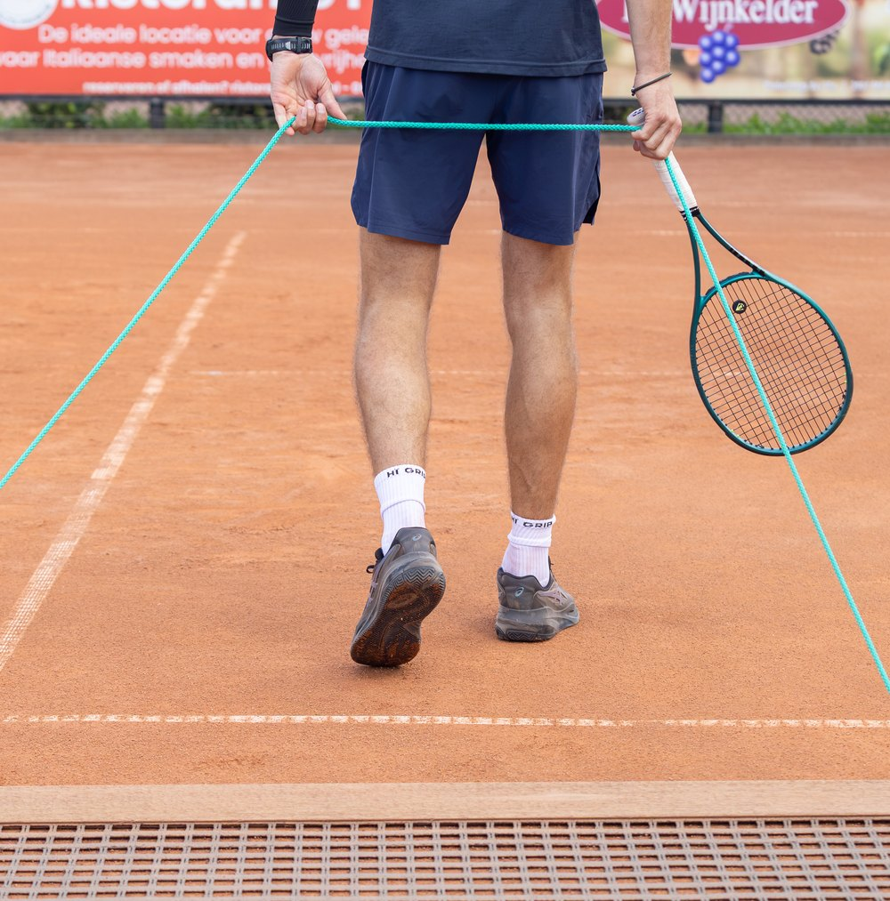
THE FUTURE OF HÏ GRIP
OWN PHOTO
OWN PHOTO
OWN PHOTO
Prototype or first samples of the Performance Tubes, footless socks, studio
PERFORMANCE TUBES
SKI SOCKS · ALPINE PRO
PERFORMANCE ACADEMY
COMING SOON
COMING SOON
COMMUNITY OF ATHLETES
Notes:
What comes after the Performance Grip Socks. Performance Tubes and Performance Ski Socks · ALPINE PRO: coming soon. Do not mention a launch date or product claims; they are not fixed in the facts file. Internally the financial plan schedules ski socks with gel protection for Q4 2027, but that is an internal assumption and not a public promise. Performance Academy: the community of HÏ Grip athletes, connected by events, sportswear and trust. Also in development: high-end sportswear, data gadgets, compression, outdoor, recovery and trend-driven branding.
PHOTO: Tubes: OWN needed (prototype/samples); the Drive folder PERFORMANCE TUBES is empty, so this is a placeholder. Ski: design from Drive > Productfoto's > PERFORMANCE SKI SOCKS (4.png), a design and not yet a real photo. Academy: TVB Open (KC8A0140).

Slide 10
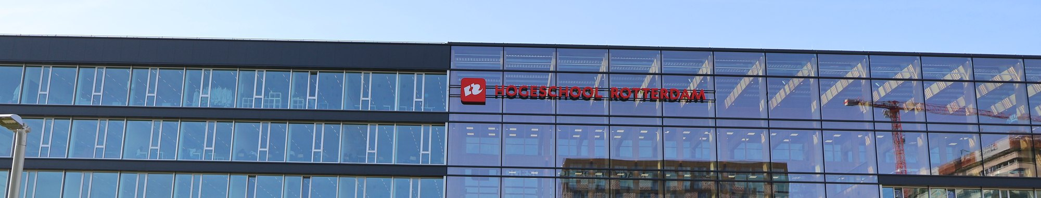
OUR ROAD TO 2031
2026–27
2028–29
2031
SCALE B2B AND SUPPLY CHAIN
NATIONWIDE, PRO CLUBS, EU
MARKET LEADER IN THE NETHERLANDS
OWN PHOTO
Notes:
Roadmap 2026 to 2031. 2026–27: scale B2B, optimise the supply chain, Performance Academy, partnerships with universities. 2028–29: B2B network across the Netherlands, partnerships with professional clubs, then EU expansion. 2031: leading Dutch performance sportswear brand. The old pitch had a joke here about living in and being everywhere in the Netherlands; use it in your talk.
PHOTO: OWN. Drive > Over Ons > ROTTERDAM BUSINESS SCHOOL (IMG_0442). Need a stronger 'Netherlands' image? Stock search term: 'Dutch sports field sunset'.

Slide 11
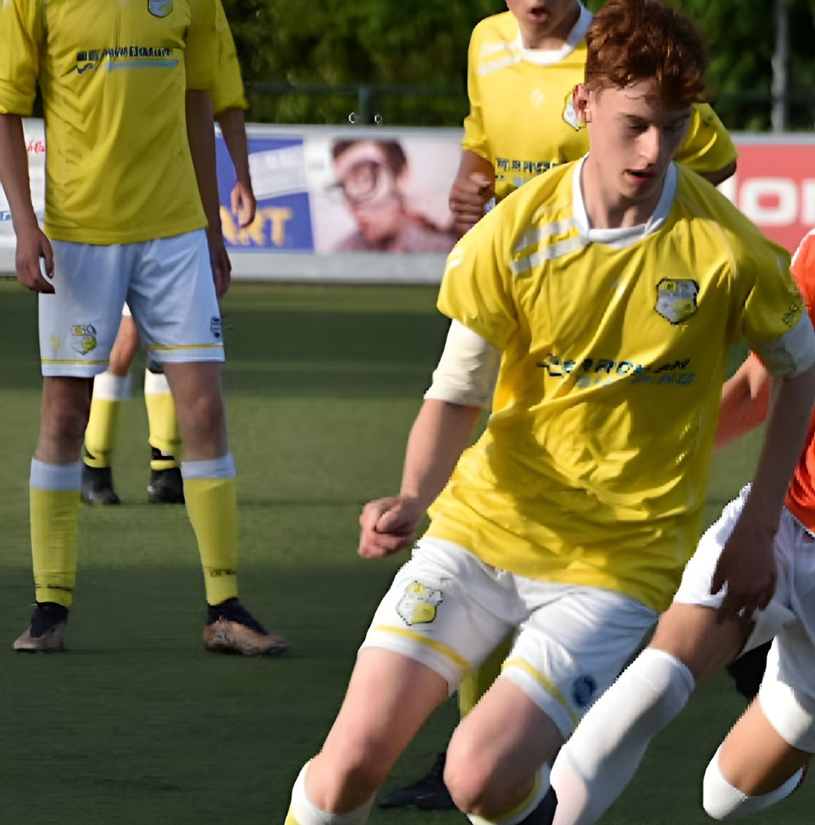
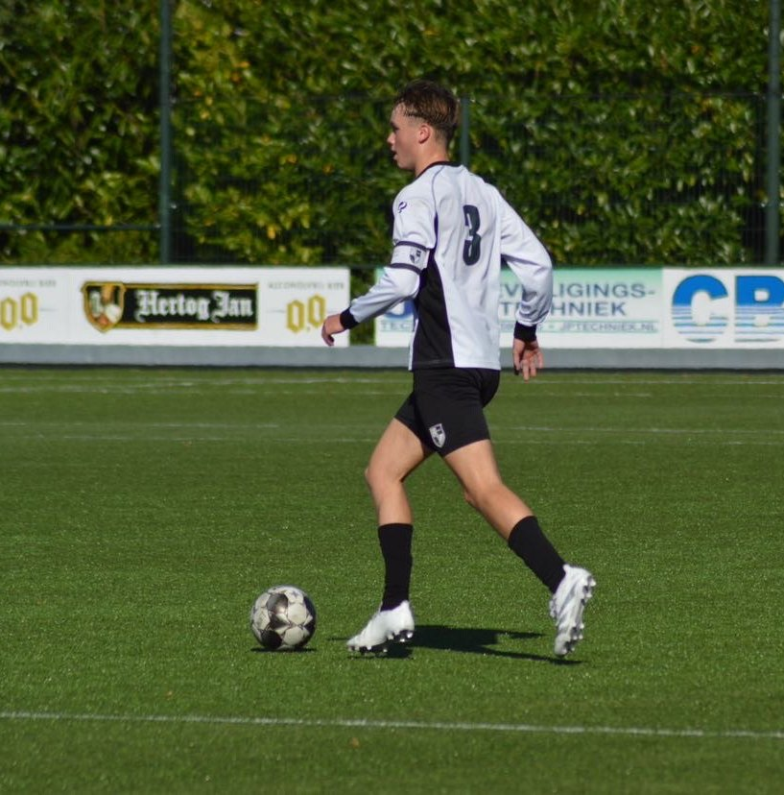
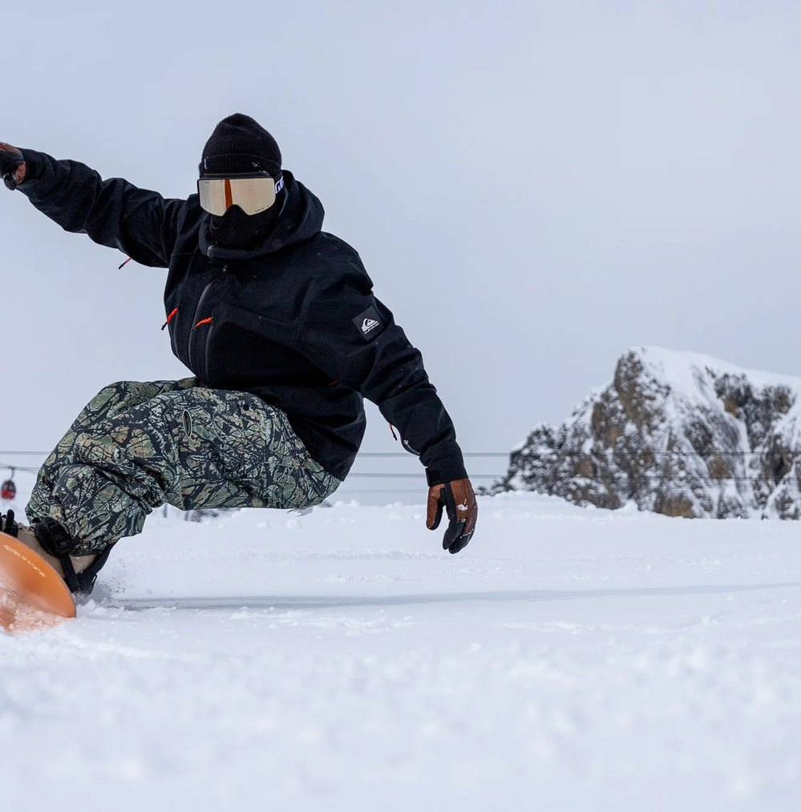
WE ARE HÏ GRIP
OWN PHOTO
OWN PHOTO
OWN PHOTO
LARS CRETZ
TIGO TWIGT
TIMO HEIJLIGERS
FINANCE, DESIGN, ADS, AI
SALES, B2B, WEBSITE
PURCHASING, IMPORT, B2B
Notes:
We are the three founders. Lars Cretz: football, tennis; finance, design, Meta, TikTok, AI, R&D, fulfilment. Tigo Twigt: skiing, football, running; sales, operations, B2B, LinkedIn, website, email marketing, customer service. Timo Heijligers: snowboarding, gym; B2B, purchasing, website, finance, R&D, ads, import, sales. Tell for each person why you believe in this.
PHOTO: OWN. Drive > Over Ons: LARS OUD, TIGO OUD, TIMO OUD (sports action photos). 'OUD' and 'JONG' in the file names are assumed to mean older and child; please check. Real portraits are even better.

Slide 12
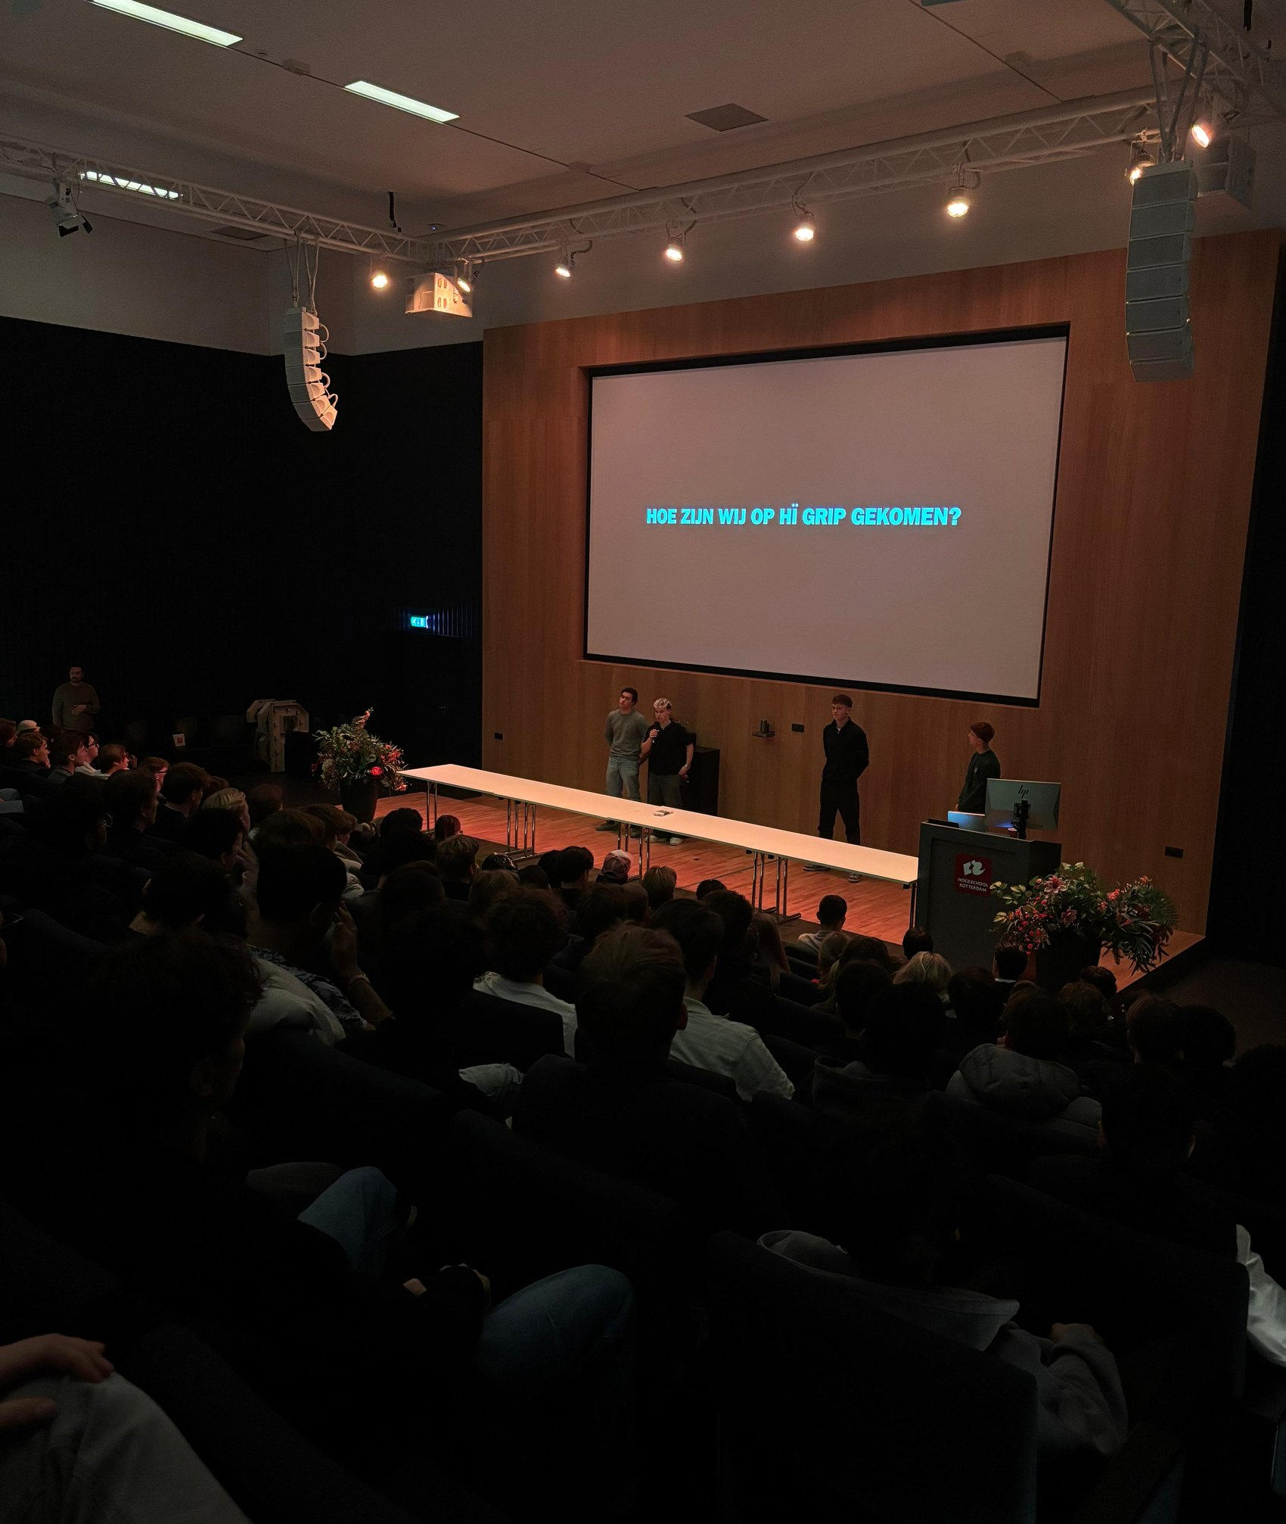
WE'RE NOT ALONE
OWN PHOTO
DENZEL
AI TEAM MEMBER, 24/7
4 COACHES
HANS · BIANCA · ROBERT · JEROEN
ALONGSIDE OUR STUDIES
BUILT BY THREE FOUNDERS
Notes:
Denzel is our AI content agent running 24/7: fully integrated in the workflow via Claude, Higgsfield, Obsidian and VS Code. Tasks: website creative, partner research, edit and caption, idea generation, strategic thinking. Coaches: Hans Scheffer (creative mentor), Bianca Verschuren (industry mentor), Robert Ruisaard (entrepreneurial mentor) and Jeroen Cremers (add role). We do this alongside our studies.
PHOTO: OWN. Drive > Over Ons: AUDITORIUM (pitch to a packed room). Better: a photo with the coaches or the workspace with Denzel.

Slide 13
WHAT GROWTH TAKES
€25,100
€172,100
€374,300
2027
2029
2031
CAPITAL REQUIREMENT AT 31 DECEMBER
Notes:
Capital requirement at 31 December (excl. VAT), from Financial Plan 2026–2031 (v5 balance 31-12): 2026 €13,260, 2027 €25,100, 2028 €69,700, 2029 €172,100, 2030 €263,800, 2031 €374,300. Most of it is inventory, B2B receivables and cash buffer. The plan is profitable every year (net result 2027 €28,380 to 2031 €96,904) and the capital requirement, financing plan and operating budget reconcile. Note: in that model only Qredits €25,000 (2028) is new money next to the investor's loan (€25,000, 2026); the model states that an extra investor is not needed. Make sure your story around the €50,000 ask matches this and explain why extra capital speeds up growth.
PHOTO: No photo: deliberately a typographic slide.

Slide 14
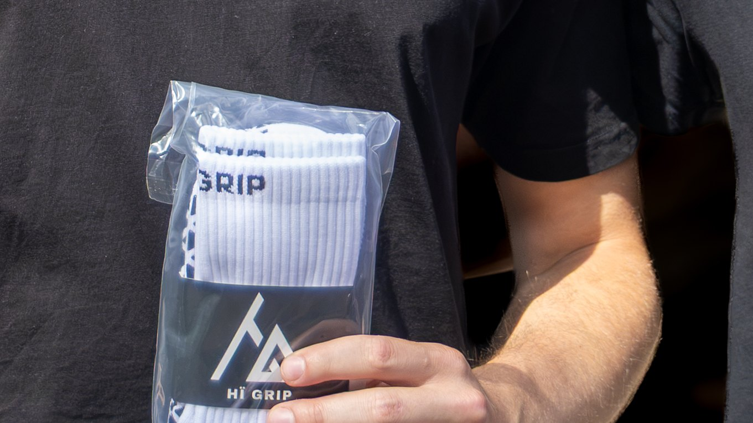
WE'RE ASKING €50,000
OWN PHOTO
€20,000
SKI SOCK PURCHASING
€30,000
MARKETING AND CONTENT
FOB + LOGISTICS
INFLUENCERS · ADS · SHOOTS · EVENTS
Notes:
The ask: €50,000. Split: €20,000 for purchasing ski socks (FOB plus logistics) and €30,000 for marketing and content: influencers, Meta ads, content shoots and physical events. Why now: proven traction with returning customers, a driven team with broad skills, financially healthy with margins in both B2B and B2C. Check the fit with the financial plan before the pitch (see slide 13).
PHOTO: OWN. Drive > TVB Open 2026 (KC8A0034-2): founder with a pack of socks. Better: a team photo of all three with product.

Slide 15
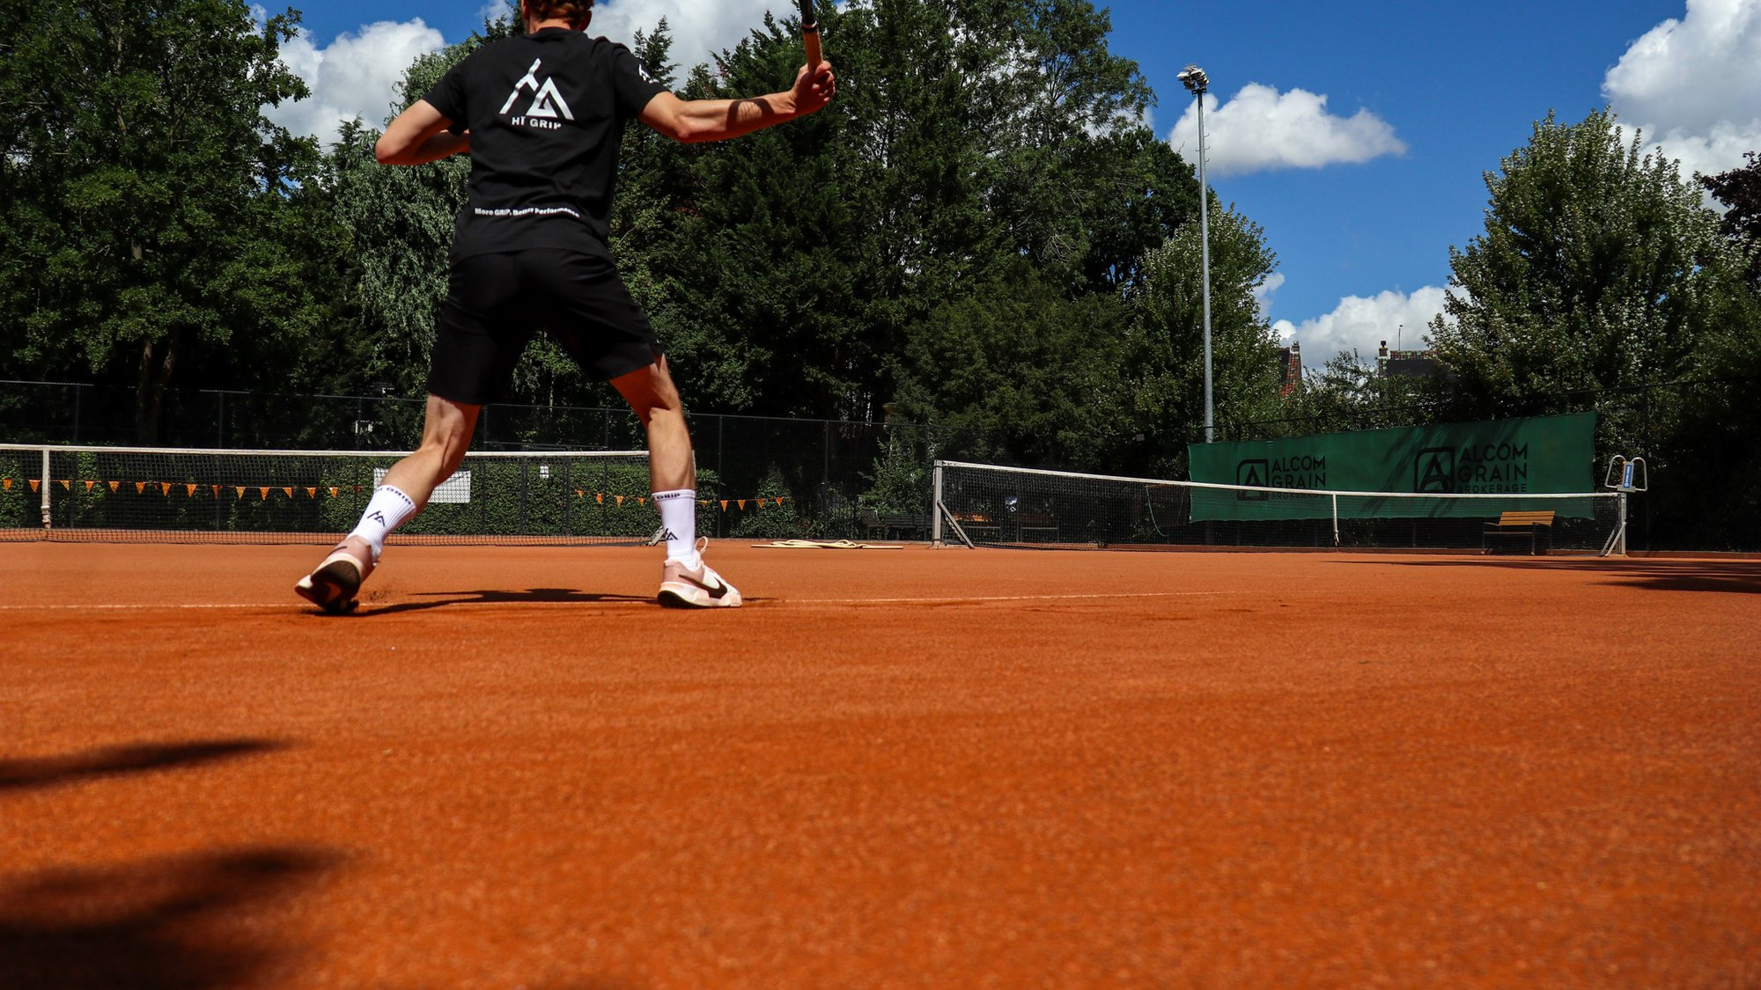
KEEP GOING WHEN OTHERS STOP
OWN PHOTO
INFO@HIGRIP.NL
HIGRIP.NL
LARS · TIGO · TIMO
Notes:
Close with the slogan and the contact details: info@higrip.nl and higrip.nl. Actively ask for a conversation.
PHOTO: OWN. Drive > Content B2C > Sporten > TENNIS > Wit 2.0 (IMG_4210).

