Slide 1
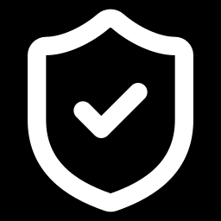
Day 1: Getting started
GBB · IAMS
Internal Audit Management Software training
Monday, 26 October 2026
https://audit.galaxybackbone.com.ng/
Notes:
Welcome everyone. Three days, one hour each. Today: getting started. Open the IAMS link on your laptop while we start.

Slide 2
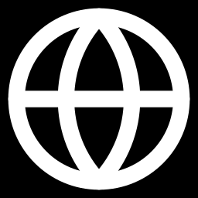
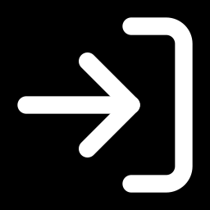
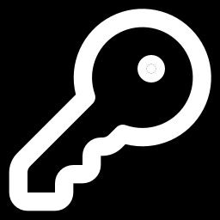
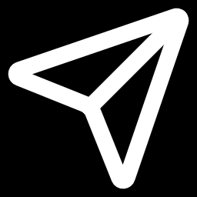
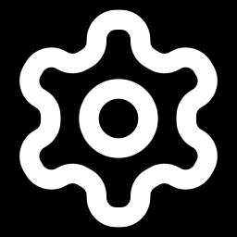
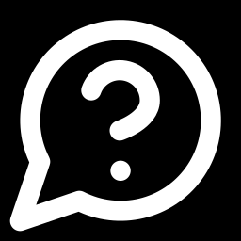
Today's plan
1. What IAMS is
2. Logging in and your profile
8 min
10 min
3. Roles and permissions
4. Requests and notifications
8 min
20 min · hands-on
5. The Settings page
6. Your questions
8 min
6 min
Notes:
Part 4 is the practical part: you will send requests to each other.

Slide 3
What IAMS is
Part 1
One place for all our audit work
Notes:
Read the SAY lines from the Part 1 script.

Slide 4
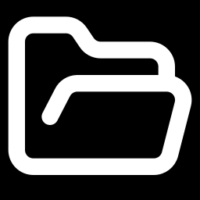
One place for all our audit work
Before IAMS
With IAMS
Work moves by email, Excel and shared folders
We carry memos from office to office for signature
Hard to know which version is the latest
"Who approved this, and when?" means searching
Everything happens inside one system
You approve and sign inside IAMS, with your saved signature
Every file is stored in one place
Every action is recorded: who did what, and when
It’s basically a system that digitalizes the entire audit process
→
Notes:
Ask: How many of you have waited days for a signature on an audit document?

Slide 5
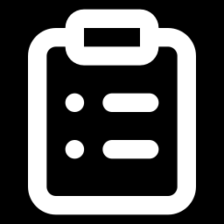
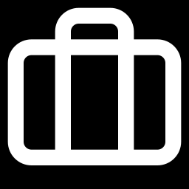
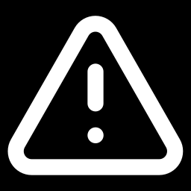
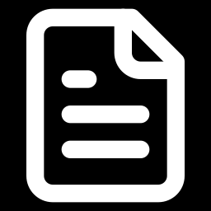
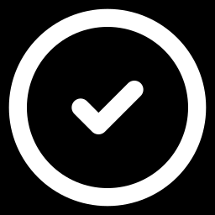
The journey of one audit: six steps
WATCH THE SCREEN
Where:
Sidebar
›
How IAMS works
1
2
3
4
5
6
›
›
›
›
›
Audit Universe
Audit Programme
Engagement
Findings
Review
Follow-up
The list of everything we can audit
This year's plan. The CAE approves it
One real audit: the team does the work
Problems the team finds
Signed by Manager, Director, CAE, then issued
Auditee fixes, auditor checks, audit closes
At every important step someone must approve, and nobody can approve their own work. We do all six steps live on Wednesday.
Notes:
Open How IAMS works in the sidebar and point to each step. Do not go into detail; Wednesday covers it.

Slide 6
Our three days together
Monday (today)
Tuesday
Wednesday
Getting started
The tools around the audit
One full audit
Logging in and your profile
Saving your signature
Roles and permissions
Requests and notifications
The Settings page
Risk register
Assets
Documents
System audit tools
From the first step to closure
Done live, together
Who approves what, and when
Notes:
If someone asks a detailed audit question today: "Hold it for Wednesday." Write it down.

Slide 7
Logging in and your profile
Part 2
Log in, find your way around, save your signature

Slide 8

Log in
DO IT NOW
1
Open the IAMS link your trainer shared.
GBB IAMS
2
In Work email or Domain username, type your work email.
Work email or Domain username
you@galaxybb.local or username
3
Type your Password.
Password
4
Click Sign in. You land on the Home page.
••••••••
Sign in
Can't get in? Raise your hand. Don't keep trying, or your account may be blocked for a while.
What the login page looks like
Notes:
Wait until everyone is on the Home page. After each page loads, wait a few seconds before clicking.

Slide 9

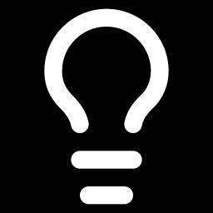
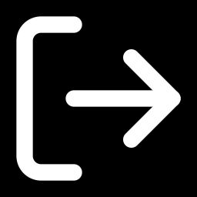
Find your way around
DO IT NOW
GBB IAMS
Search…
4
2
1
Sidebar
Your menu. Click a group (▾) to open it.
Home
Workflow ▾
Audit Lifecycle ▾
Audit Modules ▾
System Audit ▾
Notifications
Risk Register
How IAMS works
System ▾
2
Bell
Your notifications. A number means something new.
1
3
Your name
Opens your Profile. The icon beside it signs you out.
4
Search
Find any page quickly.
3
Your menu may look different from your neighbour's. It depends on your role.
Your name
Notes:
Let people click around for one minute. Point out that System and Audit Modules start closed.

Slide 10
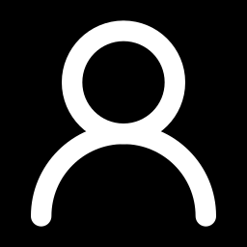
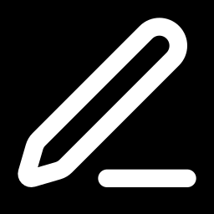
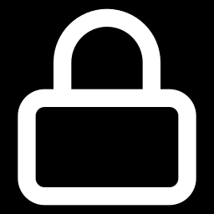
Your Profile page
DO IT NOW
Open:
Your name (bottom of sidebar)
›
Profile
Profile
Signature
Your name, email, department and job title come from GBB records. You can edit your display name, phone and skills, then click Save profile.
Your signature. IAMS stamps it on every document you sign. Next slide.
Security
Access
Think someone else is using your account? Click Log out everywhere.
Your role(s), and the full list of what your role lets you do.
Notes:
Walk through the four tabs. Spend the most time on Signature (next slide).

Slide 11
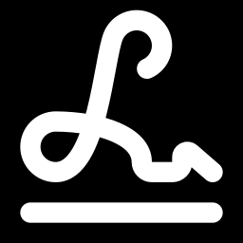
Save your signature
DO IT NOW
Where:
Profile
›
Signature
1
Click the Signature tab. You see My signature.
2
Choose Draw and sign with your mouse or finger.
3
Not happy with it? Click Clear and sign again.
No saved signature,
no signing.
4
Click Use signature. Your signature now shows on the page.
When you approve in IAMS, you don't print and sign. IAMS stamps this saved signature for you.
Prefer a picture? Choose Upload and pick a PNG or JPG of your signature. To change it later, click Replace or Remove.
Notes:
Ask everyone to raise a hand when their signature is saved. Walk round and help. Do not move on until most hands are up.

Slide 12
Roles and permissions
Part 3
Why your menu is different from your neighbour's

Slide 13

Permissions are keys, roles are key rings
Raise a finding
→
→
Upload evidence
Auditor role
all the keys an auditor needs
You
Write a working paper
Permission = allowed to do one thing.
Role = all the permissions one kind of job needs.
No permission = the button or page is not there for you.
Notes:
IAMS does not look at your job title. It looks at the keys you hold. The System Admin decides which keys each role has.

Slide 14
The roles we have at GBB
Role | In simple words
Super Admin (System Admin) | Can do everything. Creates users, roles and settings.
CAE (Chief Audit Executive) | Head of audit. Approves the yearly programme, final sign-off on reviews, issues them.
Director | Oversight. Second signature on every audit review.
Audit Manager | Plans audits, sets up the team, approves working papers and closures.
Audit Lead | Leads one audit, day to day.
Auditor | Does the audit work on the audits they are assigned to.
Auditee | The department being audited. Sends documents, answers findings, fixes problems.
Audit Committee | Sees the committee report pack only.
Viewer | Can look. Cannot change anything.
Notes:
Ask people to find their own role in this table, then check it in Profile › Access.

Slide 15
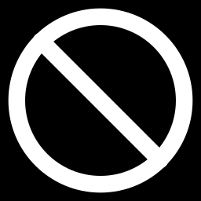
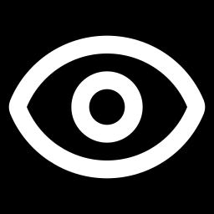
Two rules no role can break
You cannot approve your own work
You see your own work
Someone else must approve what you submit. Even the CAE. This is called segregation of duties.
Auditors see the audits they work on. Auditees see only their own department's findings. Senior roles like Director and CAE see everything.
Question: an Audit Manager submits a working paper. Can they approve it themselves? (No. Someone else must.)
Notes:
Ask the question on the slide and let the class answer.

Slide 16
How the admin creates a role
ADMIN ONLY · WATCH
Where:
System
›
Settings
›
Role Management
1
Click Create Role.
Good to know
2
Type a Name (for example: Training Observer) and a Description. Click Create role.
Each role row shows how many permissions it has.
Only the System Admin can change roles.
Built-in system roles cannot be deleted.
3
On the new role's row, click Permissions.
4
Tick the permissions you want. They are grouped by area. Select all ticks a whole group.
5
Click Save permissions.
Notes:
Do this live as Super Admin. Delete the Training Observer role after class.

Slide 17
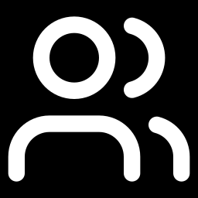
How the admin gives a role to a person
ADMIN ONLY · WATCH
Where:
System
›
Users
1
Find the person and click Edit on their row.
Also on this page
2
Click the Roles box and pick the role.
New User: add a person.
View: see a person's details.
Deactivate: when someone leaves GBB. We never delete people, so their history stays.
3
Click Save changes.
The person sees the change after they log out and log in again.
Most people get their role automatically from their GBB Active Directory group. That link is set in Settings › Directory.
Notes:
Show the Users list, then edit one user live.

Slide 18
Requests and notifications
Part 4
Hands-on: you will send, approve and sign requests

Slide 19
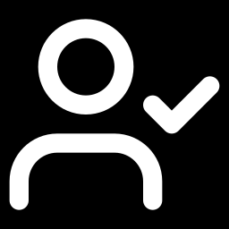
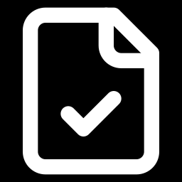
What is a request?
Where:
Workflow
›
Requests
→
→
→
You send it
Person 1 acts
Person 2 acts
Done
Attach the document. Choose who acts, in order.
Approve, Sign or Reject
Approve, Sign or Reject
You get a PDF with every signature
If anyone clicks Reject, the request stops and comes back to you with their reason.
Two tabs on the Requests page
Don't mix it up
To action: waiting for you (red number). Requests: ones you sent or were part of.
Review/Approval (also under Workflow) is for formal audit documents. We use it on Wednesday.
Notes:
Before IAMS you printed the memo and walked to your oga's office. Now IAMS moves it from person to person.

Slide 20
Exercise: get into groups of three
DO IT NOW
A
B
C
Person A: The sender
Person B: Acts first
Person C: Acts second
Creates the request and attaches a PDF. Gets the signed copy at the end.
Gets a notification and an email, then clicks Approve.
Gets it after B, then signs with their saved signature.
Have a small PDF ready on your laptop. Person C: check your signature is saved (Profile › Signature).
Notes:
Give people one minute to form groups and decide A, B and C.

Slide 21
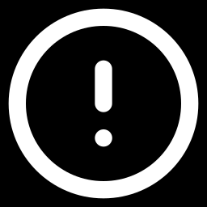
Person A: send the request
DO IT NOW
Where:
Workflow
›
Requests
›
New request
1
Title: type Day 1 practice - your name
Rules
2
Description: one line, for example "Please approve my training memo".
You cannot add yourself.
The order matters: B acts first, then C.
Up to 20 people per request.
Signed copies are made for PDF attachments only.
3
Recipients (in order): in Search people to add… add B first, then C. Use the arrows to change the order.
4
Attachments (optional): choose your small PDF.
5
Click Create request. You see Request sent. Click Open request to follow it.
Notes:
Walk round. Common mistake: adding C before B. Use the up and down arrows to fix the order.

Slide 22
Person B: approve it
DO IT NOW
Where:
Workflow
›
Requests
›
To action
1
Watch the bell. Within about a minute you get Request awaiting your action. Check your email too.
After you approve
The request moves to C automatically.
C gets a notification and an email.
Your approval is recorded with the time.
2
Go to To action and open the request (or click the notification).
3
Read it and open the attachment.
4
Under It's your turn, click Approve.
Want to leave a note? Type it in the Activity box and click Comment.
Notes:
If no notification arrives after a minute, refresh the page.

Slide 23
Person C: sign it
DO IT NOW
Where:
Workflow
›
Requests
›
To action
1
After B approves, you get Request awaiting your action.
Why type your name?
2
Open the request from To action.
Typing your name confirms that you read the request and its attachments. IAMS records who signed, when, and exactly what was signed.
3
Click Sign. You see your saved signature.
4
In the box, type your full name exactly as IAMS shows it.
5
Click Sign now.
Notes:
Common mistake: name typed differently (missing middle name, different spelling). Copy it exactly as shown.

Slide 24
Person A: see the result
DO IT NOW
1
Your bell shows Request completed.
2
Open the request. Recipients shows who acted, in order.
3
Activity shows comments and signatures, with the time.
No printing.
No walking.
No waiting.
4
Under Signed documents, click Download. Open the PDF and find the signature page with both signatures.
Who has their signed PDF? Show the class.
Notes:
Ask one person to show their signed PDF on the projector.

Slide 25
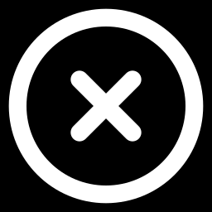
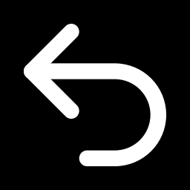
Saying no, and fixing mistakes
WATCH THE SCREEN
Reject a request
Made a mistake?
1
Click Reject.
Sender only: while it is still pending, open it and click Cancel request.
Wrong person or wrong file? Cancel it and send a new one.
Files can only be added when you create the request, so nobody can change what people sign.
2
Write why, in the box.
3
Click Submit rejection.
The request stops. The sender gets Request rejected with your reason.
Notes:
Do the rejection at the front with a volunteer. Show that the sender gets the reason.

Slide 26
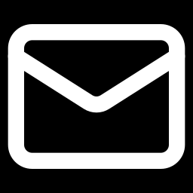
Notifications: the bell and your email
DO IT NOW
1
Click the bell at the top right, then View all. (Or Sidebar › Notifications.)
Two places, every time
The bell inside IAMS
Your work email
For requests, approvals, audit assignments, and findings raised against your department
2
Use the All and Unread tabs.
3
Click a notification to open the item it is about.
4
Click Mark all read to clear the list.
Allow up to one minute. Still nothing? Refresh the page.
Notes:
Everyone should have at least one notification from the exercise. Let them try Mark all read.

Slide 27

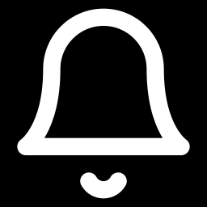
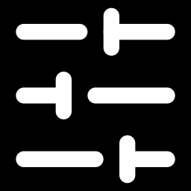
Escalations: nothing sits on a table forever
Request sent
After 24 hours
About 3 days later
Waiting for someone to act
No action: that person gets a reminder
Still nothing: the sender is told
Audit approvals and late audits go higher, step by step: the person, then their manager, then senior management.
GBB sets the times
Admin: Workflow › Escalation Policies. Hours per level. The All row covers requests.
Default times shown. The admin can change them without a programmer.
Notes:
Show the escalation that arrived in the demo account bell (see Before class setup). Do not open Workflow › Escalations; it shows an empty page by design.

Slide 28
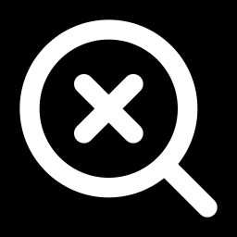
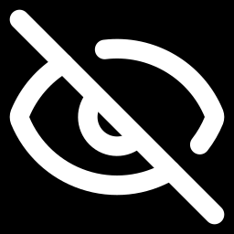
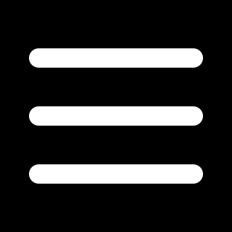
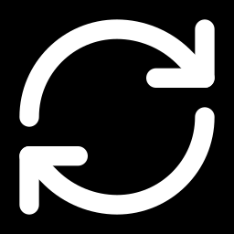
Stuck? Quick fixes
Can't find a person to add
No notification yet
No Approve or Sign buttons
They may have the Viewer or Audit Committee role, which cannot receive requests. Tell the trainer.
Wait one minute, then refresh the page.
It is not your turn yet. Someone before you must act first.
Sign now doesn't work
Can't see a menu item
"Something went wrong"
Type your full name exactly as IAMS shows it.
That is your role. Check Profile › Access.
Refresh the page. If it stays, raise your hand.
Notes:
Keep this slide up while people finish the exercise.

Slide 29
The Settings page
Part 5
Where GBB sets its own rules, without a programmer

Slide 30
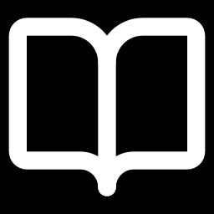
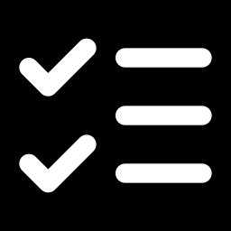
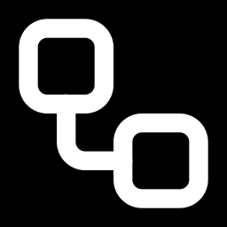
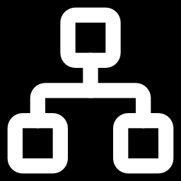
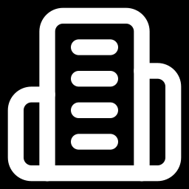
Settings: tab by tab
ADMIN ONLY · WATCH
Where:
System
›
Settings
Role Management
Working Paper Templates
Review Templates
Checklist Templates
Roles and their permissions (Part 3).
The standard form for an auditor's record of work.
The layout of the final audit review (the report).
Controls loaded automatically when an audit starts.
Audit Customization
Directory
System Configuration
Audit Managers can look, but only the System Admin can change.
The rules of the audit process. Next slide.
Links Active Directory groups to IAMS roles.
GBB's name, contacts, and the review footer line.
Notes:
Open each tab briefly. Do not change anything live in Approval Matrix or Lifecycle Gates.

Slide 31
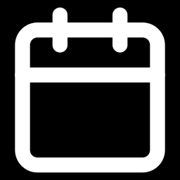
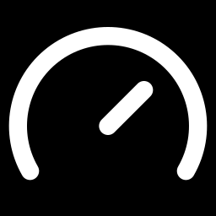
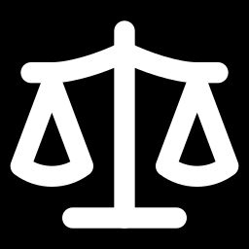
Inside Audit Customization
ADMIN ONLY · WATCH
Where:
Settings
›
Audit Customization
Lifecycle Gates
SLA Rules
Approval Matrix
What must be finished before an audit moves to its next stage.
Default deadlines for audits and for fixing findings.
Who signs what, and in what order. Example: Manager, then Director, then CAE.
Audit Taxonomy
Analytics Visibility
Planning Priority Weights
The lists people pick from: audit types, priorities, categories, severities.
Which numbers show on dashboards and management reports.
How IAMS ranks what to audit next year.
Notes:
Question: if management decides the Director no longer signs reviews, do we call the developers? No. The admin changes the Approval Matrix.

Slide 32
What we learnt today
IAMS keeps the whole audit in one place, in six steps.
How to log in, find your way around, and save your signature.
Your role decides what you can see and do. The admin manages roles.
How to send, approve and sign a request, and how IAMS notifies and escalates.
Settings is where GBB sets its own rules.
Notes:
Read the five points, then open the floor for questions.

Slide 33
Questions?
Before tomorrow:
1. Save your signature (Profile › Signature)
2. Send one request to a colleague, and act on one you receive
Tomorrow: the tools around the audit
Notes:
Collect questions. Write down anything you promise to answer tomorrow.

