Slide 1
BhashaForge
A Console-Based Banglish Mini Compiler & Interpreter
Using Java OOP
Presented By: Himadry Deb Nigam
Course: Object Oriented Programming (OOP)
JAVA
JDBC
MYSQL
INTELLIJ IDEA

Slide 2

Project Introduction
BhashaForge is a console-based mini compiler/interpreter built using Java and Object-Oriented Programming concepts. The system allows users to write code using Banglish keywords, execute custom programs, store user code using JDBC + MySQL, and view previously saved programs.
Write Code
Write programs using Banglish keywords
Execute
Execute custom programs in the console
Store
Store user code using JDBC + MySQL
View
View previously saved programs

Slide 3
Project Objectives
1
Build a Custom Language
Build a custom Banglish programming language
2
Compiler Concepts
Understand compiler/interpreter concepts
3
Apply OOP Principles
Apply real-world OOP principles
4
Lexer → Parser → Interpreter
Learn the full compiler workflow
5
Database Storage
Store user programs using database
6
Console Application
Create a fully console-based Java application

Slide 4


Technologies Used
Programming Language
Java
IDE
IntelliJ IDEA
Database
MySQL (XAMPP)
Database Connectivity
JDBC (Java Database Connectivity)
Concepts Used
OOP
File Handling
Database Management
Compiler Design Basics

Slide 5

System Architecture
The BhashaForge system follows a classic compiler pipeline, processing user input through distinct stages before producing output. Additional modules including a User System, JDBC Database Storage, and an Environment Variable Manager support the core pipeline.
User Input
Parser
Output
Source code or commands
Generate AST structure
Results or program output
Lexer
Interpreter
Tokenization of input
Execute semantic actions
Each stage transforms the input further — from raw text to tokens, to an Abstract Syntax Tree, and finally to executed results displayed in the console.

Slide 6
Main Features
Banglish Language Support
Variables & Arithmetic
Full Banglish programming language support with native keywords
Variable declaration and arithmetic operations
Print & Conditions
User Login System
Print statements, if conditions, and while loops
Secure user login with account management
Save & Load Programs
Error Handling
JDBC database integration to save and load user programs
Built-in error handling system for robust execution

Slide 7

OOP Concepts Used
Encapsulation
Inheritance
Private variables and getter methods
AST Node classes extend abstract Node class
Polymorphism
Abstraction
Different node execution behaviors
Abstract Node class and interfaces
Interface
Composition
Storage interface implementation
Interpreter uses Environment object
Method Overloading & Overriding: Used extensively in Interpreter and Node classes to handle diverse execution scenarios.

Slide 8
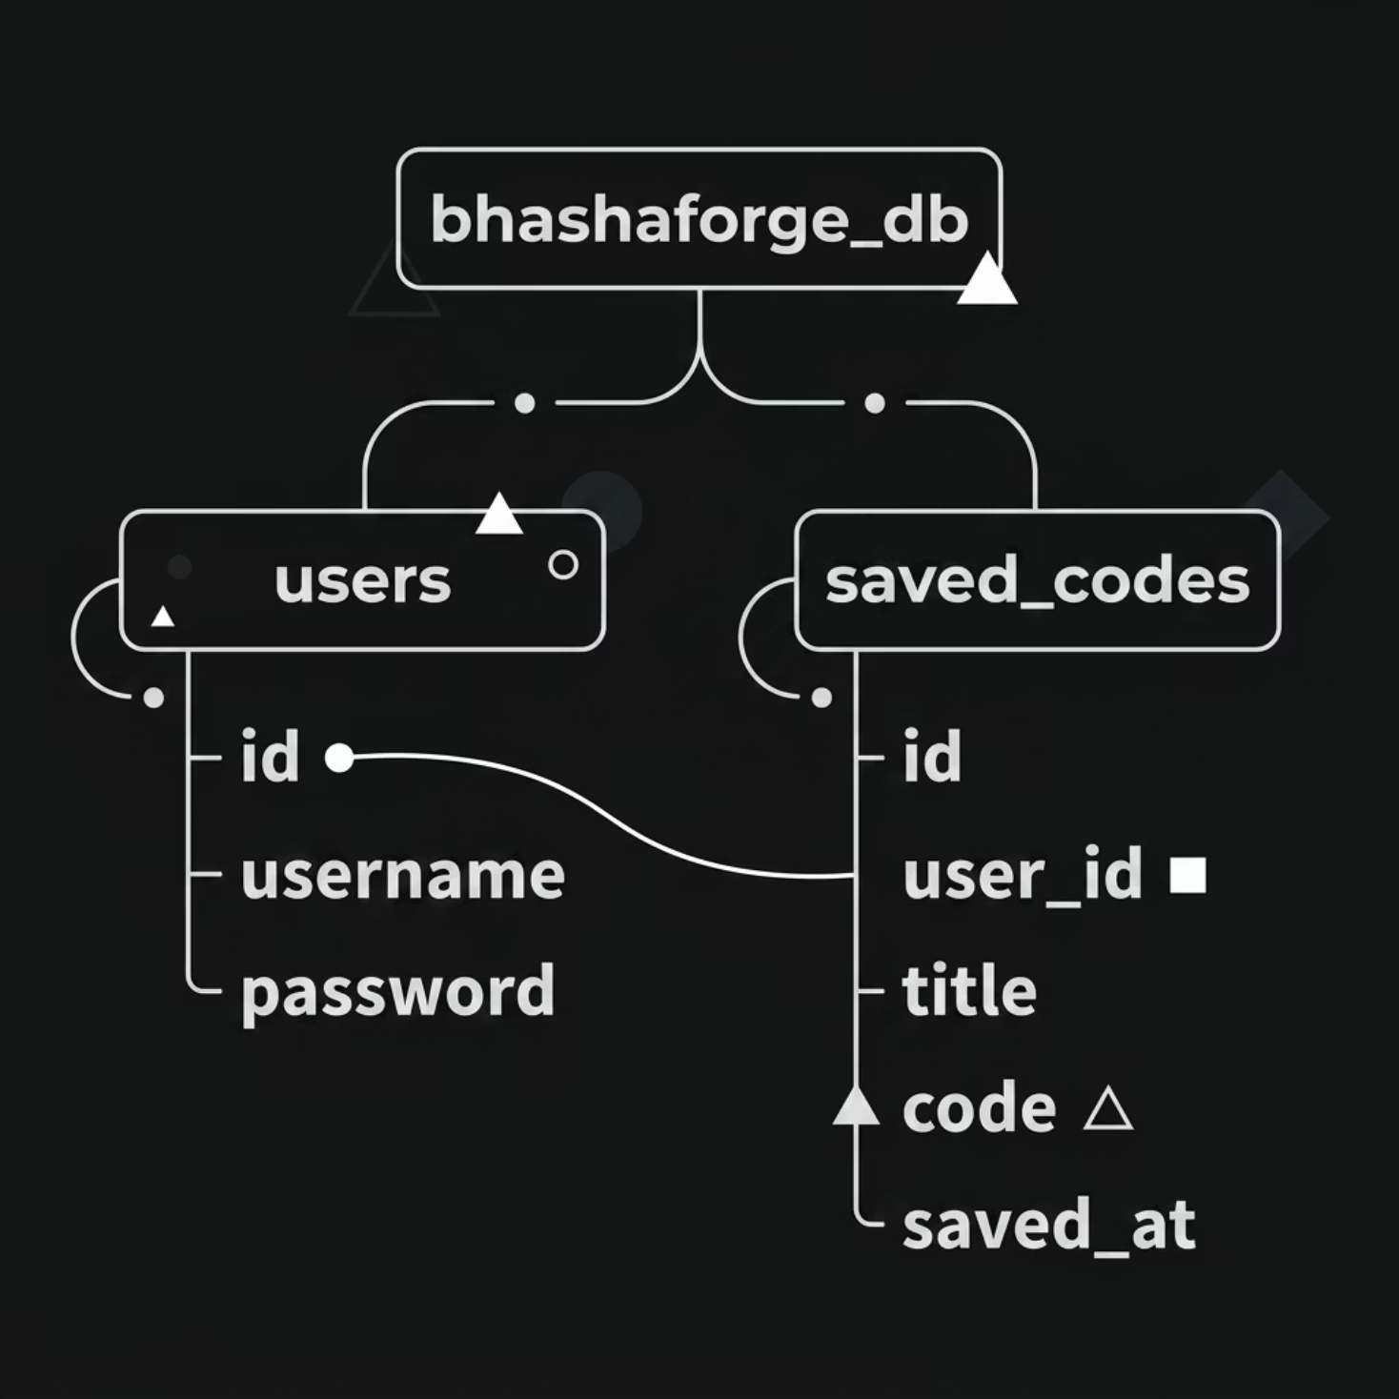

Database Design (JDBC + MySQL)
Database Name
bhashaforge_db
Purpose
Store user accounts
Save user-written programs
Load previous codes

Slide 9
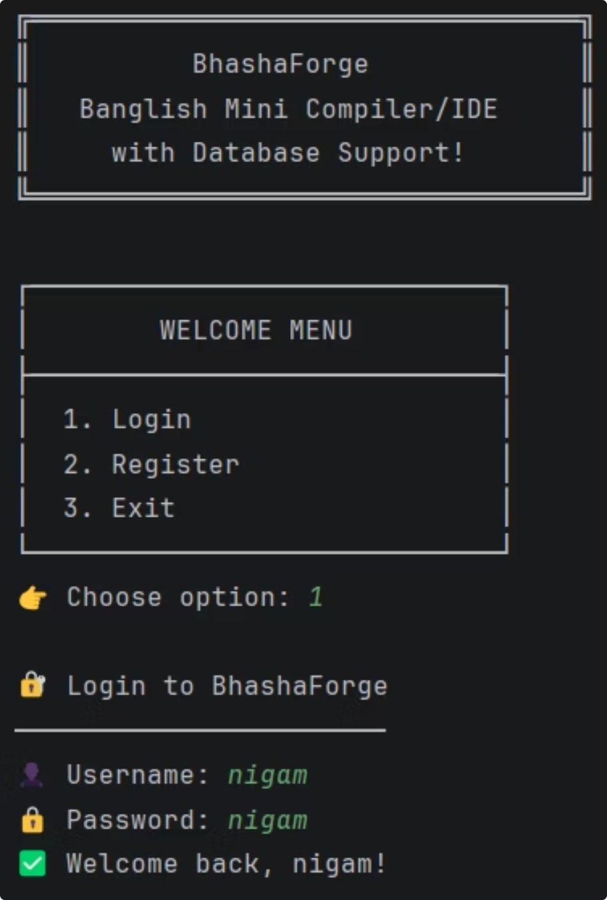
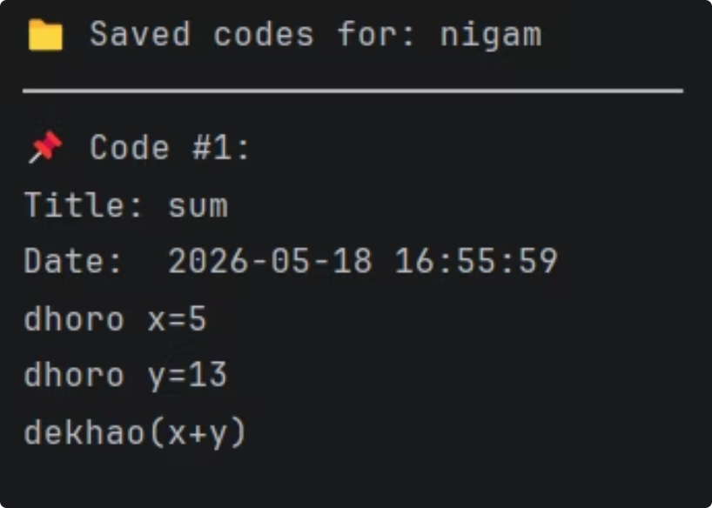
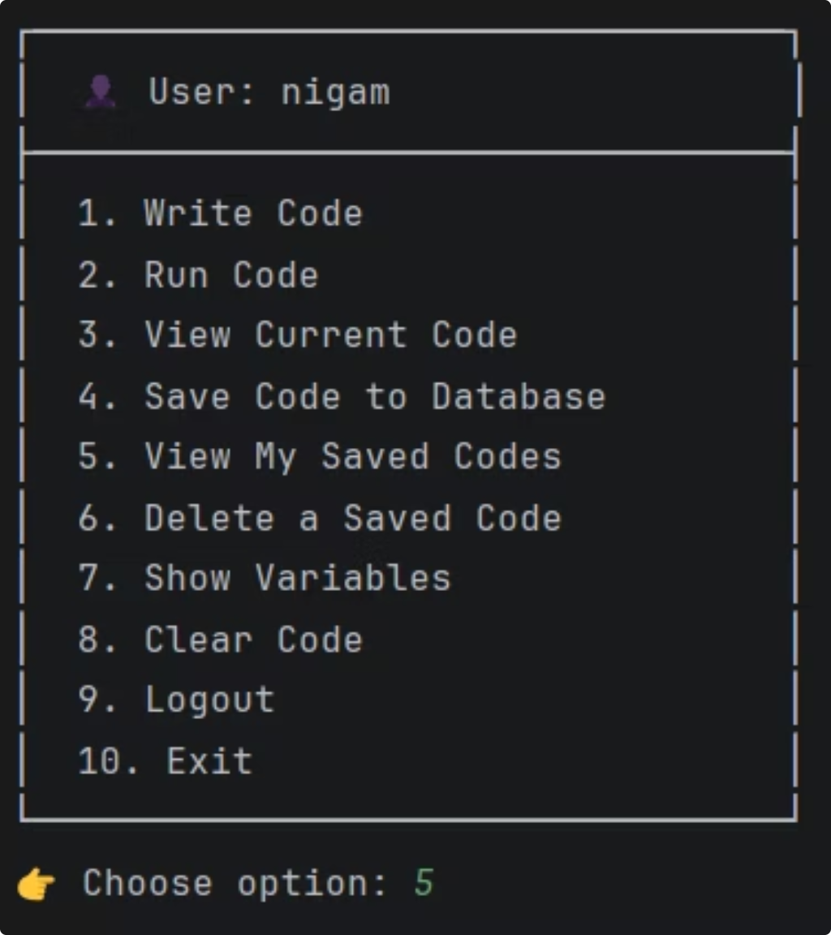
Project Interface

Slide 10
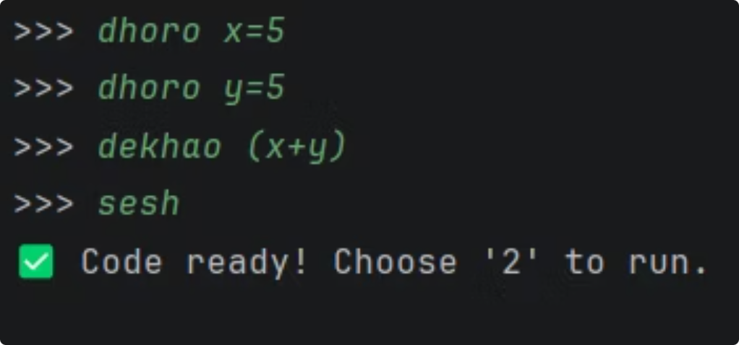
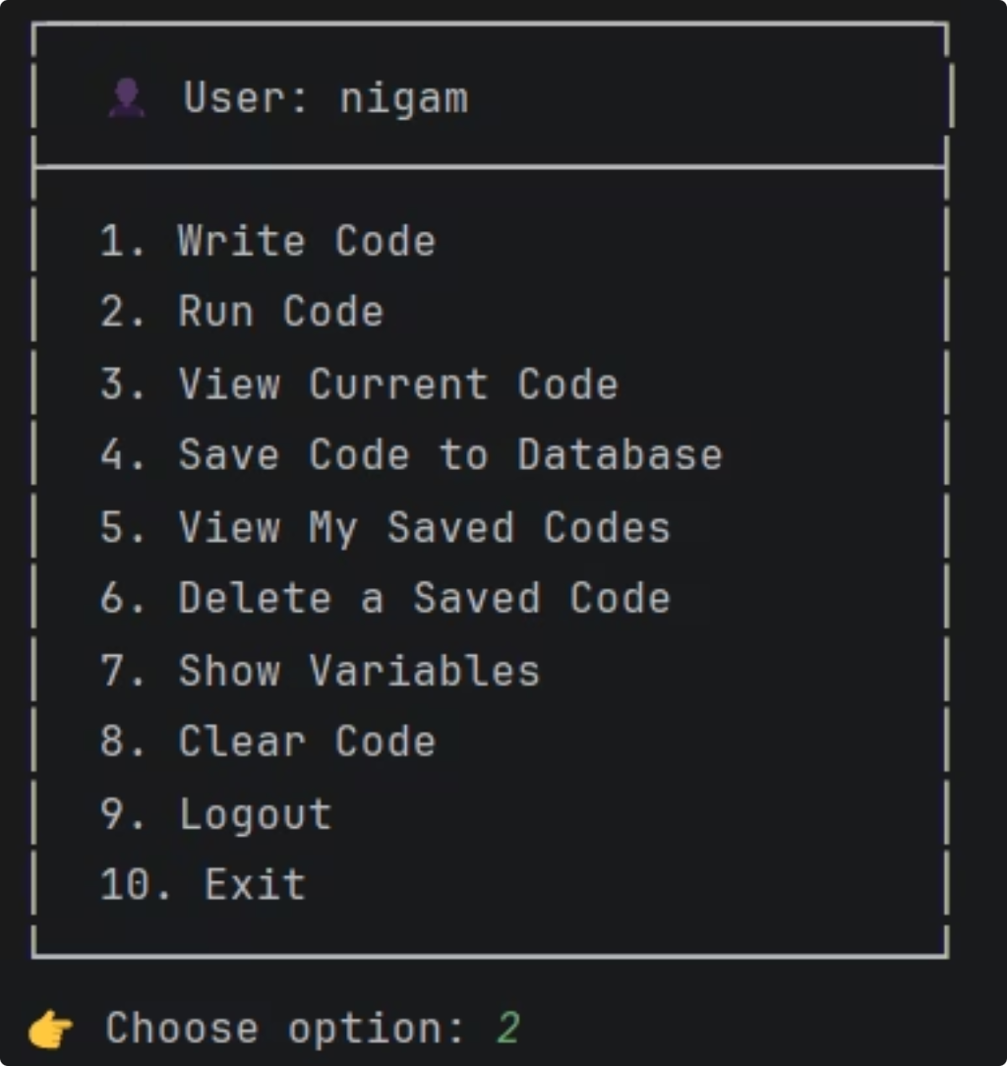
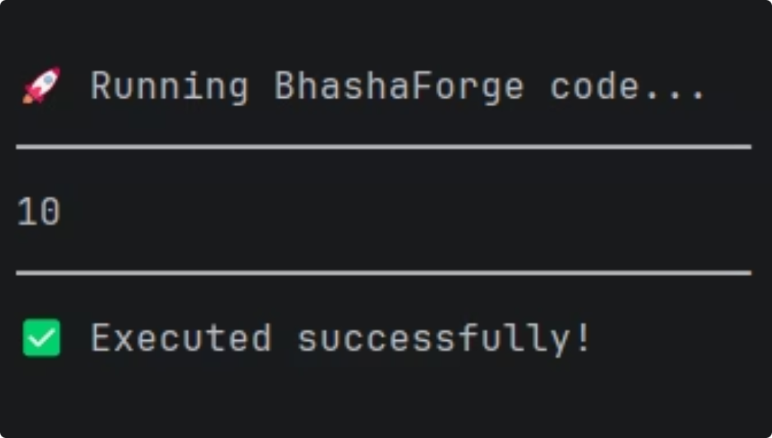
Sample Input & Output

Slide 11
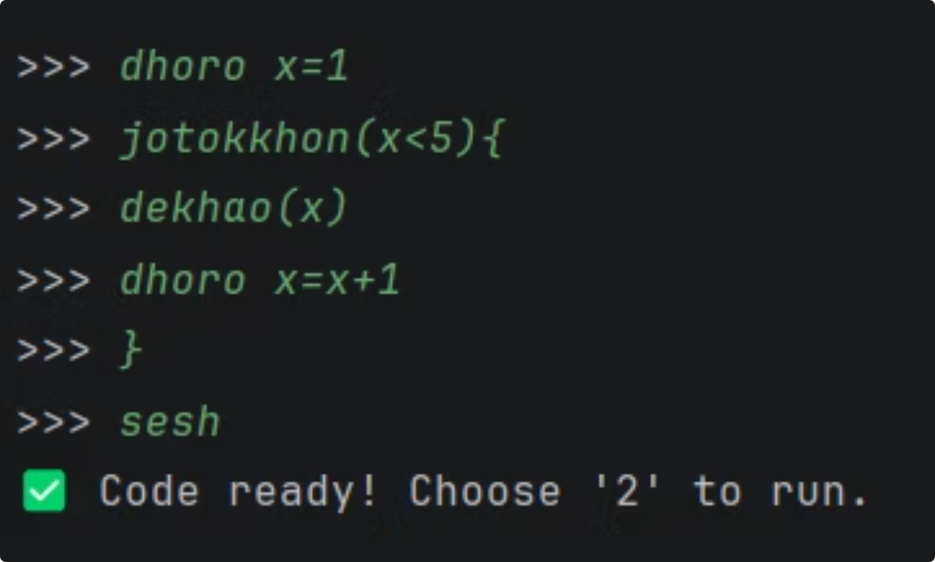
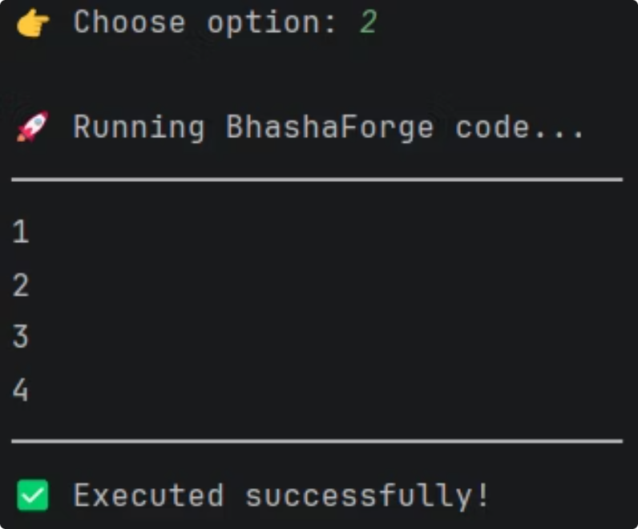
Sample Input & Output
How It Works
The dhoro keyword declares a variable, dekhao prints output, jotokkhon for while and jodi handles conditional logic — all in natural Banglish syntax.
dhoro
dekhao
jodi-nahole
jotokkhon
Declare a variable
Print a value
If-else condition
while

Slide 12
Conclusion & Future Improvements
BhashaForge successfully demonstrates Java OOP concepts, compiler/interpreter basics, JDBC database connectivity, and console-based application development — all within a single cohesive project.
Future Improvements
GUI Version
Better Banglish Syntax Support
Function Support
Code Editor
Error Suggestions
Online Compiler Version
Thank You — BhashaForge bridges the gap between native language and programming logic, making coding more accessible.

