Slide 1

Presentation
On
”Blood Management System”
Himshikha Rai(15756)
Denis Gurung(15755)

Slide 2
Content
Introduction
Problem Statement
Objectives
Software Development Life Cycle
Features
What’s new???
Technologies used
Use case Diagram
Conclusion

Slide 3
Introduction
An android application to provide a common platform for donors and patients.
Ability to keep the record of the donors, donation programs.
A means to notify the donors about the donation events.

Slide 4
Problem Statement
Have a difficult time finding donors at emergency.
Time consuming
Costly
Manual data entry is
-error prone
-less relevant

Slide 5
Objective
To maintain the donors details and donation event details
To develop the application through which we can reduce the human efforts.
To make the application run on different language
To bring donor and patient in a common platform\

Slide 6
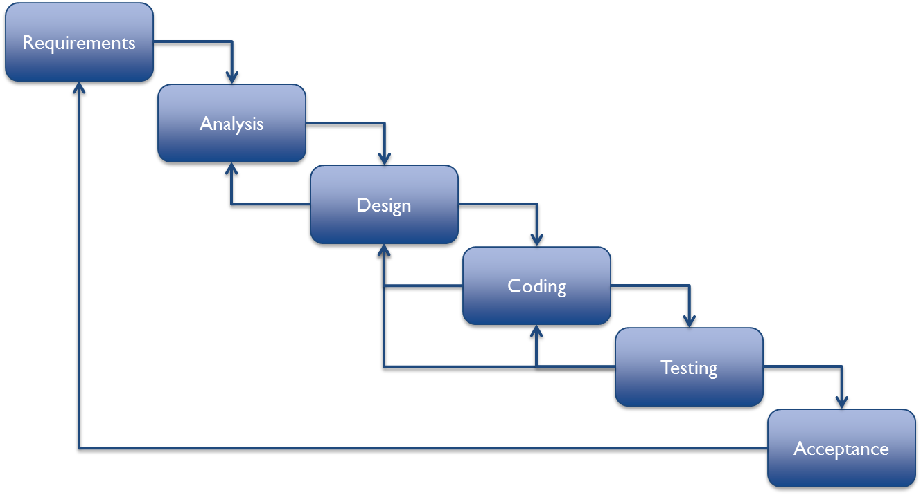
Software Development Life Cycle
Figure : Incremental Model

Slide 7
Features
Register as donor
Login through valid email and password
See Donors List
Search for the required blood
Set donation events
See Blood Banks and contact

Slide 8
What's new????
Change language in Nepali and French
Notification to donors

Slide 9
Technologies used
Programming Language: Java
Database Management System: Sqlite
Development Toll: Android Studio

Slide 10
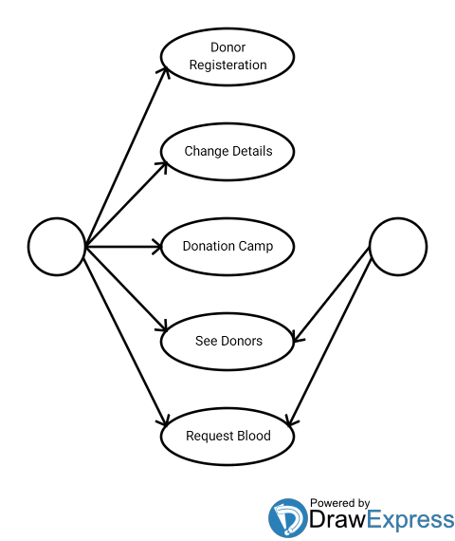
Use case diagram for Blood Management System
Donor
Patient

Slide 11
Conclusion
Thank You!!!!!!!!!!!

