Slide 1
Internet Of Things

Slide 2
What is IoT?
Interconnection of devices on internet, communicating with each other either by receiving or sending data.
The scale of communication varies from a smart watch sending vitals to emergency contact to a satellite locating one’s current location.

Slide 3
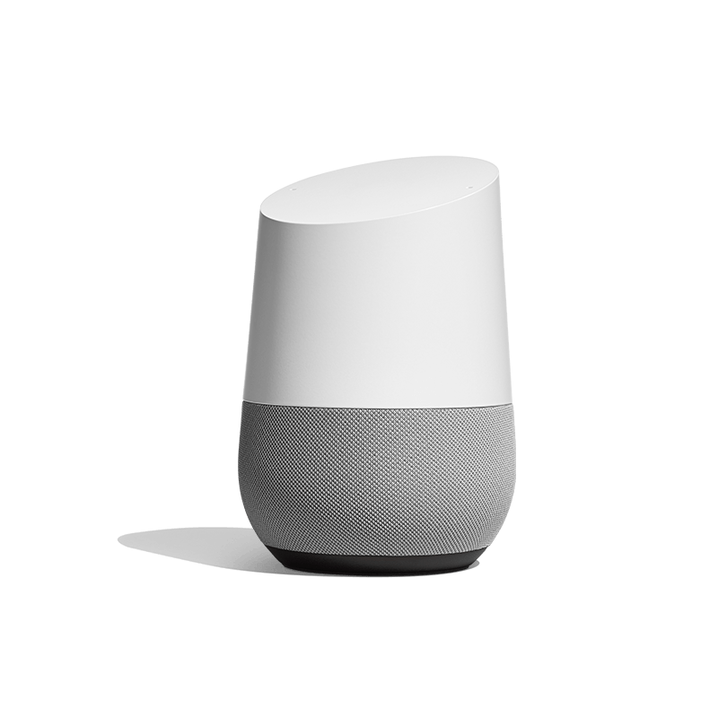
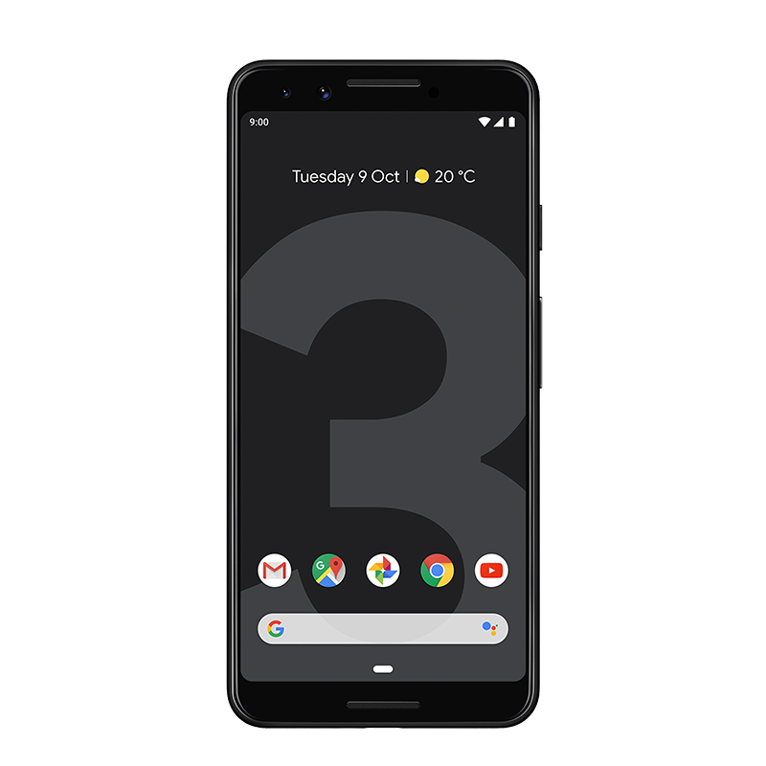
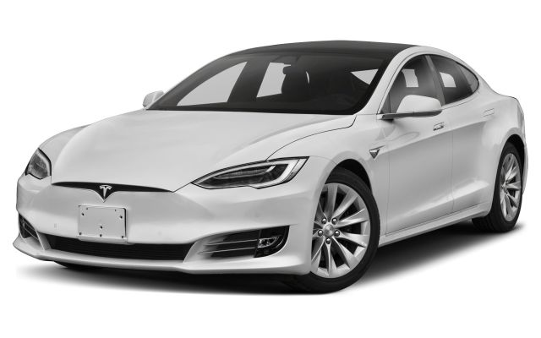
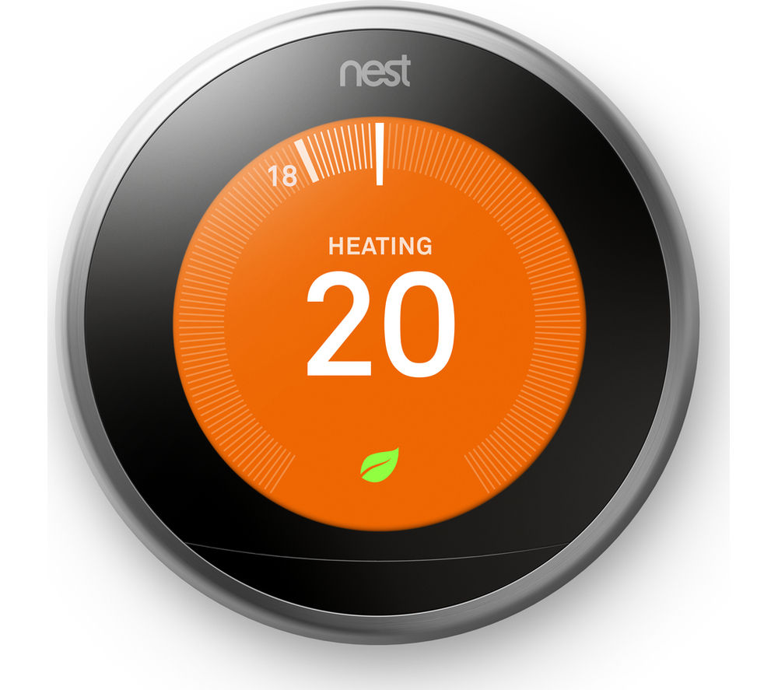
Example

Slide 4
Privacy
Our devices are no where secure as they should be.
Internet of things should not compromise on the privacy of a user without their consent.

Slide 5
Alternatively
Internet of things does improve our day to day life.
Despite it fueling the stigma of automation even further, the convenience provided by Internet of things cannot be unseen.

