Slide 1


Slide 2
Block chain
They are chain of blocks containing information. Was first used in 1991 to timestamps documents Gained popularity in 2009 when bitcoin was implemented using block chain.

Slide 3
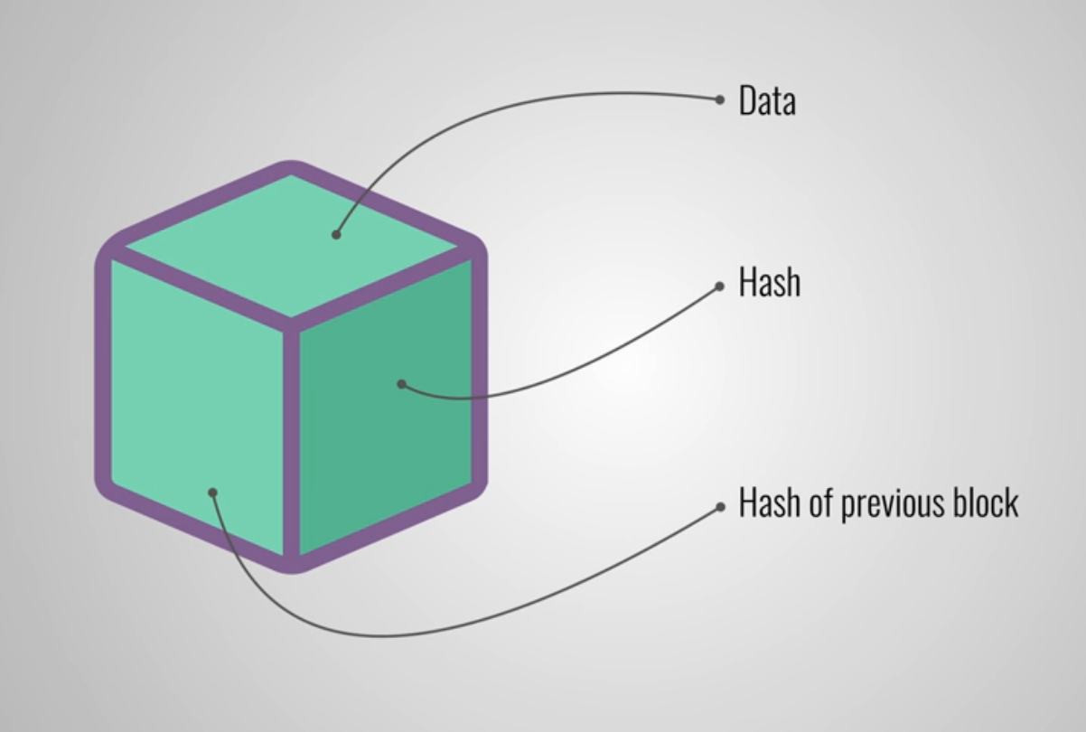
Structure of each block

Slide 4
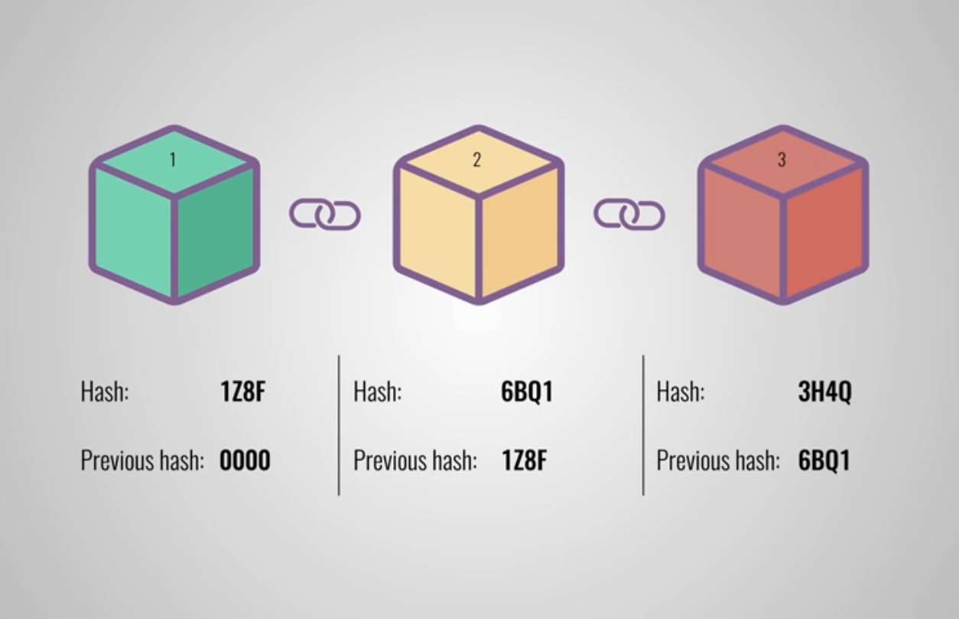
Structure of each chain

Slide 5
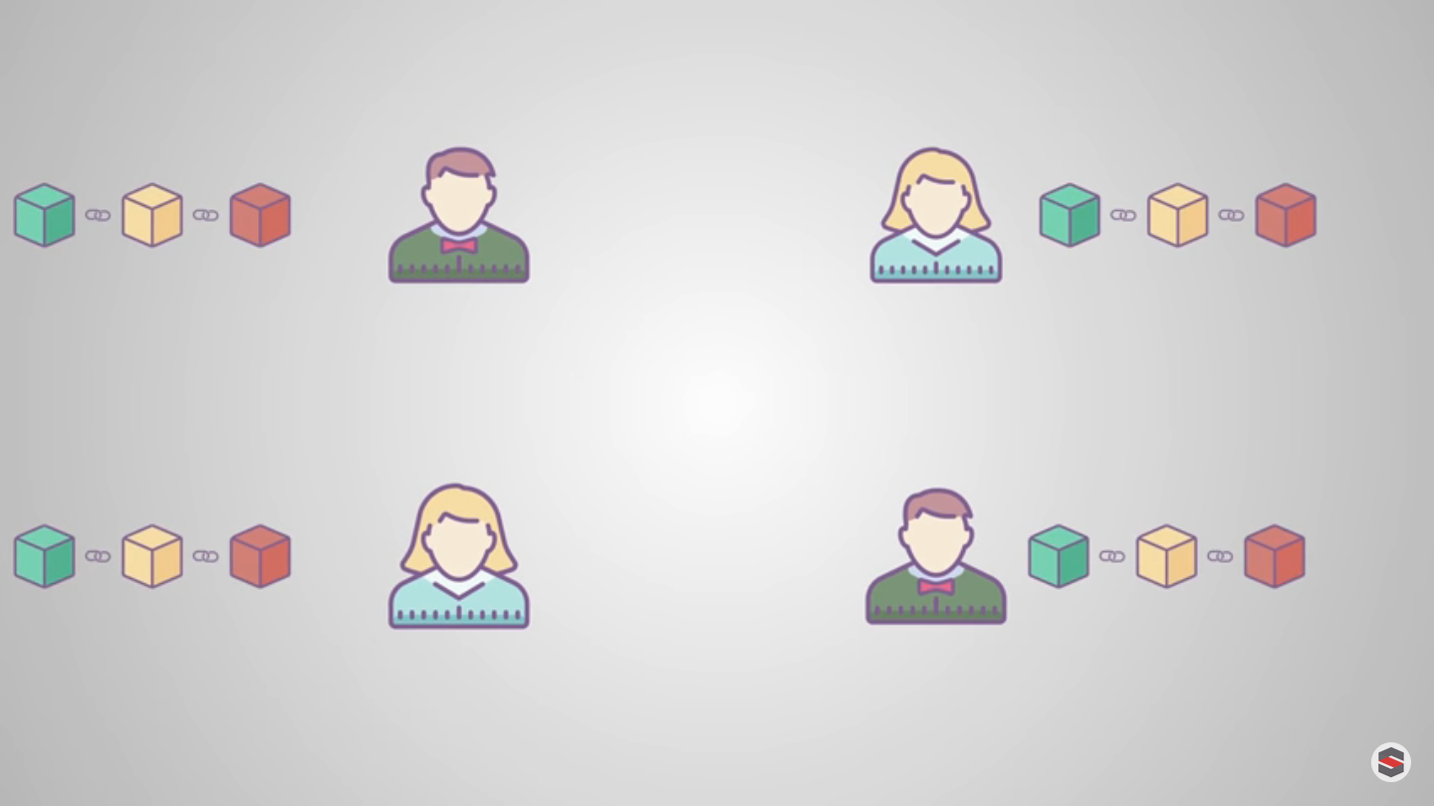
Peer to Peer Network

Slide 6
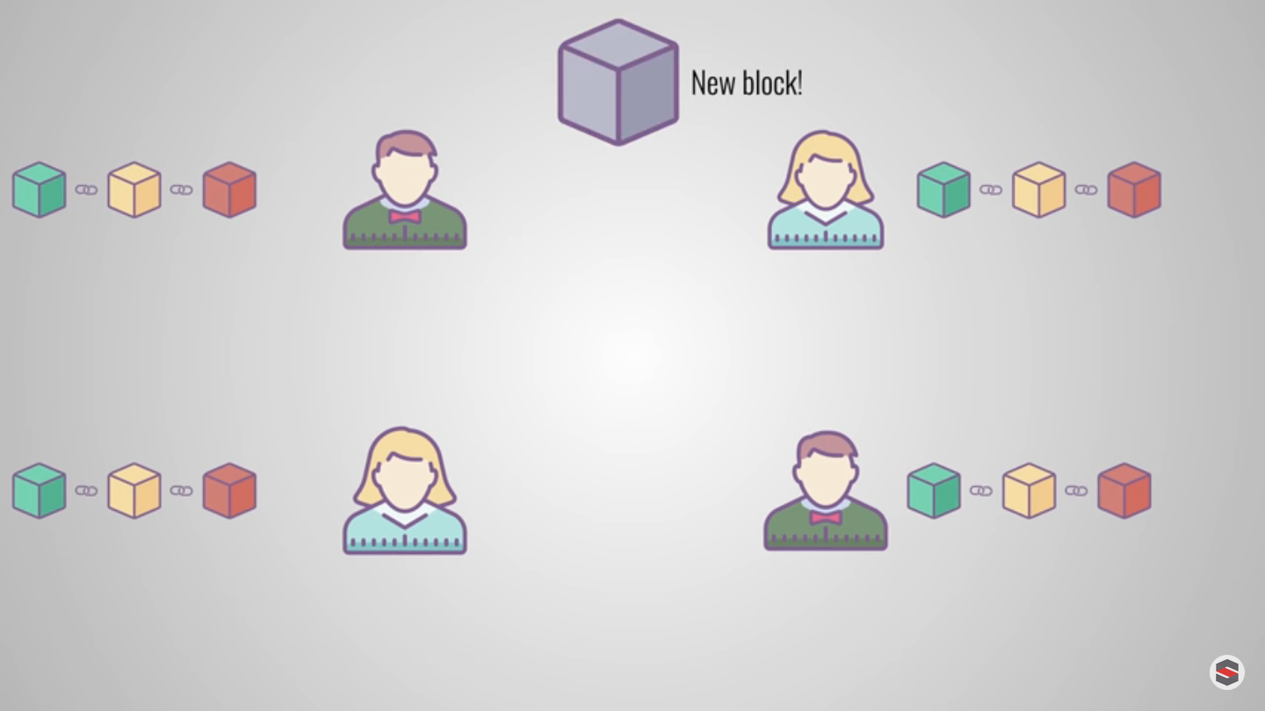
Proof of work

