Slide 1


Blood Management
System
Presented By:
Himshikha Rai(15756)
Denis Gurung(15755)
Department of Software Engineering NEPAL COLLEGE OF INFORMATION TECHNOLOGY
Balkumari, Lalitpur, Nepal

Slide 2
What is Blood Management System???
An android application to provide a common platform for donors and patient.
A means to advertise the blood donation events to the public.
The system keeps the record of all the donors, recipients, blood donation programs,
This system also has the ability to keep track of the donor's donation records.

Slide 3
Why Blood Management System???
The public can only know about the blood donation events through conventional media means such as radio, news paper or television advertisements.
There is no information regarding the blood donation programs available on any of the portal.
The current system that is using by the blood bank is manual system.
With the manual system, there are problems in managing the donors' records.
Thus, the Blood Management System will provide the availability of donors.

Slide 4
Problem Statement
Entering the details about the blood groups, members, addresses, etc. And tracking the databases is complicated when the details are maintained manually. This makes the maintenance of schedule erroneous.
There are various limitations of manual system listed below:-
It is time consuming.
It leads to error prone results.
Reports take time to produce.
Thus to overcome this limitations the blood management system is needed whose main propose is to save user's time and to provide the user simplest and fastest application.

Slide 5
Objective
To maintain the donor details, blood request details.
To make easier and faster application for the user.
To also bring the donor and the patient in a common platform.
To develop the application through which we can reduce the human efforts.
To create a bridge between the demand and supply of blood.

Slide 6
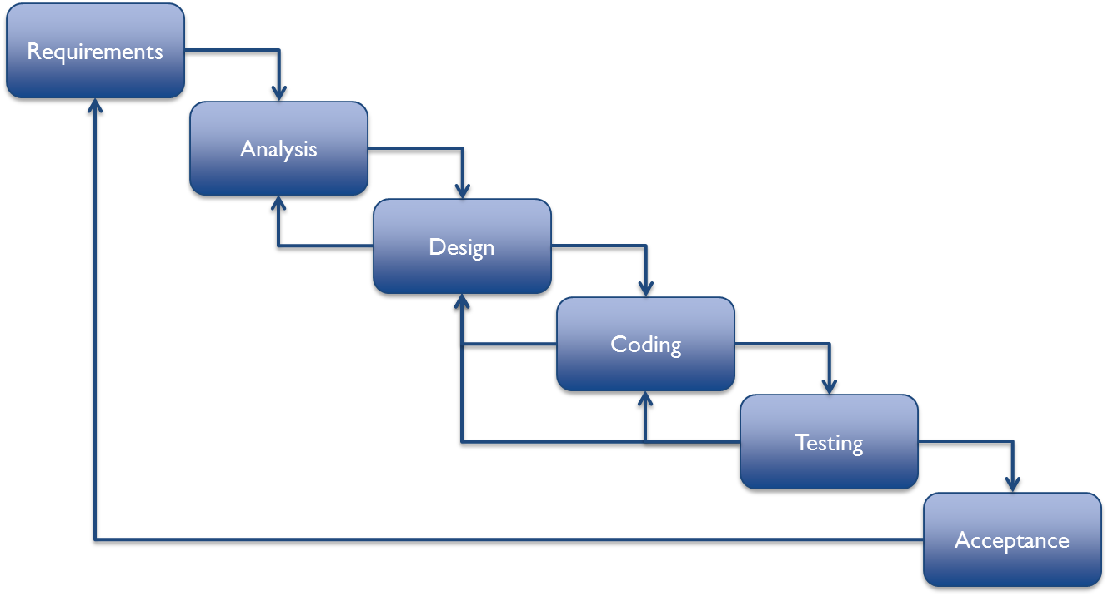
Software Development Life Cycle
Figure : Incremental Model

Slide 7
Technologies to be
used
Programming Language: Java
Database Management System: MySql
Development Tool: Android Studio

Slide 8
Why to choose us???
Our application will notify you when the donation event is organized.
Supports English and Nepali Language.
User can request a blood online.

Slide 9
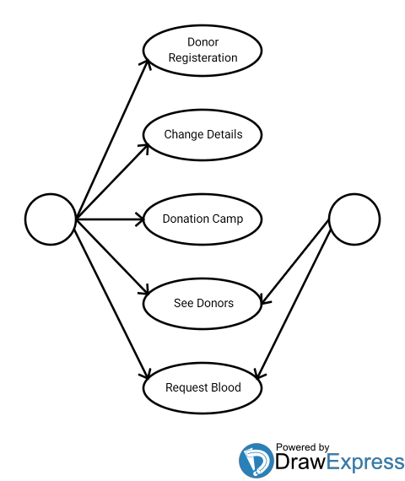
Use case diagram for Blood Management System
Donor
Patient

Slide 10

Conclusion
Management information system helps to make the system paper less.
It will help to create a bridge between the demand and supply of blood.
This project intends to computerize the blood and donor management system in a blood bank in order to improve the record management efficiency due to the grown size of records of data
Thank You!!!!

