Slide 1

ClickDeal
Submitted by: Sajjan Paudel() Barsha Thapa()
Ritesh Adhikari() Sagar Thapa Shrestha()
Department of Software Engineering
Nepal College of Information Technology
Balkumari, Lalitpur, Nepal

Slide 2
Overview
Web Based online shopping
Platform for those who want to do hassle free shopping .
By using our website an user will be able to but the latest and greatest of the products in an affordable price

Slide 3
Problem Statement
Traditional ways are time consuming
Limitations like physical space for inventories
Use of paper billing system which consumes large volume of paper which is tedious.

Slide 4
Project Objectives
Manage the authentication and authorization of users for different pages. The users are basically visitors, customers(registered members), admins, etc.To display the hidden message successfully from the cover image if and only if private key is matched.
Making the website fast and attractive, up selling userson related products, incentivizing buyers..
Make it responsive so it looks and works great on different sized displays.

Slide 5
Scope and Limitation
The scope of the study encompasses:
Giving the users ability to shop with just a few clicks.
Visibility of lower Costs , locating the Product quicker, eliminating travel time and Cost, remaining open all the time are the main scopes of clickdeal.
The limitations of the project are listed below:
The software needs internet access.
Only pay with Cash on Delivery available.

Slide 6
Task Status Overview
S.N. | TASKS | TASK STATUS
1. | Database | Comlpeted
2. | Admin Dashboard | Completed
3. | Comparison | Remaining
4. | Front end | Currently working

Slide 7
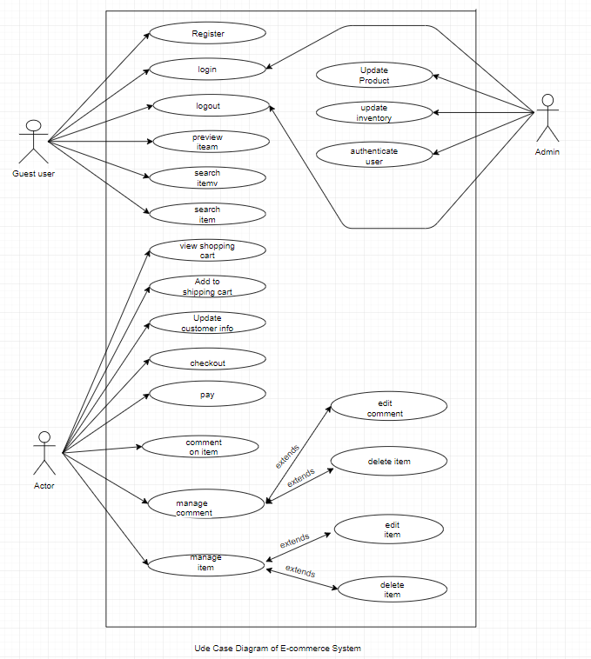
Use case Diagram

Slide 8
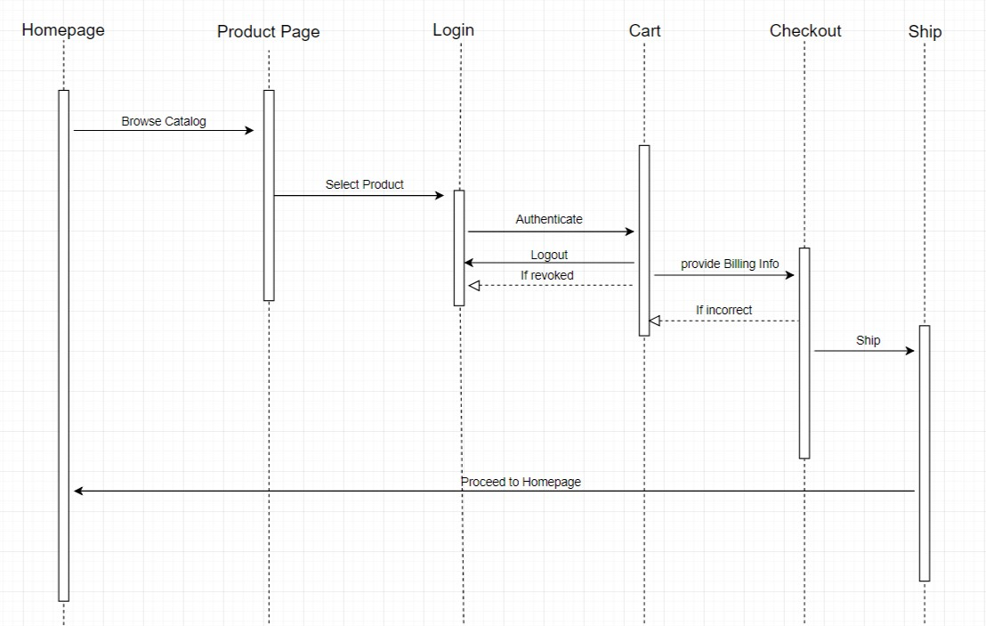
Sequence Diagram

Slide 9
Works to be done
Front-End completion
Comparision Feature.

Slide 10
Questions??

Slide 11
Thank you!

