Slide 1


Blood Management
System
Presented By:
Himshikha Rai(15756)
Denis Gurung(15755)
Supervisor:
Amit Srivastava
Department of Software Engineering NEPAL COLLEGE OF INFORMATION TECHNOLOGY
Balkumari, Lalitpur, Nepal

Slide 2
Content:
Introduction
Problem Statement
Objectives
Software Development Life Cycle
Tasks Done so far
Tasks Remaining
Use case Diagram

Slide 3
Introduction
An android application to provide a common platform for donors and patient.
A means to notify the donors about the donation events.
The system keeps the record of all the donors, recipients, blood donation programs,
This system also has the ability to keep track of the donor's donation records.

Slide 4
Problem Statement
Have a difficult time finding donors at emergency.
Time consuming
Costly
Manual data entry is
-error prone
-less relevant

Slide 5
Objective
To maintain the donor details, blood request details.
To make easier and faster application for the user.
To also bring the donor and the patient in a common platform.
To develop the application through which we can reduce the human efforts.
To create a bridge between the demand and supply of blood.

Slide 6
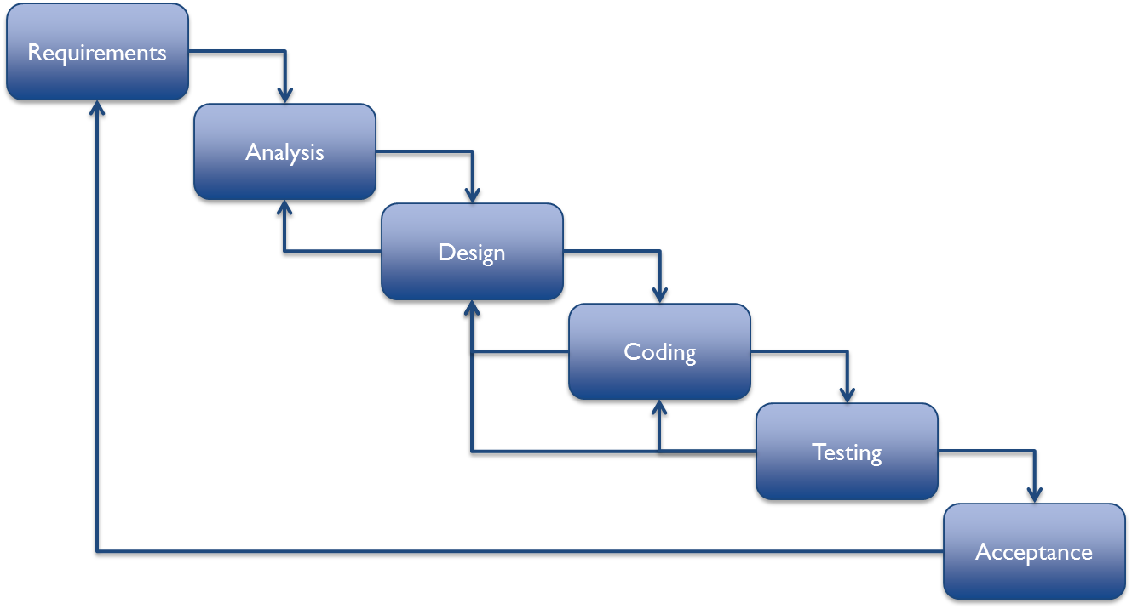
Software Development Life Cycle
Figure : Incremental Model

Slide 7
Technologies used
Programming Language: Java
Database Management System:Sqlite
Development Tool: Android Studio

Slide 8
Tasks performed:
Login form
Donor Registration
Change Language
Sqlite Database

Slide 9
Tasks Remaining:
Push notification to users
Setting Donation events
Making an application attractive
Request for blood

Slide 10
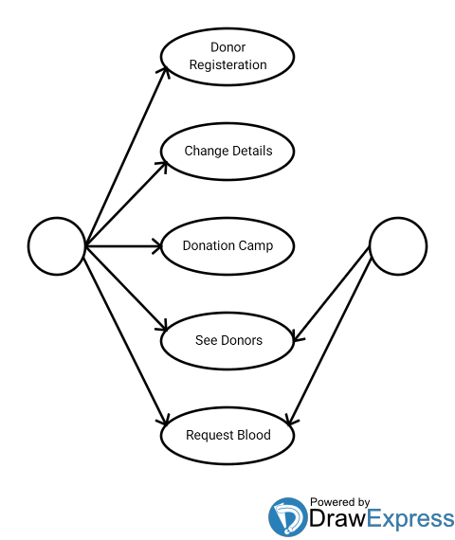
Use case diagram for Blood Management System
Donor
Patient

Slide 11

Thank You!!!!

