Slide 1

Virtualization of a Real-Time Operating System for Robot Control with a Focus on Real-Time Compliance
Halil Pamuk, BSc.
Sebastian Rauh, MSc. Beng.

Slide 2
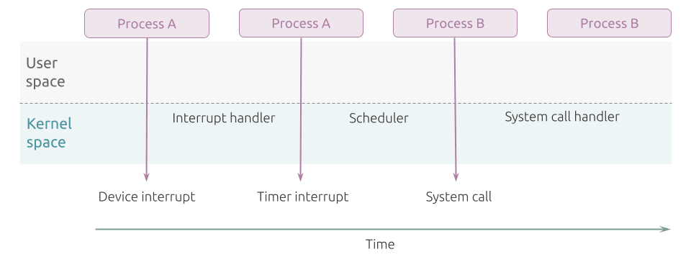
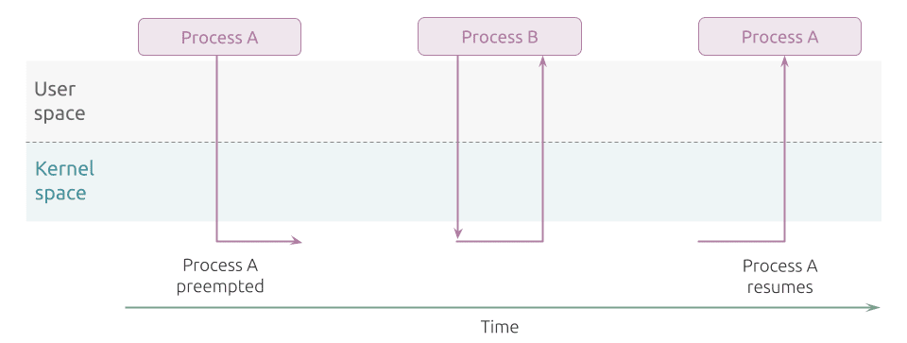
Introduction
Robots perform time-critical tasks
Delays → catastrophic consequences
General-Purpose Operating System vs Real-Time Operating System
Figure x:
Figure x:

Slide 3
Problem and Task Definition
Task: Bring latency of virtualization closer to hardware (below 50 μs)
Virtualization
Advantages | Disadvantages
Scalability & Flexibility | Increased overhead and latency
Cheaper | Performance variability
Remote management | Complexity

Slide 4
Methodology
Asses Initial Situation
Measure initial latency difference between bare metal & untuned virtualization with the latency tool of Xenomai
Real-Time Performance Tunings
Sequentially tune virtualization through BIOS, kernel, host, guest and QEMU configurations
Comparison
Measure the latency difference with the latency tool
Validation
Measure the latency difference with a real-time robotic application

Slide 5
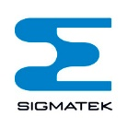
Application Context and Conditions
This work was written at SIGMATEK GmbH & Co KG
Host OS: Ubuntu 22.04.4 LTS, PREEMPT-RT
Guest OS: Salamander 4
Built with Yocto [1]
Virtualized through Quick Emulator (QEMU) [2]
Hard real-time with Xenomai 3 [3]
Trace-cmd [4] and Kernelshark [5] for kernel tracing and visualization

Slide 6
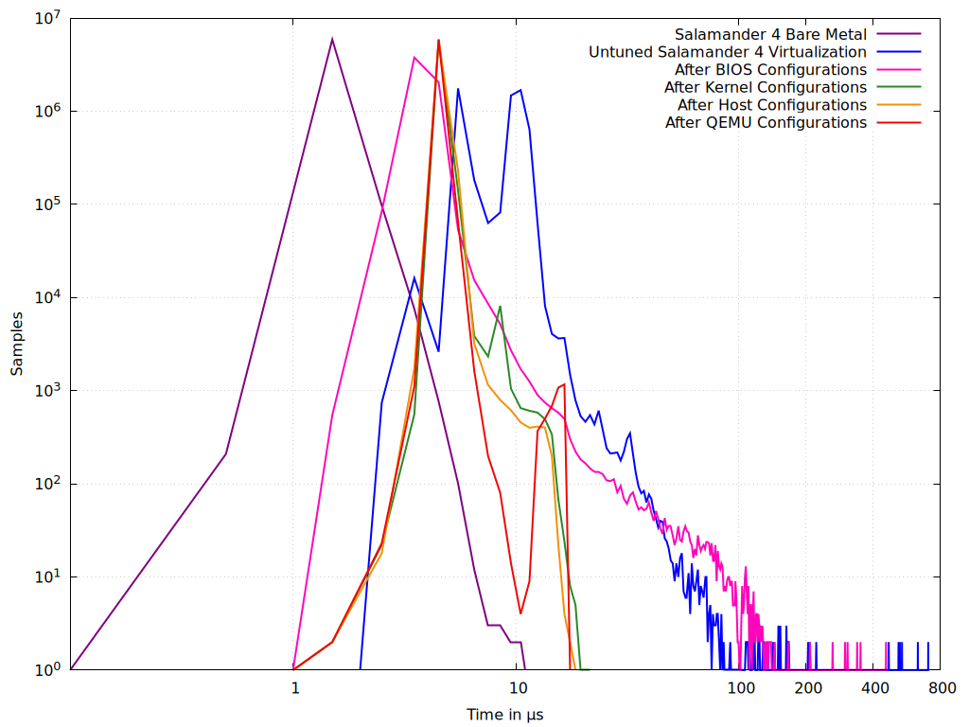
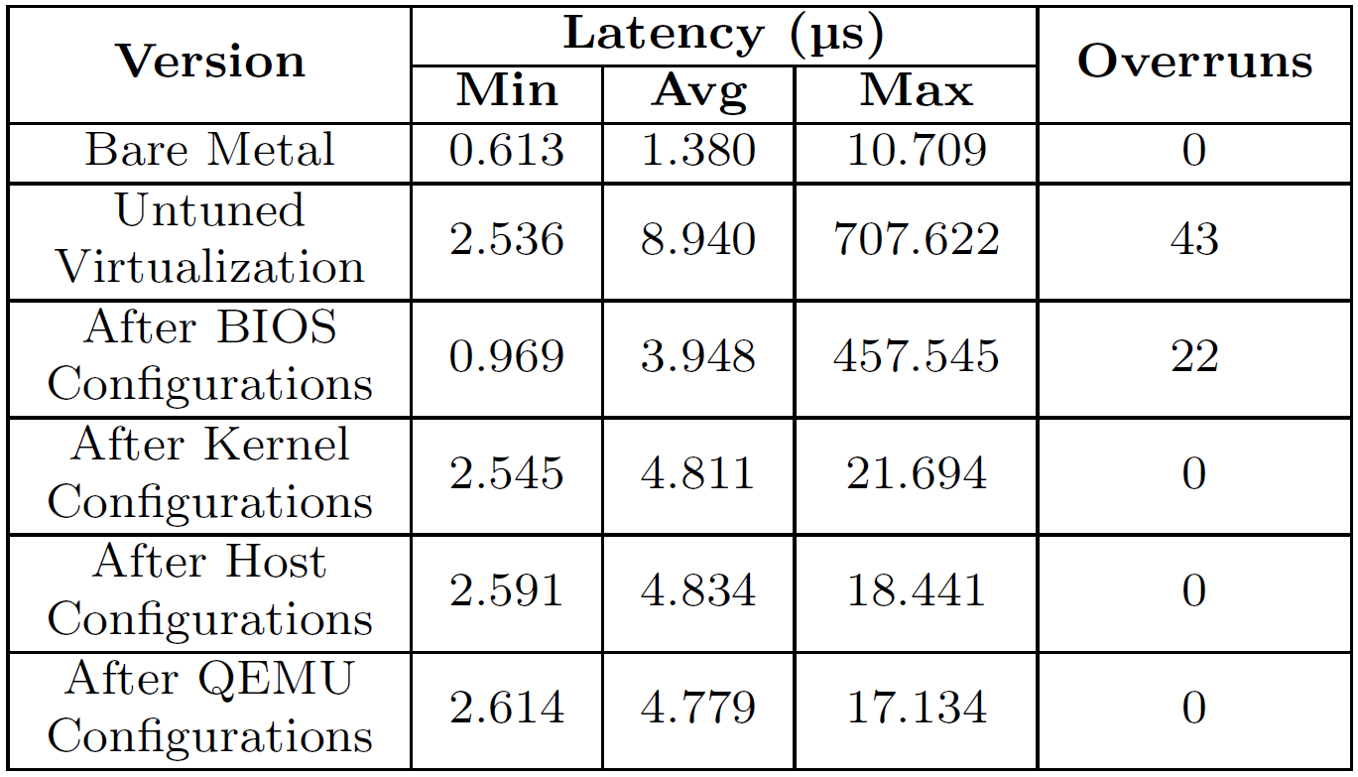
Results – Latency Tool
10 minutes with a sampling period of 100 µs, priority of 99
LEGENDE GRÖßER UND X UND Y
Table x:
Figure x:

Slide 7
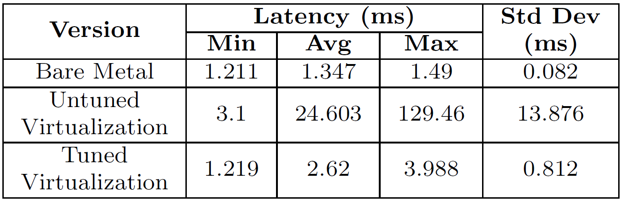
Results – Robotic Application
Difference between command issuance time and the time the signal reaches the PWM module was measured 1,000 times for the bare metal, untuned, and tuned versions of Salamander 4.
Table x:

Slide 8
Discussion
Latency Tool
Worst latency decreased from 707.622 µs to 17.134 µs
No overruns
Close to bare metal’s 10.709 µs
Goal achieved
Robotic Application
Worst latency dropped from 129 ms to 3.988 ms
Close to bare metal’s 1.49 ms
Tunings validated

Slide 9
Outlook
Additional configurations
Other hypervisors and virtualization technologies
More testing under workloads

Slide 10
References
[1] https://docs.yoctoproject.org/
[2] https://www.qemu.org/
[3] https://xenomai.org/
[4] https://trace-cmd.org/
[5] https://kernelshark.org/

